Slide 1
Project: IEEE P802.15 Working Group for Wireless Personal Area Networks (WPANs)
Submission Title: Necessity Review of Channel Models for LED-ID LOS Applications
Date Submitted: Sep. 15, 2015
Source: Jaesang Cha, Yeong Min Jang, Soo-Young Chang, Sebong Jang, Jaekwon Shin, Daehyeon Kim, and Junghoon Lee
Company: SNUST, Kookmin Univ., SYCA, Kimin Electronics Co., Ltd, Fivetek Co., Ltd, Namuga Co., Ltd, and Dong Seoul Univ.
Address: Seoul National University of Science & Tech. (SNUST), Seoul, Korea, Voice: +82-2-970-6799
email: chajs@seoultech.ac.kr
Re: TCD of 802.15.7r1
Abstract: Results of review of channel models for LED-ID LOS applications
Purpose: To review of channel models for LED-ID LOS applications
Notice: This document has been prepared to assist the IEEE P802.15. It is offered as a basis for discussion and is not binding on the contributing individual(s) or organization(s). The material in this document is subject to change in form and content after further study. The contributor(s) reserve(s) the right to add, amend or withdraw material contained herein.
Release: The contributor acknowledges and accepts that this contribution becomes the property of IEEE and may be made publicly available by P802.15.

Slide 2
Contents
LED-ID LOS Applications
Channels of LED-ID LOS Applications
Conclusions

Slide 3
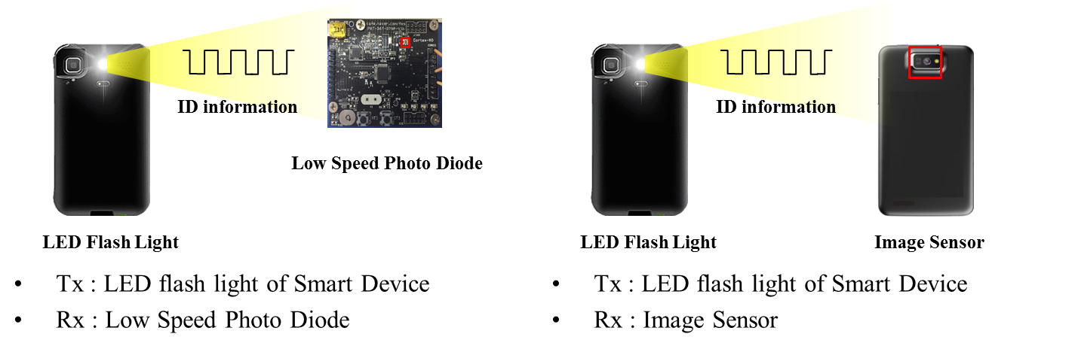
LED-ID LOS Applications (1)
LED-ID receiver can be implemented via low rate PD or image sensor from TCD definition.
Picture below shows examples of Handset LED-ID tx/rx.
- Left figure shows low rate PD receiver.
- Right figure shows image sensor receiver.

Slide 4
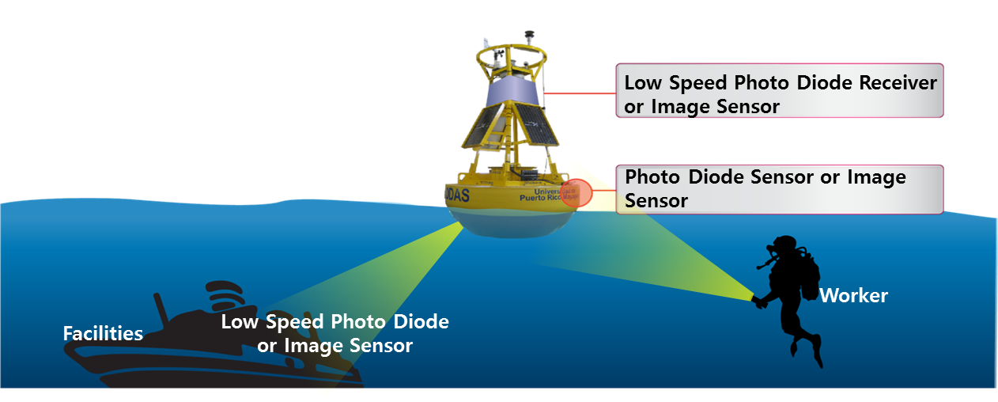
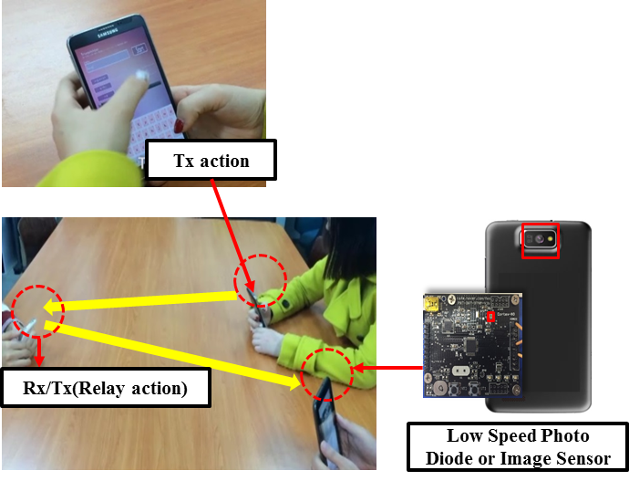
LED-ID LOS Applications (2)
Underwater/Seaside Communication
Point-to-(multi)point / Communication
Underwater/Seaside Communication
Point-to-(multi)point communication

Slide 5
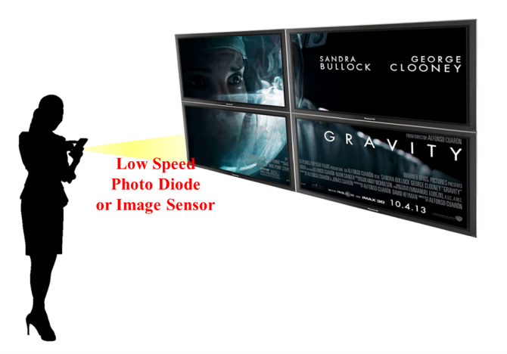
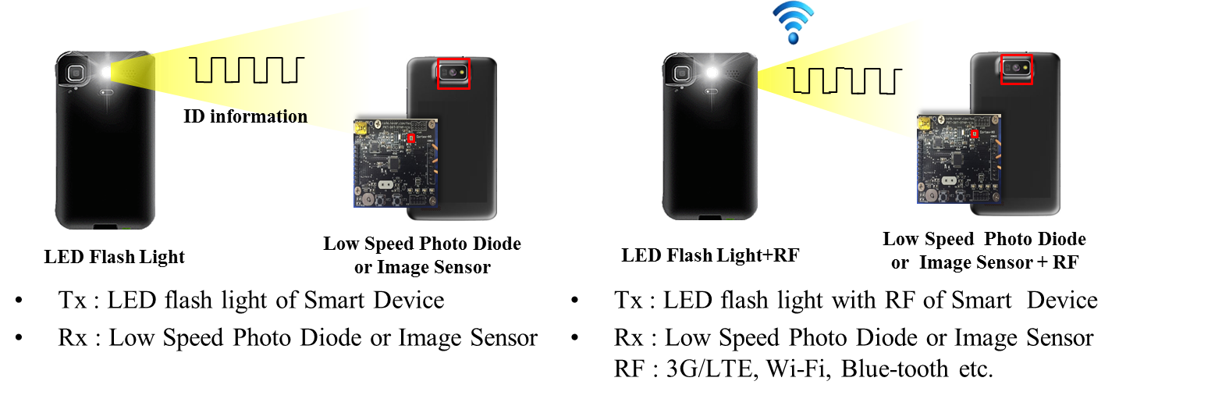
LED-ID LOS Applications (3)
Digital signage
D2D/IoT
Digital signage
D2D/IoT

Slide 6
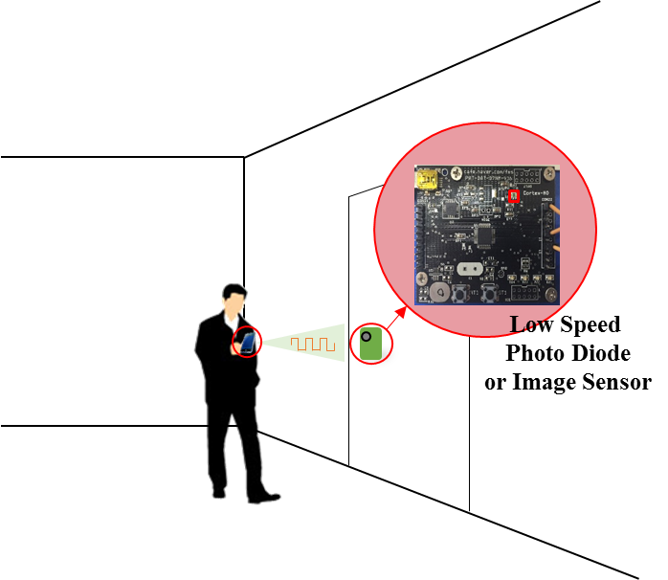
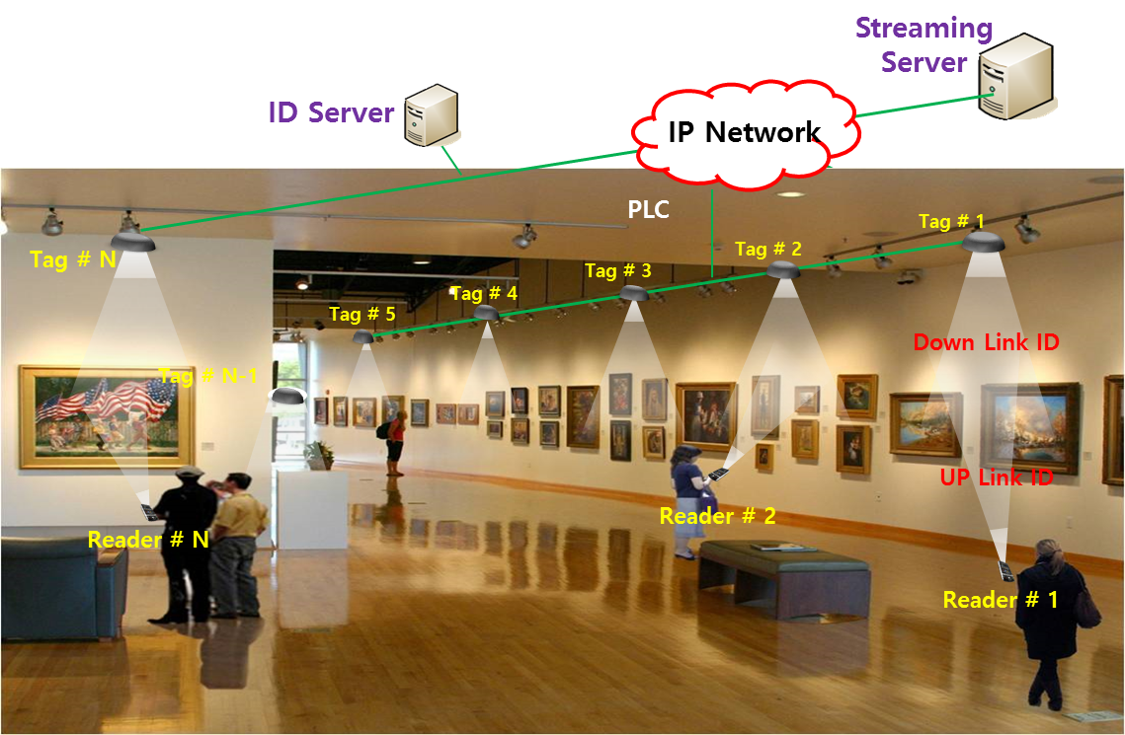
LED-ID LOS Applications (4)
LOS Authentication
Identification based service
LOS Authentication
Identification based service

Slide 7
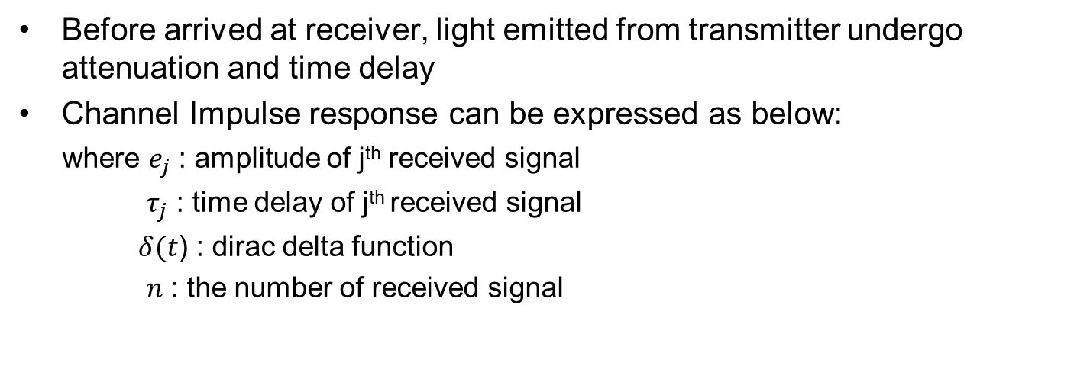
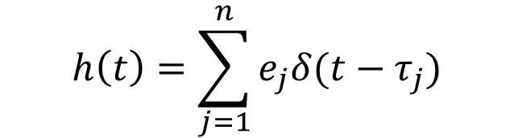
Channels of LED-ID LOS Applications
Before arrived at receiver, light emitted from transmitter undergo attenuation and time delay
Channel Impulse response can be expressed as below:
where $e_{j}$ : amplitude of j^{th} received signal
$τ_{j}$ : time delay of j^{th} received signal
$δ(t$) : dirac delta function
$n$ : the number of received signal
$$h\left(t\right)=\sum_{j=1}^{n}{e_{j}δ(t−τ_{j}})$$

Slide 8
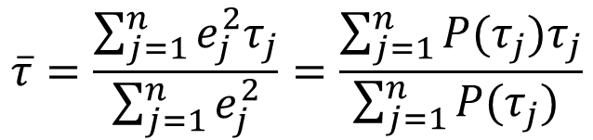
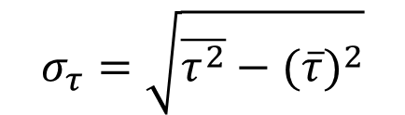
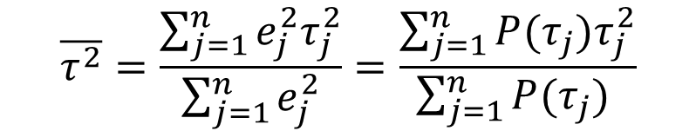
Channels of LED-ID LOS Applications (cont’d)
Mean Excess Delay, Mean Square Delay, and RMS Delay Spread
- Mean Excess Delay :
- Mean Square Delay :
- RMS delay spread :
$$\overline{τ}=\frac{\sum_{j=1}^{n}{e_{j}^{2}τ_{j}}}{\sum_{j=1}^{n}{e_{j}^{2}}}=\frac{\sum_{j=1}^{n}{P(τ_{j})τ_{j}}}{\sum_{j=1}^{n}{P(τ_{j}) }}$$
$$\overline{τ^{2}}=\frac{\sum_{j=1}^{n}{e_{j}^{2}τ_{j}^{2}}}{\sum_{j=1}^{n}{e_{j}^{2}}}=\frac{\sum_{j=1}^{n}{P(τ_{j})τ_{j}^{2}}}{\sum_{j=1}^{n}{P(τ_{j}) }}$$
$$σ_{τ}=\sqrt{\overline{τ^{2}}−{(\overline{τ})}^{2}}$$

Slide 9
Channels of LED-ID LOS Applications (cont’d)
Suppose indoor circumstance as below:
Parameters | Values
Size of space | W(Width) : 20m D(Depth) : 8m H(Height) : 2.3m
LED position | LED1 : W(8m), D(4m), H(2.3m) LED2 : W(12m), D(4m), H(2.3m)
PD position | PD1 : W(8m), D(3m), H(0.3m) PD2 : W(14m), D(5m), H(0.3m) PD3 : W(2m), D(2m), H(0.3m)
PD size | 1cm²
FOV | 70°
Wall reflective coefficient | 0.8
LED power | 1Watt
PD1 : LOS from both LEDs
PD2 : LOS from LED2 and NLOS from LED1
PD3 : NLOS from both LEDs

Slide 10
Channels of LED-ID LOS Applications (cont’d)
Channel Impulse responses at each receiver
- LOS cases (PD1&2) have a dominant LOS signal power and low multipath powers.
- NLOS case (PD3) has a collection of lower power multipath signals.
LOS circumstance
PD1
PD2
PD3
(LOS from both LEDs)
(LOS from LED2 and NLOS from LED1)
(NLOS from both LEDs)

Slide 11
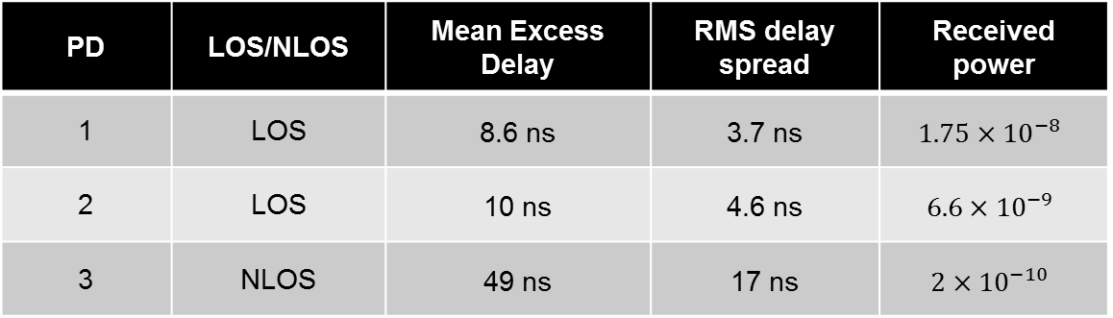
Channels of LED-ID LOS Applications (cont’d)
Numeric analysis of channel impulse responses
LOS cases : PDs 1&2
- RMS delay spread : 3.7~4.6ns
NLOS case : PD 3
- RMS delay spread : 17ns
PD | LOS/NLOS | Mean Excess Delay | RMS delay spread | Received power
1 | LOS | 8.6 ns | 3.7 ns
2 | LOS | 10 ns | 4.6 ns
3 | NLOS | 49 ns | 17 ns
LOS cases have much smaller RMS delay spread than NLOS case.
NLOS case has lower received power than LOS cases.

Slide 12
Channels of LED-ID LOS Applications (cont’d)
LED-ID data rates : Max 1Mbps
In OOK case : signal duration is 1000ns.
Consideration of signal duration and RMS delay spread
Symbol duration = 1000ns
RMS delay spread
= max 4.6ns
$$RMS delay spread to symbol duratio ratio=\frac{RMS delay spread}{signal duration}=\frac{4.6}{1000}=0.0046$$

Slide 13
Conclusions
In a short range LOS circumstance, there are a high amplitude LOS signal and very low amplitude NLOS signals.
RMS delay spread to symbol duration ratio is very small (~0.0046), so we need to focus on LOS signals only.
As a result, we can simply approximate LED-IDs’ LOS channel characteristics as a one path model in a short range LOS circumstance.

