Slide 1
Project: IEEE P802.15 Working Group for Wireless Personal Area Networks (WPANs)
Submission Title: [A Study on mmWave Beamforming for High-Speed Train Communication]
Date Submitted: [11 September, 2015]
Source: [Junhyeong Kim, Bing Hui, Hee-Sang Chung, JunHwan Lee] Company [ETRI]
Address [218 Gajeong-ro, Yuseong-gu, Daejeon, 305-700, KOREA]
Voice:[+82-42-860-6239], FAX: [+82-42-860-6732], E-Mail:[jhkim41jf@etri.re.kr]
Abstract: [A Study on mmWave Beamforming for High-Speed Train Communication]
Purpose: [For discussion]
Notice: This document has been prepared to assist the IEEE P802.15. It is offered as a basis for discussion and is not binding on the contributing individual(s) or organization(s). The material in this document is subject to change in form and content after further study. The contributor(s) reserve(s) the right to add, amend or withdraw material contained herein.
Release: The contributor acknowledges and accepts that this contribution becomes the property of IEEE and may be made publicly available by P802.15.

Slide 2
Contents
Introduction
Network Structure
Beamforming
Simulation
Conclusions
References

Slide 3


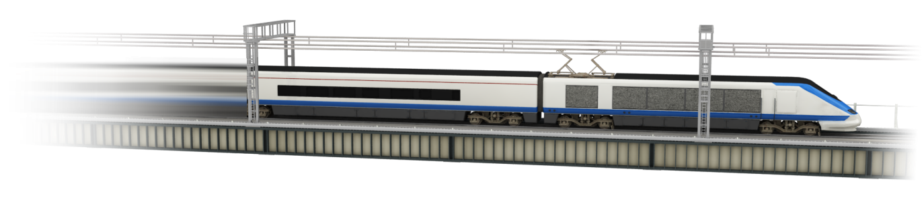

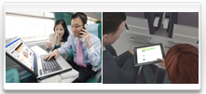

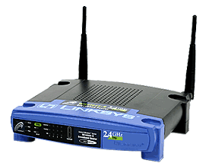


Introduction
Hierarchical two-hop network for fast moving vehicles
  Mobile wireless backhaul link
    High rate rail communications Interest Group (IG HRRC) : a multi-gigabit-per-second mobile wireless backhaul supporting high-mobility up to 500km/h
  Access link
    Small cell (Wi-Fi and femto cell)
Backhaul Link
mmWave
Backhaul Link
mmWave
TE
RU
RU
Access Link
(inside vehicle)
DU
GW : Gateway
DU : Digital Unit
RU : Radio Unit
TE : Terminal Equipment
Public Internet
GW

Slide 4
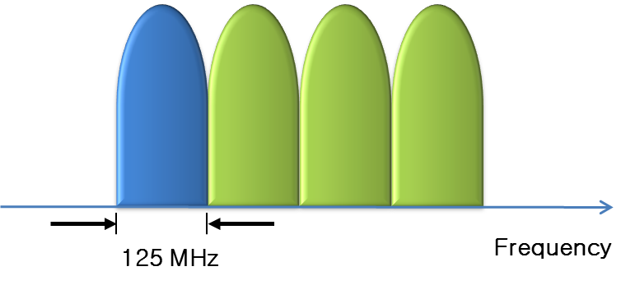
Introduction
Various technical challenges and potential solutions
  Capacity improvement
    Millimeter-wave due to its vast amount of underutilized spectrum
    MIMO techniques (polarized antenna)
  Path loss and atmospheric attenuation of millimeter-wave
    coverage improvement by using beam-forming technique
  Inter-carrier interference (ICI) by Doppler effect
    Proper sub-carrier spacing design for OFDM
    Millimeter-wave beam-forming techniques → Doppler frequency shift in the frequency domain can be simply overcome by automatic frequency control (AFC)
ETRI’s approach to physical layer design
Mobile Wireless Backhaul Link (Outside Vehicle) | OFDM based on mmWave Beamforming (2-link multi-flow)
Data throughput (DL) | 2 Gbps using 500-MHz bandwidth
Spectral efficiency | 4 bps/Hz
Mobility Support | 500 km/h
User Access Link (Inside Vehicle) | WiFi or Femto

Slide 5
Network Structure
Millimeter-wave beamforming for HST communication
  Dual link multi-flow : same radio resources (time and frequency) are assigned to both links

Slide 6
Beamforming
3D beam radiation pattern
  Horizontal and vertical beam width (3dB) : approximately 8 degrees
  Maximum beamforming gain : 21.58 dBi

Slide 7
Beamforming
Adaptive BF : require automatic tracking of signals of moving targets by continuously updating their parameters based on the received signals
  Control the beam direction with an accuracy 1˚
  Beam radiation pattern remains unchanged during beam steering

Slide 8
Beamforming
Fixed BF : BF parameters are fixed
  In the case of TX, the beam direction of m-th D-RU and m+1-th D-RU is (d_{RU}/2, 0, 0) and the beam direction of m+2-th D-RU and m+3-th D-RU is (3∙d_{RU}/2, 0, 0)
  In the case of RX, the beam directions of T-RU 1 and T-RU 2 are simply set to direct in the negative and positive direction of the x-axis respectively

Slide 9
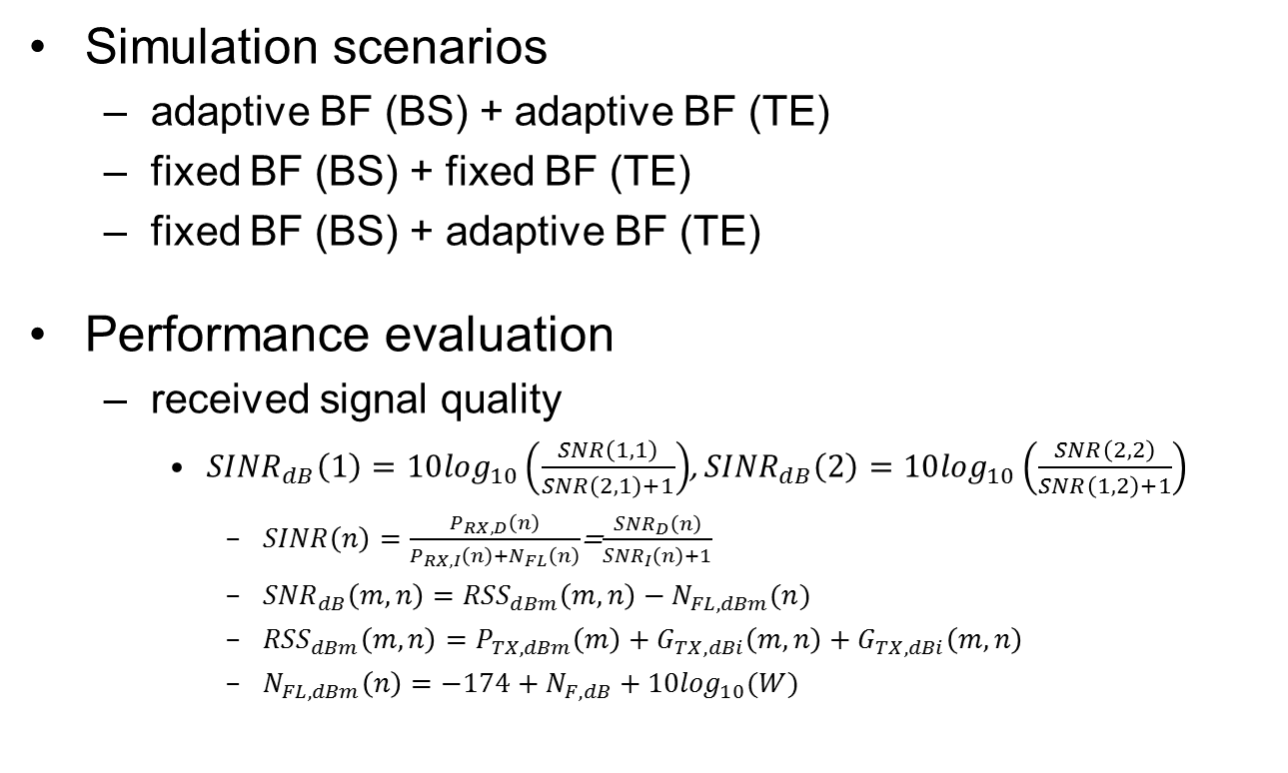
Simulation
Simulation scenarios
  adaptive BF (BS) + adaptive BF (TE)
  fixed BF (BS) + fixed BF (TE)
  fixed BF (BS) + adaptive BF (TE)
Performance evaluation
  received signal quality
    ${SINR}_{dB}\left(1\right)=10\log_{10}\left(\frac{SNR\left(1,1\right)}{SNR\left(2,1\right)+1}\right)$, ${SINR}_{dB}\left(2\right)=10\log_{10}\left(\frac{SNR\left(2,2\right)}{SNR\left(1,2\right)+1}\right)$
      $SINR\left(n\right)=\frac{P_{RX,D}\left(n\right)}{P_{RX,I}\left(n\right)+N_{FL}\left(n\right)}$=$\frac{{SNR}_{D}\left(n\right)}{{SNR}_{I}\left(n\right)+1}$
      ${SNR}_{dB}\left(m,n\right)={RSS}_{dBm}\left(m,n\right)−N_{FL,dBm}(n)$
      ${RSS}_{dBm}\left(m,n\right)=P_{TX,dBm}\left(m\right)+G_{TX,dBi}\left(m,n\right)+G_{TX,dBi}\left(m,n\right)$
      $N_{FL,dBm}\left(n\right)=−174+N_{F,dB}+10\log_{10}(W)$

Slide 10
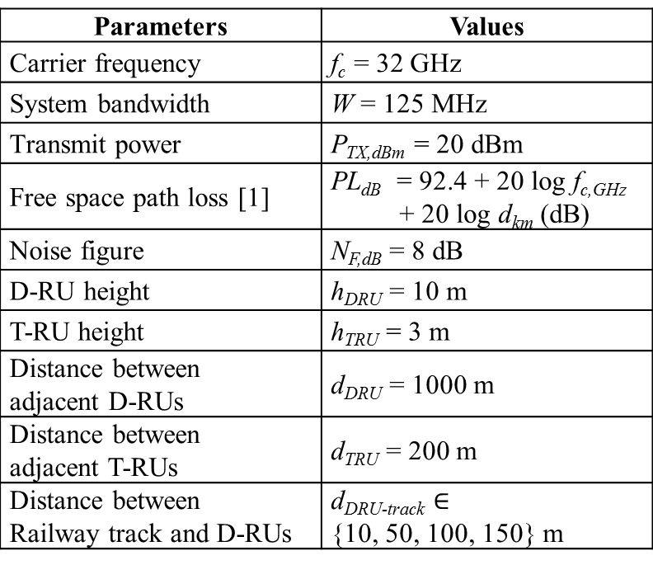
Simulation
Major parameters
Parameters | Values
Carrier frequency | f_{c} = 32 GHz
System bandwidth | W = 125 MHz
Transmit power | P_{TX,dBm} = 20 dBm
Free space path loss [1] | PL_{dB} = 92.4 + 20 log f_{c,GHz} + 20 log d_{km} (dB)
Noise figure | N_{F,dB} = 8 dB
D-RU height | h_{DRU} = 10 m
T-RU height | h_{TRU} = 3 m
Distance between adjacent D-RUs | d_{DRU} = 1000 m
Distance between adjacent T-RUs | d_{TRU} = 200 m
Distance between Railway track and D-RUs | d_{DRU-track} $∈$ {10, 50, 100, 150} m

Slide 11
Simulation
Simulation results : received signal quality
  As the HST moves far away from the D-RU, the effect of adaptive BF is negligible whereas it is important to use adaptive BF if the T-RU is close to D-RU

Slide 12
Simulation
Simulation results : received signal quality
  Received signal strength < 2 dB in the HST location from 200m to 800m
    If the T-RUs are placed sufficiently far away from each other, inter-D-RU interference at each T-RU is significantly reduced with a properly sharp beam pattern designed for both TX and RX side

Slide 13

Simulation
Simulation results : AoD, AoA
  Both vary according to $d_{DRU−track}$
  $d_{DRU−track}$ : distance between DRU and railway track
AoD : Angle of Departure
(transmit beamforming)
AoA : Angle of Arrival
(receive beamforming)

Slide 14

Simulation
Simulation results
  $d_{DRU−track}=10 m$
AoD : Angle of Departure
(transmit beamforming)
AoA : Angle of Arrival
(receive beamforming)

Slide 15
Conclusions
Different BF schemes are appropriate for different HST location
The fixed BF can achieve very similar performance to that of adaptive BF in most of time
  giving a valuable insight into designing the mmWave BF based HST communication system from feasibility and implementation perspective
As future works, it is worth to study the performance of adaptive BF in the presence of calibration error and the HST communication system in various environments including the case of HST running along the curved line.

Slide 16
References
ITU-R P.525-2, “Calculation of free-space attenuation”

