Slide 1
Project: IEEE P802.15 Working Group for Wireless Personal Area Networks (WPANs)
Submission Title: [ TG8 MAC information flow and service primitives ]
Date Submitted: [ July 14th, 2015 ]
Source: [Marco Hernandez, Huan-Bang Li, Igor Dotlić, Ryu Miura ]
Company: [NICT]
Address: [3-4 Hikarino-oka, Yokosuka, 239-0847, Japan]
Voice:[+81 46-847-5439] Fax: [+81 46-847-5431] E-Mail:[]
Re: [In response to call for technical contributions TG8]
Abstract: [ ]
Purpose: [Material for discussion in 802.15.8 TG]
Notice: This document has been prepared to assist the IEEE P802.15. It is offered as a basis for discussion and is not binding on the contributing individual(s) or organization(s). The material in this document is subject to change in form and content after further study. The contributor(s) reserve(s) the right to add, amend or withdraw material contained herein.
Release: The contributor acknowledges and accepts that this contribution becomes the property of IEEE and may be made publicly available by P802.15.

Slide 2
802.15 Architecture
Logical Link Control
Service Specific
Convergence Sublayer
Upper layers have direct access to the MAC or through 802.2 LLC
15.4 MAC primitives have been defined in this context

Slide 3
802.15.8 Architecture, proper
Service Access Point
MAC Information Base
MAC Data Service Entity
MAC Management Service Entity
PHY Data
PHY Management Service Entity

Slide 4
802.15.8 Architecture
The MAC is divided into:
MAC data service
Data transfer, ACK, CAP, CFP.
MAC management service
Access to the IB, peering, di-peering, CFP allocation, message pending, network start, scanning, search.
both are accessed through respective SAP.
What is the level of detail we are aiming for the draft?

Slide 5
MAC data primitives
Example of MDSE-SAP

Slide 6
Data transfer flow
Example:

Slide 7
MAC management primitives
Example:

Slide 8
Peering message flow
Example:

Slide 9
Di-peering message flow
Example:

Slide 10
Passive scan flow
Example:

Slide 11
Active scan flow
Example:

Slide 12
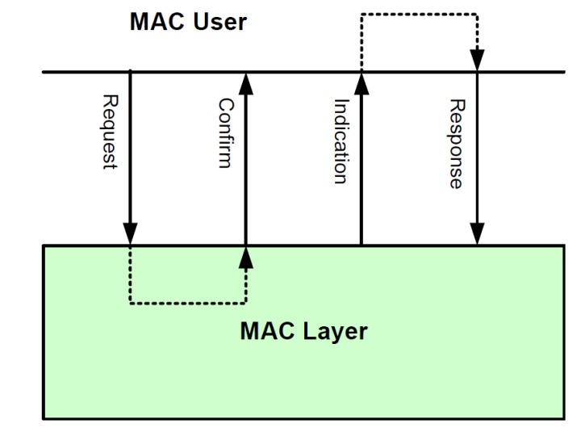
MAC Service Primitives
As described before, communications are passed between the MAC User and MAC Layer by means of service primitives:
Request, confirm, indication, response.

Slide 13
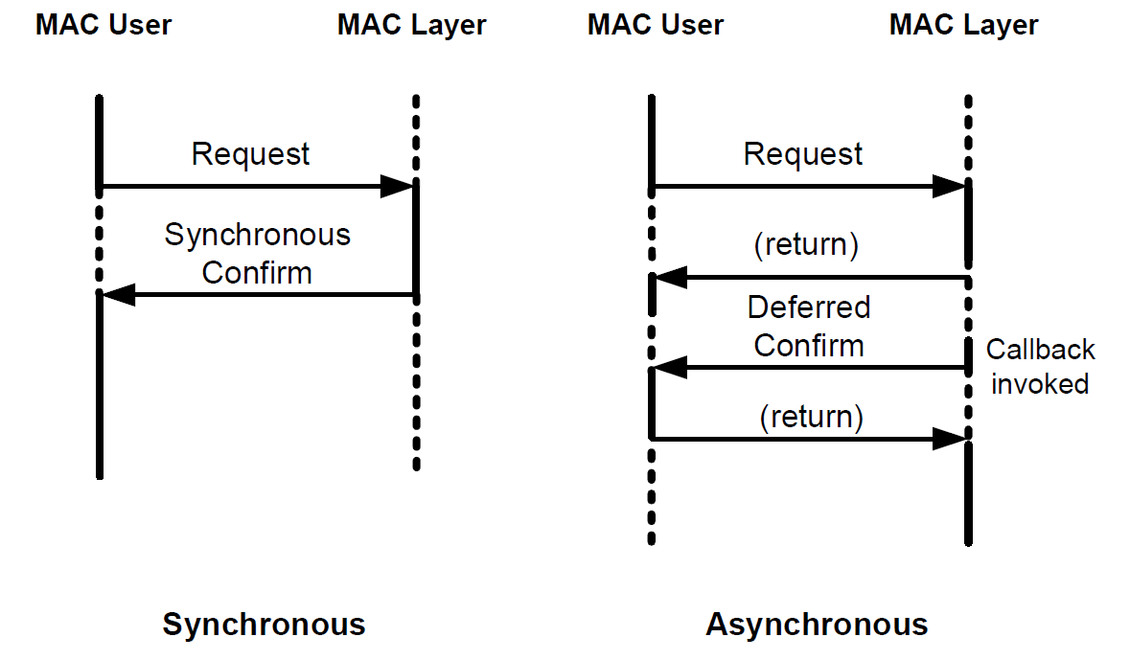
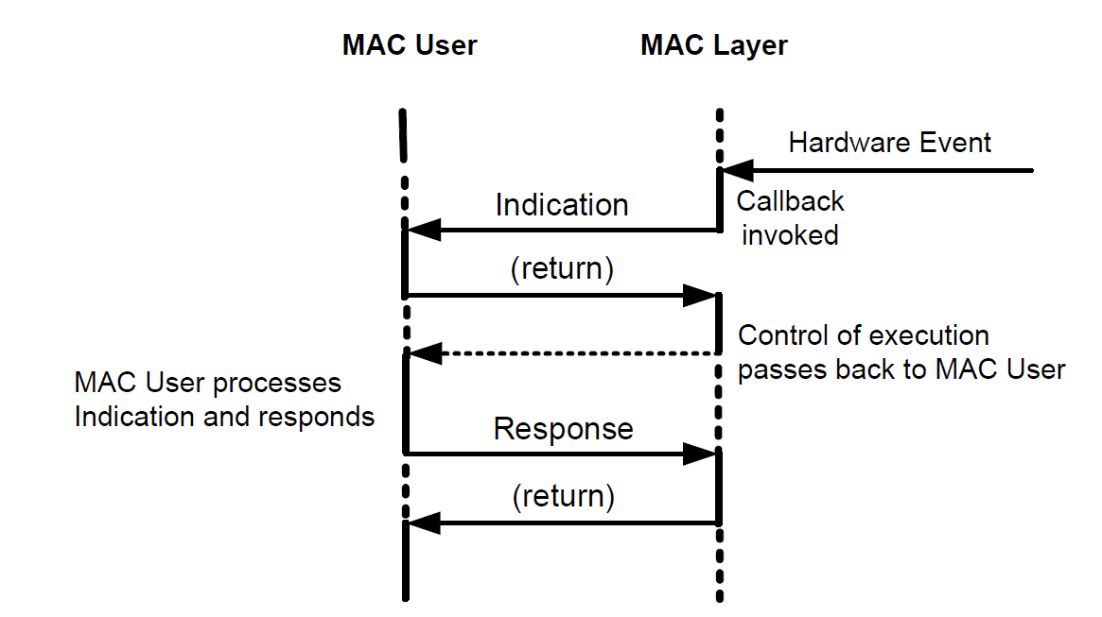
Implementation of Service Primitives

Slide 14
Implementation of Service Primitives
The question is: how much/long we should invest in defining service primitives for the MAC?
The PHYs do not have any (at least now).
We propose TG8 implements a basic set of primitives for network synchronization, discovery, peering and communication.
We provided some examples for communication, peering, di-peering, passive/active scan.
While in course of letter ballot, we will see if we need to add more.

