Slide 1
Project: IEEE P802.15 Working Group for Wireless Personal Area Networks (WPANs)
Submission Title: LiFi Reference Channel Models: Office, Home, Hospital
Date Submitted: July 13, 2015
Source: Murat Uysal and Farshad Miramirkhani, Ozyegin University
Address: Ozyegin University, Nisantepe Mh. Orman Sk. No:34-36 Çekmekoy 34794 Istanbul, Turkey
Voice: +90 (216) 5649329, Fax: +90 (216) 5649450, E-Mail: murat.uysal@ozyegin.edu.tr
Abstract: In response to «Call for Proposals for OWC Channel Models» issued by 802.15.7r1, this contribution proposes LiFi reference channel models for indoor environments such as office, home and hospital.
Purpose: To introduce reference channel models for the evaluation of different PHY proposals.
Notice: This document has been prepared to assist the IEEE P802.15. It is offered as a basis for discussion and is not binding on the contributing individual(s) or organization(s). The material in this document is subject to change in form and content after further study. The contributor(s) reserve(s) the right to add, amend or withdraw material contained herein.
Release: The contributor acknowledges and accepts that this contribution becomes the property of IEEE and may be made publicly available by P802.15.

Slide 2
LiFi Reference Channel Models: Office, Home, Hospital

Slide 3
Outline
  Introduction
  Overview of Channel Modeling Methodology
  Typical Indoor Scenarios
  High Speed Communication Scenarios: Office, Home, Hospital
  Modeling of Indoor Environment
  Source Modeling
  Illumination Level Requirements
  Channel Impulse Responses (CIR)
Conclusions

Slide 4
Overview of Channel Modeling Methodology
CAD Objects (Furniture, etc)
3D Indoor Environment Modeling
(Zemax)
Channel DC Gain
Light Source Specifications
Non-Sequential Ray-Tracing
(Zemax)
Channel Impulse Response
(Matlab)
Mean Excess Delay Spread
Characterization
Detector Specifications
Coherence Bandwidth
Material Reflectance Values
RMS Delay Spread
  A flexible and efficient method for realistic VLC channel modeling
    Wavelength dependency
    Realistic light sources
    Effect of objects within the environment and types of surface (coating) materials
See IEEE 15-15-0352-00-007a “Channel Modeling for Visible Light Communications” for additional details

Slide 5
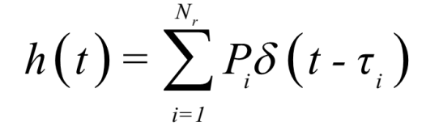
Overview of Channel Modeling Methodology
  Creation of 3D indoor environment in Zemax involves the selection of
    Room size and shape
    CAD objects within the environment (furniture etc)
    Position and type of transmitters and receivers
    Type and properties of materials (walls, floor, ceiling, objects etc)
  The Zemax non-sequential ray-tracing tool generates an output file, which includes all the data about rays such as the detected power and path lengths for each ray.
  The data from Zemax output file is imported to MATLAB and using these information, the CIR is expressed as
P_{i} = the power of the ith ray
τ_{i} = the propagation time of the ith ray
δ(t) = the Dirac delta function
N_{r} = the number of rays received at the detector

Slide 6
Characterization of CIR
Channel Parameters | Definition
Channel DC Gain
Mean Excess Delay Spread
RMS Delay Spread
Frequency Correlation Function
Coherence Bandwidth (Correlation level of 0.9)
Channel Transfer Function

Slide 7
Typical Indoor VLC Scenarios
Typical indoor VLC scenarios can be divided into the following two categories
High Illumination Scenarios
  Conference Centers
  Exhibition Halls
  Presentation Theaters
  Sports Halls
High Speed Communication Scenarios
  Office
  Home
  Hospitals
In this contribution, we focus on the latter.

Slide 8
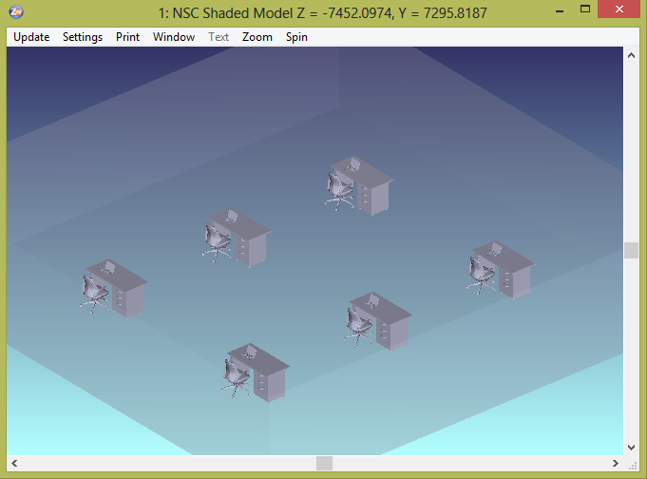
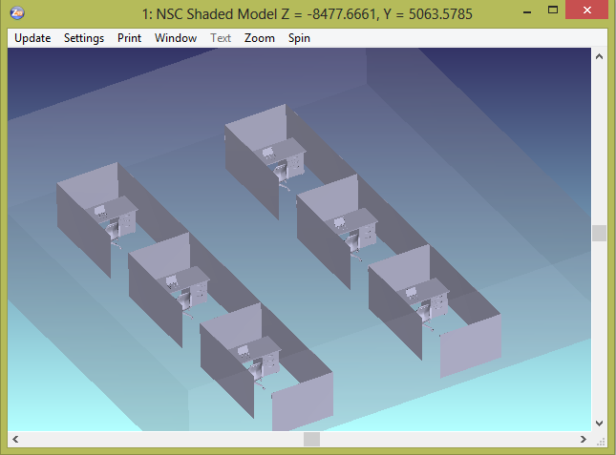
Simulation Scenario 1: Office
Typical office places include furniture (e.g., desk, chairs, cubicles etc) and various equipments (e.g., computers, printers etc). CAD objects of such furniture and equipment can be imported to Zemax for modeling of realistic scenarios.
Open Office
Office With Cubicles

Slide 9
Simulation Parameters
Room size | 14m × 14m × 3m
Materials | Walls: Plaster Ceiling: Plaster Floor: Pinewood
Objects | 6 desks and a chair paired with each desk 6 laptops on each desk 6 cubicles (optional)
Objects specifications | Cubicles: Plaster Desk: Pinewood (Typical height of 0.85m) Chair: Pinewood Laptop: Black gloss paint
Number of luminaries | 32
Input power per each luminary | 48 W

Slide 10
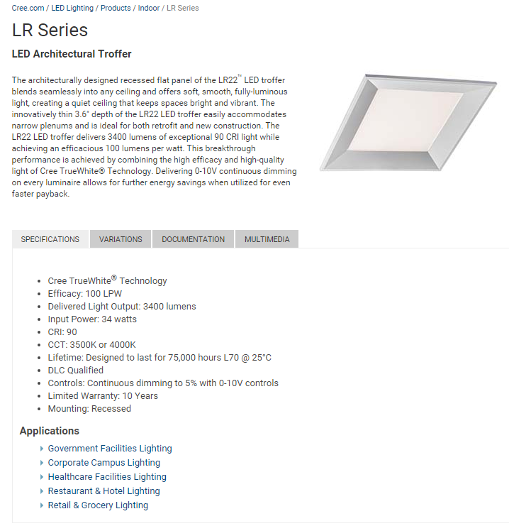
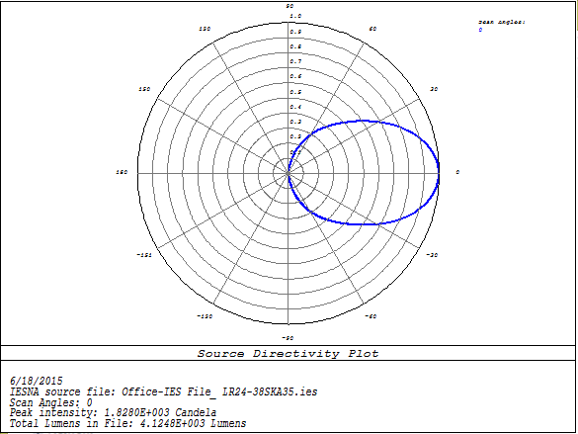
Light Source
In simulation study, we use the LED luminary “LR24-38SKA35” from Cree
Simulated emission pattern in Zemax

Slide 11
Illumination Level Requirements
For typical indoor scenarios with dispersed light, the illumination requirements according to Illuminating Engineering Society of North America (IES) Standard* lead to expected surface illumination levels between 100 lx and 1000 lx.
Average illumination level in an office environment (for a comfortable working area) is 500 lx. This is the required illumination level on desk surface.
The achieved illumination level depends on the properties of luminary (i.e., lighting output) as well as the arrangement of luminaries (i.e., number of luminaries, distance between them, etc).
Illumination Uniformity
  The ideal value of uniformity is 1
  Typical values are larger than 0.5
  * “Lighting of indoor work places”, International Standard. ISO 8995:2002 CIE S 008/E-2001.

Slide 12
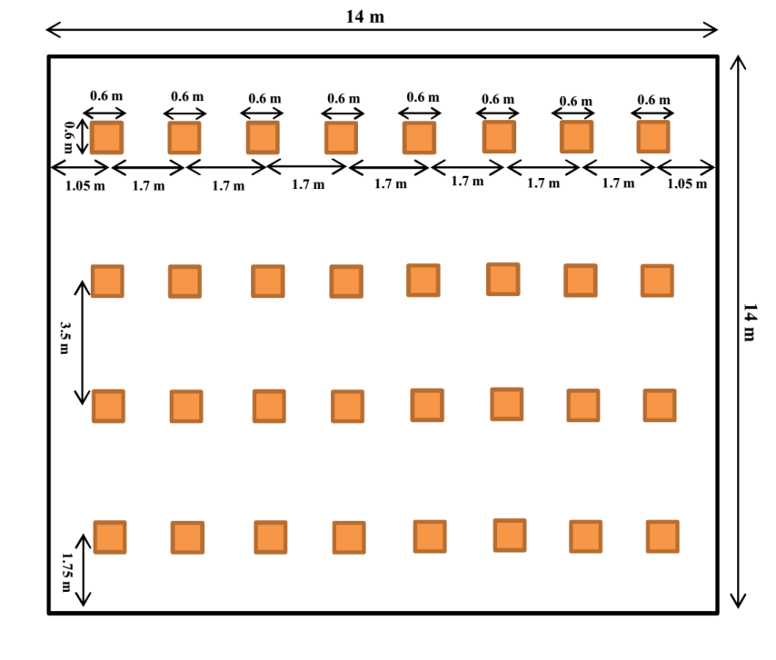
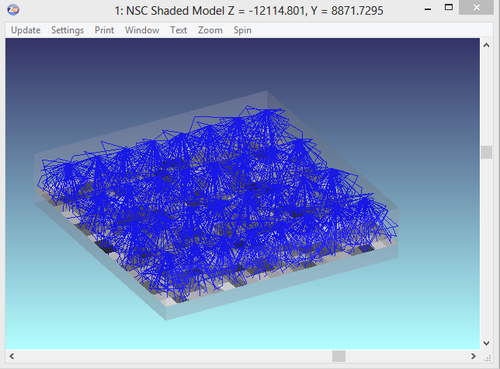
Illumination Levels
Based on the properties of employed luminary, required illumination level (500 lx) and the size of office place, we arrange the luminaries as follows:
Delivered light output from each luminary | 3504 lumens
Average of illumination level | 533 lx
Uniformity of illumination | 0.5211
Arrangement of luminaries
Evaluation of illumination levels in Zemax

Slide 13
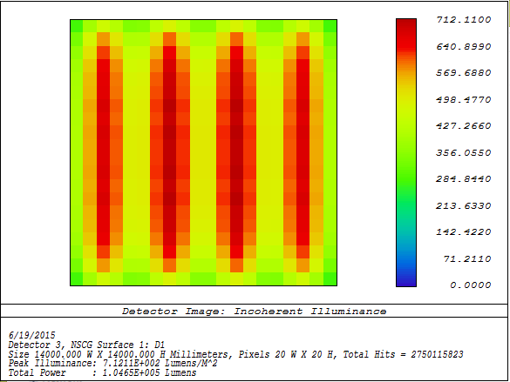
Illumination Patterns
Simulated illumination levels in Zemax
Illumination level contours in Matlab
Different colors show different values of illumination (lx) at the height of desk in office place. Red indicates the highest illumination level.
The minimum and maximum values of illumination are 278 lx and 712 lx respectively.

Slide 14
Location of Test Points (Receivers)
For evaluation of CIRs, we place 24 test points in the simulated office place. These PDs are placed in three categories
In the corridors at a height of 1.7 m (e.g., people who stand with a cell phone in hand) | D1-D12
On the desk next to the laptop at a height of 0.85 m (e.g., a USB-type device connected to laptop) | D13-D18
On the top of chairs at a height of 1.1 m (e.g., people who sit with a cell phone in hand to his/her ear) | D19-D24

Slide 15
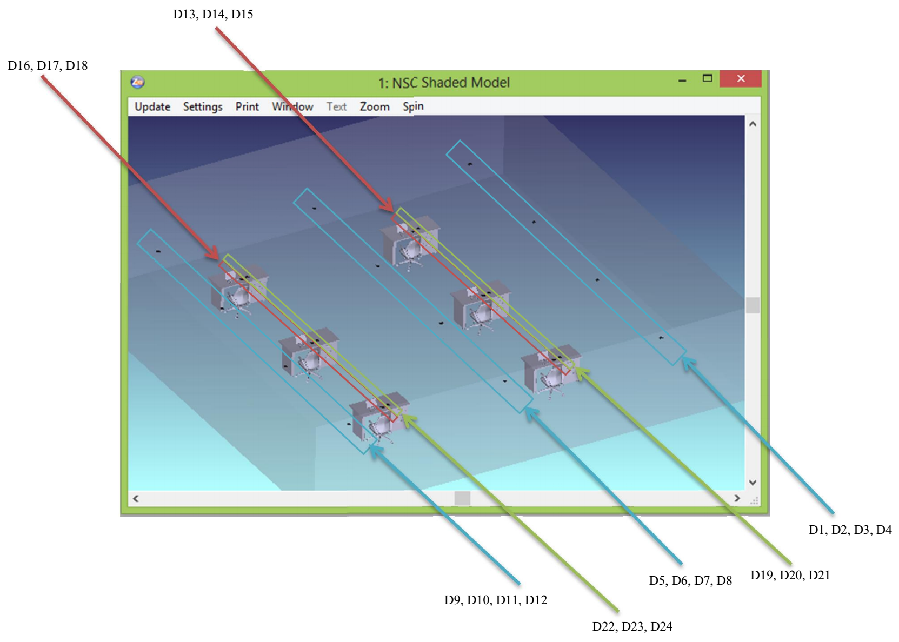
Test Points (Open Office)

Slide 16
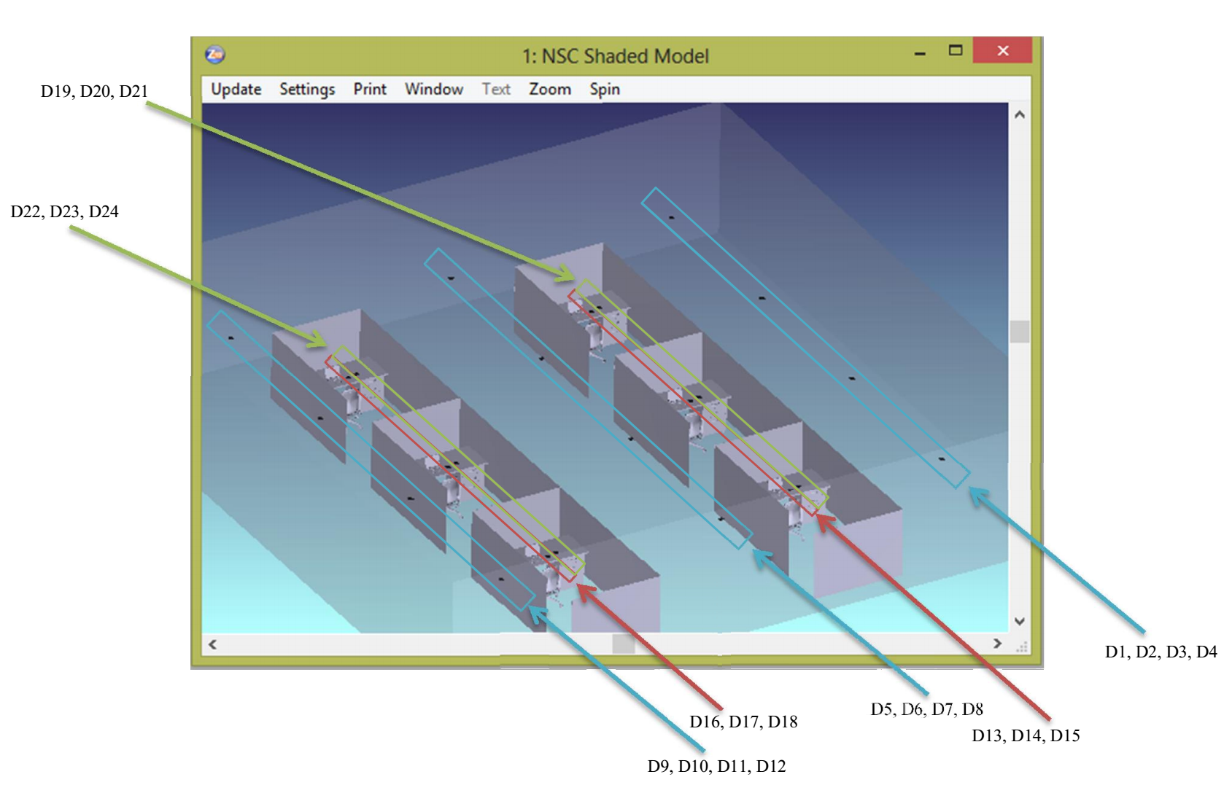
Test Points (Office with Cubicles)

Slide 17
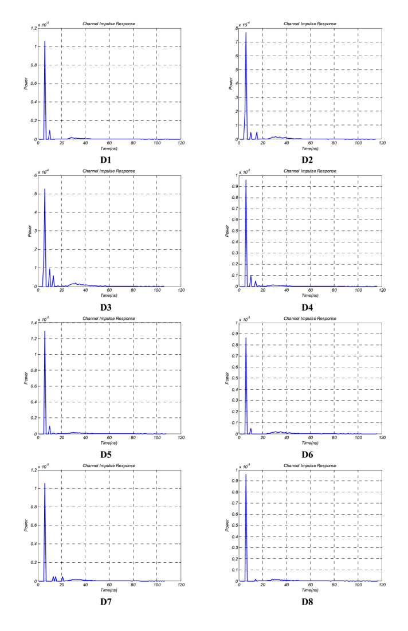
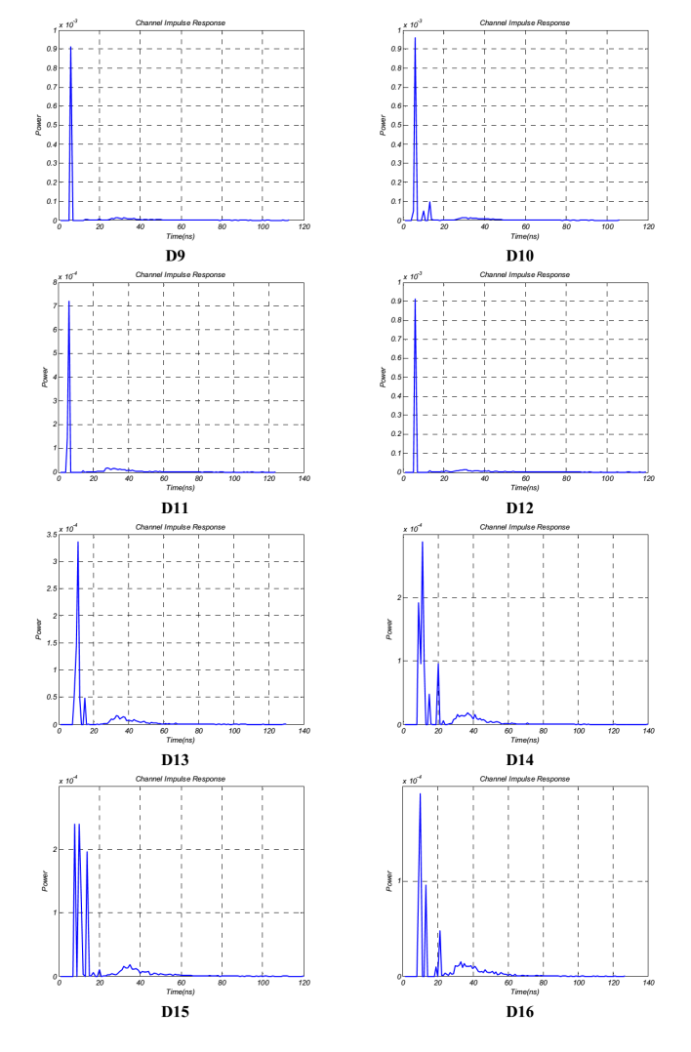
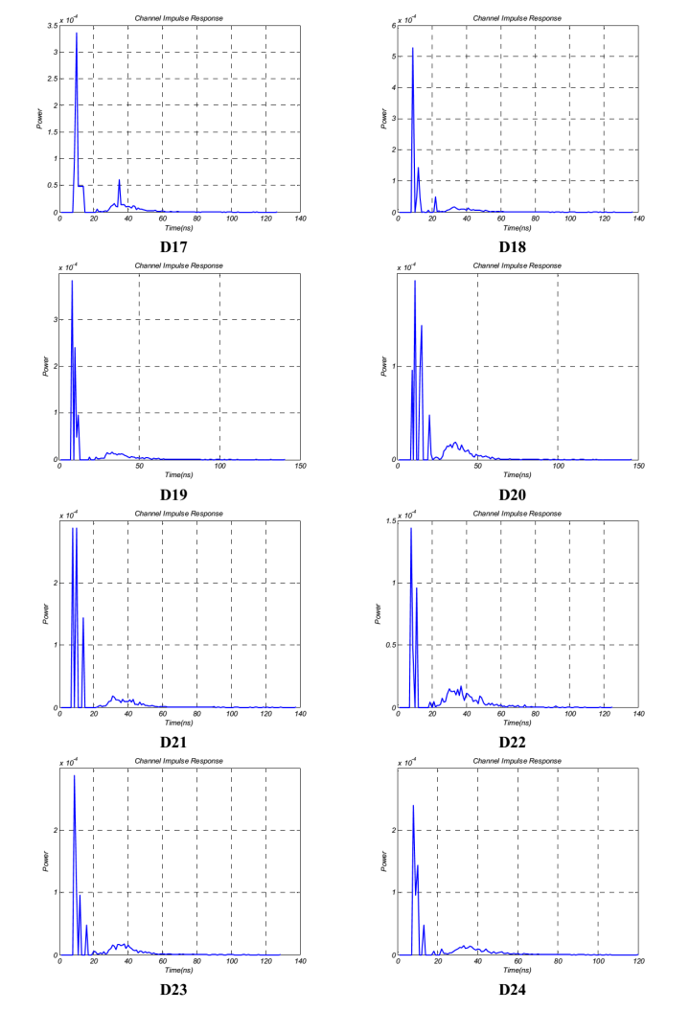
CIR Results (Open Office)

Slide 18
Channel Characteristics
Reference: Empty room
With respect to an empty room of the same size
  RMS delay spread ↓ (avg. 1.8 %)
  Channel DC gain ↓ (avg. 7.7 %)
  DC gains of D1-D12 (within corridors) are larger than other ones because with a height of 1.7 m they are located closer to the source.
More multipath effects are observed in CIRs of D13-D24 because these receivers are near the objects such as laptops or chairs.
D1 | 13.44 | 1.26×10⁻³ | 12.08 | 1.37×10⁻³
D2 | 12.32 | 1.64×10⁻³ | 13.37 | 1.31×10⁻³
D3 | 14.01 | 1.16×10⁻³ | 14.16 | 1.07×10⁻³
D4 | 12.09 | 1.51×10⁻³ | 11.86 | 1.31×10⁻³
D5 | 13.52 | 1.36×10⁻³ | 11.96 | 1.66×10⁻³
D6 | 12.69 | 1.73×10⁻³ | 14.04 | 1.18×10⁻³
D7 | 14.18 | 1.37×10⁻³ | 12.88 | 1.47×10⁻³
D8 | 13.09 | 1.47×10⁻³ | 13.52 | 1.21×10⁻³
D9 | 12.74 | 1.28×10⁻³ | 13.20 | 1.13×10⁻³
D10 | 13.67 | 1.26×10⁻³ | 12.60 | 1.38×10⁻³
D11 | 12.99 | 1.61×10⁻³ | 14.43 | 1.13×10⁻³
D12 | 12.67 | 1.39×10⁻³ | 13.46 | 1.13×10⁻³
D13 | 15.34 | 9.34×10⁻⁴ | 14.65 | 8.49×10⁻⁴
D14 | 15.00 | 9.36×10⁻⁴ | 14.07 | 1.09×10⁻³
D15 | 16.03 | 9.52×10⁻⁴ | 13.65 | 1.07×10⁻³
D16 | 15.63 | 8.54×10⁻⁴ | 16.02 | 6.76×10⁻⁴
D17 | 15.94 | 9.23×10⁻⁴ | 15.29 | 9.40×10⁻⁴
D18 | 15.12 | 9.77×10⁻⁴ | 14.20 | 1.06×10⁻³
D19 | 15.29 | 1.00×10⁻³ | 14.70 | 1.03×10⁻³
D20 | 16.06 | 9.44×10⁻⁴ | 14.34 | 8.67×10⁻⁴
D21 | 15.17 | 1.06×10⁻³ | 14.56 | 9.73×10⁻⁴
D22 | 16.40 | 7.40×10⁻⁴ | 17.61 | 5.67×10⁻⁴
D23 | 16.63 | 8.17×10⁻⁴ | 15.64 | 8.21×10⁻⁴
D24 | 14.36 | 1.14×10⁻³ | 15.66 | 7.78×10⁻⁴
Ave | 14.34 | 1.17×10⁻³ | 14.08 | 1.08×10⁻³
(ns)
(ns)

Slide 19
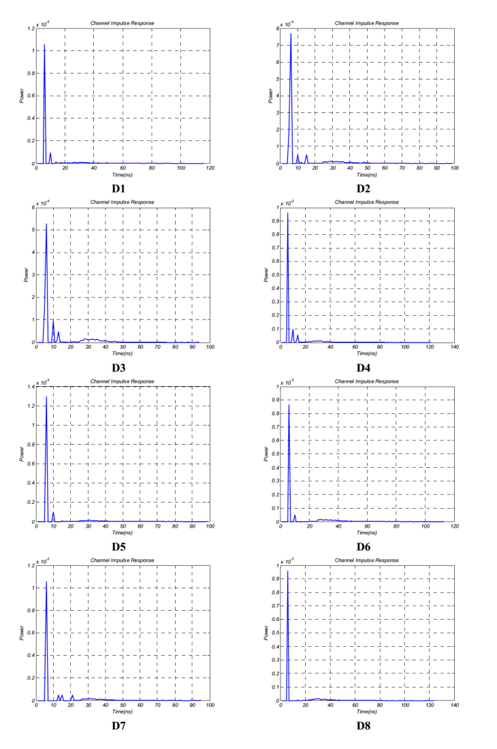
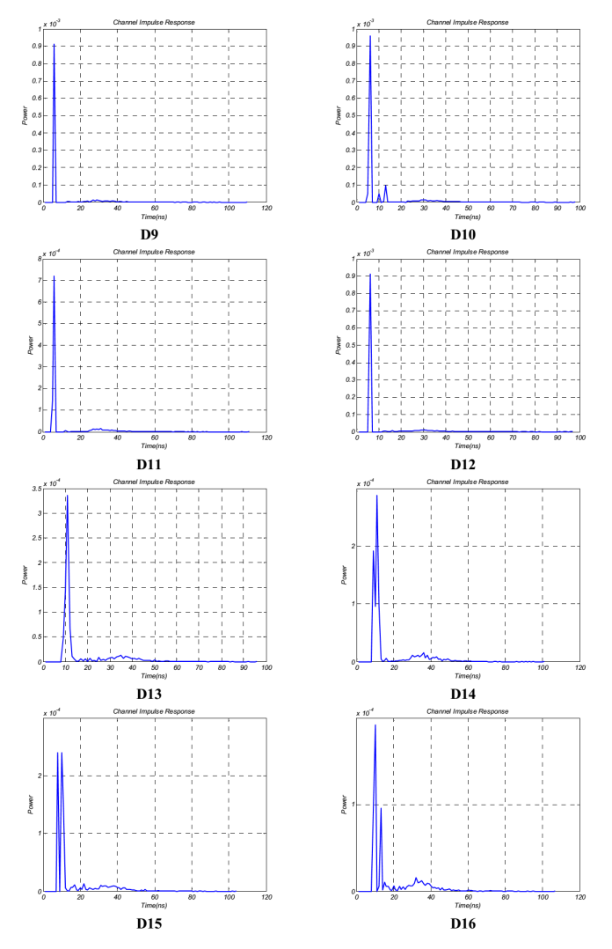
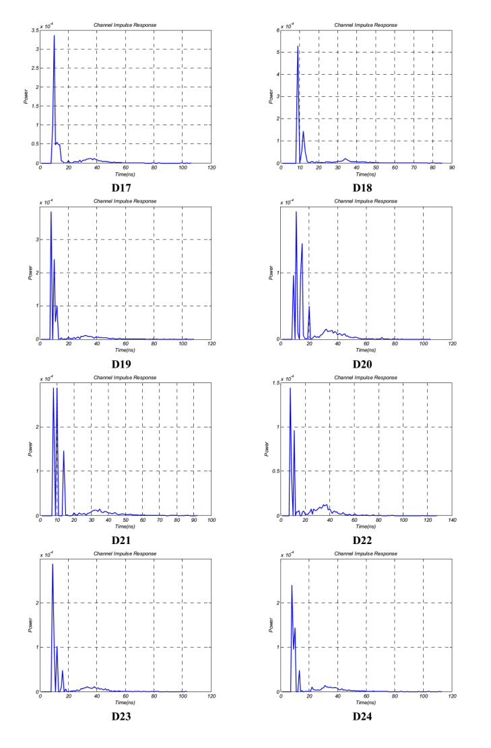
CIR Results (Office with Cubicles)

Slide 20
Channel Characteristics
 | (ns)
D1 | 10.27 | 1.33×10⁻³
D2 | 11.56 | 1.26×10⁻³
D3 | 12.27 | 1.03×10⁻³
D4 | 10.80 | 1.30×10⁻³
D5 | 10.32 | 1.60×10⁻³
D6 | 12.50 | 1.14×10⁻³
D7 | 11.67 | 1.43×10⁻³
D8 | 12.27 | 1.16×10⁻³
D9 | 11.65 | 1.11×10⁻³
D10 | 10.97 | 1.36×10⁻³
D11 | 12.23 | 1.06×10⁻³
D12 | 11.06 | 1.10×10⁻³
D13 | 11.71 | 8.10×10⁻⁴
D14 | 12.19 | 8.79×10⁻⁴
D15 | 12.16 | 8.58×10⁻⁴
D16 | 12.94 | 6.01×10⁻⁴
D17 | 12.21 | 8.39×10⁻⁴
D18 | 11.46 | 9.95×10⁻⁴
D19 | 11.68 | 9.67×10⁻⁴
D20 | 12.73 | 8.27×10⁻⁴
D21 | 12.27 | 9.24×10⁻⁴
D22 | 14.87 | 5.03×10⁻⁴
D23 | 12.86 | 7.28×10⁻⁴
D24 | 13.69 | 7.36×10⁻⁴
Ave | 12.01 | 1.02×10⁻³
  With respect to open office, channel DC gain decreases (0.7% - 19.8% with an average of 5.5%). This decrease is a result of the presence of cubicles. The rays within cubicles hit the cubicle walls and decay more rapidly than those rays in open office.
  With respect to open office, RMS delay spread decreases (8.9% - 20.5% with an average of 14.7%). Since the rays cannot pass through cubicle walls, delay spread values are smaller.

Slide 21
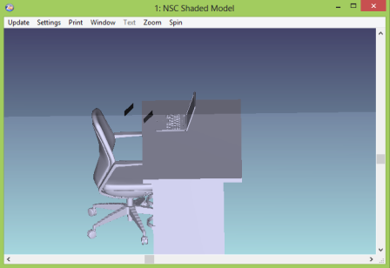
Effect of Rotation
To evaluate the effect of rotation, we further consider the same test points in the open office and assume 45º rotation at the receiver.
In the corridors at a height of 1.7m with 45º rotation (e.g., people who stand with a cell phone in hand) | D1-D12
On the top of chairs at a height of 0.95m with 45º rotation (i.e., people with a cell phone in hand) | D13-D18
On the top of chairs at a height of 1.1m with 45º rotation (e.g., people who sit with a cell phone in hand to his/her ear) | D19-D24
Height: 1.1m
Height: 0.95m

Slide 22
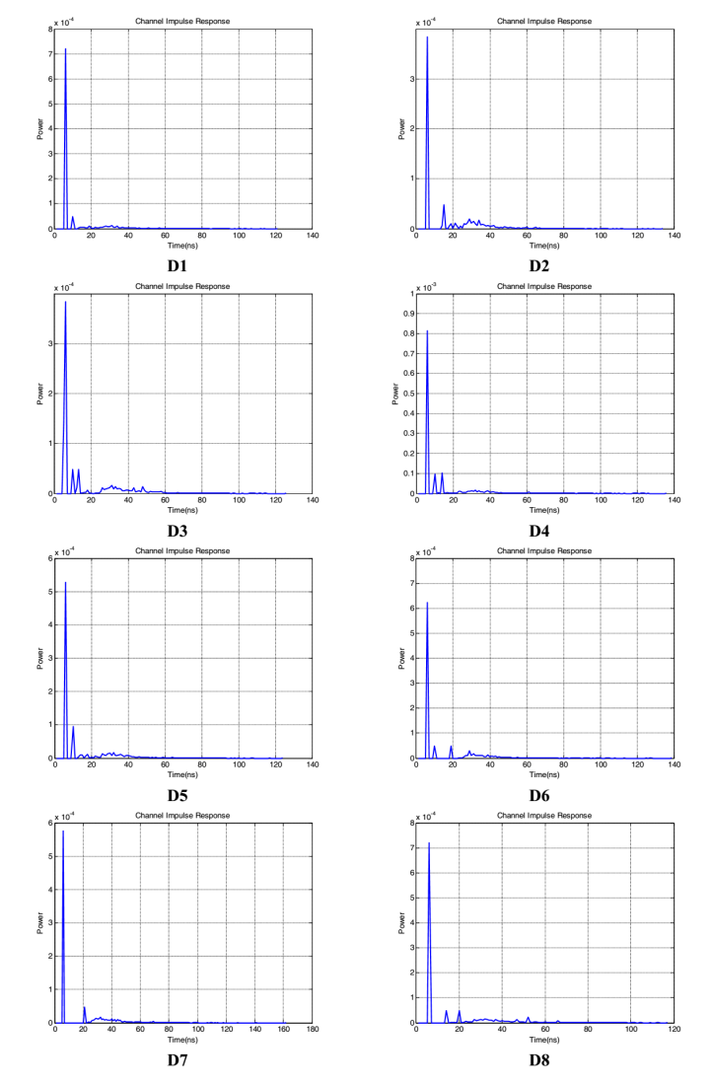
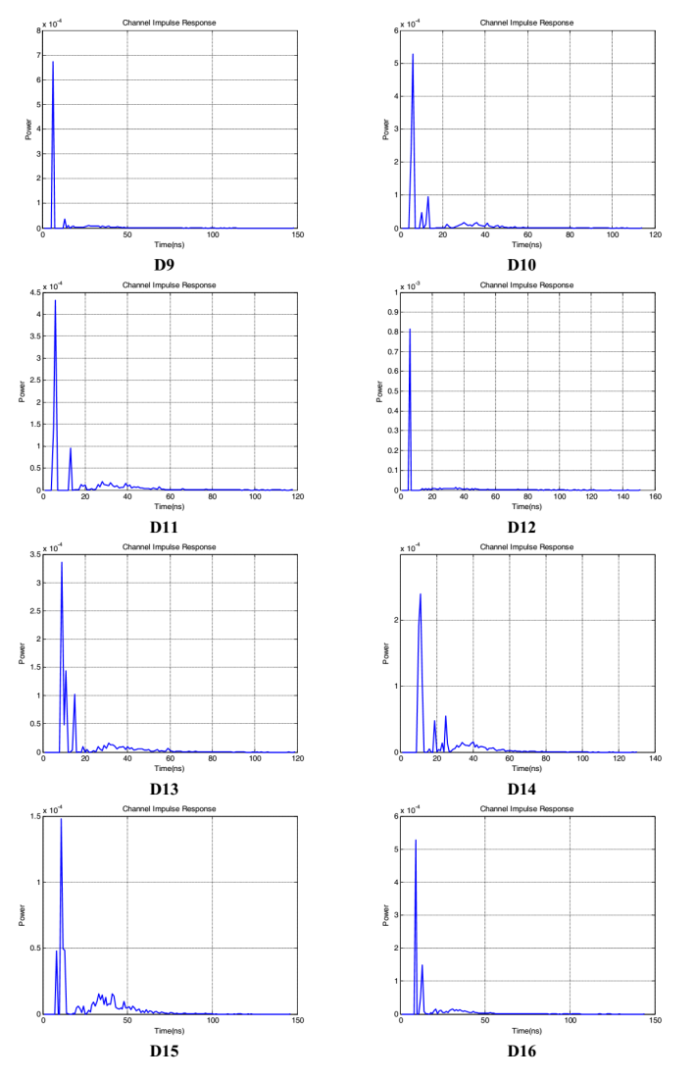
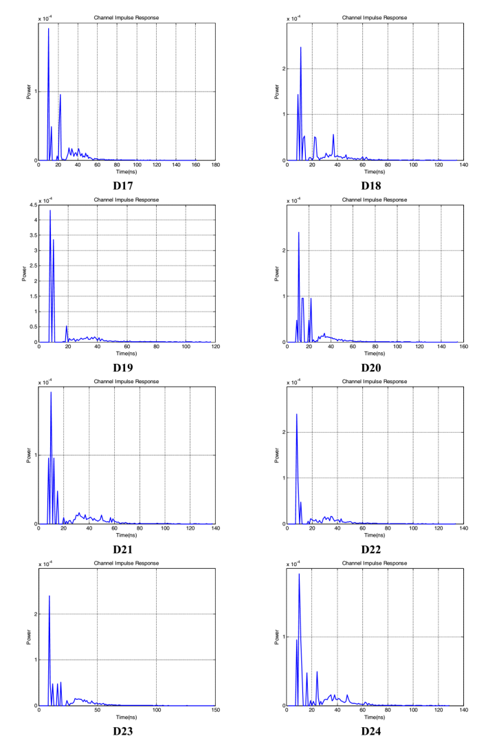
CIR Results (Effect of Rotation)

Slide 23
Channel Characteristics
 | (ns)
D1 | 13.72 | 9.87×10⁻⁴
D2 | 16.72 | 7.04×10⁻⁴
D3 | 17.04 | 8.97×10⁻⁴
D4 | 14.53 | 1.28×10⁻³
D5 | 15.26 | 9.07×10⁻⁴
D6 | 15.91 | 9.86×10⁻⁴
D7 | 17.81 | 8.86×10⁻⁴
D8 | 17.24 | 1.10×10⁻³
D9 | 14.18 | 9.25×10⁻⁴
D10 | 14.88 | 1.18×10⁻³
D11 | 16.61 | 9.73×10⁻⁴
D12 | 16.31 | 1.07×10⁻³
D13 | 15.09 | 8.87×10⁻⁴
D14 | 15.81 | 9.31×10⁻⁴
D15 | 16.68 | 5.67×10⁻⁴
D16 | 14.21 | 1.02×10⁻³
D17 | 16.05 | 6.62×10⁻⁴
D18 | 16.47 | 9.26×10⁻⁴
D19 | 14.35 | 1.10×10⁻³
D20 | 14.86 | 8.84×10⁻⁴
D21 | 18.36 | 7.22×10⁻⁴
D22 | 16.77 | 6.76×10⁻⁴
D23 | 16.55 | 7.12×10⁻⁴
D24 | 17.10 | 8.26×10⁻⁴
Ave | 15.93 | 9.08×10⁻⁴
In the previous simulations, detectors were pointed toward the luminaries. In the current simulations, detectors are rotated with a 45º.
  With respect to the previous case, channel DC gain decreases (avg. 15.9%). This decrease is a result of rotation since the detector is not pointed towards the source.
  With respect to the previous case, RMS delay spread increases (avg. 13.1%) due to additional multipath as a result of rotation.

Slide 24
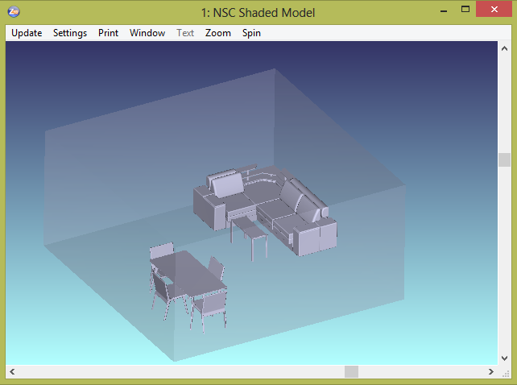
Simulation Scenario 2: Home
We consider a living room with table, chairs, couch and coffee table.

Slide 25
Simulation Parameters
Materials | Walls: Plaster Ceiling: Plaster Floor: Pinewood
Room size | 6m × 6m × 3m
Objects | Table with 4 chairs Couch Coffee table
Object Specifications | Tables: Wooden with size of 2m × 1m × 0.9m Chairs: Wooden matched with table Couch: Cotton Coffee table: Glass
Number of luminaries | 9
Input power per each luminary | 12 W

Slide 26

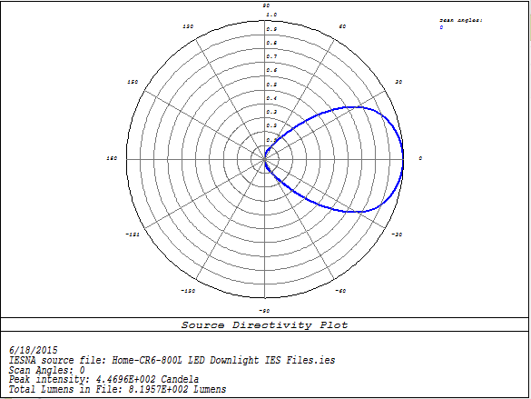
Light Source
In simulation study, we use the LED luminary “CR6-800L” from Cree
Simulated emission pattern in Zemax

Slide 27
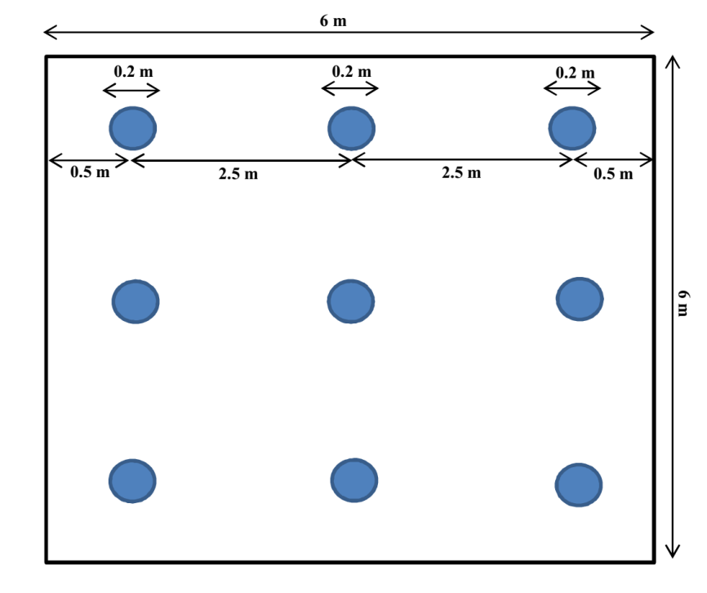
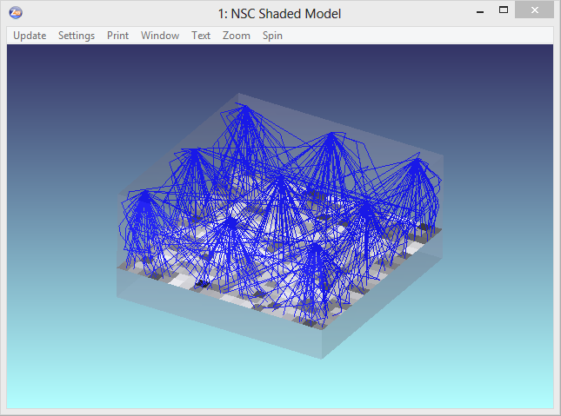
Illumination Levels
Based on the properties of luminary, required illumination level (150 lx) and the size of room, we arrange the luminaries as follows:
Delivered light output from each luminary | 804 lumens
Average of illumination level | 153 lx
Uniformity of illumination | 0.9068
Arrangement of luminaries
Evaluation of illumination level in Zemax

Slide 28
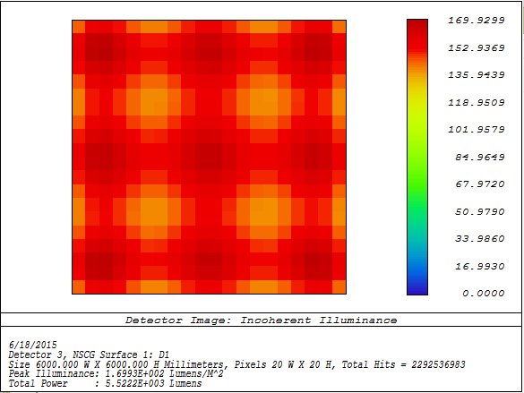
Illumination Patterns
Simulated illumination levels in Zemax
Illumination level contours in Matlab
The minimum and maximum values of illumination are 139 lx and 169 lx.

Slide 29
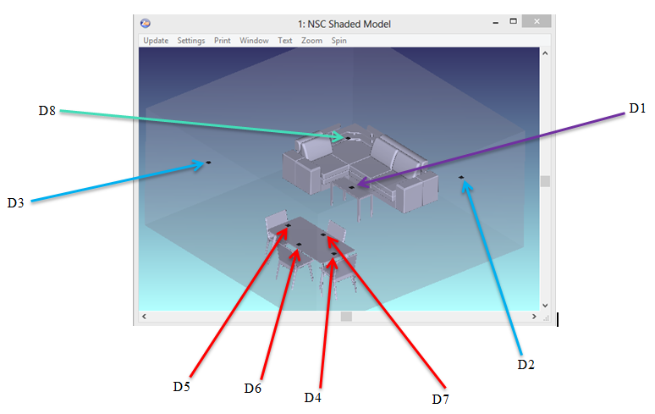
Location of Test Points (Receivers)
For evaluation of CIRs, we place 8 test points in our home environment.
On the coffee table at a height of 0.6 m | D1
Next to the wall at a height of 1.7m (e.g., standing people) | D2-D3
On the table at a height of 0.9 m | D4-D7
On the top of couch at height of 1.1 m (e.g., sitting people) | D8

Slide 30
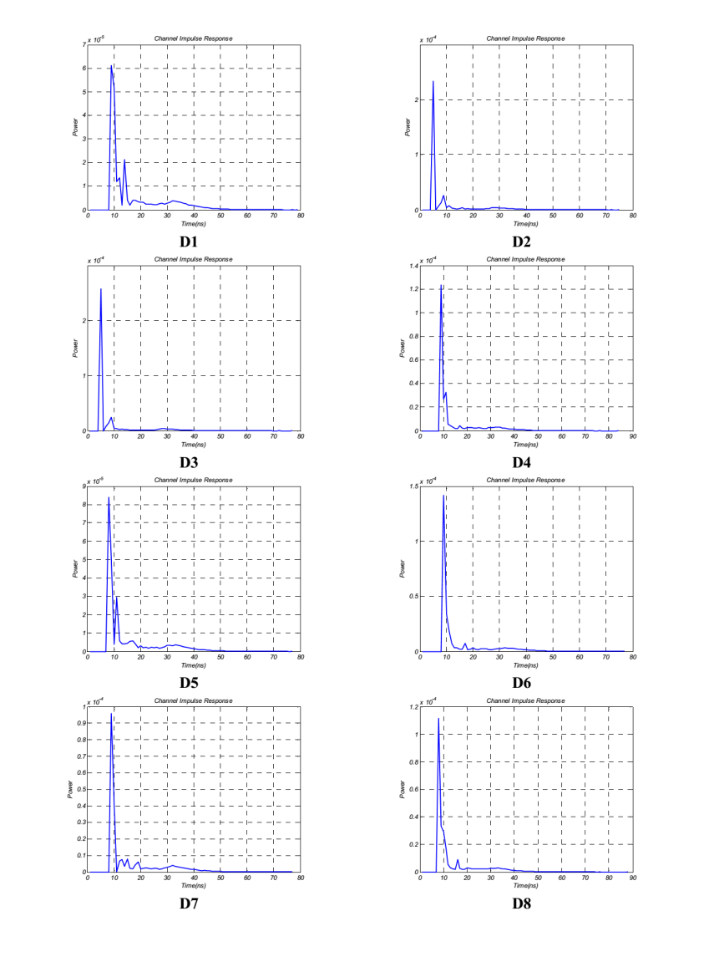
CIR Results (Home)

Slide 31
Channel Characteristics
Reference: Empty room
With respect to an empty room of the same size
  RMS delay spread ↓ (avg. 6.5 %)
  Channel DC gain ↓ (avg. 0.08 %)
  DC gains of D2-D3 are larger than other ones because with a height of 1.7 m they are located closer to the source.
  RMS delay spread of home environment is smaller than those in office place because the dimension of living room is smaller.
D1 | 11.50 | 2.38×10⁻⁻⁴ | 10.67 | 2.46×10⁻⁴
D2 | 9.79 | 3.50×10⁻⁻⁴ | 9.32 | 3.57×10⁻⁴
D3 | 9.59 | 3.79×10⁻⁻⁴ | 9.10 | 3.76×10⁻⁴
D4 | 10.94 | 2.52×10⁻⁻⁴ | 9.91 | 2.65×10⁻⁴
D5 | 11.31 | 2.60×10⁻⁻⁴ | 10.44 | 2.63×10⁻⁴
D6 | 10.31 | 2.97×10⁻⁻⁴ | 9.88 | 2.81×10⁻⁴
D7 | 11.39 | 2.46×10⁻⁻⁴ | 10.56 | 2.36×10⁻⁴
D8 | 10.45 | 2.79×10⁻⁻⁴ | 9.82 | 2.75×10⁻⁴
Ave | 10.66 | 2.87×10⁻⁴ | 9.96 | 2.87×10⁻⁴
(ns)
(ns)

Slide 32
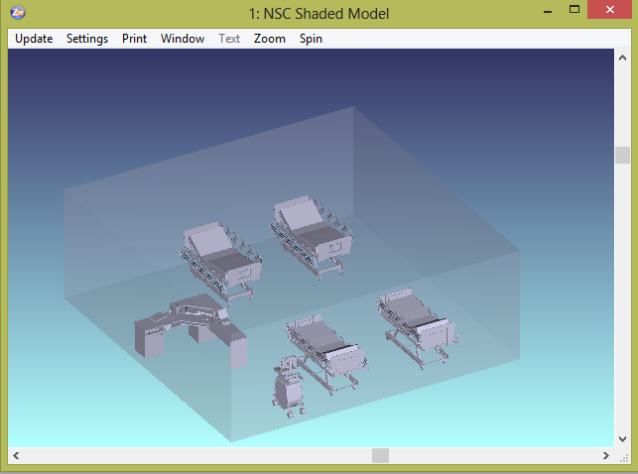
Simulation Scenario 3: Hospitals
We consider a hospital emergency room with beds, reception desk and large diagnostic instruments such as MRI, CT Scan, surgical equipment, etc.
Notes:
Note1:

Slide 33
Simulation Parameters
Materials | Walls: Plaster Ceiling: Plaster Floor: Pinewood
Room size | 8m × 8m × 3m
Objects | 4 beds Ultrasound instrument Reception desk
Object specifications | Bed: size of 2m × 1m × 1m with metal frames Reception desk: Pinewood Ultrasound instrument: Aluminum metal
Number of luminaries | 16
Input power per each luminary | 19 W

Slide 34
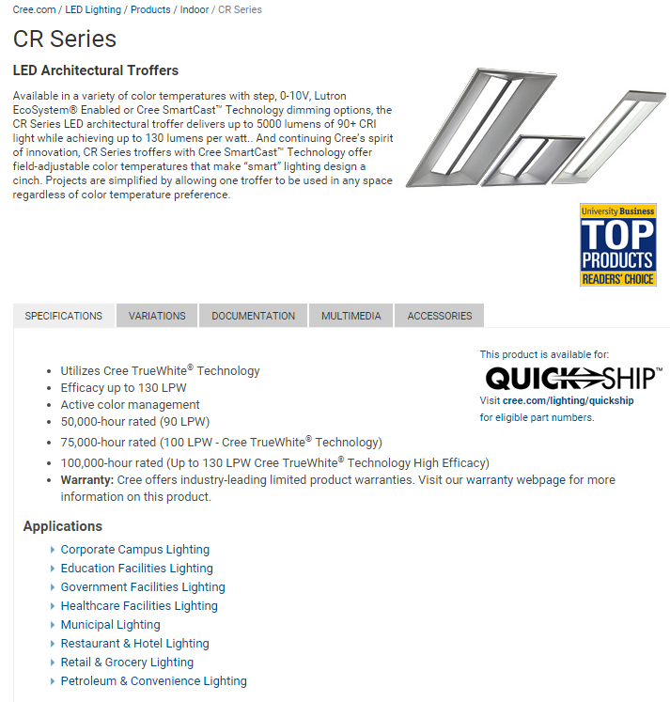
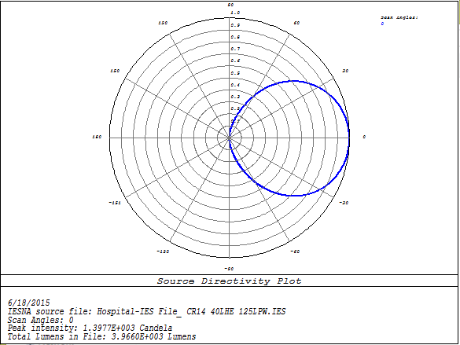
Light Source
In simulation study, we use “CR14-40L-HE” from Cree Inc.
Simulated emission pattern in Zemax
Notes:
Note1:

Slide 35
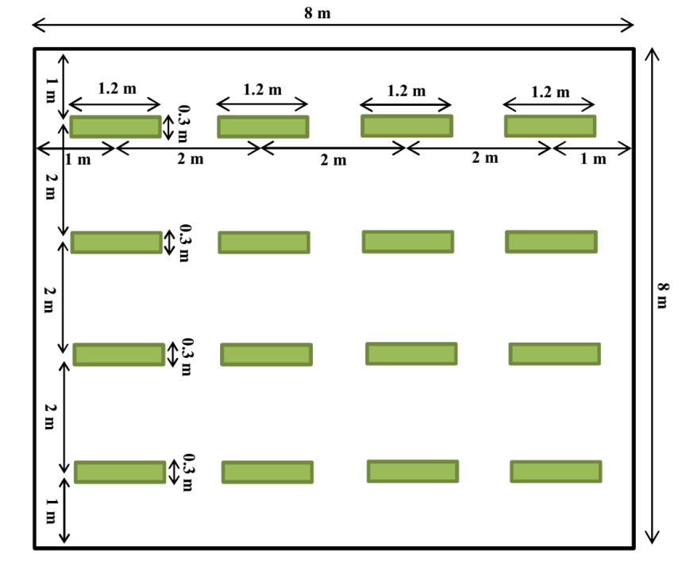
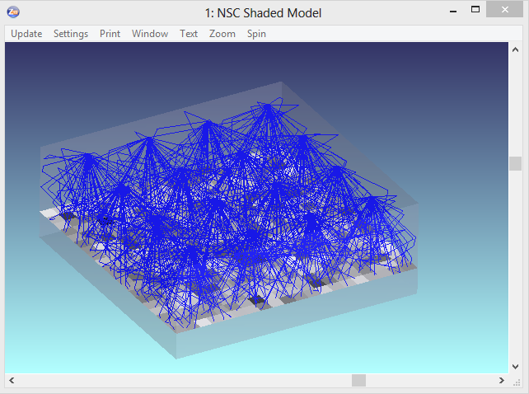
Illumination Levels
Based on the properties of luminary, required illumination level (500 lx) and the size of hospital room, we arrange the luminaries as follows
Delivered light output from each luminary | 2375 lumens
Average of illumination level | 508 lx
Uniformity of illumination | 0.5930
Arrangement of luminaries
Evaluation of illumination level in Zemax
Notes:
Note1:

Slide 36
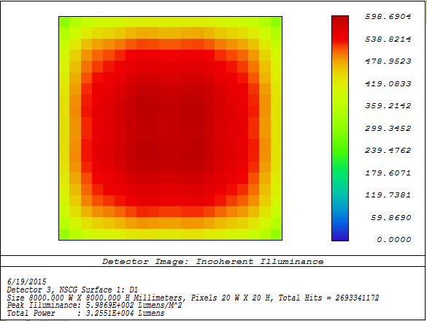
Illumination Patterns
Simulated illumination levels in Zemax
Illumination level contours in Matlab
The minimum and maximum values of illumination are 301 lx and 598 lx.
Notes:
Note1:

Slide 37
Location of Test Points
For evaluation of CIRs, we place 16 test points in simulation environment.
In the corridor between beds at a height of 1.7m (e.g., people who stand with a cell phone in hand) | D1-D3
Next to the wall at a height of 1.7m (e.g., people who stand with a cell phone in hand) | D4
Next to the bed at height of 1.7m (e.g., people who stand with a cell phone in hand) | D5-D8
On the bed at a height of 1 m (e.g., patients who lay with a cell phone in hand) | D9-D12
In front of the ultrasound machine at a height of 1.7m (e.g., people who stand with a cell phone in hand) | D13
On the reception desk at height of 0.8m (e.g., receptionist sitting at the desk) | D14-D16
Notes:
Note1:

Slide 38
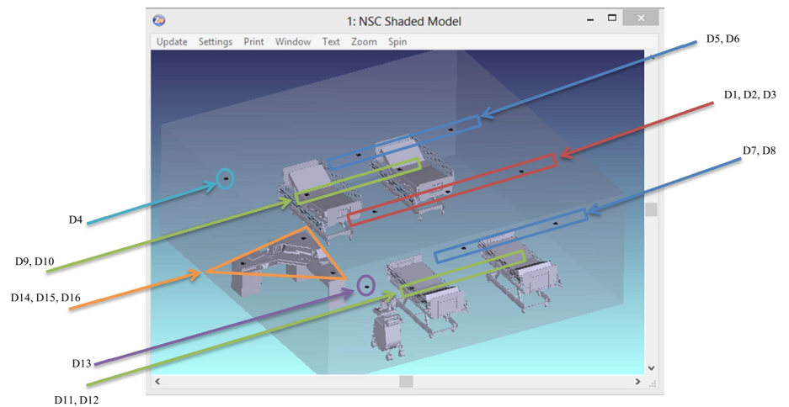
Test Points
Notes:
Note1:

Slide 39
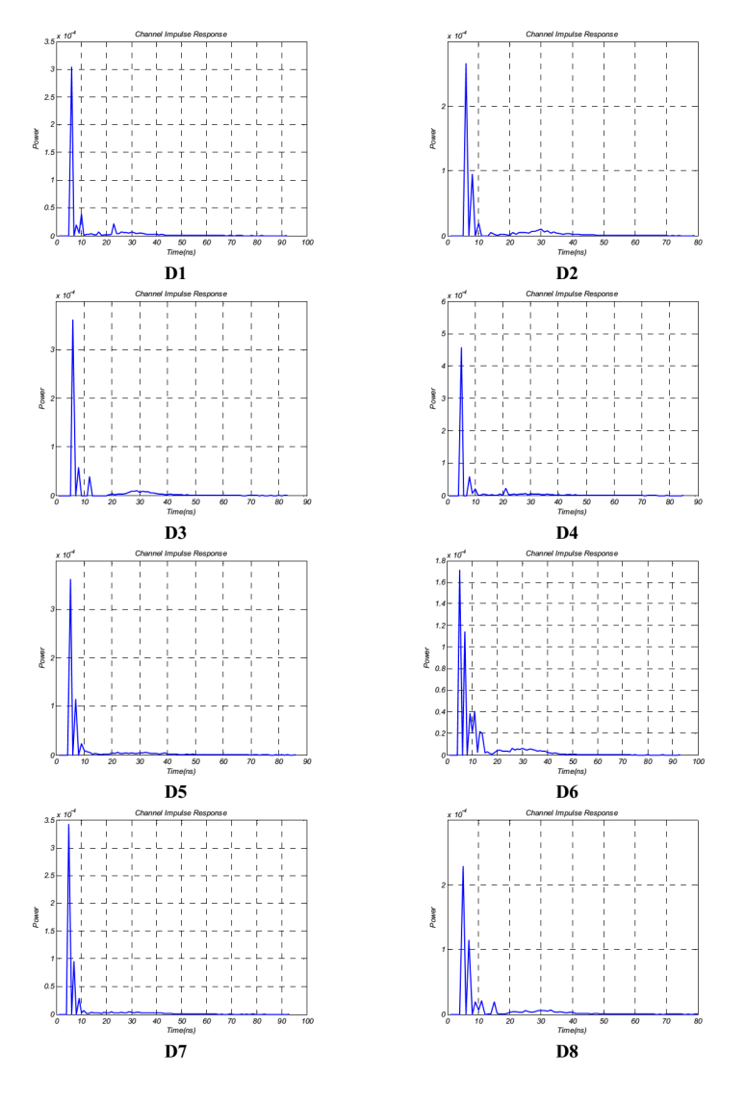
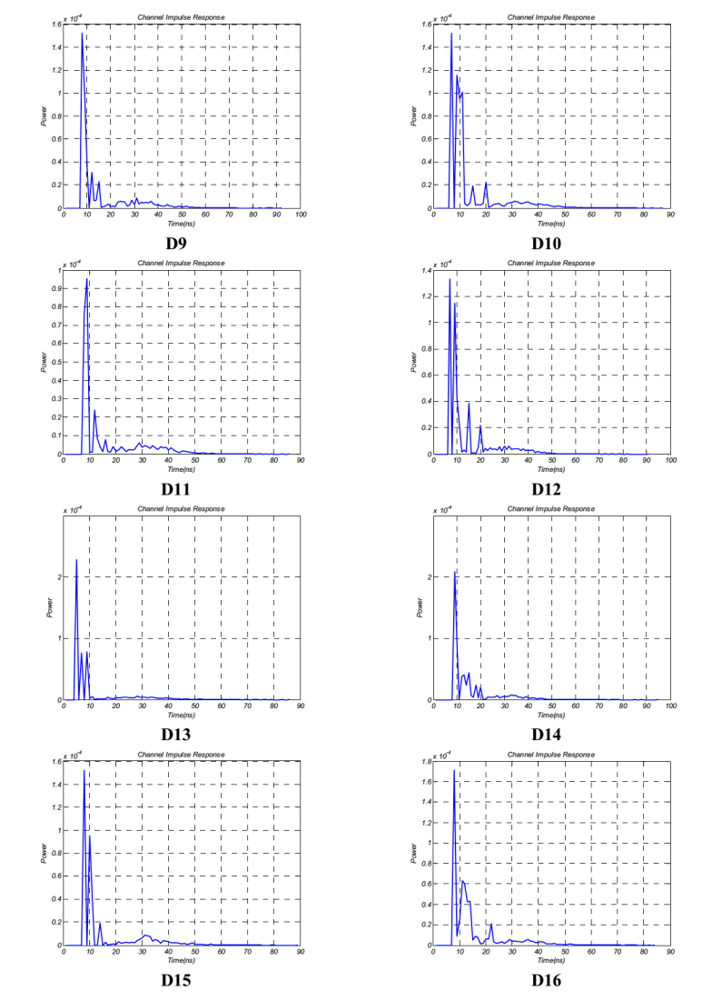
CIR Results
Notes:
Note1:

Slide 40
Channel Characteristics
Reference: Empty room
With respect to an empty room of the same size
  RMS delay spread ↓ (avg. 12.1 %)
  Channel DC gain ↓ (avg. 2.9 %)
RMS delay spread in hospital is smaller than that in office place but larger than home. In fact, the dimension of hospital room under consideration is larger than living room while it is smaller than office place.
D1 | 12.52 | 4.79×10⁻⁴ | 11.16 | 5.02×10⁻⁴
D2 | 12.97 | 4.84×10⁻⁴ | 11.37 | 5.11×10⁻⁴
D3 | 13.76 | 4.59×10⁻⁴ | 11.18 | 5.80×10⁻⁴
D4 | 11.02 | 6.38×10⁻⁴ | 10.15 | 6.65×10⁻⁴
D5 | 11.91 | 5.52×10⁻⁴ | 10.23 | 6.19×10⁻⁴
D6 | 13.10 | 5.18×10⁻⁴ | 10.68 | 5.42×10⁻⁴
D7 | 11.65 | 6.10×10⁻⁴ | 10.12 | 5.72×10⁻⁴
D8 | 12.85 | 5.28×10⁻⁴ | 11.28 | 5.13×10⁻⁴
D9 | 12.65 | 5.04×10⁻⁴ | 11.50 | 4.72×10⁻⁴
D10 | 12.36 | 5.59×10⁻⁴ | 10.38 | 6.27×10⁻⁴
D11 | 12.49 | 5.06×10⁻⁴ | 12.39 | 3.15×10⁻⁴
D12 | 12.19 | 6.07×10⁻⁴ | 10.64 | 4.82×10⁻⁴
D13 | 12.33 | 5.40×10⁻⁴ | 11.03 | 4.87×10⁻⁴
D14 | 12.51 | 5.77×10⁻⁴ | 10.04 | 6.15×10⁻⁴
D15 | 11.95 | 6.45×10⁻⁴ | 12.08 | 4.13×10⁻⁴
D16 | 12.37 | 5.27×10⁻⁴ | 10.18 | 5.56×10⁻⁴
Ave | 12.41 | 5.45×10⁻⁴ | 10.90 | 5.29×10⁻⁴
(ns)
(ns)
Notes:
Note1:
Channel DC gain of D4 (at the corner of hospital) is larger than other ones because this test point is far from objects (energy of rays don’t decay by objects) and also is near to the luminaries (at height of 1.7m).
Channel DC gains of D5 and D7 are larger than D6 and D8 because the latter ones are between the beds and energy of rays decay by objects.

Slide 41
Conclusions
  In response to «Call for Proposals for OWC Channel Models» issued by 802.15.7r1, this contribution proposed LiFi reference channel models for indoor environments such as office, home and hospital.
  The proposed models were obtained using the realistic channel modeling approach presented at Vancouver meeting.
  Based on the TG recommendations, we plan to obtain more CIRs for other indoor environments and make all CIRs available as .m files for public use.
Notes:
Note1:

Slide 42
Acknowledgments
  This work is supported in part by the EU COST Action IC1101 OPTICWISE.
  We thank Nikola Serafimovski of pureLiFi for providing simulation environment specifications of practical interest.
Notes:
Note1:

