Slide 1
Project: IEEE P802.15 Working Group for Wireless Personal Area Networks (WPANs)
Submission Title: ETRI Proposal for Close Proximity PHY
Date Submitted: July 2015.
Source: Jae Seung Lee, Young-Hoon Kim, Hoo-Sung Lee, Gyung-Chul Sihn, Moon-Sik Lee, Jee-Yon Choi, Jae-Woo Park, Ik-Jae Chun, Dong-Seung Kwon
Company: ETRI
Address: 218 Gajeong-ro, Yuseong-gu, Daejeon, 305-700, Korea
Voice: +82-42-860-1326
FAX:
E-Mail: [jasonlee@etri.re.kr, yhkim23@etri.re.kr, hslee@etri.re.kr, neuro@etri.re.kr, moonsiklee@etri.re.kr, jychoi@etri.re.kr, parkjw@etri.re.kr, ijchun@etri.re.kr, dskwon@etri.re.kr]
Re: In response to TG3e High Rate Close Proximity Call for Proposals (15-15-0381-02-003e-tg3e)
Abstract: ETRI Proposal for IEEE 802.15 TG3e PHY (PHY Part of the Full Proposal)
Purpose: To be considered in TG3e baseline document
Notice: This document has been prepared to assist the IEEE P802.15. It is offered as a basis for discussion and is not binding on the contributing individual(s) or organization(s). The material in this document is subject to change in form and content after further study. The contributor(s) reserve(s) the right to add, amend or withdraw material contained herein.
Release: The contributor acknowledges and accepts that this contribution becomes the property of IEEE and may be made publicly available by P802.15.

Slide 2
ETRI Proposal for Close Proximity PHY
July 9, 2015

Slide 3
Contents
Overview
Single Carrier PHY
Channel Bonding
Short Range MIMO with Polarization
Low Complexity SC PHY Design
High Rate SC PHY Design
Simulation Results
Conformance to TGD
Summary
Reference

Slide 4
Overview
Full PHY Proposal: Simplified PHY based on 15.3c Single Carrier PHY
  Only SC PHY is used
  The basic design of 15.3c SC PHY is inherited & simplified with some modifications to meet 15.3e requirements
SC PHY has two modes
  Low Complexity SC PHY
    For cost effective devices
    OOK modulation with RS coding
  High Rate SC PHY
    For high end devices
    Pi/2 BPSK, Pi/2 QPSK, Pi/2 8PSK, Pi/2 16QAM, Pi/2 64QAM, Pi/2 256QAM, Pi/2 1024QAM with RS coding, LDPC
Channel Bonding (up to 4 channels)
Short Range 2X2 MIMO with Polarization Separation

Slide 5
Single Carrier PHY (1/2)
Allow only SC PHY mode in 15.3e
  To avoid complexity caused by having several PHY modes
A 15.3e device shall implement at least one of the following PHY modes:
  Low Complexity SC PHY
    For cost effective devices (low power, low complexity)
    Mandatory support of OOK modulation and RS coding for LC SC PHY
  High Rate SC PHY
    For high end devices (high throughput)
    Mandatory support of Pi/2 BPSK and RS coding for HR SC PHY
    Optional support of Pi/2 QPSK, Pi/2 8PSK, Pi/2 16QAM, Pi/2 64QAM, Pi/2 256QAM, Pi/2 1024QAM modulation
    Optional support of LDPC
  Optional support of channel bonding (up to 4 channels), Short Range 2X2 MIMO with Polarization Separation for PHY modes

Slide 6
Single Carrier PHY (2/2)
Dual SC PHY modes
  OOK has been already adopted in 15.3c for low complexity and low power consumption
    Low complexity: OOK is the simplest modulation scheme – suitable for low-end devices
    Low power: Transmit power can be saved since NO carrier when the device wants to send a ‘0’
    The basic design of 15.3c OOK PHY is inherited for Low Complexity SC PHY of 15.3e
  High Rate SC PHY is based on non-OOK 15.3c PHY
    Focused on High Throughput features
      Pi/2 64QAM, Pi/2 256QAM, Pi/2 1024QAM modulation are added
    Only High rate (HR) base header is used
      15.3c uses several types of low rate (HR, MR, etc) for header/subheader transmission to help robust reception and coexistence, but HR rate is enough for transmitting header/subheader in close proximity transmission

Slide 7
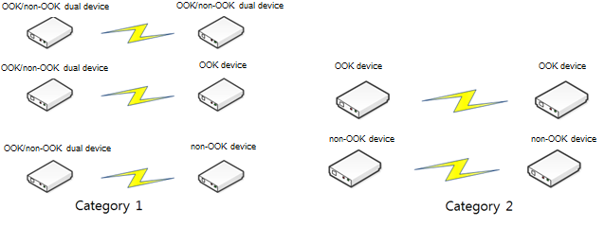
Supporting Dual Modes (1/3)
Supporting Dual modes (Low Complexity & High Rate SC PHY)
  Dual modes (SC PHY using OOK & SC PHY using non-OOK) can be supported concurrently in 15.3e
  Example: Dual mode device use cases
    At least one device support dual PHY modes (Category 1)
    Both devices support only one PHY mode (Category 2)
    → Similar use cases with 15.3c

Slide 8
Supporting Dual Modes (2/3)
15.3c already adopted dual modes for SC PHY: SC PHY without OOK & SC PHY supporting OOK only
  15.3c (Clause 12.2 Single Carrier Mode of mmWave PHY):
  “There are two mandatory MCSs for all SC DEVs except for the optional OOK/DAMI mode DEVs, the common mode signaling (CMS) and the mandatory PHY rate (MPR). The optional OOK/DAMI modes as described in 12.2.8 are allowed for low complexity SC DEVs.”
  15.3c (Clause 12.2.8 Optional OOK/DAMI Modes):
  “Optional low complexity and low power consumption MCSs, which are important for SC applications, may be employed within child piconets. As optional modes, OOK and DAMI may be employed for these applications”

Slide 9
Supporting Dual Modes (3/3)
  15.3c spec implies that 15.3c OOK devices do not have to support mandatory MCSs for non-OOK PHY mode.
    A 15.3c device may implement SC PHY without OOK
    A 15.3c device may implement SC PHY supporting OOK only (without mandatory SC PHY MCSs)
      Since mandatory PHY MCSs for SC PHY are not mandatory for OOK devices
  15.3c OOK devices should be operated within child piconets, but such restriction is not required by 15.3e
    Only two devices in the 15.3e Network
    No coexistence problem in 15.3e due to the limited range
  No problem in supporting dual modes for SC PHY in 15.3e
    15.3e is an amendment to 15.3c
    15.3c already supports dual modes for SC PHY (non-OOK & OOK only)

Slide 10
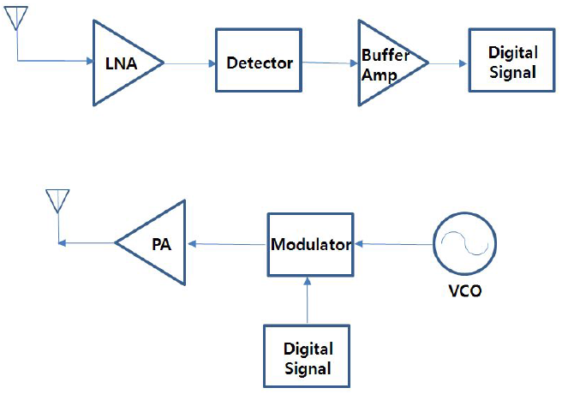
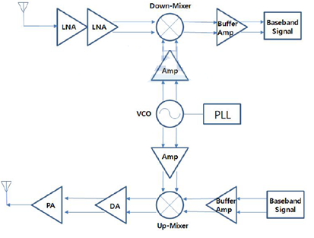
Dual mode PHY Complexity (1/2)
OOK enables simplest Radio Architecture
  OOK only device: Much simpler than FSK/PSK only devices
  Note: Dual mode MAC Complexity is described in ETRI MAC proposal document
OOK only vs. FSK/PSK only

Slide 11
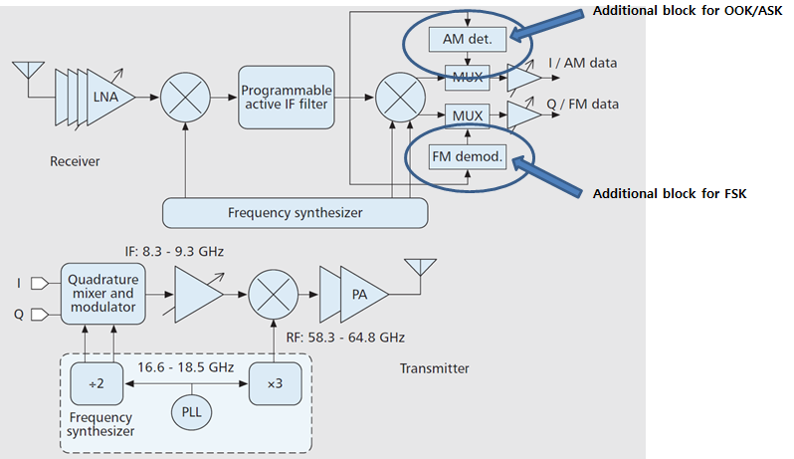
Dual mode PHY Complexity (2/2)
Additional PHY complexity by adding OOK to PSK transceiver is very low!!
  BPSK / QPSK can be an upper compatible system for OOK to support high end applications
  no significant hardware impacts for BPSK / QPSK transceiver to adopt OOK mode
Source: Single-Element and Phased-Array Transceiver Chipsets for 60-GHz Gb/s Communications, INTEGRATED CIRCIUTS FOR COMMUNICATIONS, 2011

Slide 12
Channelization (1/3)
Adopt 15.3c mmWave PHY Channelization with additional channel bonding/aggregation
  Ch2 is the default channel (specified in TGD): 15.3e may use only this channel for single band transmission
  Ch2 and Ch3 are used for 2 channel bonding (specified in TGD): Japan, Europe, US/Canada, South Korea, China
    Ch2 should be always included in the bonded channel (default channel)
    Using two bonded channels (Ch1&Ch2, and Ch3&Ch4) in adjacent Close Proximity Peer Network is not necessary since the range of one Close Proximity Peer Network is very limited
Channel 1
Channel 2
Channel 3
Channel 4
Japan (57.00
-
66.00 GHz)
Europe (57.00
-
66.00 GHz)
U.S. and Canada (57.05
-
64.00 GHz)
South Korea (57.00
-
66.00 GHz)
China (59.00
-
64.00 GHz)
Australia
(59.40
-
62.90 GHz)
57.00
57.24
58.32
59.40
60.48
61.56
62.64
63.72
64.80
65.88
66.00
Frequency
[GHz]

Slide 13
Channelization (2/3)
  Ch1, Ch2, and Ch3 are used for 3 channel bonding (Japan, Europe, US/Canada, South Korea)
  4 channel bonding: Japan, Europe, and South Korea
  It is expected that 4 channel will be available in USA sooner or later
    FCC Request for Comment on 60 GHz Bands:
      “We seek comment on the advisability of amending our rules to allow unlicensed Part 15 operations in the 64-71 GHz band segment.” (FCC)
      (Reference: 15-14-0639-03-003d, FCC NOI on Frequencies Above 24 GHz, FCC-14-154A1, GN Docket No. 14-177, November 2014)

Slide 14
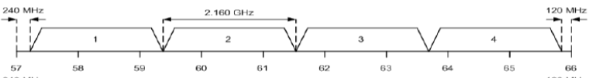
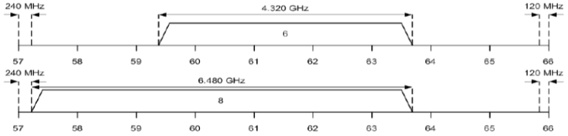
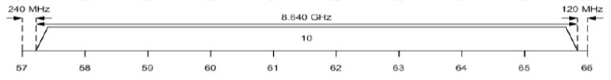
Channelization (3/3)
15.3e PHY Channelization
CHNL_ID | Start Frequency | Center Frequency | Stop Frequency | Remarks
1 | 59.400 GHz | 60.480 GHz | 61.560 GHz | Default channel (Ch 2)
2 | 59.400 GHz | 61.560 GHz | 63.720 GHz | Channel 2&3 bonding (Japan, Europe, US/Canada, South Korea, China)
3 | 57.240 GHz | 60.480 GHz | 63.720 GHz | Channel 1&2&3 bonding (Japan, Europe, US/Canada, South Korea)
4 | 57.240 GHz | 61.560 GHz | 65.880 GHz | 4 Channel bonding (Japan, Europe, and South Korea)

Slide 15
Channel Bonding Options
Option 1: 2x Contiguous Channel Bonding
  Chip rate for 2 channel bonding: 1.76 X 2 = 3.52 Gchip/s
Option 2: 2.2x Contiguous Channel Bonding (utilizing 0.4 GHz between single channels)
    Chip rate for 2.2x channel bonding: 3.92 GHz Gchip/s
Cons & Pros
  Option 2: 10% higher throughput can be achieved by adopting option 2
  Option 2 is more complex to implement
1.08GHz
2.84GHz
0Hz
1.08GHz
2.16GHz
3.04GHz

Slide 16
Short Range MIMO with Polarization (1/3)
Optional support of 2X2 Short Range MIMO with Polarization Separation
      Basic model of SR MIMO [Source: 15.3e TGD]
  Two antenna elements directly communicate with each other
    Low spatial correlation
    Channel capacity obtained by ZF at the receiver without BF is almost the same as that using eigenmode transmission [8]
Tx#1
Rx#1
MIMO
d
propagation
Tx#2
channel
Rx#2
D

Slide 17
Short Range MIMO with Polarization (2/3)
Polarization can provide more gain to Short Range MIMO transmission
  The use of co-located orthogonally-polarized antennas is a cost effective MIMO scheme for providing de-correlation
  Orthogonal polarizations ideally offer a good separation between channels with de-correlation at both transmit and receive sides
  Measurement results in [9] show that the use of circular polarization can effectively reduce the RMS delay spread by about 50% over vertical and horizontal polarization

Slide 18
Short Range MIMO with Polarization (3/3)
Cost effective solution for achieving 100 Gbps throughput
  Many RF chains are required to implement high order MIMO
    Better to use small number of antenna (2X2 MIMO) with higher multilevel modulation (~ 1024 QAM) to achieve 100 Gbps throughput
  Polarization can make it possible to use higher multilevel QAM in MIMO transmission to achieve 100 Gbps
  Propose to use circular polarization for 2X2 MIMO
    MIMO capable 15.3e device shall support polarization (2X2)
    Use RHCP & LHCP
    If a 15.3e device only has one antenna, RHCP shall be used
    (RHCP is mandatory for 15.3e device)

Slide 19
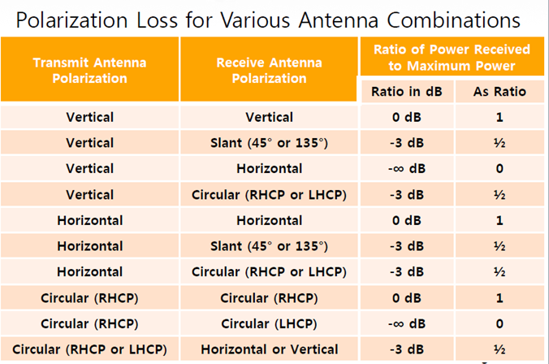
Polarization Separation (1/5)
Polarization loss

Slide 20
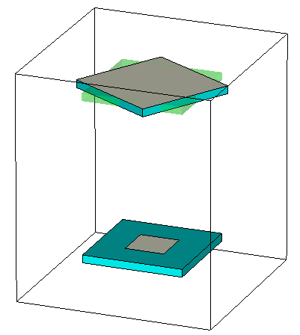

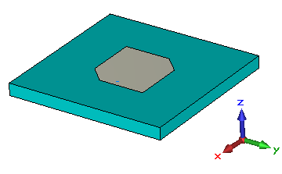
Polarization Separation (2/5)
Analysis on antenna characteristics related to Positioning
  Characteristics analysis due to Angle variation between reader/tag
z
Angle Variation
Linear polarization patch antenna
y
Receiver sensitivity (R_{sense})
x
Unit : [mm]
3.2
3.2
1.27
Shadow region
0.254

Slide 21
Polarization Separation (3/5)
Analysis on antenna characteristics related to Positioning
  Characteristics analysis due to Angle variation between reader/tag
Receiver sensitivity (R_{sense})
Receiver sensitivity (R_{sense})
Linear polarization patch antenna
Circular polarization patch antenna

Slide 22
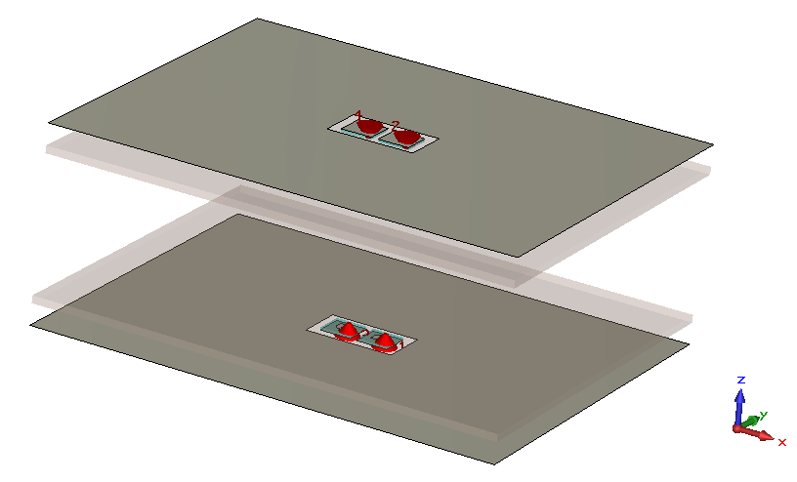
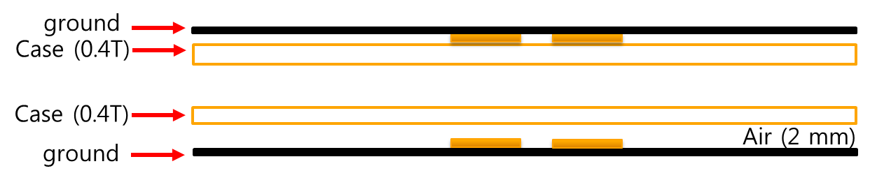
Polarization Separation (4/5)
Simulation environment
Ant#4
(LHCP)
Ant#2
(RHCP)
Case : 40 x 50 mm²
ground : 40 x 50 mm²
Case (Polyimide)
- Epsilon : 3.5
- Loss tangent : 0.0027
Ant#3
(LHCP)
Ant#1
(RHCP)

Slide 23
Polarization Separation (5/5)
Analysis on antenna characteristics related to Positioning
  Characteristics analysis on RHCP & LHCP transmission between reader/tag
    35 dB gain when the antenna gap is more than 20 mm : 1024QAM is possible
antenna gap(G)

Slide 24
Low Complexity SC PHY Design

Slide 25
Low Complexity SC PHY
  Inherit the concept of OOK PHY from 15.3c
    There is one mandatory MCS (mandatory PHY rate (MPR)) for all 15.3e SC DEVs except for the optional OOK mode DEVs. The optional OOK mode is allowed for low complexity SC DEVs.
    No coexistence problem in 15.3e due to the limited range, so it is not necessary to support CMS
    Note: MAC features related to OOK PHY are described in ETRI MAC Proposal document

Slide 26
Low Complexity SC PHY frame format
(1/3)
  PHY frame format: very similar to 15.3c SC PHY
  Preamble Structure

Slide 27
Low Complexity SC PHY frame format
(2/3)
  LC SC PHY preambles shall be modulated in OOK waveform with spreading factor of 2 in bit repetition
  Each field consists of 128 bit Golay sequence a₁₂₈ & b₁₂₈
  SNYC field consists of 16 code repetitions of Golay sequence a₁₂₈
    The SYNC field is used primarily for frame detection
  SFD consists of 4 code repetitions of Golay sequence a₁₂₈
    SFD is used to establish frame timing and to indicate MCSs including number of bonded channels and number of antennas

Slide 28
Low Complexity SC PHY frame format
(3/3)
  The usage of the four SFD codes:
    1 for delimiter & CES selection
    3 for OOK MCS selections
    SFD 1 is the delimiter. The values are:
    . - a₁₂₈ : delimiter indication & indicate that CES is not present
    . - b₁₂₈: delimiter indication & indicate that CES is present
    SFD 2, 3, 4 indicate OOK MCS (including MIMO, channel bonding indication)
SFD pattern (SFD2, SFD3, SFD4) | OOK MCS
+a +a +a | 0
+a +a –a | 1
+a –a +a | 2
+a –a –a | 3
-a +a +a | 4
-a +a –a | 5
-a –a +a | 6
-a –a -a | 7
+b +b +b | 8
+b +b -b ~ -b –b –b | reserved

Slide 29
Preamble for MIMO & Channel Bonding
  If MCS indicates that MIMO (2 stream) is used, then two CES are included
  If Channel Bonding is used,
    CES sequence (8 code repetition) is repeated n times (n: number of bonded channel): 128 bit golay sequence * n times
    SFD (4 code repitition), SYNC (16 code repitition) are also repeated n times
    Number of CES depends on the number of antenna
0 or 1 or 2 CES

Slide 30
LC SC PHY Header format
  MCS is omitted since it is signaled using SFD
  32 bit length
Scrambler Seed ID: contains the scrambler seed identifier value
Aggregation: set to 1 if aggregation is used
The Frame Length: an unsigned integer equal to the number of octets in the MAC frame body of a regular frame, excluding the FCS. It is set to zero for an aggregated frame
Low-latency Mode: set to 1 if the frame is using the low-latency aggregation mode
PCES: set to 1 if the frame includes PCES
Bits: 4 | 1 | 2 | 20 | 1 | 4
Reserved | PCES | Low-latency mode | Frame Length | Aggregation | Scrambler Seed ID

Slide 31
Base frame header construction
  Similar to 15.3c SC PHY header construction

Slide 32
Optional frame header construction
  Similar to 15.3c SC PHY header construction

Slide 33
PHY payload field construction

Slide 34
Scrambling
  Inherited from 15.3c: Use 12.2.2.10 Scrambling in 15.3c spec
  The frames are scrambled by modulo-2 addition of the data with the output of a PRBS generator
  used for the MAC header, HCS, MAC subheader, HCS (for subheader), and MAC
  used for the MAC header, HCS, MAC subheader, HCS (for subheader), and MAC frame body
  PHY preamble, PHY header, and RS bits is not scrambled
The polynomial for the PRBS generator used by the scrambler
  g(D) = 1 + D¹⁴ + D¹⁵
  where D is a single bit delay element
corresponding PRBS, is generated as follows:
      Xn = Xn – 14 ⊕ Xn – 15, n = 0, 1, 2, ...
      Init sequence:
Scrambled data bits Sn: Sn = bn ⊕ Xn (bn: unscrambled data bits)

Slide 35


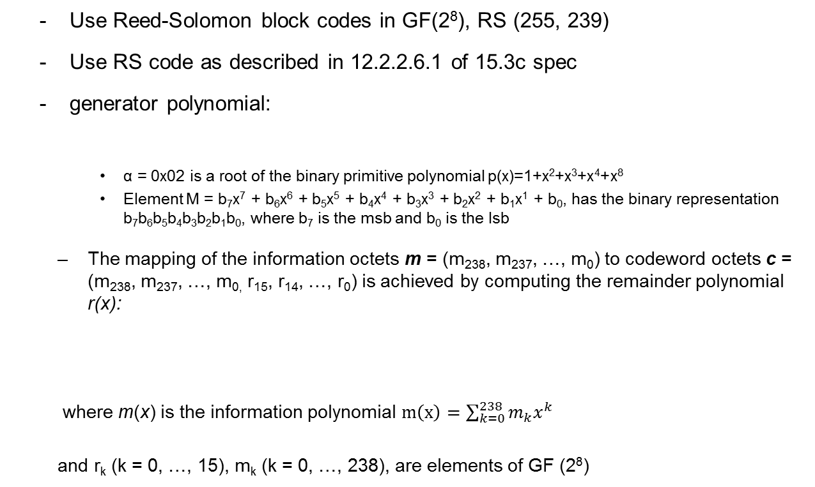
Forward Error Correction
  Use Reed-Solomon block codes in GF(2⁸), RS (255, 239)
  Use RS code as described in 12.2.2.6.1 of 15.3c spec
  generator polynomial:
    α = 0x02 is a root of the binary primitive polynomial p(x)=1+x²+x³+x⁴+x⁸
    Element M = b₇x⁷ + b₆x⁶ + b₅x⁵ + b₄x⁴ + b₃x³ + b₂x² + b₁x¹ + b₀, has the binary representation b₇b₆b₅b₄b₃b₂b₁b₀, where b₇ is the msb and b₀ is the lsb
  The mapping of the information octets m = (m₂₃₈, m₂₃₇, …, m₀) to codeword octets c = (m₂₃₈, m₂₃₇, …, m_{0,} r₁₅, r₁₄, …, r₀) is achieved by computing the remainder polynomial r(x):
  where m(x) is the information polynomial $m\left(x\right)=\sum_{k=0}^{238}{m_{k}x^{k}}$
  and r_{k} (k = 0, …, 15), m_{k} (k = 0, …, 238), are elements of GF (2⁸)

Slide 36
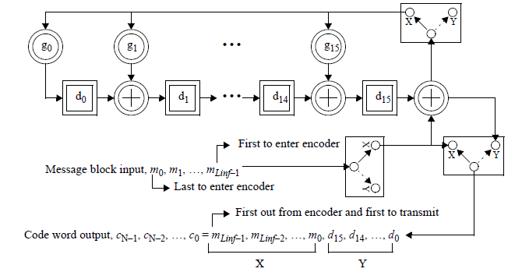
RS code
(Source: 802.15.3c spec)

Slide 37
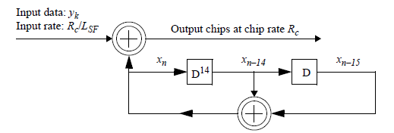
Code Spreading
To increase robustness in header and MAC frame body, Golay and pseudo random binary sequence (PRBS) codes by linear feedback shift register (LFSR) are applied for code spreading.
The following two categories of spreading are defined:
spreading factor of 2 and 6 for header (use LFSR)
  . Use procedure described in 12.2.2.8.2 PRBS generation with LFSR of 15.3c
spreading factor of 2 for header and frame body (use bit repetition)
. Input bit is repeated twice
  The 15 bit seed value of the LFSR shall be:
  [x_{–1}, x_{–2}, …, x_{–15}] = [0101 0000 0011 111]
(Source: 802.15.3c spec)

Slide 38
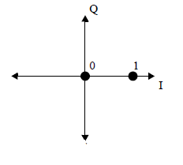
Constellation Diagram
Use the same constellation Diagram as defined in 12.2.8.1 of 15.3c
represented by two points in the constellation map
binary '1' with the presence of the signal, and a binary '0' with the absence of it
K_{MOD}: SQRT (2)
(Source: 802.15.3c spec)

Slide 39
LC PHY MCS
MCS identifier | Chip Rate | Data rate (Mb/s) | Modulation | Spreading factor | FEC type | Bonding | MIMO
0 | 1760 | 825 | OOK | 2 | RS (255,239) | 1 | 1 | 255 | 239 | 1
1 | 1760 | 1650 | OOK | 1 | RS (255,239) | 1 | 1 | 255 | 239 | 1
2 | 1760 | 3299 | OOK | 1 | RS (255,239) | 1 | 2 | 255 | 239 | 1
3 | 3920 | 3674 | OOK | 1 | RS (255,239) | 2 | 1 | 255 | 239 | 1
4 | 3920 | 7348 | OOK | 1 | RS (255,239) | 2 | 2 | 255 | 239 | 1
5 | 6080 | 5699 | OOK | 1 | RS (255,239) | 3 | 1 | 255 | 239 | 1
6 | 6080 | 11397 | OOK | 1 | RS (255,239) | 3 | 2 | 255 | 239 | 1
7 | 8240 | 7723 | OOK | 1 | RS (255,239) | 4 | 1 | 255 | 239 | 1
8 | 8240 | 15446 | OOK | 1 | RS (255,239) | 4 | 2 | 255 | 239 | 1

Slide 40
High Rate SC PHY Design

Slide 41

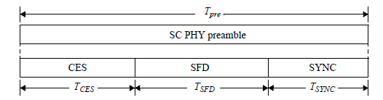
HR PHY frame format (1/2)
  PHY frame format: Similar to 15.3c SC PHY frame format
  Preamble Structure

Slide 42
HR PHY frame format (2/2)
SYNC field is used for frame detection and uses a repetition of codes for a higher of robustness
  consist of 14 code repetitions of a₁₂₈
SFD: used to establish frame timing
  Only HR header is used
    15.3c uses several types of low rate (HR, MR, etc)
    for header/subheader to help robust reception and coexistence
    Using HR rate is enough for transmitting header/subheader
    in close proximity transmission
  SFD 1: delimiter indication (+a₁₂₈)
  SFD 2,3,4: indicates MIMO & Channel Bonding
SFD pattern (SFD2, SFD3, SFD4)
+a +a +a | 1 stream, 1 channel
+a +a –a | 1 stream, 2 channel
+a –a +a | 1 stream, 3 channel
+a -a –a | 1 stream, 4 channel
-a +a +a | 2 stream, 1 channel
-a +a –a | 2 stream, 2 channel
-a –a +a | 2 stream, 3 channel
-a –a -a | 2 stream, 4 channel

Slide 43
Preamble for MIMO & Channel Bonding
  If SFDs indicate that MIMO (2 stream) is used, then two CES are included
  If Channel Bonding is used,
    SYNC (14 code repetition), SFD(4 code repitition) are repeated n times (n: number of bonded channel)
    CES sequence (9 code) is repeated n times (n: number of bonded channel): [b₁₂₈ b₂₅₆ a₂₅₆ b₂₅₆ a₂₅₆]
    Number of CES depends on the number of antenna
1 or 2 CES

Slide 44
HR SC PHY Header format
  40 bit length
Scrambler Seed ID: contains the scrambler seed identifier value
Aggregation: set to 1 if aggregation is used
MCS: indicates MCS
Frame Length: an unsigned integer equal to the number of octets in the MAC frame body of a regular frame, excluding the FCS. It is set to zero for an aggregated frame
Low-latency Mode: set to 1 if the frame is using the low-latency aggregation mode
Pilot Word Length: the length of the pilot word used in the current frame
PCES: set to 1 if the frame includes PCES
No of bonded channel: 00~11 (1 channel ~ 4 channel bonding)
MIMO: indicates whether MIMO is used (2X2 MIMO)
Bits: 4 | 1 | 2 | 1 | 2 | 1 | 20 | 4 | 1 | 4
Reserved | MIMO | No. of bonded channel | PCES | Pilot Word Length | Low-latency mode | Frame Length | MCS | Aggregation | Scrambler Seed ID

Slide 45
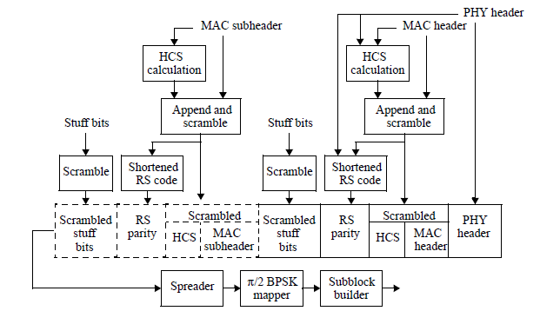
Frame header construction
  Use the same frame header construction described in 15.3c
(Source: 802.15.3c spec)

Slide 46
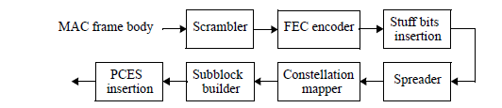
PHY payload field construction
  Use the same payload field construction described in 15.3c
(Source: 802.15.3c spec)

Slide 47
HR PHY MCS (1/8)
    1 antenna, 1 channel
MCS identifier | Chip Rate | Data rate (Mb/s) with pilot word length = 0 | Modulation | Spreading factor | FEC type | Bonding | MIMO
0 | 1760 | 825 | pi/2 BPSK/(G)MSK | 2 | RS (255,239) | 1 | 1
1 | 1760 | 1650 | pi/2 BPSK/(G)MSK | 1 | RS (255,239) | 1 | 1
2 | 1760 | 1320 | pi/2 BPSK/(G)MSK | 1 | LDPC (672,504) | 1 | 1
3 | 1760 | 3299 | pi/2 QPSK | 1 | RS (255,239) | 1 | 1
4 | 1760 | 2640 | pi/2 QPSK | 1 | LDPC (672,504) | 1 | 1
5 | 1760 | 3285 | pi/2 QPSK | 1 | LDPC (1440,1344) | 1 | 1
6 | 1760 | 3960 | pi/2 8-PSK | 1 | LDPC (672,504) | 1 | 1
7 | 1760 | 4928 | pi/2 8-PSK | 1 | LDPC (1440,1344) | 1 | 1
8 | 1760 | 5280 | pi/2 16-QAM | 1 | LDPC (672,504) | 1 | 1
9 | 1760 | 6571 | pi/2 16-QAM | 1 | LDPC (1440,1344) | 1 | 1
10 | 1760 | 7920 | pi/2 64-QAM | 1 | LDPC (672,504) | 1 | 1
11 | 1760 | 9856 | pi/2 64-QAM | 1 | LDPC (1440,1344) | 1 | 1
12 | 1760 | 10560 | pi/2 256-QAM | 1 | LDPC (672,504) | 1 | 1
13 | 1760 | 13141 | pi/2 256-QAM | 1 | LDPC (1440,1344) | 1 | 1
14 | 1760 | 13200 | pi/2 1024-QAM | 1 | LDPC (672,504) | 1 | 1
15 | 1760 | 16427 | pi/2 1024-QAM | 1 | LDPC (1440,1344) | 1 | 1
Notes:
8, 512 삭제?

Slide 48
HR PHY MCS (2/8)
    1 antenna, 2 channel
MCS identifier | Chip Rate | Data rate (Mb/s) with pilot word length = 0 | Modulation | Spreading factor | FEC type | Bonding | MIMO
0 | 3920 | 1837 | pi/2 BPSK/(G)MSK | 2 | RS (255,239) | 2 | 1
1 | 3920 | 3674 | pi/2 BPSK/(G)MSK | 1 | RS (255,239) | 2 | 1
2 | 3920 | 2940 | pi/2 BPSK/(G)MSK | 1 | LDPC (672,504) | 2 | 1
3 | 3920 | 7348 | pi/2 QPSK | 1 | RS (255,239) | 2 | 1
4 | 3920 | 5880 | pi/2 QPSK | 1 | LDPC (672,504) | 2 | 1
5 | 3920 | 7317 | pi/2 QPSK | 1 | LDPC (1440,1344) | 2 | 1
6 | 3920 | 8820 | pi/2 8-PSK | 1 | LDPC (672,504) | 2 | 1
7 | 3920 | 10976 | pi/2 8-PSK | 1 | LDPC (1440,1344) | 2 | 1
8 | 3920 | 11760 | pi/2 16-QAM | 1 | LDPC (672,504) | 2 | 1
9 | 3920 | 14635 | pi/2 16-QAM | 1 | LDPC (1440,1344) | 2 | 1
10 | 3920 | 17640 | pi/2 64-QAM | 1 | LDPC (672,504) | 2 | 1
11 | 3920 | 21952 | pi/2 64-QAM | 1 | LDPC (1440,1344) | 2 | 1
12 | 3920 | 23520 | pi/2 256-QAM | 1 | LDPC (672,504) | 2 | 1
13 | 3920 | 29269 | pi/2 256-QAM | 1 | LDPC (1440,1344) | 2 | 1
14 | 3920 | 29400 | pi/2 1024-QAM | 1 | LDPC (672,504) | 2 | 1
15 | 3920 | 36587 | pi/2 1024-QAM | 1 | LDPC (1440,1344) | 2 | 1

Slide 49
HR PHY MCS (3/8)
    1 antenna, 3 channel
MCS identifier | Chip Rate | Data rate (Mb/s) with pilot word length = 0 | Modulation | Spreading factor | FEC type | Bonding | MIMO
0 | 6080 | 2849 | pi/2 BPSK/(G)MSK | 2 | RS (255,239) | 3 | 1
1 | 6080 | 5699 | pi/2 BPSK/(G)MSK | 1 | RS (255,239) | 3 | 1
2 | 6080 | 4560 | pi/2 BPSK/(G)MSK | 1 | LDPC (672,504) | 3 | 1
3 | 6080 | 11397 | pi/2 QPSK | 1 | RS (255,239) | 3 | 1
4 | 6080 | 9120 | pi/2 QPSK | 1 | LDPC (672,504) | 3 | 1
5 | 6080 | 11349 | pi/2 QPSK | 1 | LDPC (1440,1344) | 3 | 1
6 | 6080 | 13680 | pi/2 8-PSK | 1 | LDPC (672,504) | 3 | 1
7 | 6080 | 17024 | pi/2 8-PSK | 1 | LDPC (1440,1344) | 3 | 1
8 | 6080 | 18240 | pi/2 16-QAM | 1 | LDPC (672,504) | 3 | 1
9 | 6080 | 22699 | pi/2 16-QAM | 1 | LDPC (1440,1344) | 3 | 1
10 | 6080 | 27360 | pi/2 64-QAM | 1 | LDPC (672,504) | 3 | 1
11 | 6080 | 34048 | pi/2 64-QAM | 1 | LDPC (1440,1344) | 3 | 1
12 | 6080 | 36480 | pi/2 256-QAM | 1 | LDPC (672,504) | 3 | 1
13 | 6080 | 45397 | pi/2 256-QAM | 1 | LDPC (1440,1344) | 3 | 1
14 | 6080 | 45600 | pi/2 1024-QAM | 1 | LDPC (672,504) | 3 | 1
15 | 6080 | 56747 | pi/2 1024-QAM | 1 | LDPC (1440,1344) | 3 | 1

Slide 50
HR PHY MCS (4/8)
    1 antenna, 4 channel
MCS identifier | Chip Rate | Data rate (Mb/s) with pilot word length = 0 | Modulation | Spreading factor | FEC type | Bonding | MIMO
0 | 8240 | 3861 | pi/2 BPSK/(G)MSK | 2 | RS (255,239) | 4 | 1
1 | 8240 | 7723 | pi/2 BPSK/(G)MSK | 1 | RS (255,239) | 4 | 1
2 | 8240 | 6180 | pi/2 BPSK/(G)MSK | 1 | LDPC (672,504) | 4 | 1
3 | 8240 | 15446 | pi/2 QPSK | 1 | RS (255,239) | 4 | 1
4 | 8240 | 12360 | pi/2 QPSK | 1 | LDPC (672,504) | 4 | 1
5 | 8240 | 15381 | pi/2 QPSK | 1 | LDPC (1440,1344) | 4 | 1
6 | 8240 | 18540 | pi/2 8-PSK | 1 | LDPC (672,504) | 4 | 1
7 | 8240 | 23072 | pi/2 8-PSK | 1 | LDPC (1440,1344) | 4 | 1
8 | 8240 | 24720 | pi/2 16-QAM | 1 | LDPC (672,504) | 4 | 1
9 | 8240 | 30763 | pi/2 16-QAM | 1 | LDPC (1440,1344) | 4 | 1
10 | 8240 | 37080 | pi/2 64-QAM | 1 | LDPC (672,504) | 4 | 1
11 | 8240 | 46144 | pi/2 64-QAM | 1 | LDPC (1440,1344) | 4 | 1
12 | 8240 | 49440 | pi/2 256-QAM | 1 | LDPC (672,504) | 4 | 1
13 | 8240 | 61525 | pi/2 256-QAM | 1 | LDPC (1440,1344) | 4 | 1
14 | 8240 | 61800 | pi/2 1024-QAM | 1 | LDPC (672,504) | 4 | 1
15 | 8240 | 76907 | pi/2 1024-QAM | 1 | LDPC (1440,1344) | 4 | 1

Slide 51
HR PHY MCS (5/8)
    2 antenna, 1 channel
MCS identifier | Chip Rate | Data rate (Mb/s) with pilot word length = 0 | Modulation | Spreading factor | FEC type | Bonding | MIMO
0 | 1760 | 1650 | pi/2 BPSK/(G)MSK | 2 | RS (255,239) | 1 | 2
1 | 1760 | 3299 | pi/2 BPSK/(G)MSK | 1 | RS (255,239) | 1 | 2
2 | 1760 | 2640 | pi/2 BPSK/(G)MSK | 1 | LDPC (672,504) | 1 | 2
3 | 1760 | 6598 | pi/2 QPSK | 1 | RS (255,239) | 1 | 2
4 | 1760 | 5280 | pi/2 QPSK | 1 | LDPC (672,504) | 1 | 2
5 | 1760 | 6571 | pi/2 QPSK | 1 | LDPC (1440,1344) | 1 | 2
6 | 1760 | 7920 | pi/2 8-PSK | 1 | LDPC (672,504) | 1 | 2
7 | 1760 | 9856 | pi/2 8-PSK | 1 | LDPC (1440,1344) | 1 | 2
8 | 1760 | 10560 | pi/2 16-QAM | 1 | LDPC (672,504) | 1 | 2
9 | 1760 | 13141 | pi/2 16-QAM | 1 | LDPC (1440,1344) | 1 | 2
10 | 1760 | 15840 | pi/2 64-QAM | 1 | LDPC (672,504) | 1 | 2
11 | 1760 | 19712 | pi/2 64-QAM | 1 | LDPC (1440,1344) | 1 | 2
12 | 1760 | 21120 | pi/2 256-QAM | 1 | LDPC (672,504) | 1 | 2
13 | 1760 | 26283 | pi/2 256-QAM | 1 | LDPC (1440,1344) | 1 | 2
14 | 1760 | 26400 | pi/2 1024-QAM | 1 | LDPC (672,504) | 1 | 2
15 | 1760 | 32853 | pi/2 1024-QAM | 1 | LDPC (1440,1344) | 1 | 2

Slide 52
HR PHY MCS (6/8)
    2 antenna, 2 channel
MCS identifier | Chip Rate | Data rate (Mb/s) with pilot word length = 0 | Modulation | Spreading factor | FEC type | Bonding | MIMO
0 | 3920 | 3674 | pi/2 BPSK/(G)MSK | 2 | RS (255,239) | 2 | 2
1 | 3920 | 7348 | pi/2 BPSK/(G)MSK | 1 | RS (255,239) | 2 | 2
2 | 3920 | 5880 | pi/2 BPSK/(G)MSK | 1 | LDPC (672,504) | 2 | 2
3 | 3920 | 14696 | pi/2 QPSK | 1 | RS (255,239) | 2 | 2
4 | 3920 | 11760 | pi/2 QPSK | 1 | LDPC (672,504) | 2 | 2
5 | 3920 | 14635 | pi/2 QPSK | 1 | LDPC (1440,1344) | 2 | 2
6 | 3920 | 17640 | pi/2 8-PSK | 1 | LDPC (672,504) | 2 | 2
7 | 3920 | 21952 | pi/2 8-PSK | 1 | LDPC (1440,1344) | 2 | 2
8 | 3920 | 23520 | pi/2 16-QAM | 1 | LDPC (672,504) | 2 | 2
9 | 3920 | 29269 | pi/2 16-QAM | 1 | LDPC (1440,1344) | 2 | 2
10 | 3920 | 35280 | pi/2 64-QAM | 1 | LDPC (672,504) | 2 | 2
11 | 3920 | 43904 | pi/2 64-QAM | 1 | LDPC (1440,1344) | 2 | 2
12 | 3920 | 47040 | pi/2 256-QAM | 1 | LDPC (672,504) | 2 | 2
13 | 3920 | 58539 | pi/2 256-QAM | 1 | LDPC (1440,1344) | 2 | 2
14 | 3920 | 58800 | pi/2 1024-QAM | 1 | LDPC (672,504) | 2 | 2
15 | 3920 | 73173 | pi/2 1024-QAM | 1 | LDPC (1440,1344) | 2 | 2

Slide 53
HR PHY MCS (7/8)
    2 antenna, 3 channel
MCS identifier | Chip Rate | Data rate (Mb/s) with pilot word length = 0 | Modulation | Spreading factor | FEC type | Bonding | MIMO
0 | 6080 | 5699 | pi/2 BPSK/(G)MSK | 2 | RS (255,239) | 3 | 2
1 | 6080 | 11397 | pi/2 BPSK/(G)MSK | 1 | RS (255,239) | 3 | 2
2 | 6080 | 9120 | pi/2 BPSK/(G)MSK | 1 | LDPC (672,504) | 3 | 2
3 | 6080 | 22794 | pi/2 QPSK | 1 | RS (255,239) | 3 | 2
4 | 6080 | 18240 | pi/2 QPSK | 1 | LDPC (672,504) | 3 | 2
5 | 6080 | 22699 | pi/2 QPSK | 1 | LDPC (1440,1344) | 3 | 2
6 | 6080 | 27360 | pi/2 8-PSK | 1 | LDPC (672,504) | 3 | 2
7 | 6080 | 34048 | pi/2 8-PSK | 1 | LDPC (1440,1344) | 3 | 2
8 | 6080 | 36480 | pi/2 16-QAM | 1 | LDPC (672,504) | 3 | 2
9 | 6080 | 45397 | pi/2 16-QAM | 1 | LDPC (1440,1344) | 3 | 2
10 | 6080 | 54720 | pi/2 64-QAM | 1 | LDPC (672,504) | 3 | 2
11 | 6080 | 68096 | pi/2 64-QAM | 1 | LDPC (1440,1344) | 3 | 2
12 | 6080 | 72960 | pi/2 256-QAM | 1 | LDPC (672,504) | 3 | 2
13 | 6080 | 90795 | pi/2 256-QAM | 1 | LDPC (1440,1344) | 3 | 2
14 | 6080 | 91200 | pi/2 1024-QAM | 1 | LDPC (672,504) | 3 | 2
15 | 6080 | 113493 | pi/2 1024-QAM | 1 | LDPC (1440,1344) | 3 | 2

Slide 54
HR PHY MCS (8/8)
    2 antenna, 4 channel
MCS identifier | Chip Rate | Data rate (Mb/s) with pilot word length = 0 | Modulation | Spreading factor | FEC type | Bonding | MIMO
0 | 8240 | 7723 | pi/2 BPSK/(G)MSK | 2 | RS (255,239) | 4 | 2
1 | 8240 | 15446 | pi/2 BPSK/(G)MSK | 1 | RS (255,239) | 4 | 2
2 | 8240 | 12360 | pi/2 BPSK/(G)MSK | 1 | LDPC (672,504) | 4 | 2
3 | 8240 | 30892 | pi/2 QPSK | 1 | RS (255,239) | 4 | 2
4 | 8240 | 24720 | pi/2 QPSK | 1 | LDPC (672,504) | 4 | 2
5 | 8240 | 30763 | pi/2 QPSK | 1 | LDPC (1440,1344) | 4 | 2
6 | 8240 | 37080 | pi/2 8-PSK | 1 | LDPC (672,504) | 4 | 2
7 | 8240 | 46144 | pi/2 8-PSK | 1 | LDPC (1440,1344) | 4 | 2
8 | 8240 | 49440 | pi/2 16-QAM | 1 | LDPC (672,504) | 4 | 2
9 | 8240 | 61525 | pi/2 16-QAM | 1 | LDPC (1440,1344) | 4 | 2
10 | 8240 | 74160 | pi/2 64-QAM | 1 | LDPC (672,504) | 4 | 2
11 | 8240 | 92288 | pi/2 64-QAM | 1 | LDPC (1440,1344) | 4 | 2
12 | 8240 | 98880 | pi/2 256-QAM | 1 | LDPC (672,504) | 4 | 2
13 | 8240 | 123051 | pi/2 256-QAM | 1 | LDPC (1440,1344) | 4 | 2
14 | 8240 | 123600 | pi/2 1024-QAM | 1 | LDPC (672,504) | 4 | 2
15 | 8240 | 153813 | pi/2 1024-QAM | 1 | LDPC (1440,1344) | 4 | 2

Slide 55
Base Header Rates
    Use only High rate (HR)
      15.3c uses several types of low rate (HR, MR, etc) for header/subheader transmission to help robust reception and coexistence, but HR rate is enough for transmitting header/subheader in close proximity transmission
    15.3e uses only low-latency frames for high throughput
      In 15.3c, MAC subheaders and the MSDU subheaders use the same MCS for the MAC frame body if low-latency frames are used
      → No need to use separate subheader rates
    Use the same base header rates as defined in 15.3c spec
Header class | Header rate (Mb/s) | Modulation scheme | Spreading factor | Pilot Word length (chips) | Coded bits per subblock | Number of occupied subblocks | Number of stuff bits
HR (High Rate) | 206 | Pi/2 BPSK /(G)MSK | 2 | 176 | 168 | 2 | 72

Slide 56
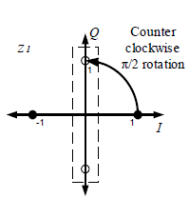
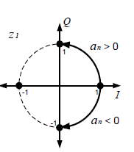
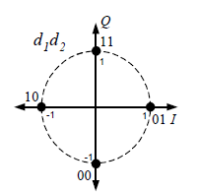
Modulation: BPSK, (G)MSK, QPSK
    Pi/2 BPSK /(G)MSK, pi/2 QPSK: Use the same modulation scheme as defined in 15.3c spec
    Pi/2 BPSK pre-coded (G)MSK Pi/2 QPSK
    (Clause 12.2.2.5.1) (Clause 12.2.2.5.1) (Clause 12.2.2.5.2)
(Source: 802.15.3c spec)

Slide 57
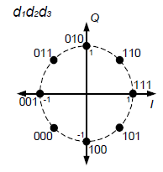
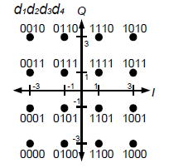
Modulation: 8-PSK, 16-QAM
    pi/2 8-PSK, pi/2 16-QAM: Use the same modulation scheme as defined in 15.3c spec
    Pi/2 8-PSK pi/2 16-QAM
    (Clause 12.2.2.5.3) (Clause 12.2.2.5.4)
(Source: 802.15.3c spec)

Slide 58
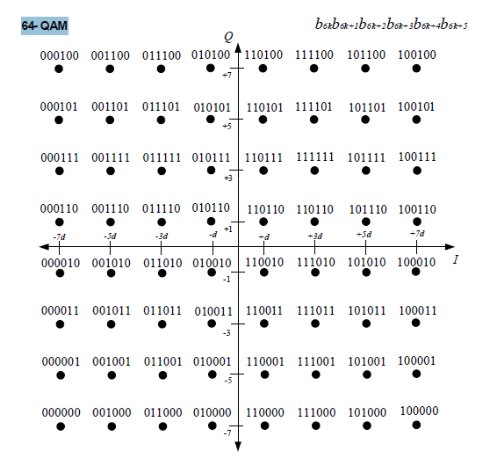
Modulation: 64 QAM
    pi/2 64-QAM: Use the same modulation scheme as defined in 15.3c spec (Clause 12.3.2.6)
(Source: 802.15.3c spec)

Slide 59
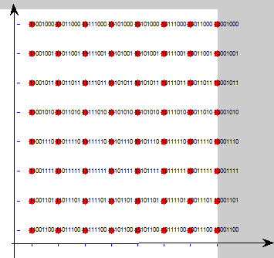
Modulation: 256-QAM (1/4)
    pi/2 256-QAM (gray coded)

Slide 60
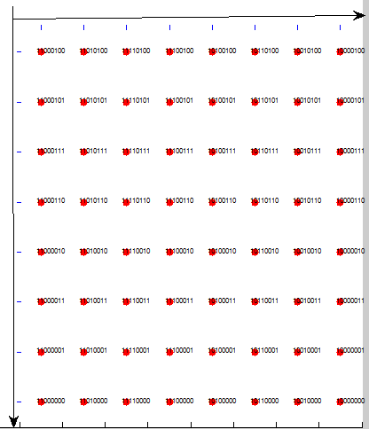
Modulation: 256-QAM (2/4)
    pi/2 256-QAM (gray coded)

Slide 61
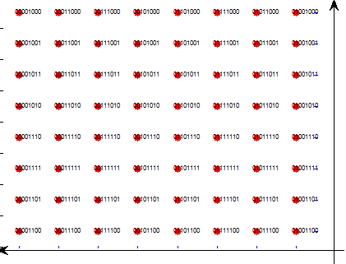
Modulation: 256-QAM (3/4)
    pi/2 256-QAM (gray coded)

Slide 62
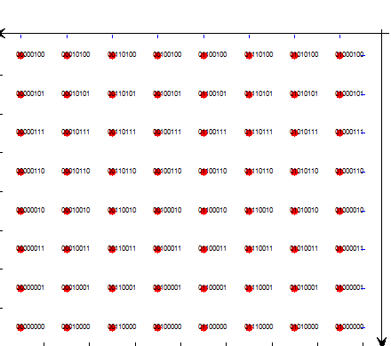
Modulation: 256-QAM (4/4)
    pi/2 256-QAM (gray coded)

Slide 63
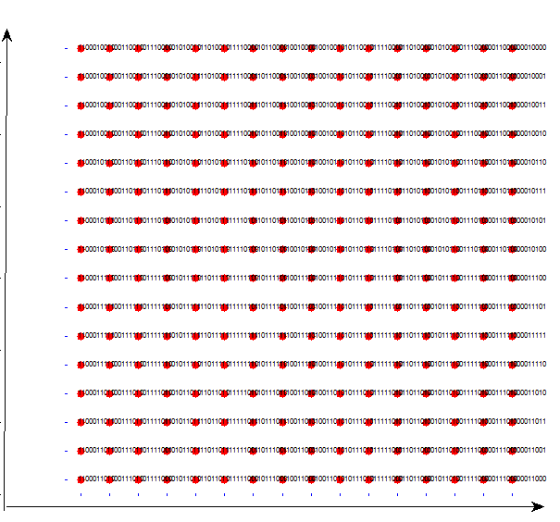
Modulation : Pi/2 1024-QAM (1/4)

Slide 64
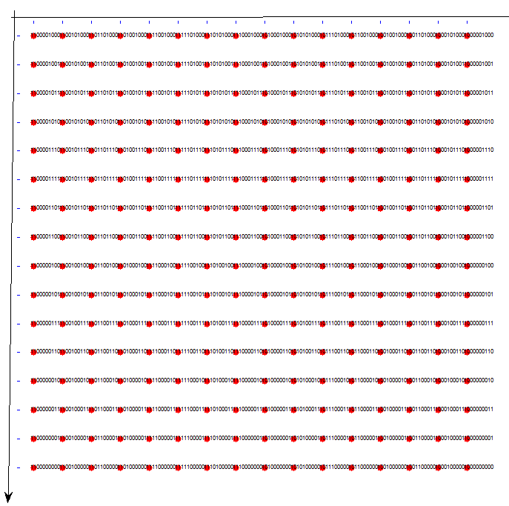
Modulation : Pi/2 1024-QAM (2/4)

Slide 65
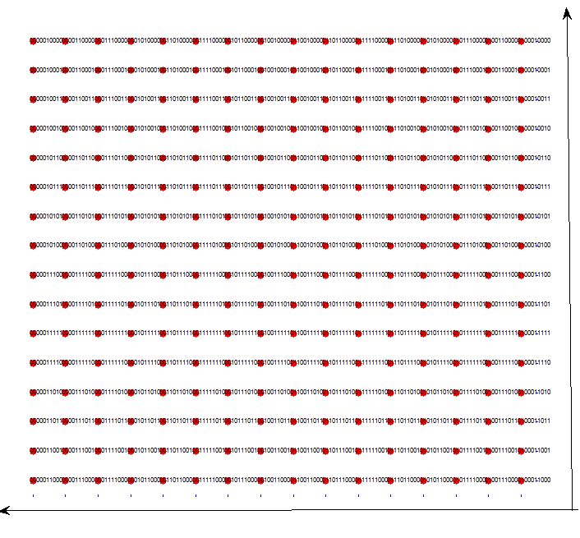
Modulation : Pi/2 1024-QAM (3/4)

Slide 66
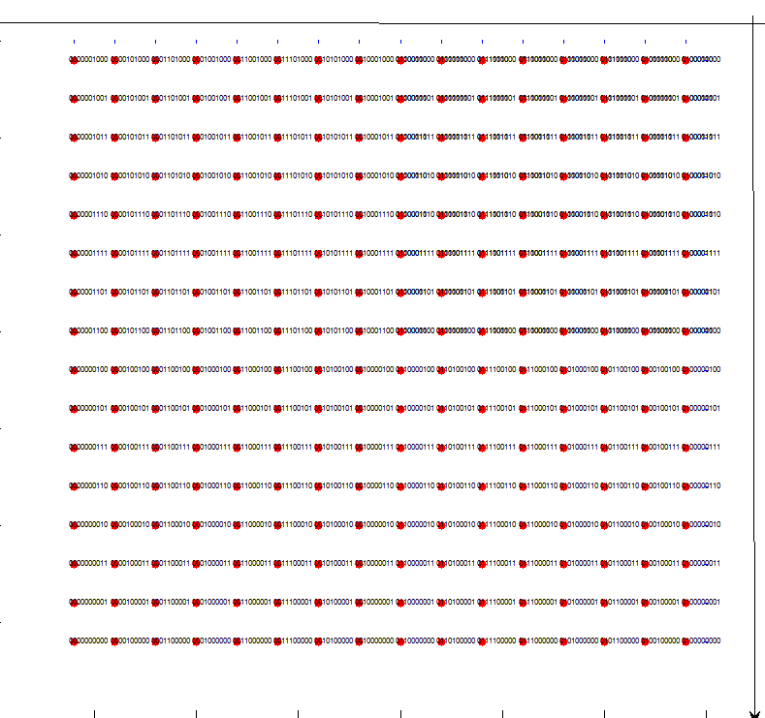
Modulation : Pi/2 1024-QAM (4/4)

Slide 67
Coding
    RS Code: Use RS code as described in 12.2.2.6.1 of 15.3c spec
      See description in RS Coding slide in LC PHY Part
    Irregular LDPC Code: Use Irregular LDPC Code as described in 12.2.2.6.2 of 15.3c spec
    Rate 14/15 LDPC code: Use Rate 14/15 LDPC Code as described in 12.2.2.6.3 of 15.3c spec

Slide 68
Scrambling
  Inherited from 15.3c: Use 12.2.2.10 Scrambling in 15.3c spec
  The frames are scrambled by modulo-2 addition of the data with the output of a PRBS generator
  used for the MAC header, HCS, MAC subheader, HCS (for subheader), and MAC
  used for the MAC header, HCS, MAC subheader, HCS (for subheader), and MAC frame body
  PHY preamble, PHY header, and RS bits is not scrambled
The polynomial for the PRBS generator used by the scrambler
  g(D) = 1 + D¹⁴ + D¹⁵
  where D is a single bit delay element
corresponding PRBS, is generated as follows:
      Xn = Xn – 14 ⊕ Xn – 15, n = 0, 1, 2, ...
      Init sequence:
Scrambled data bits Sn: Sn = bn ⊕ Xn (bn: unscrambled data bits)

Slide 69
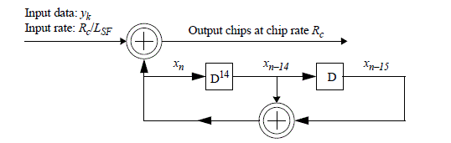
PRBS generation
    LFSR is used as described in 12.2.2.8.2 of 15.3c
    the data bits are spread with a PRBS generated using an LFSR
      Only spreading factor of 2 is used in 15.3e proposal
    Code Spreading: LFSR Shall be used
      - Only spreading factor of 2 is used in 15.3e proposal

Slide 70
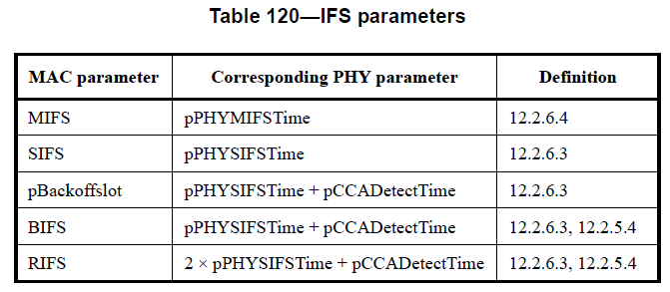
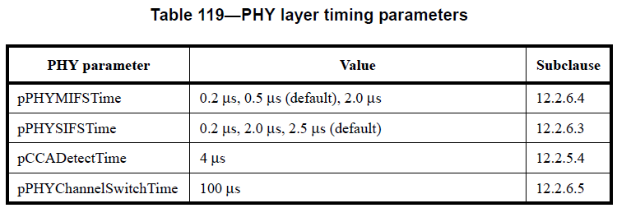
PHY Layer Timing, IFS Parameters (1/2)
Inherits parameters from 15.3c SC PHY (SC LR PHY, HR PHY)
  MIFS: 0.2 μs, 0.5 μs (default), 2.0 μs
  SIFS: 0.2 μs, 2.0 μs, 2.5 μs (default)
  BIFS: SIFS + CCA(4 μs) (6.5 μs (default))
  RIFS: 2*SIFS + CCA(4 μs) (9 μs (default)) - Retransmission
  Slot time : SIFS + 4 μs (6.5 μs (default))
Additional IFS:
  Initiator IFS : SIFS
  Responder IFS : SIFS + CCA
  Priority based channel access in bi-directional CTA
Corresponding tables in 15.3c spec:

Slide 71
PHY Layer Timing, IFS Parameters (2/2)
Receive-to-transmit turnaround time: inherits 15.3c definition (clause 12.2.6.2 of 15.3c spec)
Transmit-to-receive turnaround time: inherits 15.3c definition (clause 12.2.6.3)
Time between successive transmissions: inherits 15.3c definition (clause 12.2.6.4)
Channel switch: inherits 15.3c definition (clause 12.2.6.5)

Slide 72
Simulation and Performance Evaluation
Modulation scheme:
  Case 1: 1024 QAM with LDPC(1440,1344)
  Case 2: OOK with RS(255,239)
AWGN and SISO channels are tested.
  Channel Parameters: Initial decay (2.85 dB), Decay factor(0.167ns), Rice factor(8.09 dB), One cluster(Max delay 1ns)
Signal Bandwidth: 1.76 GHz
Assumptions
  Perfect synchronization
  No FDE, Carrier frequency offset (0 ppm)
  PA nonlinearity: (AM-AM with p = 2)
    Output backoff from full saturation
  TX/RX ANT gain are introduced
Payload length = 16 Kbytes
BER @ 1e-6 and FER @ 8% are adopted as target for required Eb/No

Slide 73
Link Budget Margin (AWGN) (1/2)
 | Description | Value (QAM/OOK) | Remarks
Tx side
(a) | Average Tx Power level (Pt) | -5.0 /-25 dBm | Case1 / Case 2
(b) | Tx_Ant gain (Gt) | 6.0 dBi
(c) | Implementation loss (IL) | 6 dB
(d) | Center frequency (fc) | 64.8 GHz
(e) | Transmission loss at 1m (PL) | 68.7 dB
Rx side
(f) | Rx_Ant gain (Gr) | 6.0 dBi
(g) | Thermal noise (Nth) | -173.8 dBm/Hz
(h) | Rx NF (NF) | 8.0 dB

Slide 74
Link Budget Margin (AWGN) (2/2)
 | Description | Value | Remarks
Rx side (Continue)
(i) | Signal Bandwidth (BW) | 1.760 GHz
(j) | Symbol rate (SymR) | 97.2 dBHz
(k) | Noise power level (NP) | -73.3 dBm
(l) | Required Es/No for FER = 8% (EsNo) | 32.1/10.2 dB | Case1 / Case 2
(m) | System margin (SysM) | 0 dB
(n) | Required Rx level (ReqRx) | -41.2/-60.1 dBm | Case1 / Case 2
(o) | Allowable path loss (APL) | 42.2/41.1 dB | Case1 / Case 2
(p) | Maximum transmission range (MaxD) | 4.8/4.2 cm
* OBO from full saturation: 12/4 dB (1024QAM/OOK)

Slide 75
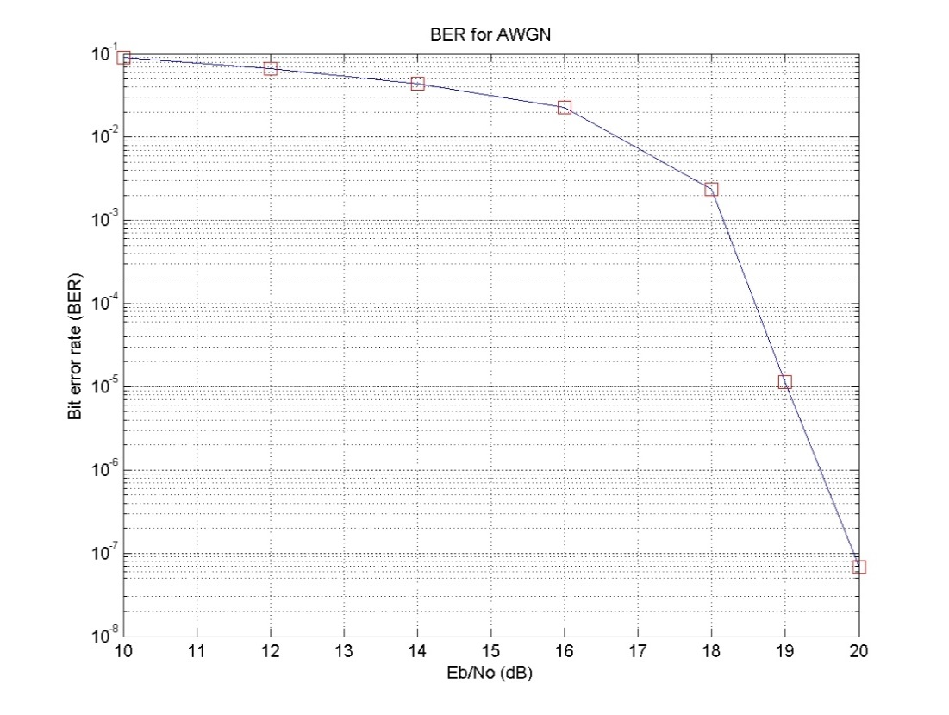
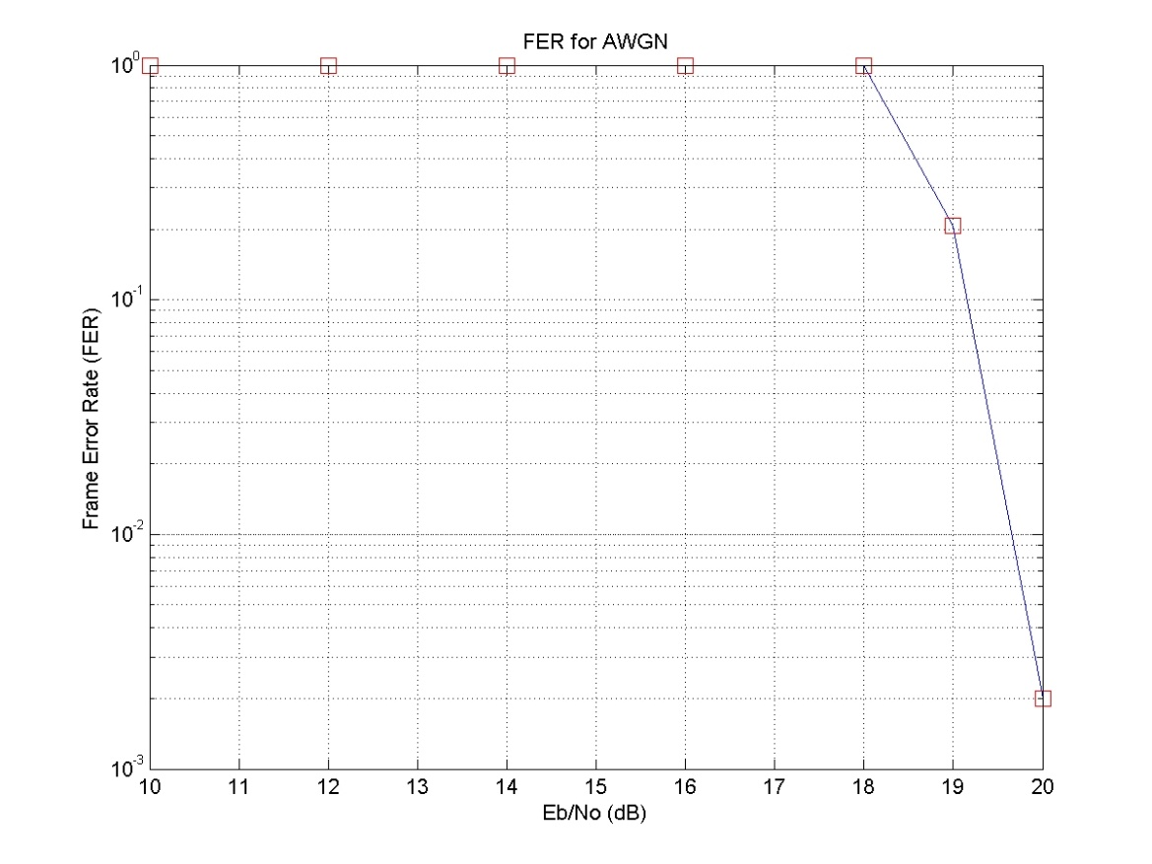
Performance in AWGN (1024-QAM)
Required Eb/No0 at BER=1e-6 (dB): 19.4
Required Eb/No0 at FER= 8% (dB): 19.2

Slide 76
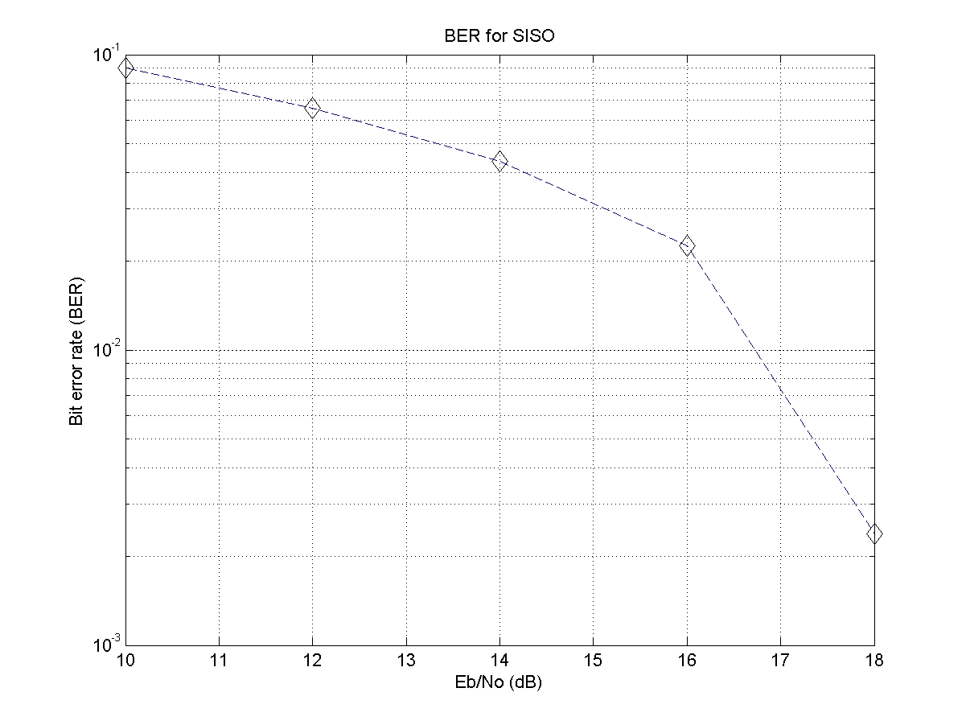
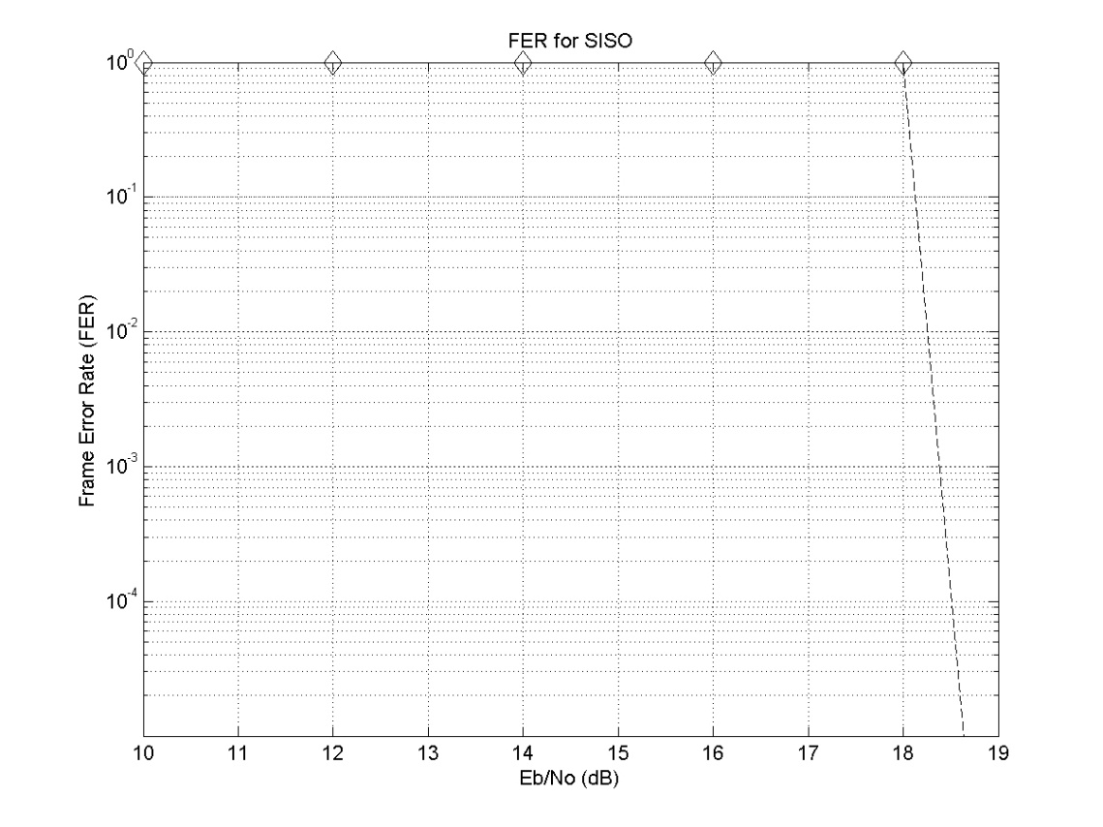
Performance in SISO channel (1024-QAM)
Required Eb/No0 at BER=1e-6 (dB): 18.6
Required Eb/No0 at FER= 8% (dB): 18.2

Slide 77
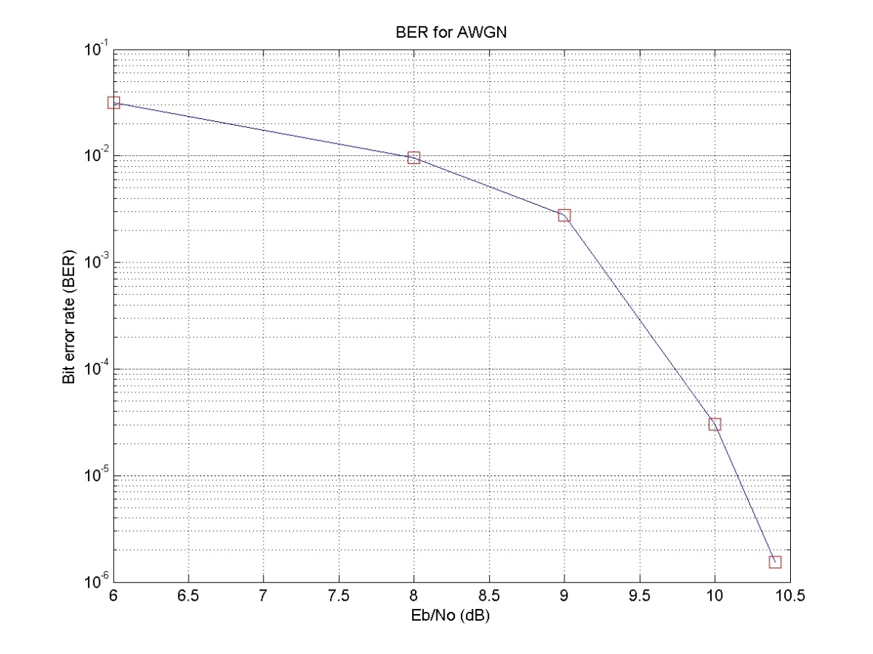
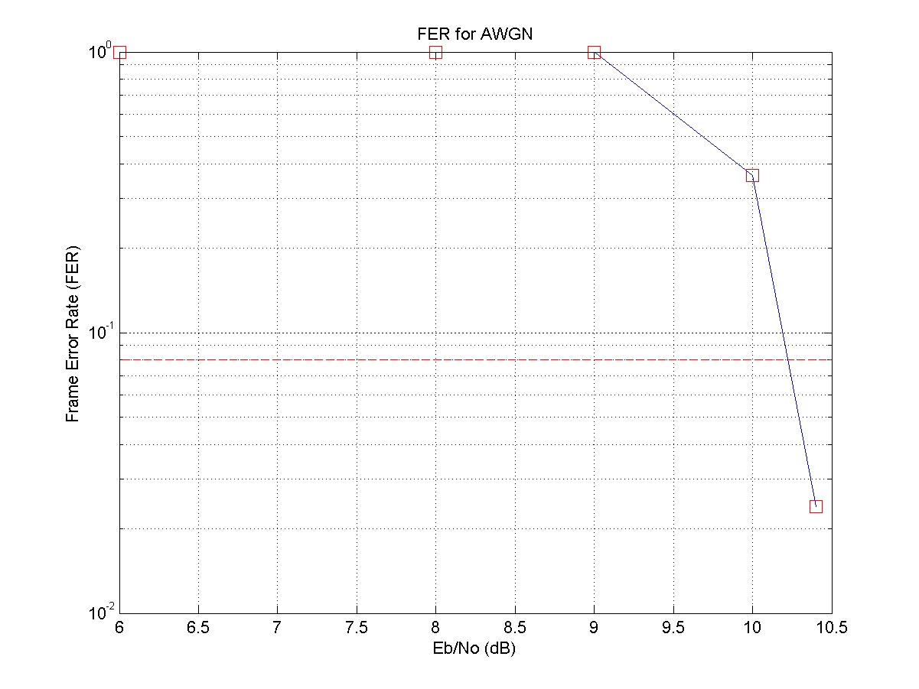
Performance in AWGN (OOK)
Required Eb/No0 at BER=1e-6 (dB): 10.5
Required Eb/No0 at FER= 8% (dB): 10.2

Slide 78
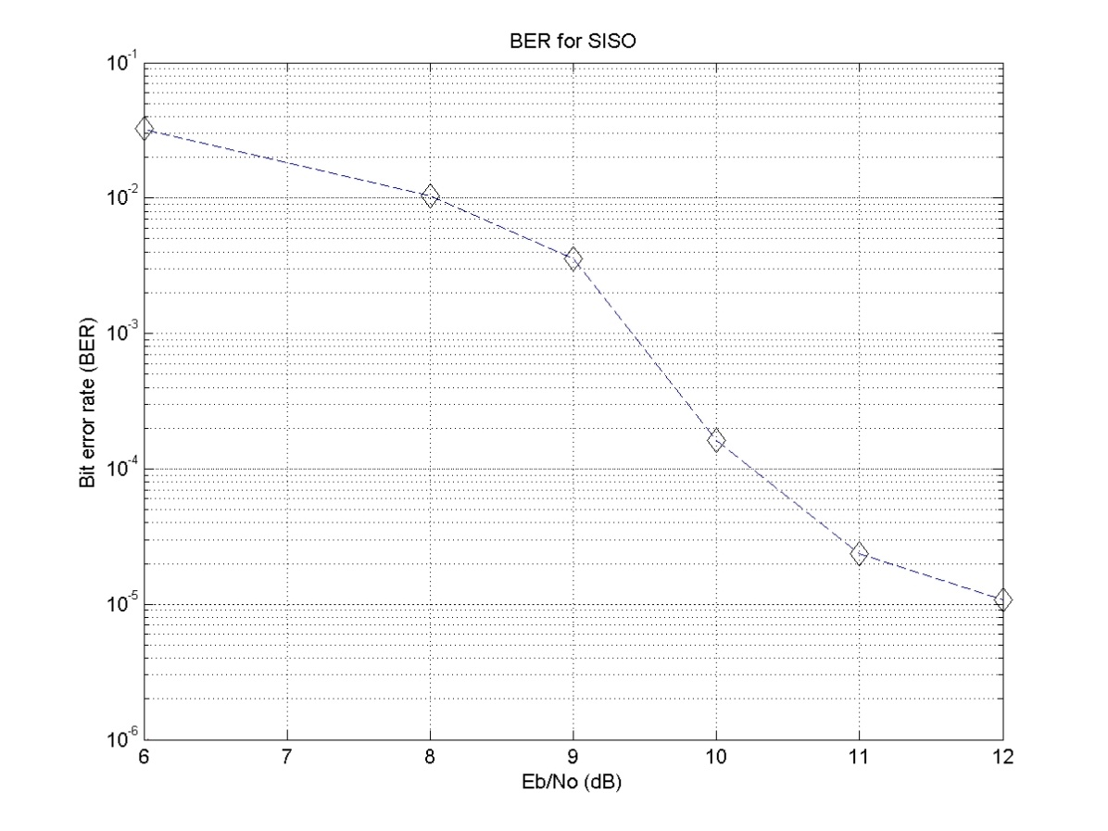
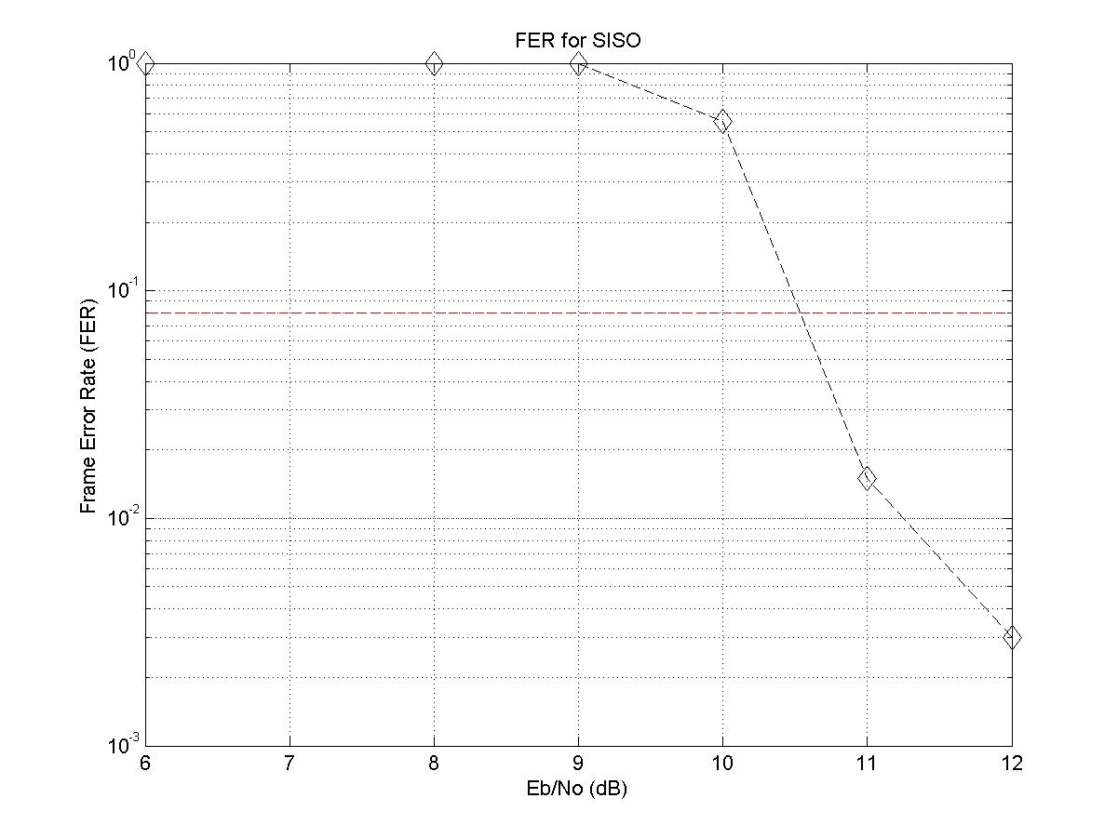
Performance in SISO channel (OOK)
Required Eb/No0 at BER=1e-6 (dB): 12.5
Required Eb/No0 at FER= 8% (dB): 10.5

Slide 79
Summary of Simulation Result
Modulation types | EsNo @8% FER (dB) | Max. Distance (cm)
Case 1 (1024-QAM, AWGN) | 31.9 | 4.9
Case 1 (1024-QAM, SISO) | 30.9 | 5.5
Case 2 (OOK, AWGN) | 9.9 | 4.3
Case 2 (OOK, SISO) | 10.2 | 4.2

Slide 80
Technical Requirements
2.1 Functional Requirements
2.1.1 Connection Topology: For the Close Proximity system, the connection is always limited to two devices and the topology is required to be Point-to-Point → Satisfied by MAC Proposal:
- See Slide 6, 11~ 13
2.1.2 Media access mechanism
The close proximity P2P system shall have the following features to achieve its basic requirements:
a. Link setup without any network identifiers → Satisfied by MAC Proposal: No Network identifier is used in the proposal
b. Network topology always limited to two devices → Satisfied by MAC Proposal: See Slide 6, 11~ 13

Slide 81
Technical Requirements
2.1 Functional Requirements
2.1.2 Media access mechanism
c. Link setup time of 2 msec or less, prior to entering active state, to meet application requirements → Satisfied by MAC Proposal: See analysis in Slide 41 ~ 46
d. A means of ensuring spatial division from other systems without beamforming → Satisfied by PHY Proposal: MIMO using polarization is used without beamforming for ensuring spatial division
e. CSMA/CA not required prior to data transmission → Satisfied by MAC Proposal: See analysis in Slide 11, 21. No CSMA/CA is used since CTA is used during data transmission phase

Slide 82
Technical Requirements
2.1 Functional Requirements
2.1.2 Media access mechanism
f. No periodic management frame transmission after connection establishment → Satisfied by MAC Proposal: beacon is not transmitted during the data transmission phase. Beacon is transmitted after a DEV is associated. See slide 11 ~ 12
g. A method to estimate whether a peer device drew apart and a procedure to promptly dissolve connection and change to a standby state when such estimation is made → Satisfied by MAC Proposal: See slide 13. If a DEV moves out of the range of the lite-PNC (e.g, 10 cm), then frames cannot be exchanged and the DEV is disassociated using the timeout mechanism. The range can be adjusted by the lite-PNC by transmit power control. Timeout period can be adjusted by using ATP value

Slide 83
Technical Requirements
2.1 Functional Requirements
2.1.3 QoS
Because of the P2P connectivity, QoS mechanisms are not applicable → No specific mechanisms are specified in the proposal since 2.1.3 does not require QoS mechanisms
2.1.4 Security
Because of the limitation of the transmission range, security mechanisms for the PHY and MAC layers may be omitted for a close proximity P2P system → Security mechanisms are omitted in the proposal since 2.1.4 allows it

Slide 84
Technical Requirements
2.1 Functional Requirements
2.1.5 Power Management
Close proximity P2P communications, where at least one of the two P2P devices in the system will be mobile/handheld, is expected to have extremely short active time. In this regard, the system shall be designed to enable low power consumption in standby state. Furthermore, the system should be designed to have low power consumption in the active state. No additional, special power management schemes are required.
→ No specific power management protocol is proposed, since 2.1.5 does not require new power management protocol should be included in the spec

Slide 85
Technical Requirements
2.2 Performance Requirements
2.2.1 Operation frequency band
The system shall use the 60 GHz unlicensed band. The channel plan is based on that of IEEE802.15.3c. Ch2 is the default channel. Ch2 and Ch3 in this band are designated as unlicensed bands in many countries. Hence the system should support the use of these two channels. Channel bonding or aggregation may be used.
→ Satisfied by PHY Proposal. PHY proposal uses 60 GHz band, and includes channel bonding schemes. See slide 12 ~ 15, 29 and 43

Slide 86
Technical Requirements
2.2 Performance Requirements
2.2.2 Transmission Range
The maximum transmission range will define the close proximity area to allow the touch operation but should be kept to within 100 mm, without any steering or beamforming, when operating at the minimum required rate as defined by each proposal. Likewise, the two P2P devices should disconnect if the separation between the two becomes larger than the close proximity area.
→ Satisfied by MAC Proposal: See slide 13. If a DEV moves out of the range of the lite-PNC (e.g, 10 cm), then frames cannot be exchanged and the DEV is disassociated using the timeout mechanism. The range can be adjusted by the lite-PNC by transmit power control. Timeout period can be adjusted by using ATP value

Slide 87
Technical Requirements
2.2 Performance Requirements
2.2.3 Spectral efficiency
MIMO may be used
→ Satisfied by PHY Proposal: See slide 16 ~ 23 of the PHY Proposal
2.2.4 Data rate
The data rates should be sufficient to support the proposed use cases in conjunction with the operational frequency plan and channel model, operating at PHY rates up to 100 Gbps.
→ Satisfied by PHY Proposal. 100 Gbps can be achieved by using channel bonding, MIMO and 1024 QAM. See slide 53~54 (MCS tables)

Slide 88
Technical Requirements
2.2 Performance Requirements
2.2.5 Link budget
The proposal should include evidence that the system meets the requirement in Section 2.2.2 (Transmission range)
See Link Budget Margin table in the PHY Proposal

Slide 89
Regulatory Requirements
3. Regulatory requirements
The output RF power levels and other regulations for each country which allow the use of the unlicensed 60 GHz band shall be followed
→ RF power levels used in slide 73 are much lower than regulations for each country.
RF power levels and regulation related parameters can be adjusted to meet the requirement by the application or manufacturers.

Slide 90
Evaluation Criteria - PHY
1. Communication distance: Must demonstrate link budget values at a distance of 10 cm based on simulation.
See Link Budget Margin table in the PHY Proposal
2. Frequency: Shall operate within the 60GHz unlicensed band
Satisfied by PHY Proposal.
3. Interference: Shall be able to operate in dense environments without mutual interference among 3e devices
→ Due to the limited range of 3e devices, 3e devices can operate without mutual interference among 3e devices
4. Coexistence: Shall be able to coexist with other systems in the same band when operating without any beamforming technology
→ Due to the limited range of 3e devices, 3e devices can coexist with other systems without beamforming

Slide 91
Evaluation Criteria - PHY
5. Calculated data rate at the PHY SAP: At least one mode shall be capable of achieving 100 Gbps satisfying the common frequency regulations of US, EU, Korea, and Japan
→ Satisfied by PHY Proposal. 3 channels can be bonded in the above countries. Proposed system can provide 100 Gbps Peak PHY rate using channel bonding, MIMO, and 1024 QAM. See slide 53~54 (MCS tables) of the PHY Proposal
6. Antenna form factor: The antenna used for satisfying the other PHY criteria shall be small enough for placement and operation inside a mobile device, including smartphones. → satisfied by PHY Proposal. Maximum 2 antennas are used, the size of an antenna is 3.2 X 3.2 mm². See slide 20 of the PHY Proposal

Slide 92
Evaluation Criteria - MAC
1. Connection setup time: less than 2 ms → Satisfied by MAC Proposal. See analysis described in slide 41 ~ 46
2. Definition of "Connection setup time": time from first successful reception of all necessary information from the management frame(s) to completion of association by both devices → The definition is used when calculating the link setup time
3. P2P: Operation shall be limited to point-to-point connection between two devices only → Satisfied by MAC Proposal:
- See Slide 6, 11~ 13 of the MAC Proposal
4. No identifiers: Connection setup shall be performed without exchanging network identifiers (PNID) for each session → Satisfied by the MAC Proposal: No Network identifier is used in the proposal

Slide 93
Evaluation Criteria - MAC
5. NO CSMA: No Listen before Talk (or CSMA) shall be used prior to transmission → Satisfied by MAC Proposal: See Slide 12, 21. No CSMA/CA is used since CTA is used during data transmission phase
6. Management frames: No periodic management frames shall be transmitted after completion of association → Satisfied by MAC Proposal: beacon is not transmitted during the data transmission phase. Beacon is transmitted after a DEV is associated. See slide 11 ~ 12 of the MAC Proposal
7. Data throughput: Shall be calculated at the MAC SAP → See the calculated MAC throughput in the MAC Proposal (Slide 47 ~ 48)

Slide 94
Evaluation Criteria - MAC
8. Error detection and correction: In the presence of random and burst errors, there shall not be serious throughput degradation nor falling into unstable states → error can be detected using FCS and mechanism. Since Ack and retransmission mechanism is provided at the MAC layer, the system can cope with random and burst errors

Slide 95
Evaluation Criteria – System Criteria
Touch action: Bringing the antennas to within about 1 cm shall trigger the two devices to establish connection. Accurate spatial alignment shall not be required.→ Satisfied by the MAC proposal. See slide 14 of the MAC Proposal (touch action)
2. Disconnection: Shall be able to disconnect promptly when devices draw apart beyond 10 cm → Satisfied by the MAC Proposal: See slide 13. If a DEV moves out of the range of the lite-PNC (e.g, 10 cm), then frames cannot be exchanged and the DEV is disassociated using the timeout mechanism. The range can be adjusted by the lite-PNC by transmit power control. Timeout period can be adjusted by using ATP value

Slide 96
Evaluation Criteria – System Criteria
3. Efficient Design: System shall achieve high throughput and low latency using simple design → Satisfied by MAC and PHY Proposal. The system provides OOK based PHY which is based on the simplest modulation method. Supporting dual PHY modes are straightforward without complex mechanisms. MIMO using polarization is used for high throughput which is very simple to implement
4. Mobile devices should be energy-efficient → Satisfied by PHY Proposal since the proposal includes OOK PHY which is very energy efficient

Slide 97
Summary
Full PHY Proposal: Simplified PHY based on 15.3c Single Carrier PHY
  Only SC PHY is used
  The basic design of 15.3c SC PHY is inherited & simplified
SC PHY has two modes
  Low Complexity SC PHY for cost effective devices
    OOK modulation with RS coding
  High Rate SC PHY for high end devices
    Pi/2 BPSK, Pi/2 QPSK, Pi/2 8PSK, Pi/2 16QAM, Pi/2 64QAM, Pi/2 256QAM, Pi/2 1024QAM with RS coding, LDPC
Channel Bonding (up to 4 channels)
Short Range 2X2 MIMO with Polarization Separation

Slide 98
References
[1] TG3e Technical Guidance document, May, 2015
[2] TG3e Channel Modeling document, May, 2015
[3] IEEE 802.15.3 – 2003 Specification, September 2003
[4] IEEE 802.15.3b – 2005 Specification, May 2006
[5] IEEE 802.15.3c – 2009 Specification, October 2009
[6] IEEE 802.11 REVmc D4.0, January 2015
[7] 15-14-0639-03-003d, FCC NOI on Frequencies Above 24 GHz, FCC-14-154A1, GN Docket No. 14-177, November 2014
      [8] Ken Hiraga et. al, On the Transmission Method for Short-Range MIMO Communication, IEEE TRANSACTIONS ON VEHICULAR TECHNOLOGY, VOL. 60, NO. 3, MARCH 2011
      [9] Manabe, T. et. al, Polarization dependence of multipath propagation and high-speed taransmission characteristics of indoor milimeter-wave channel at 60 GHz, IEEE Transactions on Vehicular Technology, 44(2), 268-274

Slide 99
Q & A

