Slide 1
doc.: IEEE 802.15-15-0410-01-007a
Project: IEEE P802.15 Working Group for Wireless Personal Area Networks (WPANs)
Submission Title: Home-page document for LED-ID : LED-ID Related Technical Features and Applications
Date Submitted: May. 13, 2015
Source: Jaesang Cha*, Min-Woo Lee**, JongHyeok Lee**, Hyung-O Kim**, Soo-Young Chang***
Company: Seoul National University of Science & Technology*
Graduate School of NID Fusion Technology, Seoul National University of Science & Technology**
CSUS***
Address:
Voice: FAX: E-Mail: chajs@seoultech.ac.kr
Re:
Abstract: This document is prepared to provide information for TG 15.7r1 home page contents regarding LED-ID.
Purpose: To provide conceptual information on LED-ID to TG 15.7r1 home page.
Notice: This document has been prepared to assist the IEEE P802.15. It is offered as a basis for discussion and is not binding on the contributing individual(s) or organization(s). The material in this document is subject to change in form and content after further study. The contributor(s) reserve(s) the right to add, amend or withdraw material contained herein.
Release: The contributor acknowledges and accepts that this contribution becomes the property of IEEE and may be made publicly available by P802.15.
Slide 1
Jaesang Cha, Seoul National Univ. of Science & Tech.

Slide 2
Home page document for LED-ID
: LED-ID Related Technical Features and Applications
Slide 2
Notes:
doc.: IEEE 802.15-09-0117-00-0007
<month year>

Slide 3
Contents
LED-ID Technology for IEEE802.15.7r1
Concept of LED-ID Technology
Use Cases of LED-ID
Conclusions

Slide 4
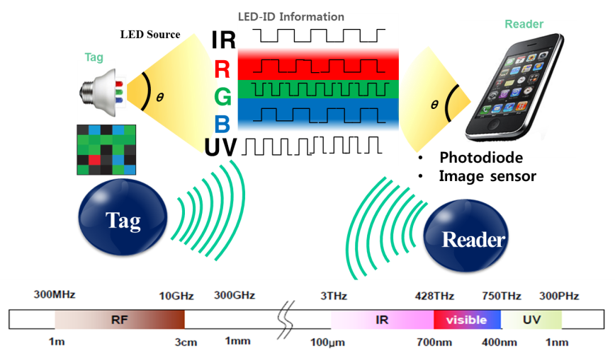
doc.: IEEE 802.15-15-0410-01-007a
LED-ID Technology for IEEE802.15.7r1
IEEE802.15.7r1 TG OWC (Optical Wireless Communications) consists of three topics as:
LED-ID: LED-ID is defined as wireless light ID (Identification) system using various LED Light signals
OCC (Optical Camera Communications)
LiFi
Concept of LED-ID
LED-ID is defined as wireless light ID (Identification) system using various LED Light signals.
LED-ID is one of three major topics of OWC while other two are OCC and LiFi.

Slide 5
doc.: IEEE 802.15-15-0410-01-007a
Concept of LED-ID Technology (1)
(LED-ID Characteristics comparing to OCC and LiFi)
Tech item | LED-ID | OCC | LiFi
IEEE 802.15.7r1 related History | Used in conventional title for IG & SG From 2012 | Used in recent title for SG From 2014 | -
Definition from IEEE Home page | LED-ID which is achieved using wireless light ID (Identification) systems using various LEDs. | Optical Camera Communications which enables scalable data rate, positioning/localization, and message broadcasting, etc. using devices such as the flash, display and image sensor as the transmitting and receiving devices | LiFi which is high-speed, bidirectional, networked and mobile wireless communications using light
Transmitter | LED Tags & display/image patterns (QR/Color code like Bar code) Smart Phone Flash lights Lighting source | Display/image patterns Flash light | Lighting Source
Dedicated Receiver | = Reader PD/Camera(Image Sensor) | Camera (Image Sensor) | PD
Data Rate | Scalable(Low& High) | Scalable (Low) | Scalable (mainly High)
Applications from PAR/CSD | IoT/D2D, Digital Signage, LBS, ITS, office/hospital, etc | Positioning/localization, and message broadcasting | High-speed, bidirectional, network & Mobile wireless communications

Slide 6
doc.: IEEE 802.15-15-0410-01-007a
Concept of LED-ID Technology (2)
(LED-ID Features/Applications from PAR/CSD)
Tech item |  | LED-ID
PAR | Scope of the Project | Transmitting devices include such sources as displays, typically found on cameras and mobile devices, and other LED based sources such as flashes, flashlights, LED Tags, LED/Laser sources, display/image patterns(like QR codes). Receivers are devices such the lens and image sensors typically found in a camera or mobile device as well as other light sensors that may be present in these or other kinds of devices.
 | Need for the Project | Potential applications include secure point-to-point communication, Location Based Services (LBS), secure point-to-multipoint communication (office, hospital, air plane), Intelligent Transportation Systems (ITS), General Information Broadcasting, Line-of-Sight (LOS) marketing, LED-ID, Device-to-Device (D2D), IoT, digital signage, Augmented Reality, and many more.
CSD | Broad market potential | Potential applications include secure point-to-point communication, Location Based Services (LBS), secure point-to-multipoint communication (office, hospital, air plane), Intelligent Transportation Systems (ITS), General Information Broadcasting, Line-of-Sight (LOS) marketing, Augmented Reality, LED-ID, IoT (Internet of Things), M2M, D2D, and many more.

Slide 7
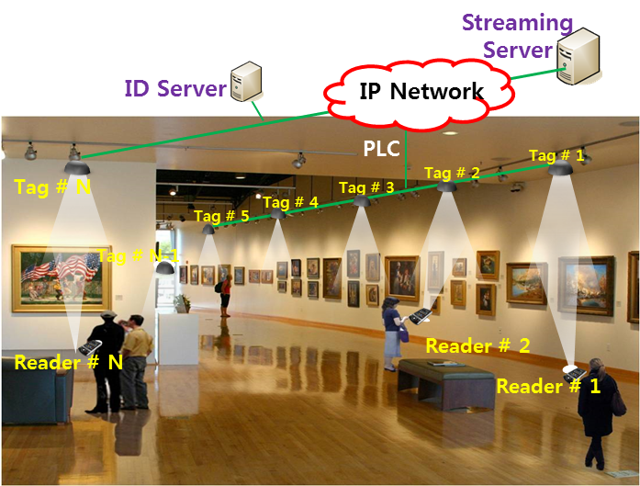
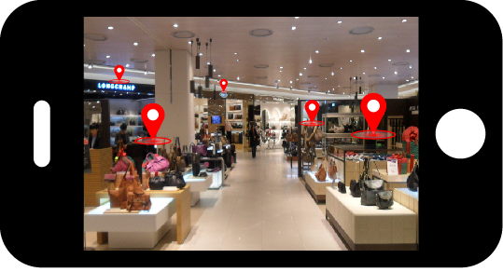
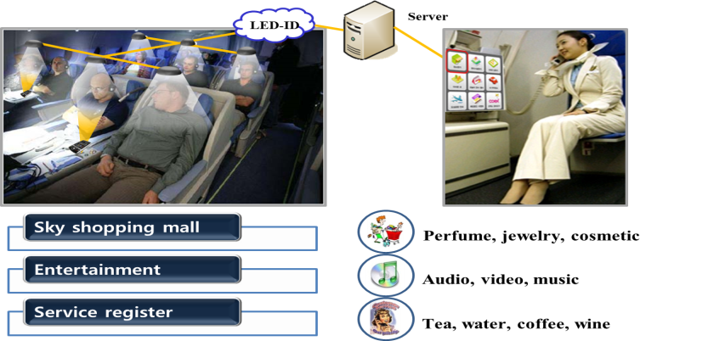
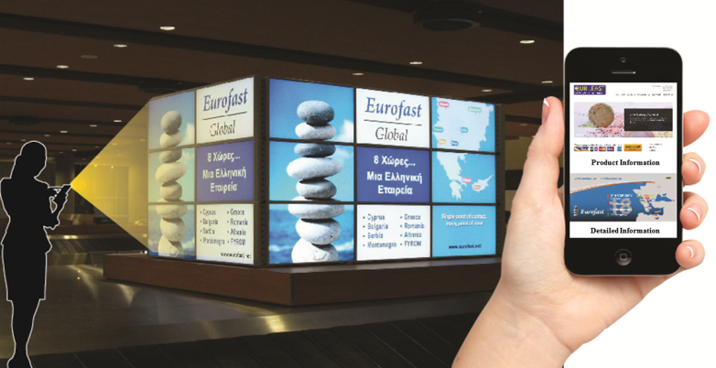
doc.: IEEE 802.15-15-0410-01-007a
Use Case of LED-ID #1:
Applications of LED-ID Services
Exhibition Service
Indoor Store Service
In-flight Service
Facility Signage/Display
LED-ID signals can be used for data transmission or positioning recognition at exhibition center, indoor store, in-flight and facility signage/display, etc.

Slide 8
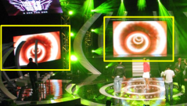
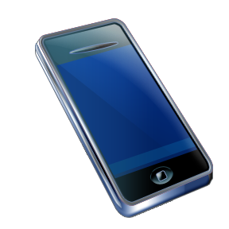
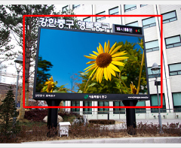
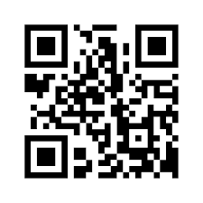
doc.: IEEE 802.15-15-0410-01-007a
Use Case of LED-ID #2:
LED QR/Color Code
Facility Signage
Color code
QR code
Tag : LED based Bar code (Color code, QR code, etc.)
Reader : Camera Image Sensor of Smart Phone/Pad

Slide 9
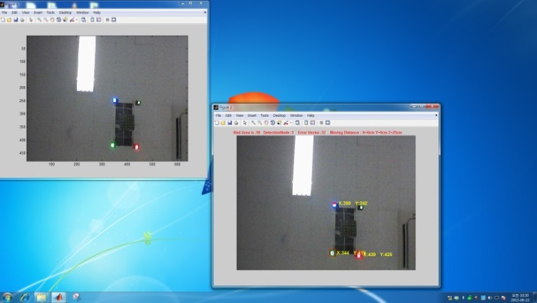
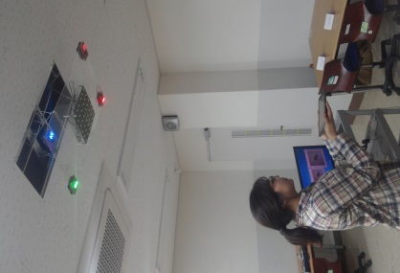
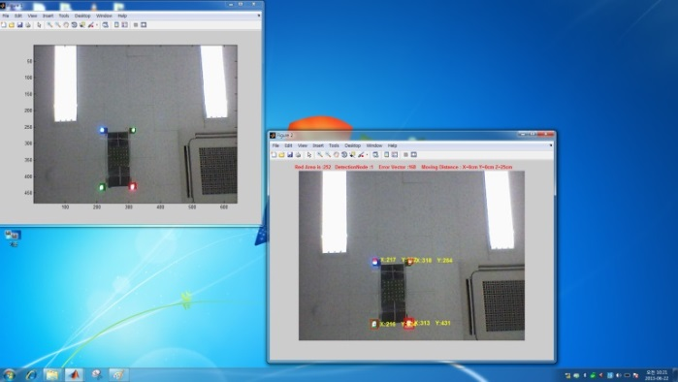
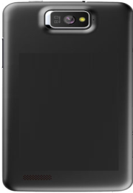
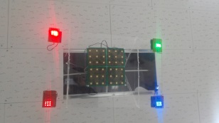
doc.: IEEE 802.15-15-0410-01-007a
Use Case of LED-ID #3:
Camera Positioning (CamPo)
Smart Phone Camera based indoor Positioning using multiple LED light signals with high resolution is possible.

Slide 10
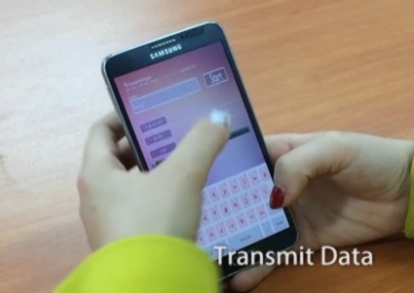
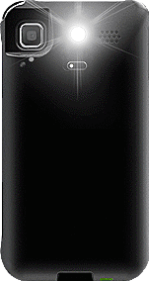
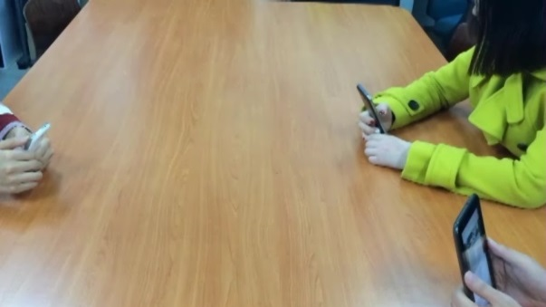
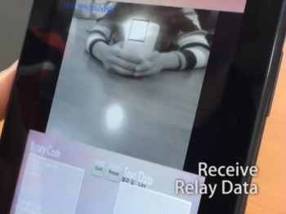
doc.: IEEE 802.15-15-0410-01-007a
Use Case of LED-ID #4:
P2P (Phone to Phone) Tx/Rx & Relay Application
VLC (OCC)
Tx action
LED Flash Light
Camera
Tx : LED flash light of Smart Device
Rx : Camera module of Smart Device
Rx/Tx (Relay action)
Rx action
Tx: LED flash light of Smart device Rx : Camera of a Smart device.
LED-ID solutions with smart phone cameras can also be a main OCC& OWC solution.

Slide 11
doc.: IEEE 802.15-15-0410-01-007a
Conclusions
LED-ID is defined as wireless light ID (Identification) systems realized using various LED Light signals.
LED-ID is one of three major topics of OWC; other two are OCC & LiFi.
Various use cases based on LED-ID can be considered.
More efficient new PHY/MAC mode(s) needs to be specified to support LED-ID features.
LED-ID concept is extensively included in the scope of the 15.7r1 work to satisfy various main components of PAR/CSD.

Slide 12
doc.: IEEE 802.15-15-0410-01-007a
Appendix
Slide 12
Notes:
doc.: IEEE 802.15-09-0117-00-0007
<month year>

Slide 13
doc.: IEEE 802.15-15-0410-01-007a
LED-ID Related PAR Components
[ Source : http://ieee802.org/15/par.html ]

Slide 14
doc.: IEEE 802.15-15-0410-01-007a
LED-ID Related CSD Components
[ Source : http://ieee802.org/15/par.html ]

