Slide 1
Project: IEEE P802.15 Working Group for Wireless Personal Area Networks (WPANs)
Submission Title: IG DEP Development of Wireless Sensing System for Factory
Date Submitted: March 10, 2015
Source: Hiroshi Kobayashi(Nissan), Ryuji Kohno(YNU/CWC-Nippon)
Contact: Ryuji Kohno(YNU/CWC-Nippon
Voice: :+358-8-553-2849, E-Mail: kohno@ynu.ac.jp
Re: IG DEP Development of Wireless Sensing System for Factory
AbstractDevelopment of Wireless Sensing System for Factory
Purpose: This document has been prepared for response to call for interest(CFI) of IG-DEP(Dependability).
Notice: This document has been prepared to assist the IEEE P802.15. It is offered as a basis for discussion and is not binding on the contributing individual(s) or organization(s). The material in this document is subject to change in form and content after further study. The contributor(s) reserve(s) the right to add, amend or withdraw material contained herein.
Release: The contributor acknowledges and accepts that this contribution becomes the property of IEEE and may be made publicly available by P802.15.
Slide 1
Slide 1
Notes:
Jul 12, 2010
Page 1

Slide 2
IEEE 802.15 IG DEP
Review of Responses to Call for Interest(CFI)
Development of
Wireless Sensing System
for Factory
Berlin, Germany
March, 2015
Hiroshi Kobayashi, Nissan Automotive

Slide 3
Agenda
Background
New Type of Equipment Diagnosis System by using wireless sensor devices
Required specification
Future Activity

Slide 4



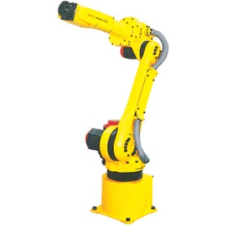
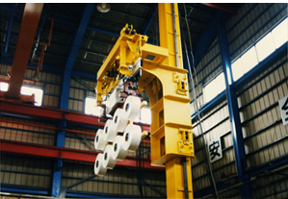
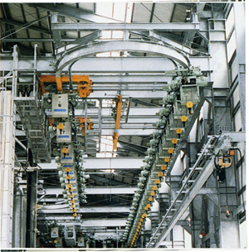
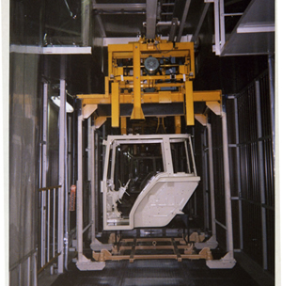
Background
Reduce Cost
Improve OEE
Reliability

Slide 5


Slide 6
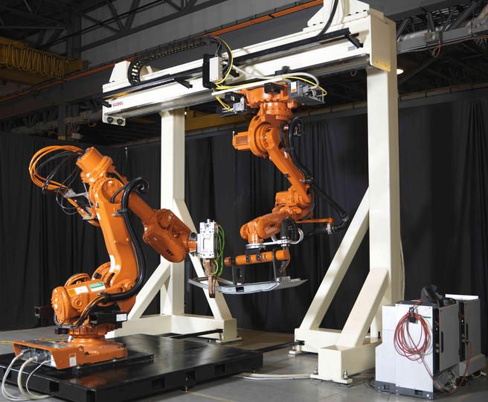
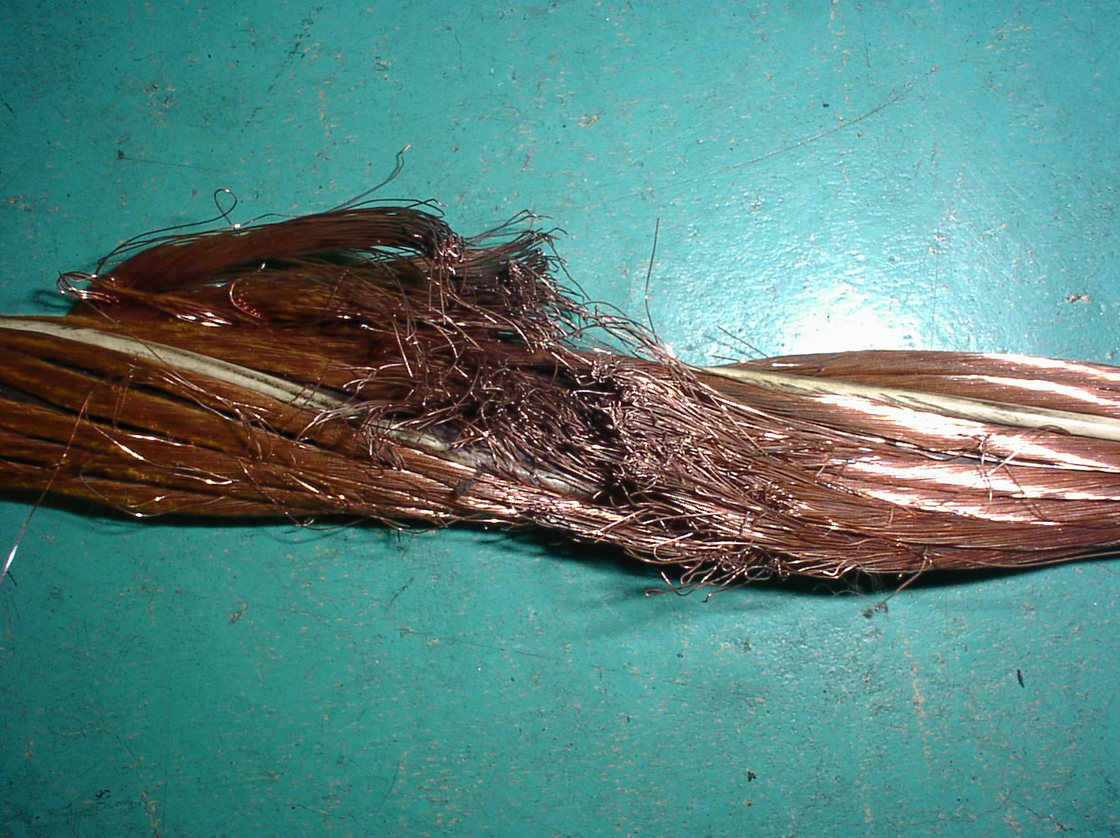
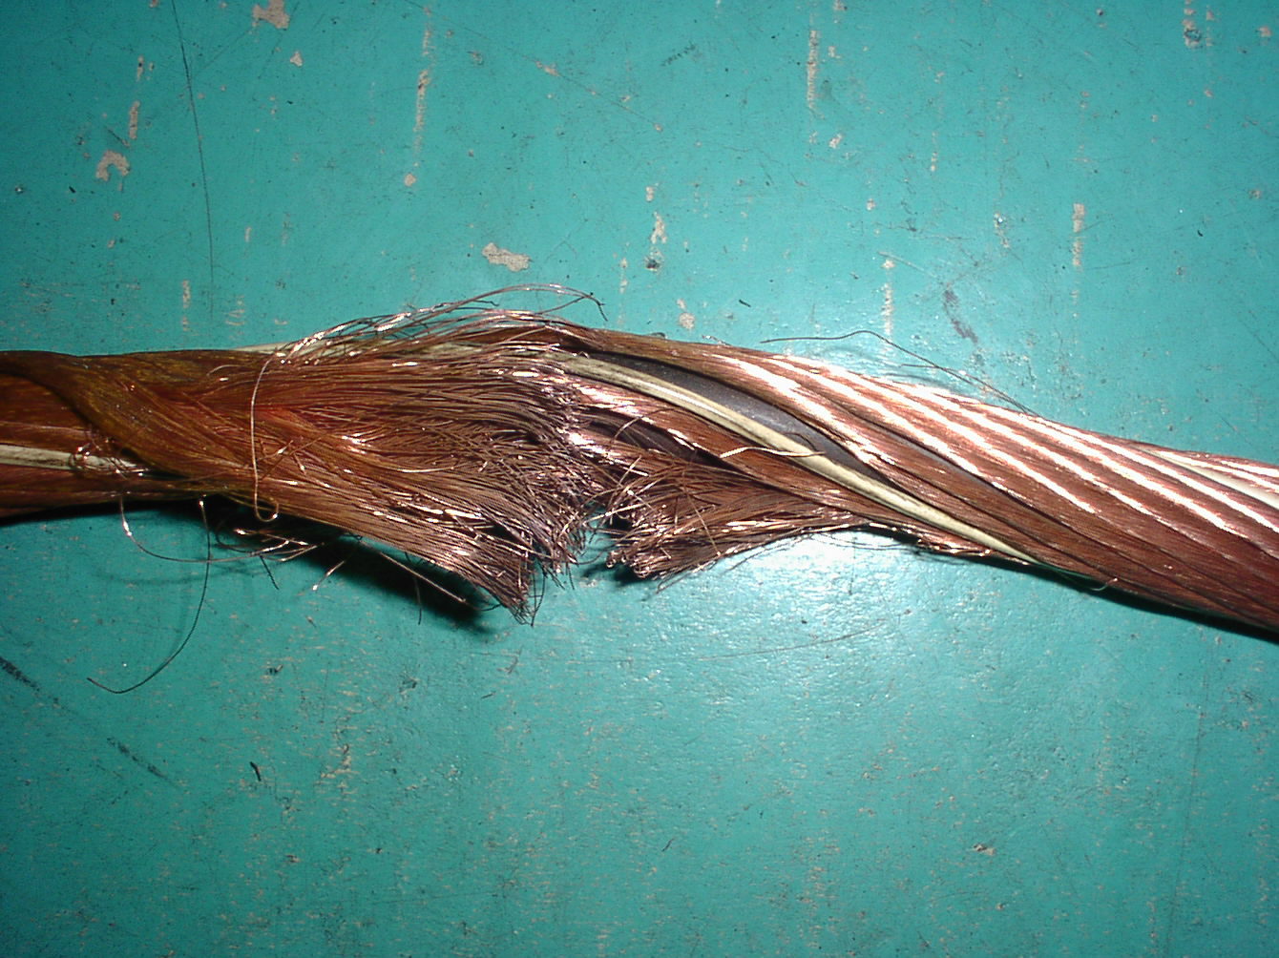

Slide 7
Agenda
Background
New Type of Equipment Diagnosis System by using wireless sensor devices
Required specification
Future Activity

Slide 8
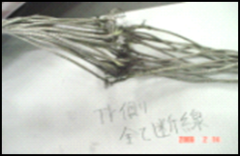
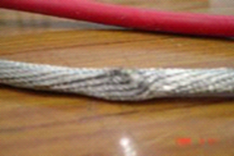
Cost Minimum and High Reliability
Concept for Equipment Diagnosis System
Parts Life Time
Failure
Extend Life Time
R²-CBM
TBM
Real –Time Diagnosis
Cable Disconnection Ratio
CBM
Maintenance Worker’s job
Very sensitive
Good Reliability to detect potential failure
Time Axis
We need Good Real-Time Diagnosis System

Slide 9
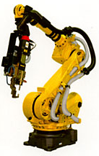
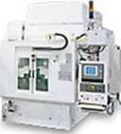
New approach to develop “Diagnosis system”
< Conventional Development Procedure >
Cable Disconnection
Deteriorated Reducers
Deteriorated Power Supply
Breakdown time
Failure mode, Failure type
Data Logger
Diagnosis
Logic
Sensor
Individual system

Slide 10
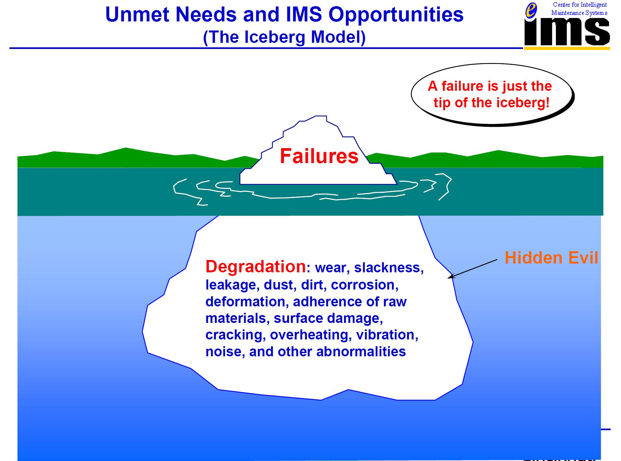
To accelerate Development Speed
We have to consider a new approach to develop!
Courtesy of Prof. Jay Lee, NSF I/UCRC on Intelligent Maintenance Systems (IMS),
Univ, of Cincinnati

Slide 11


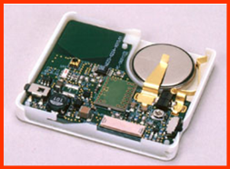
New approach to develop “Diagnosis system”
< Conventional Development Procedure >
Cable Disconnection
Deteriorated Reducers
Deteriorated Power Supply
Breakdown time
To cover whole area！
Failure mode, Failure type
Data Logger
Diagnosis
Logic
PC
Sensor
Multi-sensor
Individual system
Receiver
Rooter

Slide 12


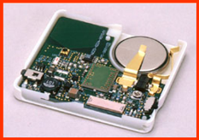
New approach to develop “Diagnosis system”
< Conventional Development Procedure >
Installation Issues
Installation Cost
PC
Restriction of installation
Reliability of wires
Data Logger
Diagnosis
Logic
Multi-sensor
PC
Sensor
Individual system
Receiver

Slide 13
Agenda
Background
New Type of Equipment Diagnosis System by using wireless sensor devices
Required specification
Future Activity

Slide 14
Required specification
3 type of Diagnosis System
  Equipment Diagnosis System in Real-time with rea-time feedback
    Real-time measuring
    Judge immediately with a certain threshold level
  Equipment Diagnosis System in Real-time (1)
    Real-time measuring and sending data in real-time
    Judge based on the comparison with the past data
  Equipment Diagnosis System in Real-time (2)
    Real-time measuring and sending data intermittently
    Judge based on the comparison with the past data
A
B
C

Slide 15
Required specification
3 type of Diagnosis System
  Equipment Diagnosis System in Real-time with rea-time feedback
    Real-time measuring
    Judge immediately with a certain threshold level
  Equipment Diagnosis System in Real-time (1)
    Real-time measuring and sending data in real-time
    Judge based on the comparison with the past data
  Equipment Diagnosis System in Real-time (2)
    Real-time measuring and sending data intermittently
    Judge based on the comparison with the past data
A
B
C

Slide 16
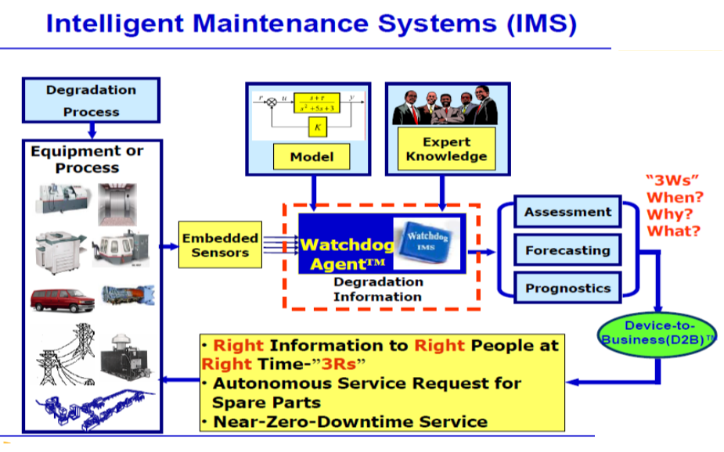
IMS Sensor

Slide 17
Required specification
3 type of Diagnosis System
  Equipment Diagnosis System in Real-time with rea-time feedback
    Real-time measuring
    Judge immediately with a certain threshold level
  Equipment Diagnosis System in Real-time (1)
    Real-time measuring and sending data in real-time
    Judge based on the comparison with the past data
  Equipment Diagnosis System in Real-time (2)
    Real-time measuring and sending data intermittently
    Judge based on the comparison with the past data
A
B
C

Slide 18
IMS Sensor

Slide 19
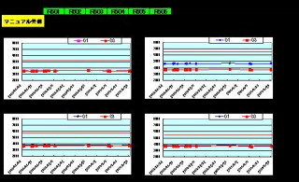
New approach to develop “Diagnosis system”
< Conventional Development Procedure >
Cable Disconnection
Deteriorated Reducers
Deteriorated Power Supply
Breakdown time
< No Countermeasure >
Failure mode, Failure type
Data Logger
Diagnosis
Logic
PC
Sensor
Receiver
Individual system
Alarm
Rooter

Slide 20
Required specification
Specification for Equipment Diagnosis System
  Response
    Real-time measuring function to communicate with receiver in real-time
    Judge immediately with a certain threshold level
  Energy consumption
    In order to prolong a life time of measuring device save energy and have good efficiency regarding communication power * At least 1 year or more
  Bilateral communication ability
    In order to change some parameters in the device
    and give some triggers to start and end measuring from outside
Notes:
Intermittent 間欠な

Slide 21
Required specification
Specification for Equipment Diagnosis System
  4. Distance to communicate with devices
  1) In order to reduce the number of receivers
  device have to have some distance to
  communicate. At least 20m or more
  5. Data transfer speed
  1) This sensor will have multi-sensors. So
  data transfer speed is very inportant.
  6. Communication capability with many sensors
  1) How many sensors can communicate at the same time
  7. Kinds of Sensors
  1) Vibration sensor 2) Thermal sensor
  3) Voltage 4) Current
  5) AE
Notes:
Intermittent 間欠な

Slide 22
Agenda
Background
New Type of Equipment Diagnosis System by using wireless sensor devices
Required specification
Future Activity

Slide 24
Required specification
The type of Diagnosis System
  Equipment Diagnosis System in Real-time with rea-time feedback
    Real-time measuring
    Judge immediately with a certain threshold level
  Equipment Diagnosis System in Real-time
    Real-time measuring
    Judge based on the comparison with the past data

