Slide 1
Project: IEEE P802.15 Working Group for Wireless Personal Area Networks (WPANs)
Submission Title: NTU Response to 15.7r1 CFA
Date Submitted: March 6, 2015
Source: Hsin-Mu (Michael) Tsai / Rick Roberts Company: National Taiwan University
Address:
Voice: E-Mail: hsinmu@csie.ntu.edu.tw
Re: IEEE802.15.7a CFA
Abstract: CFA Response
Purpose: CFA Response
Notice: This document has been prepared to assist the IEEE P802.15. It is offered as a basis for discussion and is not binding on the contributing individual(s) or organization(s). The material in this document is subject to change in form and content after further study. The contributor(s) reserve(s) the right to add, amend or withdraw material contained herein.
Release: The contributor acknowledges and accepts that this contribution becomes the property of IEEE and may be made publicly available by P802.15.

Slide 2
Universal Camera Communications with
Rolling Shutter –
Frequency Shift Keying

Slide 3
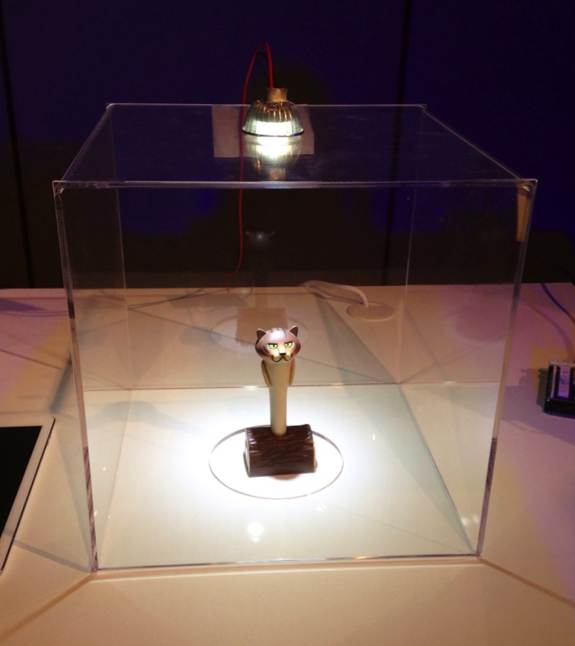
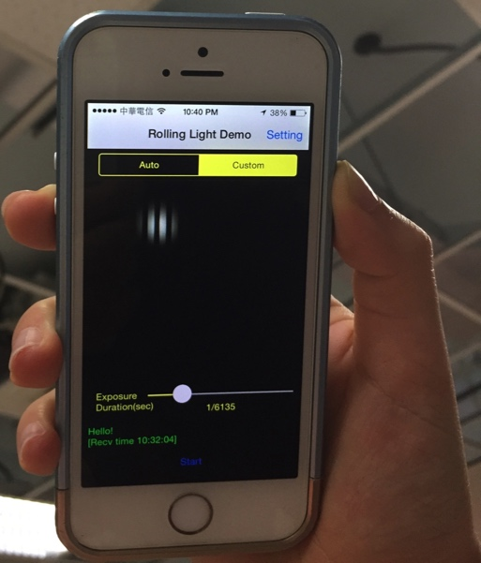
Use Case: Marketing or guide systems
Marketing or guide systems:
  LED transmits URL
  Mobile devices with (unmodified) cameras receives URL and retrieves additional information (with WiFi or cellular data connection) about the item
LED transmits URL with info. about the item
A smartphone’s camera receives URL & displays text or video about the item on the screen

Slide 4
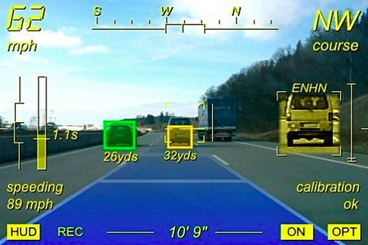
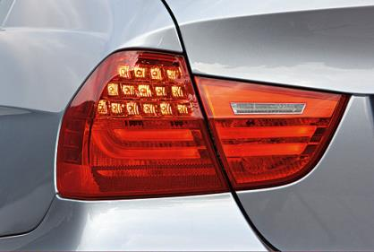
Use Case: Vehicular Communications
Vehicular Communications
  Each vehicle broadcasts its license plate number, speed, brake status periodically with the LED lighting (tail light, head light, etc.)
  Neighboring vehicles receive information with existing front & back cameras (with software upgrade) for use in Advanced Driver Assistance System (ADAS) & other safety systems
  Additional information can be received from DSRC/cellular, but these information can be visually associated with neighboring vehicle’s identity (e.g., the car that I see, in front of me and in the same lane) once the license plate number is received via camera communications

Slide 5
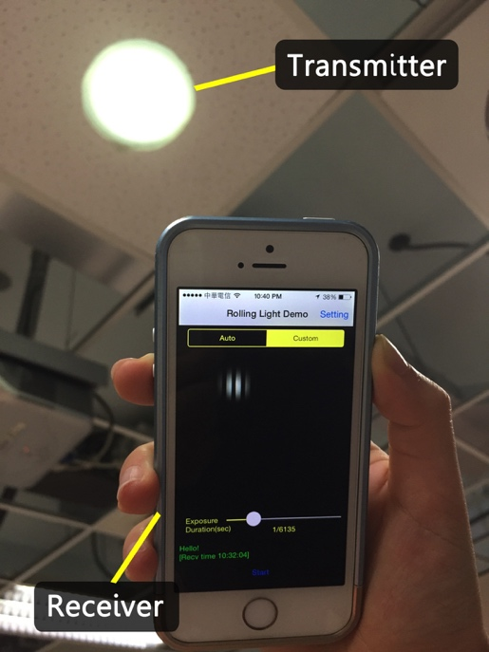
Related Research & Demo
Our proof-of-concept is demonstrated at:
H.-M. Tsai, H.-M. Lin, and H.-Y. Lee, “Demo: RollingLight - Universal Camera Communications for Single LED”, ACM Annual International Conference on Mobile Computing and Networking (MobiCom), September 2014.
“Demo: Universal Camera Communications,”
Intel Asia Innovation Summit, Taipei, Taiwan, November 2014
An LED light driven by a simple driver module (Arduino Mega 2560 + a MOSFET switch)
iOS 8 devices (iphone 5S, 5C, iPad Air) + our app can decode simple text transmitted by the light

Slide 6




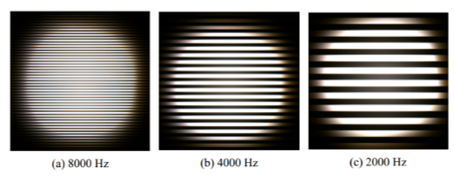
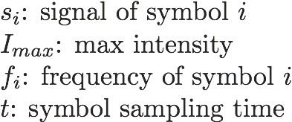
Rolling Shutter - Frequency Shift Keying
Modulation:
Square wave (2 levels)
Different frequency
→ different bit patterns
Symbol duration = frame duration
& high-order modulation
Demodulation:
Estimate strip width (signal period) with either FFT or autocorrelation methods
: width of a pair of bright
and dark strips
: frequency of symbol i
: read-out time

Slide 7
RS-FSK Design Choices
Why
Frequency Modulation?
Compatible to cameras with different sampling rates (read-out time)
Ability to decode even with loss of a large portion of signal samples
(due to unsynchronized light and camera)
Average intensity stays the same – transmissions not observable by eyes
Why
Square Wave?
Mitigate the impact due to the filtering caused by long exposure
Only two output levels – cost effective
Change of duty cycle is possible – preserve ability for dimming support

Slide 8
Visual Association
Existing computer vision techniques:
identify what a group of pixels are
(e.g., A car, lane marks, a traffic signal)
Camera communications:
received information comes from the same / nearby group of pixels (e.g., the car’s tail light)
Easily and visually associate received information with the identity of the object
(a car or a traffic signal)

Slide 9
Asking for in the standard …
A PHY mode that supports rolling shutter camera communications in line-of-sight scenarios, having the ability to decode even with loss of a large portion of signal samples, due to (1) long time gap between exposure periods of consecutive image frames (2) large TX-RX distance (3) unsynchronized TX (light) & RX (camera)
A PHY mode using RS-FSK that is compatible to a variety of cameras with different rolling shutter sampling rates (read-out time), resolution, and frame rates
A PHY mode using RS-FSK that retain the illumination functions of the light: (1) has the ability to support dimming (2) transmission is not observable by human eyes
A PHY mode using RS-FSK that can receive information coming from the same/nearby group of pixels while providing visual association with the received information and the identity of the object

