Slide 1
Project: IEEE P802.15 Working Group for Wireless Personal Area Networks (WPANs)
Submission Title: Call For Applications Response
Date Submitted: March 2015
Source: Dr. Nikola Serafimovski Company: pureLiFi Ltd.
Address: pureLiFi Ltd. ETTC, Max Born Crescent, Edinburgh, EH9 3BF, UK
Voice: +44-131-472-4704, E-Mail: nikola.serafimovski@purelifi.com
Re:
Abstract: “LiFi” is high-speed, bidirectional, networked and mobile wireless communications using light. This document seeks to illustrate the intended use of LiFi in a commercial setting (use-cases) as well as some of the high level concepts that would be useful to be integrated and/or revised.
Purpose:
Notice: This document has been prepared to assist the IEEE P802.15. It is offered as a basis for discussion and is not binding on the contributing individual(s) or organization(s). The material in this document is subject to change in form and content after further study. The contributor(s) reserve(s) the right to add, amend or withdraw material contained herein.
Release: The contributor acknowledges and accepts that this contribution becomes the property of IEEE and may be made publicly available by P802.15.

Slide 2
Call For Applications: pureLiFi Response

Slide 3
“LiFi”
high-speed, bidirectional, networked and mobile wireless communications using light.
High speed
  Data rates of at least 10 Mbps per access point
Bidirectional
  Light spectrum (190 nm – 10,000 nm wavelength) used for
  uplink and downlink
Networked
  Facilitate network connectivity and management
Mobile
  Support roaming users and multiple users per access point (hand-over and multiple access)

Slide 4
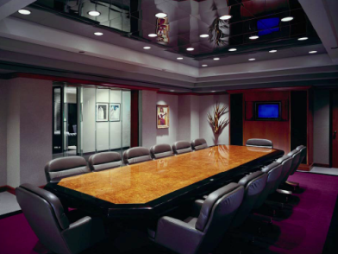



LiFi: use-cases
Security Conference rooms
Hangers and storage depos
Airplanes and Airports
EMI sensitive environments
  Hospitals, Petrochemical plants,
  Nuclear facilities, etc.

Slide 5
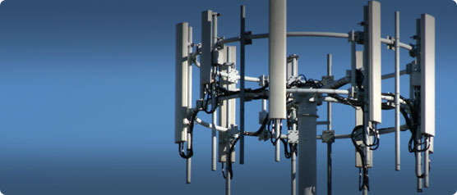
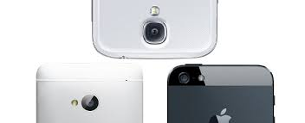
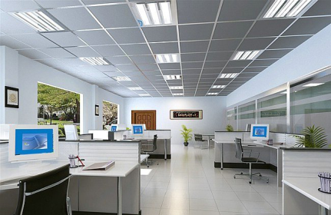
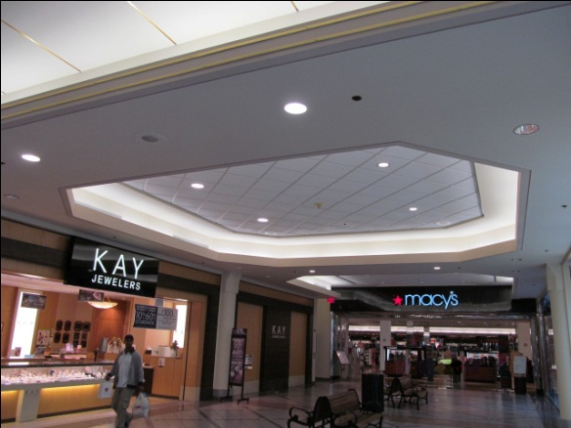
LiFi: use-cases
Spectrum relief
  Every-day mobile communications
Open plan offices
Hotels
Research Institutions

Slide 6
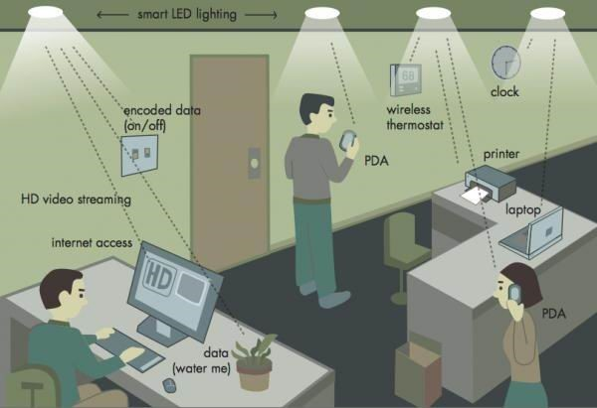
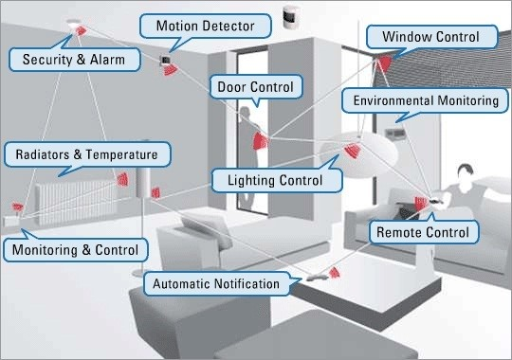
LiFi: use-cases
Smart Home
Smart Office

Slide 7
LiFi: Complementary to existing RF

Slide 8
Proof of Concept
pureLiFi Li-1st
(http://vimeo.com/90128750)
  point-to-point, high speed, bidirectional, off-the-shelf lights
pureLiFi Li-Flame
(http://youtu.be/TIAS8BxGe_8)
  high speed, bidirectional, networked and mobile wireless communications using light

Slide 9
Standard Requirements

Slide 10
LiFi: High Level Concepts
High speed
  Efficient use of optical bandwidth
Bidirectional
  Support full uplink and downlink communications without additional RF resources
Networked & Mobile
  User expectations of wireless technology
Secure & Safe
  Privacy, cybersecurity and EMI concerns

Slide 11
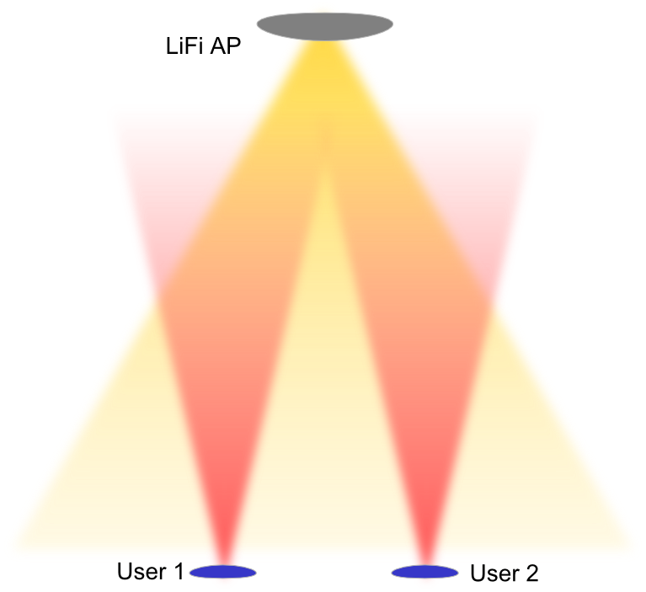
LiFi: bidirectional and multiple access support
Bidirectional
  LiFi operates entirely in the light spectrum and can help alleviate the spectrum crunch
  Users request access to the AP which may be connected to the network
  Users may see multiple APs
  APs may see multiple users
  The inherent directionality of light beams is used to define strict coverage regions

Slide 12

LiFi: mobility and hand-over support
Networked & Mobile
  Users can move from one light source to another and retain their session
  Users do not need to be aligned with the light source and may connect to the strongest light source

Slide 13
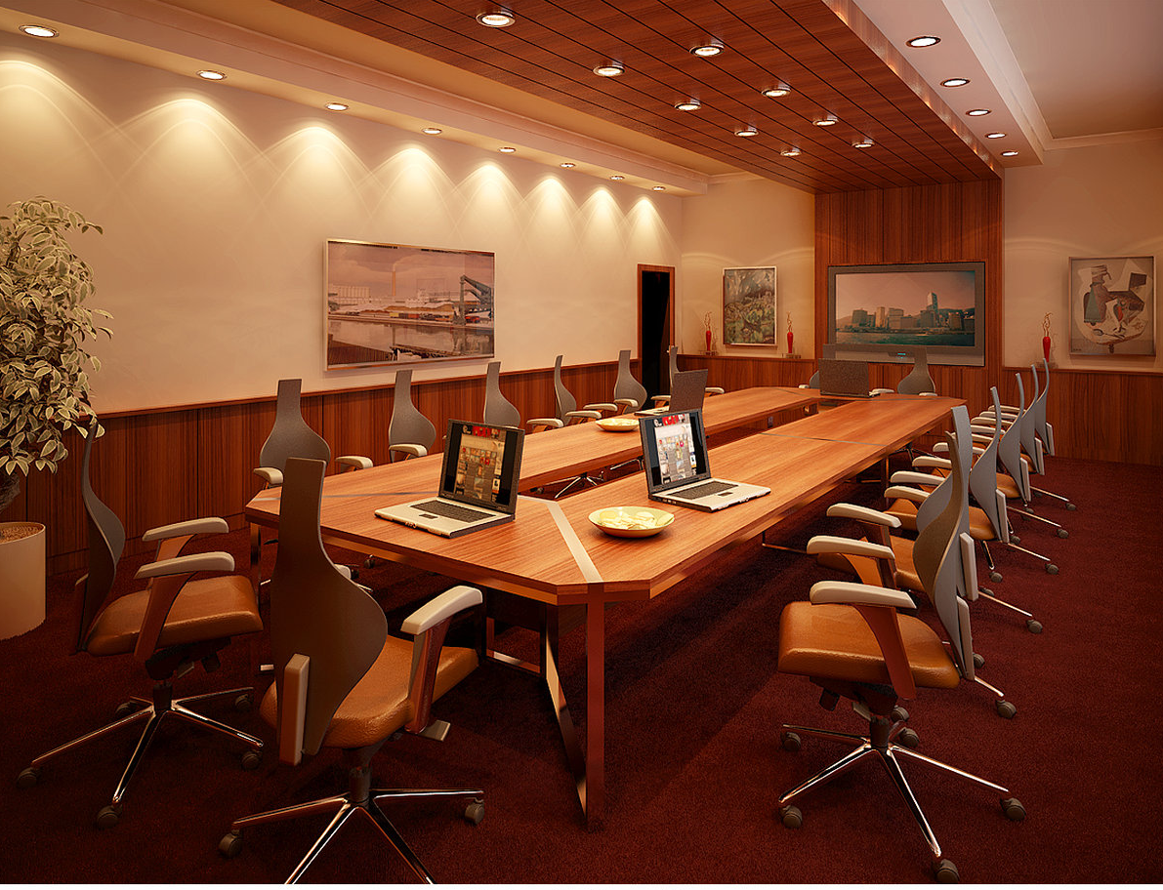
LiFi: Interference Coordination
Overlapping cells
  Mixed lighting solutions from direct and indirect light
  Seamless roaming and resource management
  Load balancing and network optimization

Slide 14

LiFi: Interference Coordination
Indirect Lighting
  The signal may be detected from reflections as well as direct line of sight
  Multipath should be considered and resource planning may be required

