Slide 1
Project: IEEE P802.15 Working Group for Wireless Personal Area Networks (WPANs)
Submission Title: 15.7 Revision: Short-Range Optical Wireless Communications Tutorial
Date Submitted: 28 Jan 2015
Source: Various – Rick Roberts (15.7r1 editor) Company: Various
Address:
Voice: FAX: E-Mail:
Re:
Abstract: Collection of industry tutorial inputs
Purpose: Tutorial presentation for the IEEE802 plenary
Notice: This document has been prepared to assist the IEEE P802.15. It is offered as a basis for discussion and is not binding on the contributing individual(s) or organization(s). The material in this document is subject to change in form and content after further study. The contributor(s) reserve(s) the right to add, amend or withdraw material contained herein.
Release: The contributor acknowledges and accepts that this contribution becomes the property of IEEE and may be made publicly available by P802.15.

Slide 2
Task Group IEEE802.15.7r1
Short-Range Optical Wireless Communications
Kickoff Tutorial

Slide 3
Table of Content
Part 1: Introduction
Part 2: Optical Camera Communications PHY
Part 3: Higher Rate PHY
Part 4: LED ID PHY

Slide 4
Part 1: Introduction

Slide 5
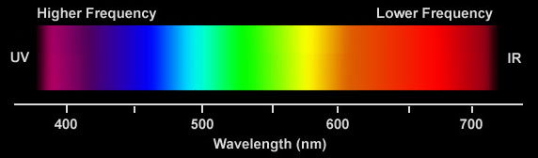
Base standard … IEEE802.15.7-2011 Short-Range Wireless Optical Communication Using Visible Light
Originally wanted to write an amendment to add IR/UV PHY options but the word “visible” in the base standard title required a revision to change the title.

Slide 6
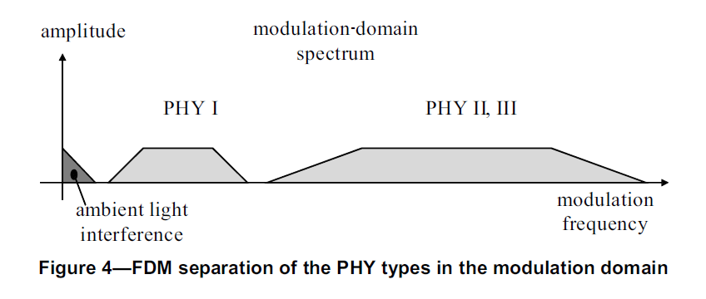
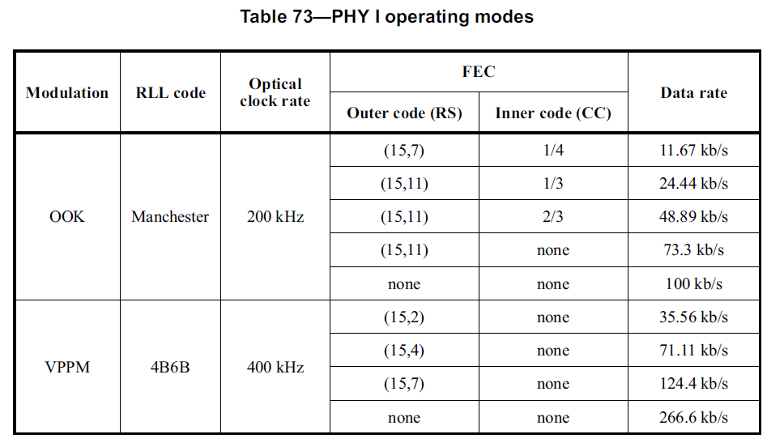

Slide 7
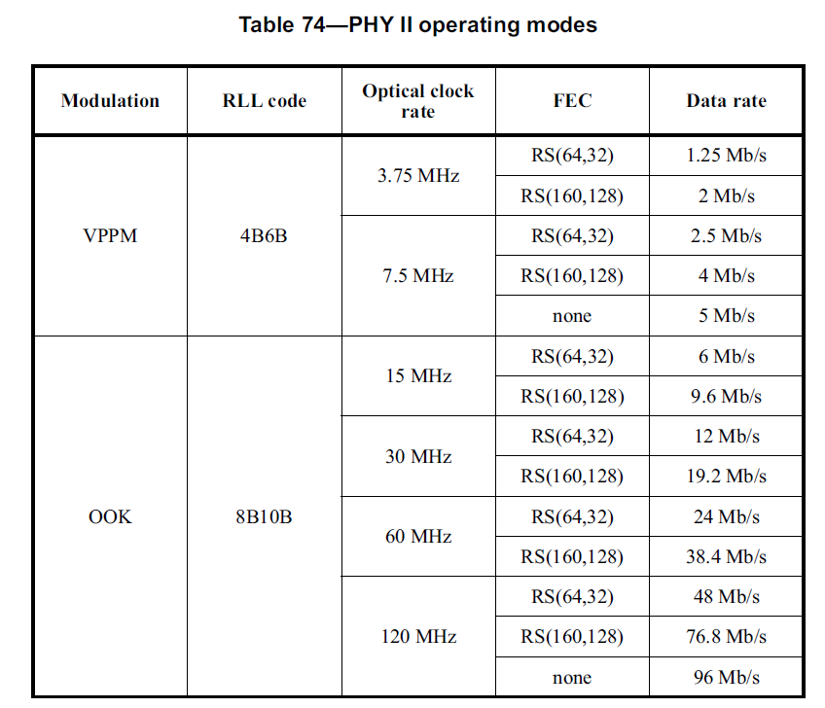
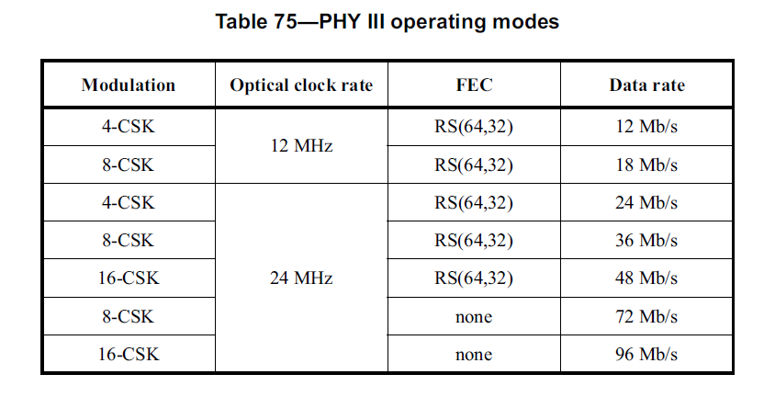

Slide 8
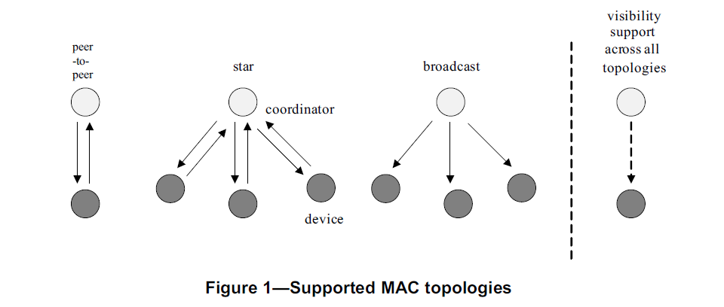
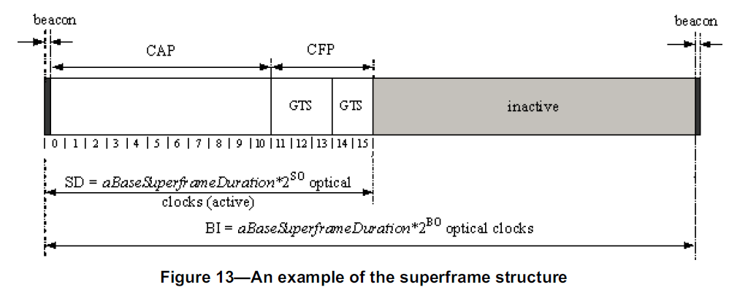

Slide 9
Part 2: Optical Camera Communications PHY

Slide 10
Intel Corporation Contribution
Rick Roberts
richard.d.roberts@intel.com

Slide 11
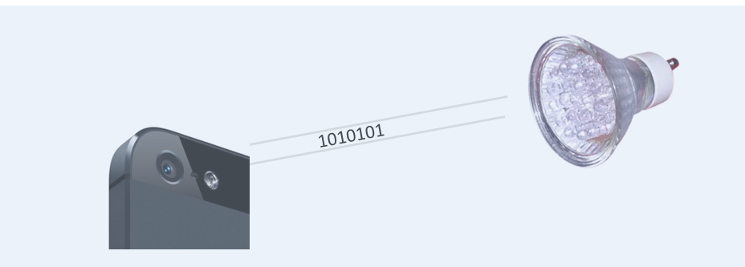
Optical Camera Communications (OCC)
A Pragmatic Form of Visible Light Communications
OCC is modulating an LED light with data bits that can be received by a camera, which then decodes the bits and extracts the data.
Phone
Camera
Today we have millions of mobile devices enabled to receive visible light communications via the camera, but we lack standards to describe the modulation format.
This contribution discusses some OCC topics of interest.

Slide 12




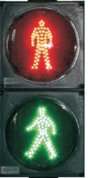
Basic idea:
each LED sign uses OCC to broadcast URL info
multiple parallel transmissions received by camera
each web page accessed via RAN
Google Glass displays webpage next to related LED sign
added information augments users reality
Augmented
Reality
31
flavors
Open
@7AM
School
Zone!

Slide 13

Comphotogrammetry: the merger of OCC and Photogrammetry such that light sources become self-identifying anchor features
1HGCM82633A004352
rightt rear taillight
<x,y,z>
1HGCM82633A004352
rightt rear taillight
<x,y,z>
1HGCM82633A004352
center rear taillight
<x,y,z>
1HGCM82633A004352
rightt rear taillight
<x,y,z>
1HGCM82633A004352
rightt rear taillight
<x,y,z>
1HGCM82633A004352
left rear taillight
<x,y,z>
1HGCM82633A004352
rightt rear taillight
<x,y,z>
1HGCM82633A004352
rightt rear taillight
<x,y,z>
1HGCM82633A004352
rightt rear taillight
<x,y,z>
High Resolution Automobile Positioning

Slide 14
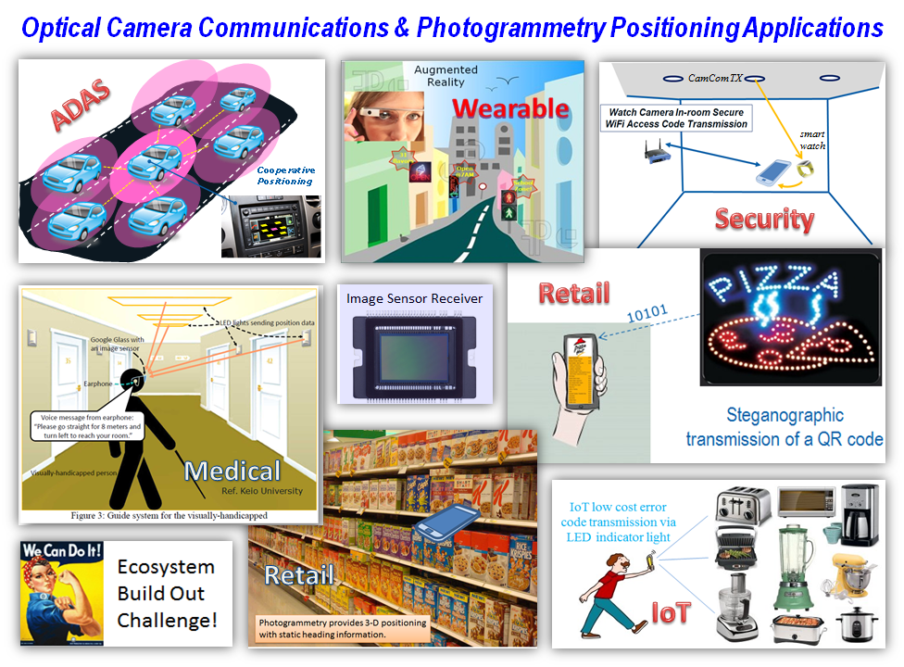

Slide 15
But first some basics about electronic cameras
Read
Out
Lens
Image
Sensor
Read Out
Circuit
Camera basic components
  Lens … spatially separates sources
  Image Sensor … array of photodiode pixels
  Readout Circuit … convert pixel signal to digital data
Cameras differ on how the pixels are exposed
Global Shutter … simultaneously expose all the pixels per frame
Rolling Shutter … time sequentially expose each row of pixels per frame

Slide 16

Because of camera lens properties, spatial separation of multiple sources is possible enabling MIMO transmission.
Example LED Signage
This LED sign has 321 LEDs …
each LED illuminates a unique pixel in the image sensor
each LED can transmit a unique data stream
321 x 321 MIMO !!!

Slide 17
CamCom data recovering algorithm on mobile platform
University of California Riverside Contribution
Dongfang Zheng, Gang Chen, Jay A. Farrell
gachen@ee.ucr.edu

Slide 18
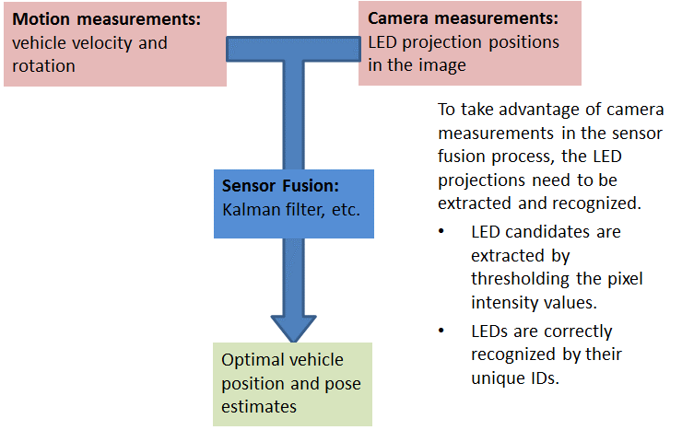
VLC Aided Navigation System

Slide 19
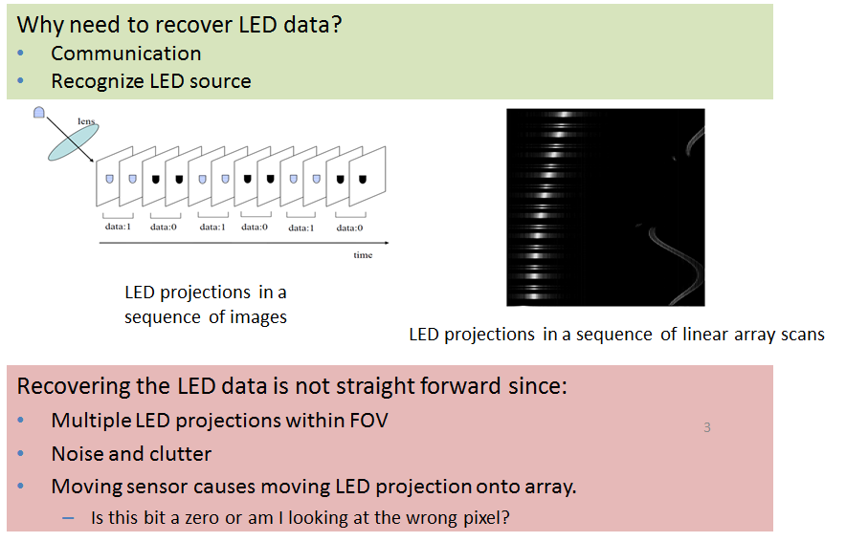
LED Data Recovery Problem when moving

Slide 20
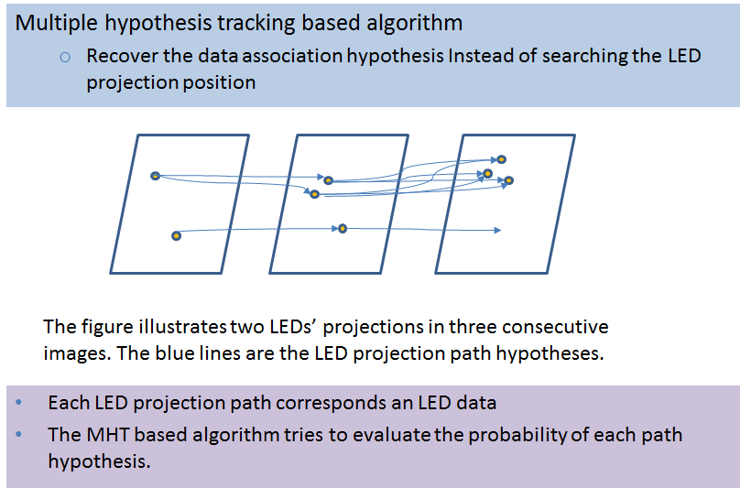
One Algorithm: MHT Based Data Recovery

Slide 21
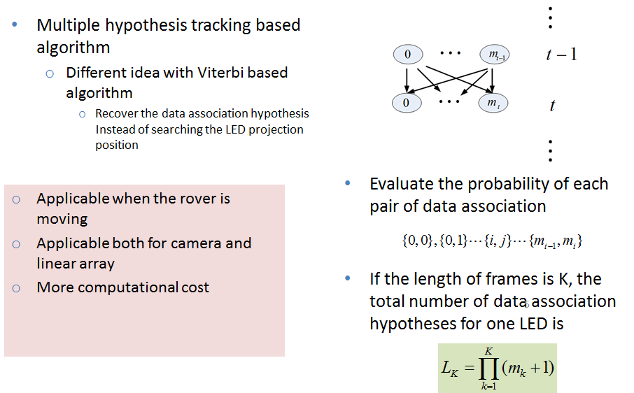
MHT Based Data Recovery
Notes:
According to these limitations, we developed another data recovery algorithm based on multiple hypothesis tracking. This method tries to recover the data association for the LED at each time step instead of recovering the LED projection position in the sensor in Viterbi-based algorithm. This method will apply to both camera and linear array, no matter how the photo-detector moves.
If the length of frames is K, the total number of data association hypothesis for one LED L_k. This number will be very huge when the steps K is long, so the MHT based data recovery method requires more computational cost than Viterbi-based algorithm.
Later we will introduce a method to only keep the first q most probable hypothesis sequences.

Slide 22
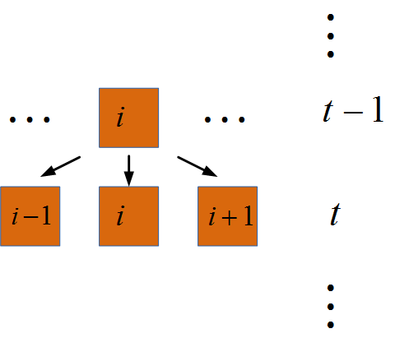
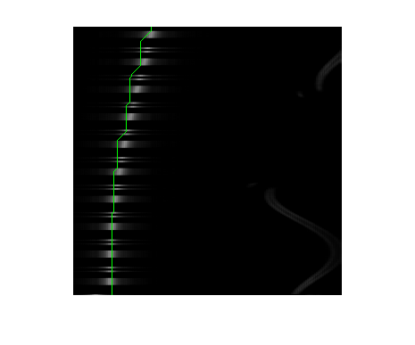
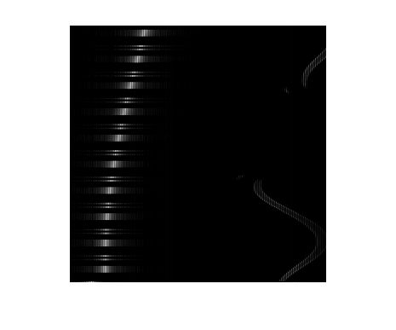
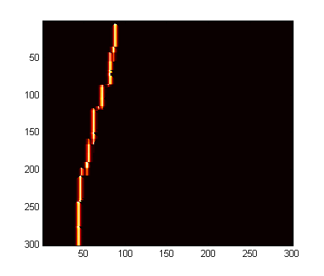
Another Algorithm: Viterbi-based Data Recovery
  Apply Viterbi algorithm to the data recovery problem of linear array.
  Assumption:
  The movement of LED projection in two consecutive scans if bounded
  The Viterbi based algorithm tries to compute the probability of each pixel that the LED projects on.
  The probability is computed by incorporating the motion and LED measurement information.

Slide 23

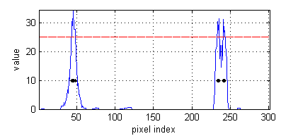
Viterbi-based Data Recovery Algorithm
State definition
  Pixel index i that the LED projected on
Observation set definition
  The pixels that have intensity values higher than the threshold
Pixel index
Assumption:
  Each LED is projected onto only one pixel in the linear array
  This is invalid but convenient for analysis
Notes:
To develop the data recovery algorithm, we firstly define the state and observation set in the problem. Since we need to recover the LED position in the linear array, so the state is defined as the LED projection position in the linear array. Notice that the definition is different from the rover’s state that we want to estimate. Here we made a assumption that each LED projection onto the linear array only occupies one pixel. This is not valid but convenient for the later analysis. We will also analyze the influence of this assumption at last.
The Observation is the pixel indexes that are probable to be the LED projections. Usually, we threshold the pixel value to extract the observations. Notice that the number of measurements at each time step does not necessary equal to 1.

Slide 24
Kookmin University Contribution
Yeong Min Jang
yjang@kookmin.ac.kr

Slide 26
Disney Research Contribution
Stefan Mangold
stefan.mangold@disneyresearch.com

Slide 28
CASIO COMPUTER CO., LTD
Nobuo IIZUKA
iizukan@casio.co.jp
OCC PHY for Low-speed OCC
MP2P with Position acquisition in PHY layer
※MP2P:Multi Point to Point
(LEDs to Camera)

Slide 29
Use Case
Unidirectional, MP2P
  MP2P can provide following functions
    Bandwidth: By parallel transmission, increasing the amount of information
    UI: Detail information select on Camera monitor. Lower layers of the communication provides a UI function .
Low speed, ID Beacon or simple data transmit
  Low speed: pulse rate 5Hz – 500Hz (Tentative)
Use at a distance range of 0.5m ~ 100m or more.
No need of specialized camera architecture.
Easy to implement in software base at smartphone or other conventional camera system.
Application: O2O, IoT, M2M ….

Slide 30
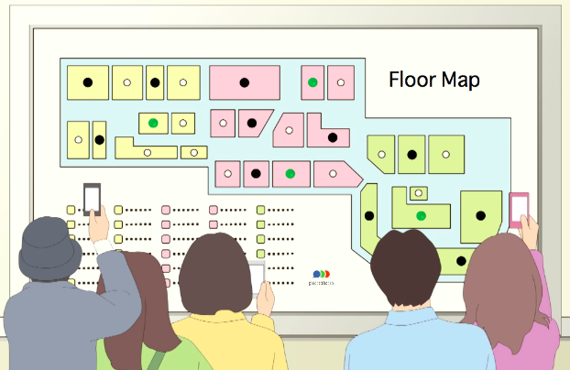




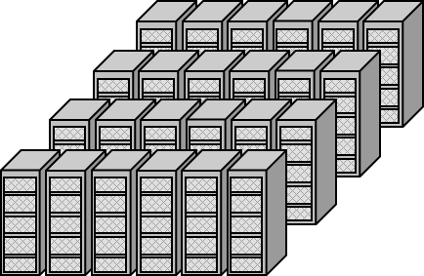
Proof of concept (Demo videos)
O2O(smartphone)
  Transmit from signage/signboard
IoT (smartphone)
  LED indicator of appliances
M2M/IoT (PC)
  Multi data receive with surveillance camera and add-on LED transmitter
Error 12345
Tap for Guide video
Error

Slide 31


Processing model
Number of signals, positions, sizes and shapes are all the unknown.
Discovery process combined with image processing is important .
Characteristics of PHY format
Image FIFO
Spatial
Discovery
Filter
(includes Tracking)
Multi point
Decoder
Data1, (X1,Y1)
Data2, (X2,Y2)
Data3, (X3,Y3)
．．．
-Time domain image filtering.
-Determines the sampling point of the signal candidates area.
-Format inspection and Decoding of the sample data sequences.
-Acquisition the multi-data and its position in the image.
-MAC layer might have mediation function of position information
VLC signals
………
Various many background noises

Slide 32
PHY that is easy to realize the discovery process
What characteristics of PHY is well for implement of “Discovery Filter”.
Well known methods? … -Not Suit, especially in low frame rate
  Frequency base (base-band frequency filter or sub-carrier filter)
  Ordinary preamble detect
  It is difficult to distinguish the signals from a natural scene.
Recommended method –work well in low frame rate
  RGB Color code (ternary modulation)
    8B6T line coding and guard ternary pulse (8B6T: 8bit to 6Tarnary)
  ON/OFF code with Pseudo header & I-4PPM
    Suit for Discovery but Inadequate bit rate on 10~30fps. (To be discussed on another occasion)
In the PHY , it might be better to considered these issues
    Frame drop (Often, It is difficult to clearly detect)
    White balance, Expures shift (Can not often control from the application layer)

Slide 33
PHY format (Tentative)
DC component of the color pulse fluctuation is suppressed (consecutive prohibited exceed the same three color)
Guard Ternary Pulse:
1T pulse to avoid the same color three consecutive
SYNC header
Type, length
payload
FCS
Sub payload-1
………
Sub payload-n
Coding
Pulse
--
2T
8B6T
6T
8B6T
8B6T
Custom Ternary
n-T
(6T+1T) x n
(Example)
………
………
OFF or achromatic
Several pulse time
Type-4bit ,
length-4bit (Number of 6T block)
payload is a series of 6T block
which separated with guard pulse
Number of Ternary pulse is depend on “length”.
Ternary level parity calculation.

Slide 34
Conclusion
MP2P with position acquisition in PHY layer
  Highly potential of new communication concept of OCC
  MP2P with position acquisition in PHY layer (※Coordinate is in the image frame)
  Position acquisition is Good Side Effect of PHY.
  Therefore, it is not necessary to care in PHY layer format for MP2P.
PHY layer format should be considered for “Discovery” process.
  8B6T line coding and guard ternary format was shown.

Slide 35
Universal Camera Communications with
Rolling Shutter – Frequency Shift Keying
National Taiwan University, Mobile and Vehicular Network Lab Contribution
Hsin-mu (Michael) Tsai (NTU), Richard Roberts (Intel)
hsinmu@csie.ntu.edu.tw

Slide 36
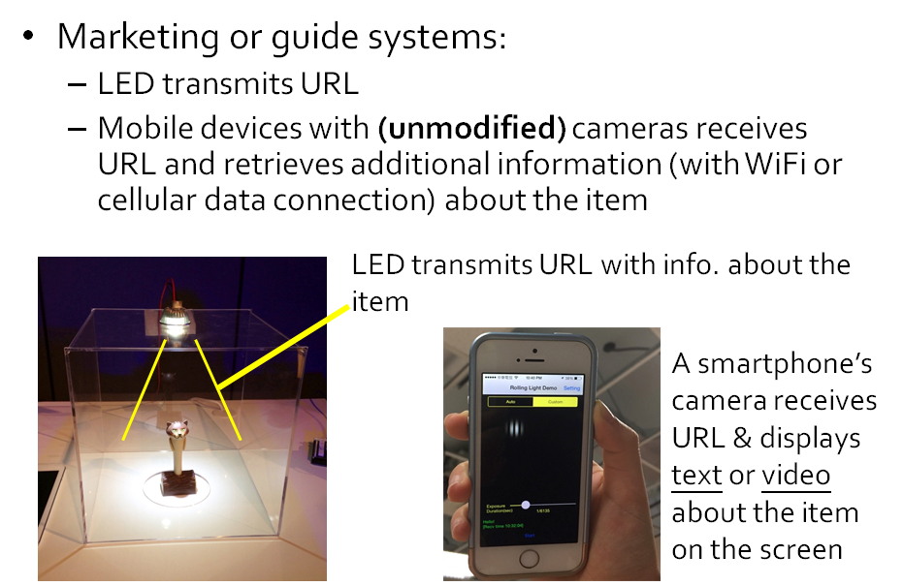
Use Case: Marketing or guide systems

Slide 37
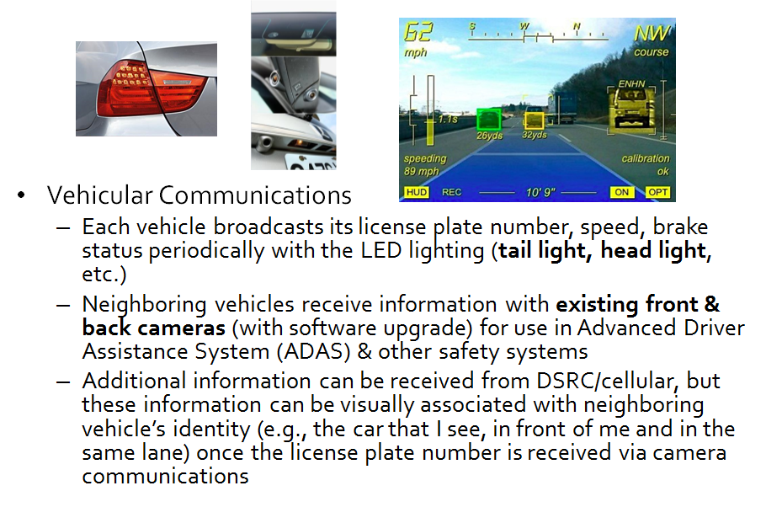
Use Case: Vehicular Communications

Slide 38
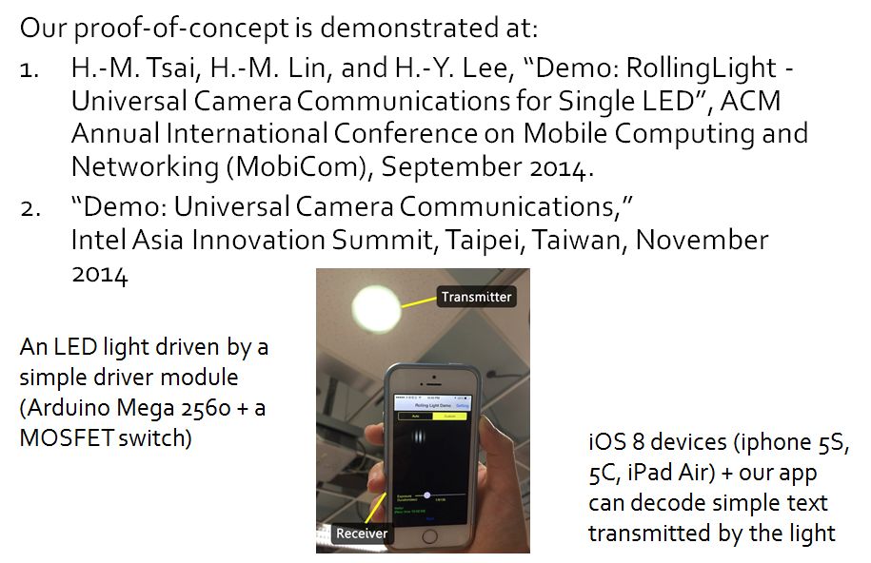
Related Research & Demo

Slide 39



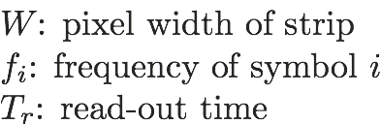

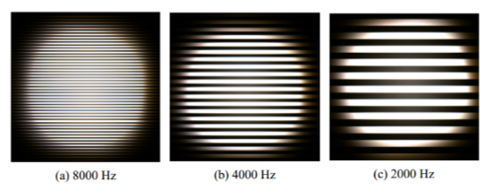
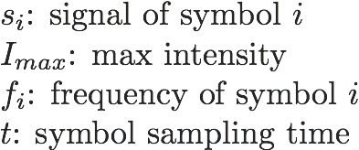
Rolling Shutter - Frequency Shift Keying
Modulation:
Square wave (2 levels)
Different frequency
→ different bit patterns
Symbol duration = frame duration
& high-order modulation
Demodulation:
Estimate strip width (signal period) with either FFT or autocorrelation methods

Slide 40
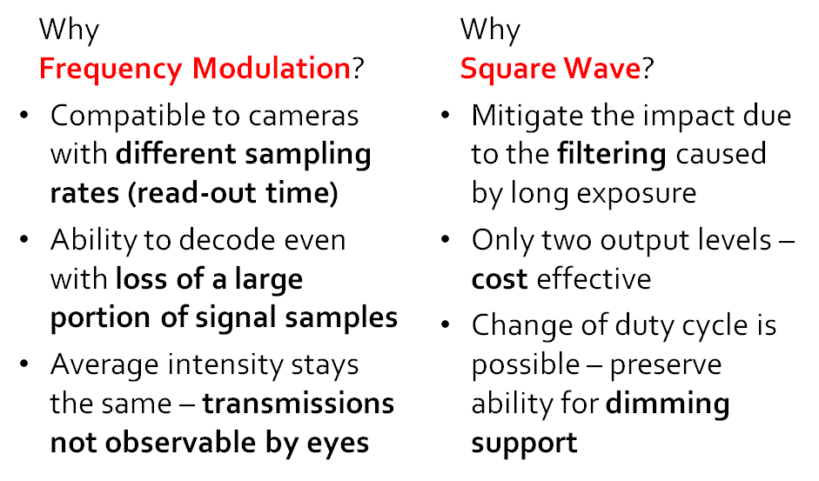
RS-FSK Design Choices

Slide 41
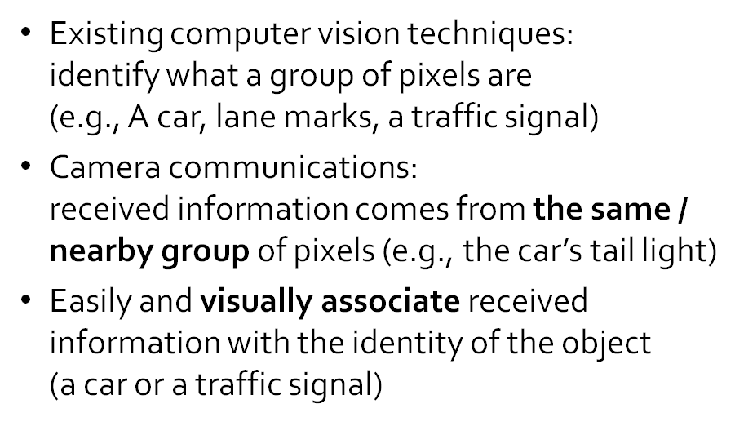
Visual Association

Slide 42
Part 3: Higher Rate PHY

Slide 43
University of Science and Technology of China Wireless-Optical Communication Key Laboratory of Chinese Academy of Sciences Contribution
Qian Gao, Chen Gong and Zhengyuan Xu
{qgao, cgong, xuzy}@ustc.edu.cn

Slide 44

Energy-efficient VLC under Lighting Constraints
    To achieve Energy-efficient VLC without interrupting illumination
    Highly efficient modulation scheme;
    LED radiation pattern design;
    Optimized LED spatial arrangement;
    ``Unshadowable VLC’’: a non-line-of-sight system architecture

Slide 45
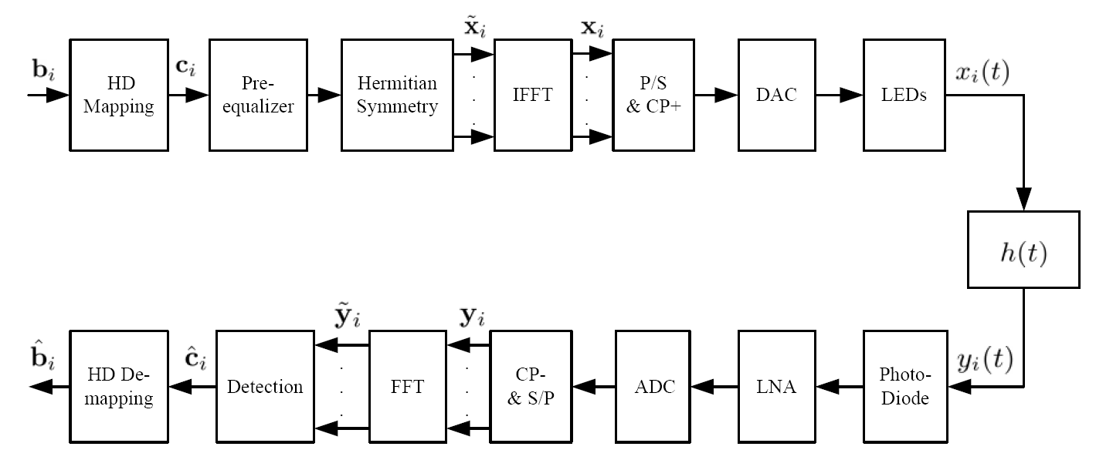
The DC-bias also carries information for a highly
energy-efficient VLC
The DC-bias in contained in here!
Constellation in high-dimensional continuous space
[1]. Q. Gao, C. Gong, R. Wang, Z. Xu, and Y. Hua, “From DC-Biased to DC-Informative Optical OFDM,” arXiv:1410.6885 [cs.IT],
Oct. 2014.

Slide 46
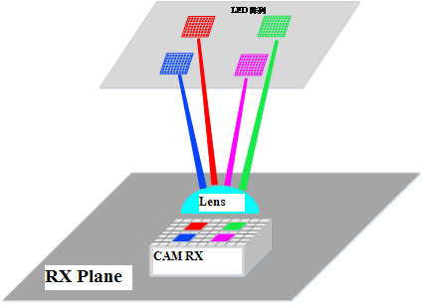
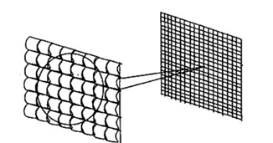
Employ or design optical devices such structure:
  Suitable for high-speed VLC;
  Suitable for high-efficiency VLC;
  Guaranteed uniformity of illumination;
  Higher gain, higher field of view, compact type.
CMOS sensor
Lens Array

Slide 47


LED spatial arrangement
For illumination uniformity
LED radiation patter design
For illumination uniformity

Slide 48
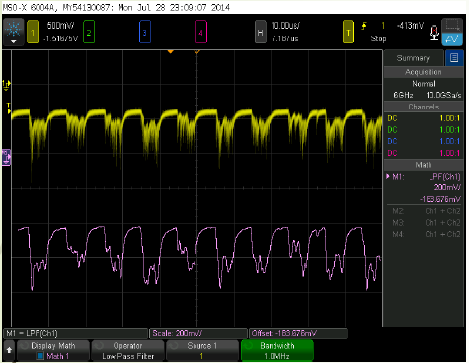
Unshadowable VLC
A non-line-of-sight transmission experiment
Back Diaphragm
No Line-of-sight guaranteed
PMT Receiver
Front Diaphragm
Beam angle 10 degrees
rectangular waveforms
Green LED

Slide 49
Conclusion
  We address the issue of VLC system design under light constraints from the following aspects:
  DC-informative modulation design;
  Methodology on optical structure theory;
  LED spatial arrangement and radiation pattern design;
  Unshadowable VLC design and experiment.

Slide 50
PureLiFi Ltd. Contribution
Nikola Serafimovski nikola.serafimovski@purelifi.com

Slide 51
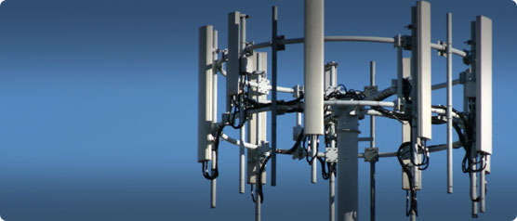
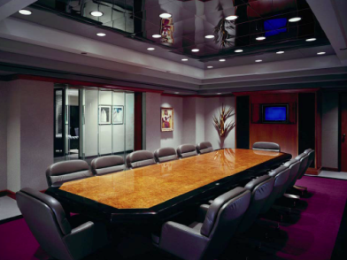


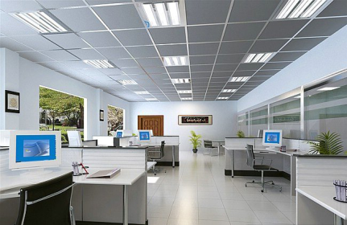

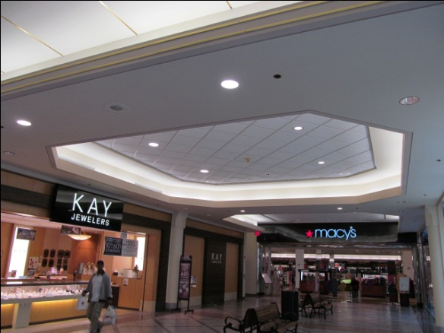

Use-Cases

Slide 52
802.15.7r1
Flexibility to deploy a range of more efficient PHY systems
Improved dimming support
Enhanced MAC
Support for greater security

Slide 53
Proof of Concept
Li-1st (http://vimeo.com/90128750)
  point-to-point, high speed, bidirectional, off-the-shelf lights
Li-Flame (http://youtu.be/TIAS8BxGe_8)
  high speed, bidirectional, networked and mobile wireless communications using light

Slide 54
Technical Principles
Optical OFDM
  - ACO-OFDM
  - DCO-OFDM
  - U-OFDM
  - …..

Slide 55
High Level Concepts
High speed
  - efficient use of Optical Bandwidth
Bidirectional
  - to alleviate spectrum
Networked & Mobile
  - user expectations of wireless technology
Secure & Safe
  - Privacy, Cybersecurity and EMI concerns

Slide 56

COST Action IC1101
Optical Wireless Communications
- An Emerging Technology
Gbit/s Optical Wireless PHY
- Joint contribution to IEEE 802 plenary tutorial -
V. Jungnickel, H. Haas, E. Ciaramella, M. Wolf, R. Green,
P. Haigh, Z. Ghassemlooy, V.P. Gill, T. Baykas, M. Uysal

Slide 57

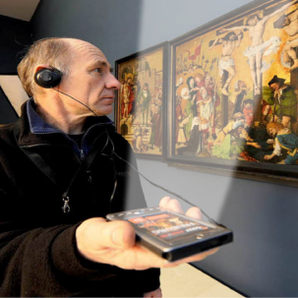
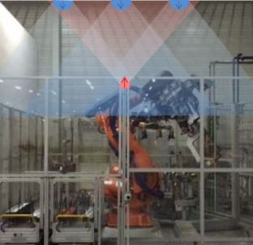



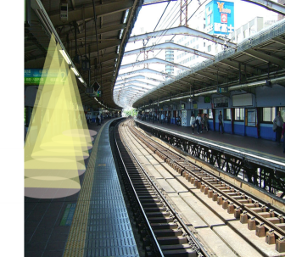


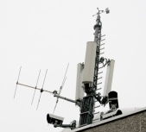
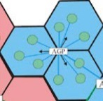

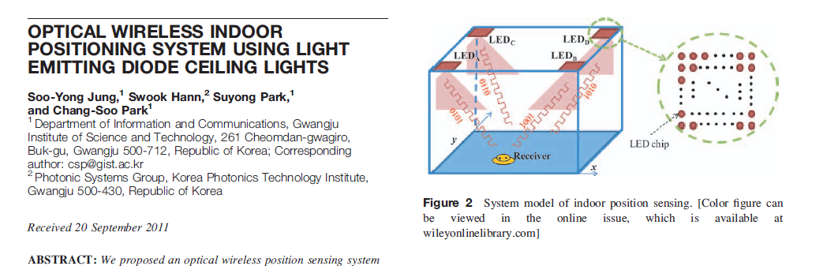

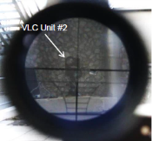
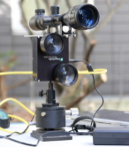
Use cases
IoT: Flexible Manufacturing
Conference Rooms
Private Households
In-flight Entertainment
Mass transportation
IoT: Car2Car, Car2Infra
Opt. Backhaul for
small cells in 5G
Augmented reality, hospitals, support for disabled people
Precise Indoor Positioning
Secure Wireless

Slide 58
Requirements
High speed: > 1 Gb/s per link
    Ultra-dense wireless scenarios, Short range (few meters), High spatial reuse
    Offload high traffic volumes to “private” optical wireless hot spots
Robustness: < 0.1 % outage in coverage area
    Seamless mobility support for heterogeneous wireless environments
    Multipoint multiuser support → positioning, low latency, handover, integration with WiFi
Low latency: < 1ms
    Short response time for the “Tactile Internet”
    Car-to-X, Industrial environments, Internet-of-things (IoT)
Precise positioning: < 10 cm
    Access points send specific beacon signals, terminals reply → time measurement
    Enhanced security support: Wireless communications near the user location only

Slide 59
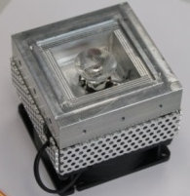
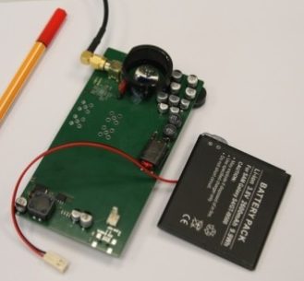
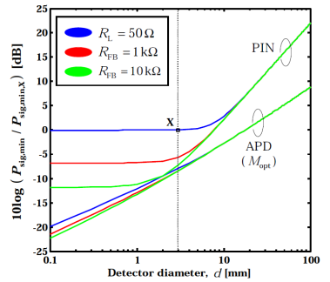
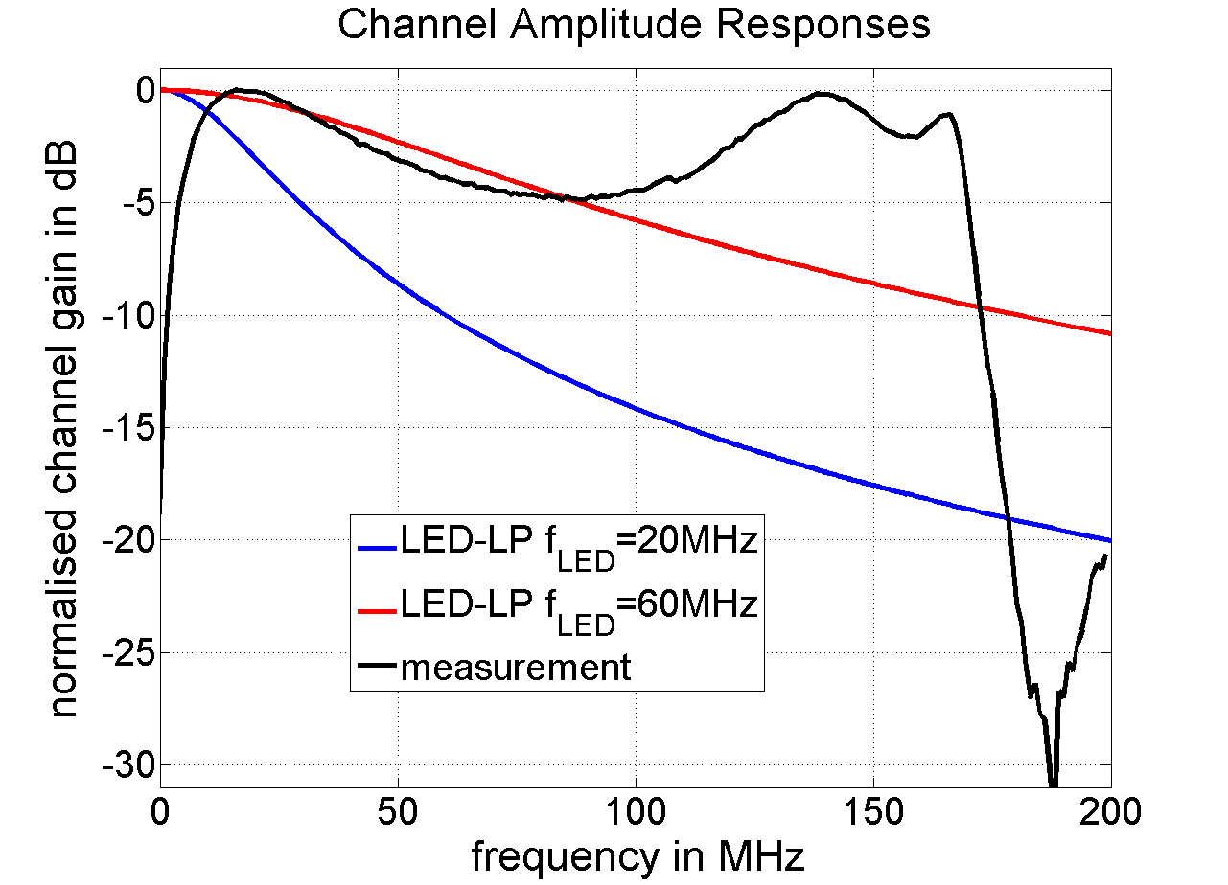
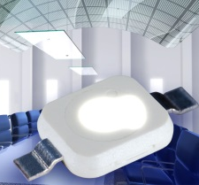


Research results
High-power LED Tx, low cost
Large-area silicon PD Rx, low cost
Large PD+TIA similar to APD
High SNR → high spectral efficiency
Broadband optical frontends:>100 MHz
Non-directed LOS+NLOS
Frequency-selective time-variant channel
Information theory suggests a multi-carrier system concept which needs adaptation to the channel

Slide 60







Key technical features
Rate-adaptive OFDM with feedback over reverse link
Clipping is controlled at fixed error rate (DCO): spectral efficiency
Asym. clipping (ACO), enh. unipolar OFDM: energy efficiency
MIMO, angular diversity transmitters and receivers
WDM (RYGB LED) to multiply data rates
Closed-loop bit-/power- loading, bit-interleaved FEC, HARQ
Cell-specific pilots for positioning, handover, interference coord.
DCO@10% clipping ratio: 2 dB to IM/DD capacity upper bound

Slide 61
Summary
Gbit/s optical wireless has many useful applications in WPAN and WLAN
  Car-to-X, machine-to-machine, WiFi backhaul, conference rooms → SOHO networks
  Augmented reality, indoor positioning, vertical and horizontal handover
  High-power LEDs and large-area silicon photodiodes are available at low cost
  High SNR, high spectral efficiency, >100 MHz bandwidth → Gbit data rates
Adaptive OFDM PHY is mature, other options are SC/FDE and M-CAP
Further performance improvements are possible through cooperation (relaying)
  Robust transmission in multipath and NLOS channels was demonstrated
  Up to 5 Gbit/s and some 100 Mbit/s were demonstrated over several meters using free LOS and diffuse reflections (NLOS), respectively
  Real-time demo with small form factor is available, onsite demo is planned

Slide 62











Supporters

Slide 63
Color Space Based Modulation and Color-Independent Visual-MIMO
California State University Sacramento Contribution
Soo-Young Chang
sychang@ecs.csus.edu

Slide 64

Generalized Color Modulation
(Color-Space Based Modulation)

Slide 65


Slide 66


Slide 67


Slide 68


Slide 69


Slide 70

Dimming Compatible and Spectrally Efficiency Modulation for VLC Lighting
Boston University Contribution
15.7r1 tutorial
IEEE802 meeting
Berlin, Germany
March 8-13, 2015
Hany Elgala & Thomas Little
Boston University
helgala&tdcl@bu.edu

Slide 71



Use Case: Downlink in VLC-Enabled Lighting
Network
VLC offloading WLAN and/or cellular traffic in a 3-tier HetNet
RF for uplink
Data aggregation in RF and/or optical
Seamless connectivity in a mobile multiuser access scenario
Gigabit applications while supporting (our use case):
  Illumination functionality
    Color tunable
    Dimmable
  High quality lighting
    CCR
    CRI
Router and WiFi AP
RF
Optical
User 1
Cell 1
Cell 2
We focus on dual-use (lighting and Communications)
Handover

Slide 72
Optical OFDM formats and constraints
Average
Peak
Optical
Power
-1 + 1i
Complex
Conjugate
IFFT
Bipolar DC biased optical OFDM (DCO-OFDM)
-1 - 1i
Peak
Dynamic Range
Average
Other unipolar formats, e.g.:
Flip OFDM (F-OFDM)
Unipolar OFDM (U-OFDM)
Position modulation OFDM (PM-OFDM)
Unipolar Asymmetric clipped optical OFDM (ACO-OFDM)

Slide 73
Why OFDM and SC-FDE?
High spectral efficiency; limited LED modulation bandwidth
Adaptive bit-loading per subcarrier; transmission impairments
Adaptive power allocation per subcarrier; transmission impairments
Fine granularity; network perspective
CP; multipath propagation causing ISI
Frequency-domain channel estimation and equalization; transmission impairments
Possibility to combine it with multiple access schemes; OFDMA
Availability of OFDM in existing signal processing/chipsets
Issue
Challenge
Alternative
LED non-linearity OFDM has high PAPR SC-FDE
How to efficiently transmit optical OFDM and SC-FDE while sustaining a bit-error performance over a large fraction of the dimming range?

Slide 74


Reverse polarity modulation (PWM+OFDM)
Existing solutions:
Superposition only during the PWM-”on”
OFDM signal sampling using the PWM
Average power reduction per OFDM symbol
Reverse polarity solution:
Continuous OFDM transmission
Example: 20% duty cycle @ 15dBm OFDM average power

Slide 75



Reverse polarity modulation simulation results and proof-of-concept setup
Simulation
Dimming vs. duty cycle; different average OFDM signal power
Experimental
Illuminance/dimming percentage vs. duty cycle; different average OFDM signal power/BER

Slide 76
Conclusion
Reverse Polarity Modulation:
  Linear dimming with conventional PWM from lighting industry
  Performance does not need to be reduced proportional to intensity
  Bit-error performance is sustained over a large fraction of the dimming range
  A practical approach; capacity is not limited by the PWM frequency
Enhanced ACO-OFDM (SEE-OFDM) and Polar Optical Transmitters:
  Improved spectral efficiency
  Effective PAPR reduction

Slide 77
Part 4: LED ID PHY

Slide 78
Seoul National University of Science & Technology Contribution
Jaesang Cha
chajs@seoultech.ac.kr

Slide 80
References
and
Backup Slides

Slide 81
Reverse Polarity modulation
Ali Mirvakili, Rahaim, Michael, Brandon, Valencia J Koomson, Hany Elgala and Thomas D. C. Little, " Wireless Access Test-bed through Visible Light and Dimming Compatible OFDM", the IEEE Wireless Communications and Networking Conference (WCNC 2015), March 09-12, 2015, New Orleans, LA, USA [to appear].
Hany Elgala and Thomas D. C. Little, "Reverse polarity optical-OFDM (RPO-OFDM): dimming compatible OFDM for gigabit VLC links", OSA Optics Express, Vol. 21, Issue 20, pp. 24288-24299, October 2013.
Thomas D. C. Little and Hany Elgala, "Adaptation of OFDM under Visible Light Communications and Illumination Constraints", the Asilomar Conference on Signals, Systems, and Computers, November 2-5, 2014, Pacific Grove, California [to appear].
Enhanced ACO-OFDM (SEE-OFDM)
H. Elgala and TDC Little, “SEE-OFDM: Spectral and Energy Efficient OFDM for Optical IM/DD Systems", the IEEE International Symposium on Personal, Indoor and Mobile Radio Communications (PIMRC 2014), September 2-5, 2014, Capital Hilton, Washington DC [to appear].
Polar transmitters (polar OFDM and polar SC-FDE)
Hany Elgala, Sarah Kate Wilson and Thomas D. C. Little, " Optical polar OFDM: on the effect of time-domain power allocation under power and dynamic-range constraints", the IEEE Wireless Communications and Networking Conference (WCNC 2015), March 09-12, 2015, New Orleans, LA, USA [to appear].
H. Elgala and TDC Little, "Polar-Based OFDM and SC-FDE Links towards Energy-Efficient Gbps Transmission under IM-DD Optical System Constraints", Journal of Optical Communications and Networking (JOCN), Volume 7, No. 2, 2014.
H. Elgala and TDC Little, "P-OFDM: Spectrally Efﬁcient Unipolar OFDM", the Optical Fiber Communication Conference and Exposition (OFC 2014), March 9-13, 2014, San Francisco, California.

Slide 82
Project: IEEE P802.15 Working Group for Wireless Personal Area Networks (WPANs)
Submission Title: [Interference Issue in Visible Light Communications]
Date Submitted: [January 23, 2015]
Source: [Chen Gong, Qian Gao, and Zhengyuan Xu]
[University of Science and Technology of China]
Address [443 Huangshan Rd, Hefei, Anhui, China]
Voice:[86-551-63603187], FAX: [86-551-63603995], E-Mail:[{cgong821,qgao, xuzy}@ustc.edu.cn]
Re: []
Abstract: [The interference issue in visible light communication is presented. Several solutions to either suppress the interference or cancel the interference are discussed.]
Purpose: [Contribution to IEEE 802.15.SG7 VLC]
Notice: This document has been prepared to assist the IEEE P802.15. It is offered as a basis for discussion and is not binding on the contributing individual(s) or organization(s). The material in this document is subject to change in form and content after further study. The contributor(s) reserve(s) the right to add, amend or withdraw material contained herein.
Release: The contributor acknowledges and accepts that this contribution becomes the property of IEEE and may be made publicly available by P802.15.

Slide 83

VLC with Multiple Transmitting LED
TX1
TX2
TX3
Signal
Signal
Signal
Interference
RX1
RX2
Multi-transmitter multi-receiver indoor visible light communication network

Slide 84
The Interference Issue
Performance degradation due to the interference:
  Received signal quality degrades
  Achievable rate decreases
  Need to find a solution for the interference management

Slide 85
Interference Suppression at the Transmitter
Add some blank subframes into the transmission signal frame
reduce the rate of the interfering user
alleviate performance degradation due to the interference
Interfering TX
interference
signal
Desired
TX
RX
all subframe with data
almost blank subframe,
interference suppression

Slide 86

Layered Transmission with Interference Cancellation
Receiver 3
(1, 1)
(1, 1)
(1, 1)
(1, 1)
(1, 2)
(1, 2)
Decode (2,1), (3,2)
Decode
(1,2), (4,1)
Decode
(3,1)
(2, 1)
(3, 1)
(3, 1)
(3, 1)
(3, 2)
(4, 1)
(4, 1)
Layered transmission at the transmitter
Successive decoding at the receiver

Slide 87
Conclusion
Interference due to multi-user visible light communication
Layer transmission with interference cancellation
  Frame coordination at the transmitter
  Interference suppression by successive decoding at the receiver

Slide 88
Project: IEEE P802.15 Working Group for Wireless Personal Area Networks (WPANs)
Submission Title: [Very High Dimensional Constellation Design for Multi-color VLC]
Date Submitted: [January 23, 2015]
Source: [Qian Gao, Chen Gong and Zhengyuan Xu]
[University of Science and Technology of China (USTC)]
Address [443 Huangshan Rd, Hefei, Anhui, China]
Voice:[86-63603995], E-Mail:[{qgao, cgong, xuzy}@ustc.edu.cn]
Re: []
Abstract: [A joint color-frequency modulation scheme is proposed. It utilizes multi-color optical channels to transmit data in color and frequency in parallel, in order to maximize energy efficiency.]
Purpose: [Adding another PHY to 15.7r1]
Notice: This document has been prepared to assist the IEEE P802.15. It is offered as a basis for discussion and is not binding on the contributing individual(s) or organization(s). The material in this document is subject to change in form and content after further study. The contributor(s) reserve(s) the right to add, amend or withdraw material contained herein.
Release: The contributor acknowledges and accepts that this contribution becomes the property of IEEE and may be made publicly available by P802.15.

Slide 89

Multi-color Visible Light Communication (MC-VLC)
(A Natural Step Towards Exploiting Full VL Band)
    With single color LEDs, due to IM/DD, only a small portion of the VL band is utilized, the bandwidth equals that of the RF baseband equivalent;
    However, all-optical VLC is expensive, manufacture of optical oscillators is not mature;
    Multi-color VLC, with RGB LEDs, or with > 3 color LEDs are necessary.

Slide 90


Big Data Needs
Fast Server
Fast Server Needs
Ultra-wide Band
Fig. in [1]. FSO bus for board-to-backplane interconnections in the presence of air turbulence.
[1]. R. Rachmaci and S. Arnon, `` Server backplane with optical wavelength diversity links’’, IEEE/OSA Journal of Lightwave Technology, Vol. 30, no. 9, pp. 1359 – 1365, May 2012.

Slide 91
Challenges of MC-VLC
Some challenges for modulation of MC-VLC System:
  Energy-efficiency Maximizing Modulation Schemes:
    It’s not optimal to apply, e.g. OFDM for each color channel;
    Color-shift Keying (CSK), requiring constant instantaneous sum intensity, is not optimal either;
  Channel specific modulation design or coding, e.g. air turbulence exists between the baud-to-backplane interconnections.

Slide 92



  What would Shannon suggest?
  Rethink about compactness of sphere packing in high dimension space (dimension=number of color channels used).
[2]. J. Karout, E. Agrell, K. Szczerba, and M. Karlsson, “Optimizing constellations for single-subcarrier intensity modulated optical systems,” IEEE Trans. Inf. Theory, vol. 58, no. 7, pp. 4645–4659, July 2012.

Slide 93
Design in a even higher dimensional space:
  Larger energy gain is expected;
  Hybrid the CSK and OFDM, towards a joint color-frequency modulation (JCFM);
  Generalize the CSK by relaxing the constant instantaneous sum intensity constraint, replaced by a fixed time average intensity constraint for each color channel;
  Challenge: complexity may increase significantly.

Slide 94

Fig.ure. Block diagram of Optical JCFM scheme, aiming at maximizing energy-efficiency.

Slide 95
Conclusion
  Multi-color VLC is suitable for board-to-backplane transmission with a big data server;
  Considering energy-efficiency, traditional OFDM or CSK schemes are not optimal;
  Frequency and color diversities are utilized jointly, and very high dimensional constellation can be designed to maximize energy-efficiency;
  Performance study on the new modulation scheme with air turbulence channel is necessary.

