Slide 1
Doc: IEEE 802.15-15-0082-00-0007
Project: IEEE 802.15.7r1 Optical Wireless Communication
Submission Title: [OWC Use Cases : LED Patch based Use Cases for Facility Signage]
Date Submitted: [16th Jan, 2015]
Source: [Jaesang Cha*, Ki Yun Kim**, Soo-Young Chang***, Yeong Min Jang ****,
Jae Kwon Shin *****]
[Seoul National Univ. of Science & Technology*, MyongJi College**, CSUS*** , KookMin University****,
Fivetek Co., Ltd.*****, ]
Address : [Seoul National University of Science & Technology, Seoul, Korea]
Voice: [82-2-970-6431], FAX: [82-2-970-6123], E-Mail:[chajs@seoultech.ac.kr]
Re: []
Abstract: [OWC Use Cases such as LED Patch based Use Cases for Facility Signage are introduced]
Purpose: [Contribution to IEEE 802.15.7r1 Optical Wireless Communication]
Notice: This document has been prepared to assist the IEEE 802.15. It is offered as a basis for discussion and is not binding on the contributing individual(s) or organization(s). The material in this document is subject to change in form and content after further study. The contributor(s) reserve(s) the right to add, amend or withdraw material contained herein.
Release: The contributor acknowledges and accepts that this contribution becomes the property of IEEE and may be made publicly available by IEEE 802.15.
Slide 1
Notes:
doc.: IEEE 802.15-09-0117-00-0007
<month year>

Slide 2
Contents
Doc: IEEE 802.15-15-0082-00-0007
LED Patch for Facility Signage
Examples of LED Patch based Facility Signage

Slide 3
Doc: IEEE 802.15-15-0082-00-0007
LED Patch for Facility Signage
Definition of LED Patch
Any thin type of LED tag/panel/signage components/devices
Attachable devices for any surface of object such as bodies, walls, etc.
Easily attachable devices to be used as signage solutions for various facilities
LED Patch for Facility Signage
LED Patch can be used as signage solutions for various facilities
LED Patch for Facility Signage is possible to provide a variety of services such as information guide tag, advertisement, promotion, etc.
Tx/Rx Concept for LED Patch for Facility Signage
Tx : pattern/blinking signals of LED
Rx : various Rx schemes (photo detector/camera image sensor)

Slide 4
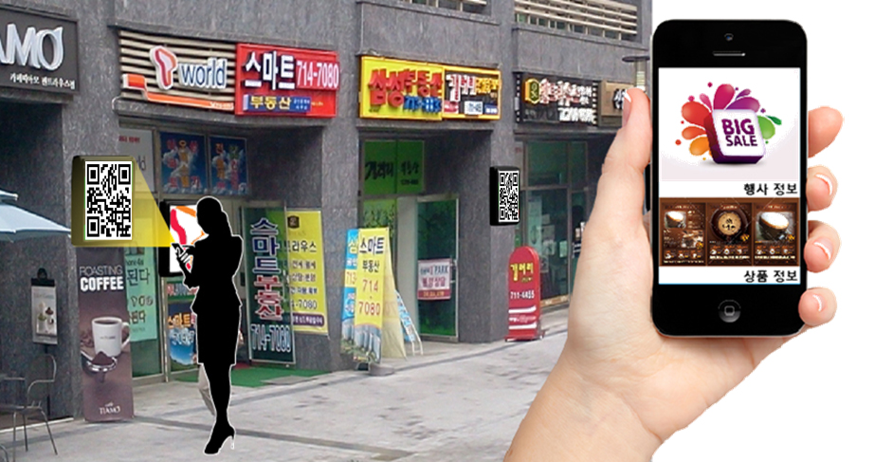
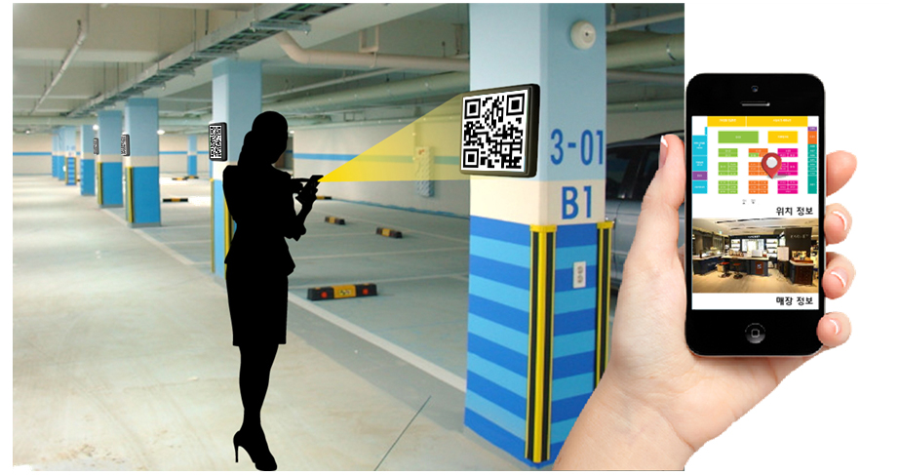
Doc: IEEE 802.15-15-0082-00-0007
Example #1 of LED Patch Based Facility Signage
LED Patch Examples for Store and Parking Facilities

Slide 5
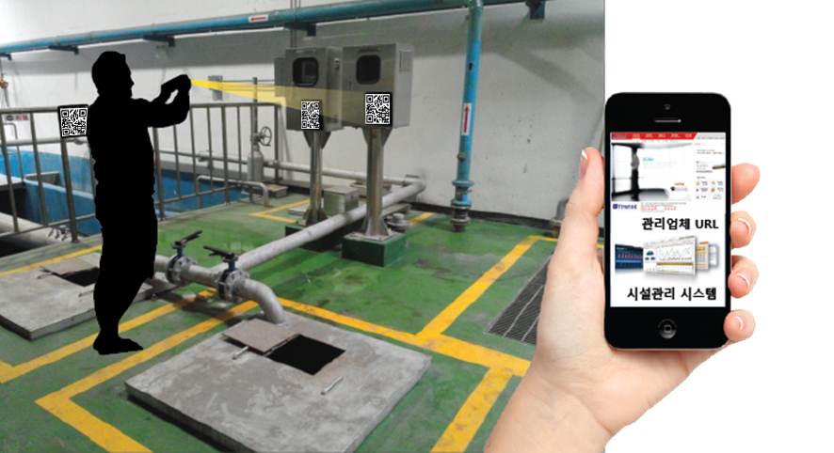
Doc: IEEE 802.15-13-0722-00-0led
Example #2 of LED Patch Based Facility Signage
Sensor Monitoring
LED Patch Example for Water and Sewage Facilities

