Slide 1
Project: IEEE P802.15 Working Group for Wireless Personal Area Networks (WPANs)
Submission Title: Reply to the comment about the protocol reference model at July 14th meeting
Date Submitted: 16 July, 2014
Source: Kiyoshi Toshimitsu, Seto Ichiro, Kenji Akiyama and Ken Hiraga
Company: Toshiba corporation, Toshiba corporation, Sony corporation and NTT corporation
Address: 1-1, Shibaura 1-Chome, Minato-ku, Tokyo Japan
Voice:+81-3-3457-3358, FAX: +81-3-5444-9323, E-Mail: kiyoshi.toshimitsu@toshiba.co.jp
Re: []
Abstract: This document describes the reply to the comment about the protocol reference model at July 14th meeting
Purpose: To discuss the protocol reference model
Notice: This document has been prepared to assist the IEEE P802.15. It is offered as a basis for discussion and is not binding on the contributing individual(s) or organization(s). The material in this document is subject to change in form and content after further study. The contributor(s) reserve(s) the right to add, amend or withdraw material contained herein.
Release: The contributor acknowledges and accepts that this contribution becomes the property of IEEE and may be made publicly available by P802.15.

Slide 2
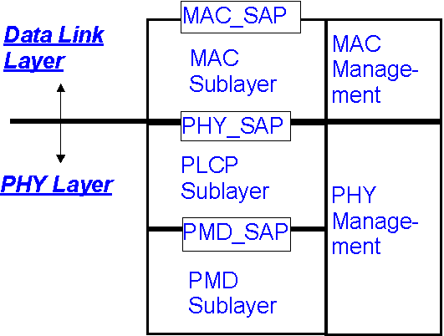
Current reference model
MAC_SAP: MAC Service Access Point
PHY_SAP: PHY Service Access Point
PLCP: PHY Layer Convergence Protocol
PHY Layer is divided into two sublayers.

Slide 3
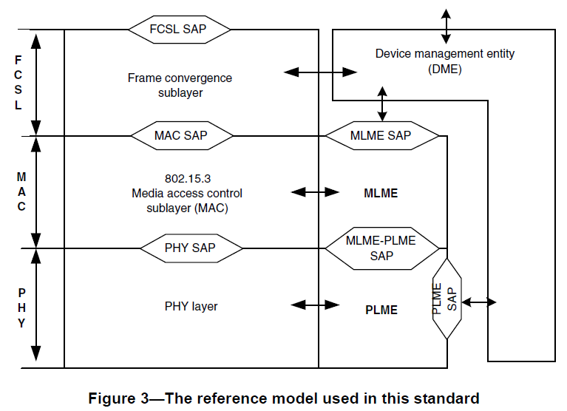
IEEE 802.15.3c reference model
IEEE802.15.3c-2009
Amendment to IEEE Std 802.15.3-2003
No replacement of Figure.3
IEEE802.15.3-2003

Slide 4
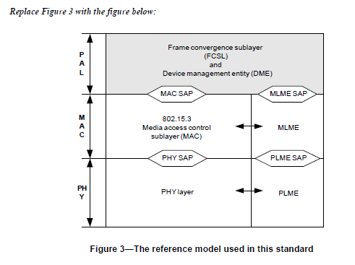
IEEE 802.15.3b reference model
IEEE802.15.3b-2005
Amendment to IEEE Std 802.15.3-2003
Replace Figure.3 with the figure below

Slide 5
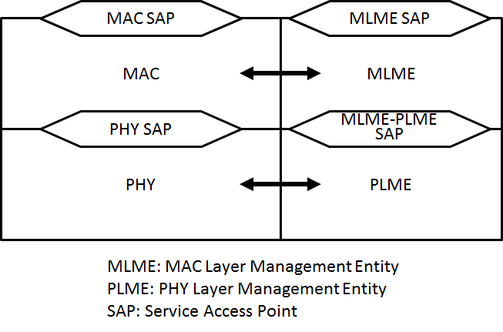
Proposal at July 14th meeting(doc.:IEEE15-14-0414-02-003d)
Start from simple reference model below using common parts of the previous reference models in 802.15.3c and 802.15.3b
Discussion about division of PHY layer should be done in the development phase of PHY and MAC specification.

Slide 6
In the case of start from current reference model
MAC_SAP: MAC Service Access Point
PHY_SAP: PHY Service Access Point
PLCP: PHY Layer Convergence Protocol
Discussion should be also done in the development phase
of PHY and MAC specification.

Slide 7
Conclusion
Protocol reference model should be discussed again in the development phase of PHY and MAC specification.

