Slide 1
doc.: IEEE 802-15-14-0438-00-007a
Project: IEEE P802.15 Working Group for Wireless Personal Area Networks (WPANs)
Submission Title: [Applications of OCC system]
Date Submitted: [July, 2014]
Source: [Yu Zeng, Nan Chi, Xiaoyuan Lu, Aiying Yang ]
[China Telecom, Fudan University, Shanghai Broadband Center, Beijing Institute of Technology]
Address [Beijing 100035, China]
Voice:[86-10-58552979], FAX: [86-10-58552979], E-Mail:[zengyu@ctbri.com.cn]
Re: []
Abstract: [Applications for Optical Camera Communication system]
Purpose: [Contribution to IEEE 802.15.SG7a OCC]
Notice: This document has been prepared to assist the IEEE P802.15. It is offered as a basis for discussion and is not binding on the contributing individual(s) or organization(s). The material in this document is subject to change in form and content after further study. The contributor(s) reserve(s) the right to add, amend or withdraw material contained herein.
Release: The contributor acknowledges and accepts that this contribution becomes the property of IEEE and may be made publicly available by P802.15.
Notes:
doc.: IEEE 802.15-09-0117-00-0007
<month year>

Slide 2
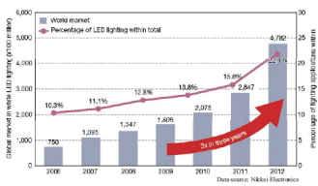
doc.: IEEE 802-15-14-0438-00-007a
OCC Overview
LED lighting in the global market
Target of OCC applications:
Extend next generation broadband communication frequency for better resource utilization
Work closely with lighting and display industry, bring unique advantages for communication
By 2018，Semiconductor lighting adaption rate will reach 80%，OCC can take off with this basis.
2

Slide 3
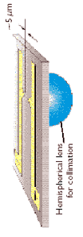
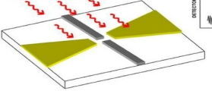
doc.: IEEE 802-15-14-0438-00-007a
    System Structure
Light Source
Channel
Receiver
Tx Module
Rx Module
Demodulator
I
Decoder
AD
Phase
Coding
Modulation
Pre-equalization
AD
LED
PIN
Q
Baseband
De-coding
De-modulation
Post-equalization
Data
transmitter：
  electrical：LED driver，electronic DSP (coding，modulation，pre-equalization),
  optical：LED chip，optical transmission antenna
receiver：
  optical：optical receiver antenna，detection chip
  electronic：receiver DSP(decoding，de-modulation，post-equalization)

Slide 4
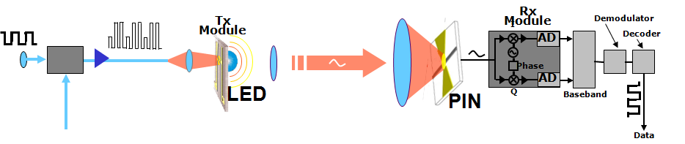
doc.: IEEE 802-15-14-0438-00-007a
    System limitation
Electronic
Optical
Current Work
Current LED and PIN，single VLC system speed x distance become barrier！
Electronic improvements pushed to limit，only revolutions on LED and PIN hardware, can lift limitations

Slide 5
Comparison for geometry
doc.: IEEE 802-15-14-0438-00-007a
Research Target：
Mid-low speed applications：
application scenario and industry push；
OCC scenario study，standardization。
High speed applications：
Push very high speed application barrier；
LiFi and WiFi coordination；

Slide 6
Systematic Plan
doc.: IEEE 802-15-14-0438-00-007a
System Requirement Analysis
OCC based application business model analysis，common technology requirements for case study and standardization，application report；
Key Technique Study
Design OCC based system and possible combination with 802.11 WLAN system structure
802.15 based high resolution indoor navigation and positioning system, short range mid-low speed communication system solution；

Slide 7
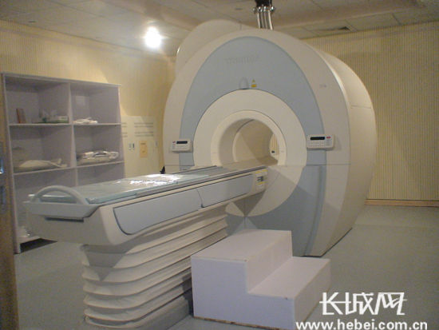
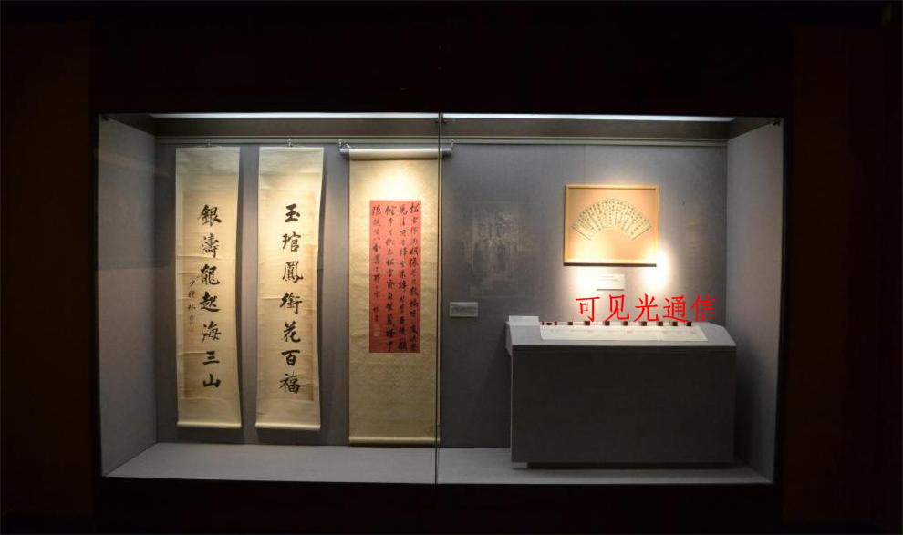
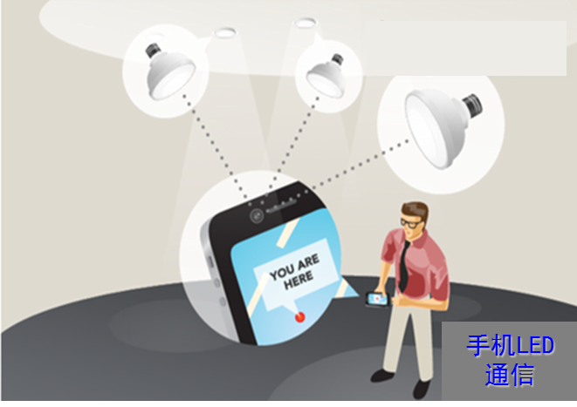
OCC applications
doc.: IEEE 802-15-14-0438-00-007a
Medical：GE health care
Mobile Manufactures
Ready case：Shanghai Museum
Marine Communication
核磁共振

Slide 8
OCC positioning
doc.: IEEE 802-15-14-0438-00-007a
TOA
TDOA
RSS
AOA
Techniques | Reference points | resolution | dimension | Complexity hardware/software
TOA | 3 | cm | 2D | high/medium
TDOA | 3 | cm | 2D | high/medium
RSS | 3 | cm | 2D/3D | low/medium
AOA | 2 | cm | 3D | high/medium
TOA (time of a rrival) TDOA(time difference of arrival) RSS (Received Signal Strength) AOA(Angle of Arrival)

Slide 9
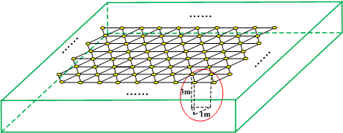
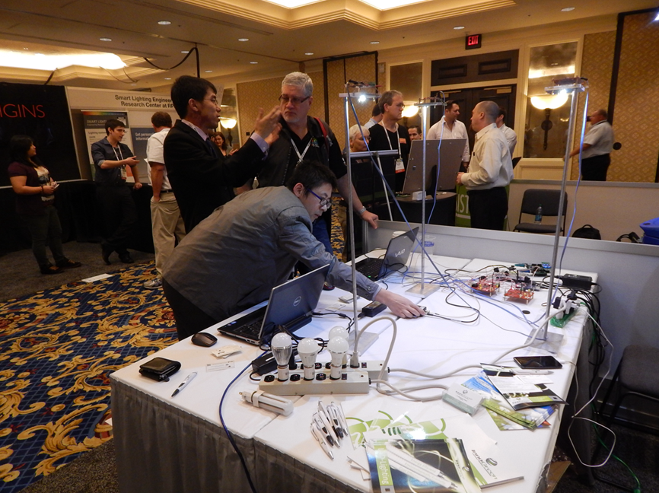
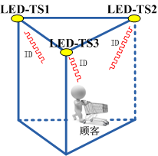
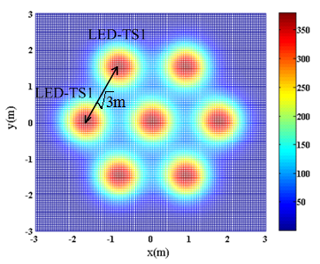
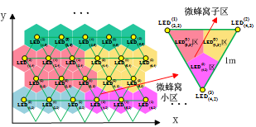
OCC positioning
doc.: IEEE 802-15-14-0438-00-007a
2014 CES
CDMA+TDMA
1m
3m
CMOS Camera RSS

Slide 10
OCC positioning
doc.: IEEE 802-15-14-0438-00-007a
China Telecom Smart Building Project (Hunan City branch)：
High Seed Internet
3 AP，500M² Office area，50 Terminal
Shopping Center Message push
2 Screen，APP download
Indoor Positioning in Supermarket
1000M²supermarket，500 lamp，trolley

