Slide 1
Project: IEEE P802.15 Working Group for Wireless Personal Area Networks (WPANs)
Submission Title: [IG 6tisch Closing Report for May 2014 Session]
Date Submitted: [16 May 2014]
Source: [Patrick Kinney] Company [Kinney Consulting LLC]
Address [Chicago area, IL, USA]
Voice:[+1.847.960.3715], E-Mail:[pat.kinney@ieee.org]
Re: [IG 6tisch Closing Report for May 2014 Session.]
Abstract: [Closing Report for the May Session]
Purpose: []
Notice: This document has been prepared to assist the IEEE P802.15. It is offered as a basis for discussion and is not binding on the contributing individual(s) or organization(s). The material in this document is subject to change in form and content after further study. The contributor(s) reserve(s) the right to add, amend or withdraw material contained herein.
Release: The contributor acknowledges and accepts that this contribution becomes the property of IEEE and may be made publicly available by P802.15.

Slide 2
Meeting Goals (Agenda 15-14-0267-00)
SC Maintenance
Thursday 20 Mar, PM2: Status and Review of IETF 6TiSCH and issue discussion
Slide 2
Notes:
May 14
Page 2

Slide 3
IETF 6tisch Goal
The 6tisch Working Group is focused upon enabling IPv6 over the TSCH mode of the IEEE802.15.4e standard. The extent of the problem space for the WG is one or more Low Power and Lossy Networks (LLNs), eventually federated through a common backbone link via one or more LLN Border Routers (LBRs).
Work Item 1: Produce "6TiSCH architecture" to describe the design of 6TiSCH networks. This document will highlight the different architectural blocks and signaling flows, including the operation of the network in the presence of multiple LBRs. Initially, the document will focus on distributed routing operation over a static TSCH schedule.
Work Item 2: Produce an Information Model containing the management requirements of a 6TiSCH node. This includes describing how an entity can manage the TSCH schedule on a 6TiSCH node, and query timeslot information from that node. A data model mapping for an existing protocol (such as Concise Binary Object Representation (CBOR) over the Constrained Application Protocol (CoAP)) will be provided.
Work Item 3: Produce "Minimal 6TiSCH Configuration" defining how to build a 6TiSCH network using the Routing Protocol for LLNs (RPL) and a static TSCH schedule. It is expected that RPL and the Objective Function 0 (OF0) will be reused as-is.
Slide 3
Notes:
May 14
Page 3

Slide 4
IG 6T Accomplishments
TSCH overview: IEEE Std.802.15.4e-2012, I.2
6tisch overview
Focus presentations on 6tisch terminology
Terminology in IPv6 over the TSCH mode of IEEE 802.15.4e draft-ietf-6tisch-terminology-01(2/13/2014)
draft-ietf-6tisch-terminology-01 (2/28/2014)
IPv6 over the TSCH mode of IEEE 802.15.4e (4/25/2014)
Slide 4
Notes:
May 14
Page 4

Slide 5
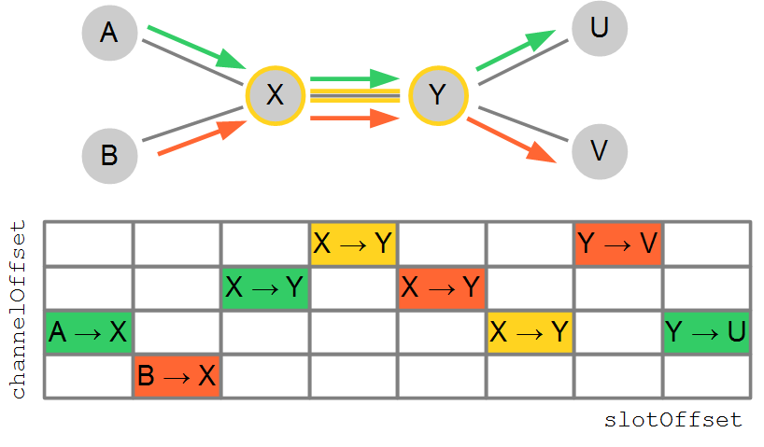
Basic 6TiSCH terminology example
Slotframe
TSCH schedule
Cell (scheduled, unscheduled, soft, hard)
Bundle
Track
draft-ietf-6tisch-terminology-01

