Slide 1
Doc: IEEE 802.15-14-0055-00-007a
Project: IEEE 802.15.7a (OCC)
Submission Title: [Technical Topics for LED based OCC]
Date Submitted: [21th Jan, 2014]
Source: [Jaesang Cha, SangWoon Lee]
[Seoul National Univ. of Science & Technology,
Nam Seoul Univ.]
Address : [Seoul National University of Science & Technology, Seoul, Korea]
Voice: [82-2-970-6431], FAX: [82-2-970-6123], E-Mail:[chajs@seoultech.ac.kr]
Re: []
Abstract: [Technical Topics for LED based OCC are introduced in the presentation.]
Purpose: [Contribution to IEEE 802.15.7a Optical Camera Communication]
Notice: This document has been prepared to assist the IEEE 802.15. It is offered as a basis for discussion and is not binding on the contributing individual(s) or organization(s). The material in this document is subject to change in form and content after further study. The contributor(s) reserve(s) the right to add, amend or withdraw material contained herein.
Release: The contributor acknowledges and accepts that this contribution becomes the property of IEEE and may be made publicly available by IEEE 802.15
Slide 1
Notes:
doc.: IEEE 802.15-09-0117-00-0007
<month year>

Slide 2
Contents
Doc: IEEE 802.15-14-0055-00-007a
LED Tag & ID information Recognition by Camera
LED Tag & Camera Positioning Techniques
LED Tag & Smart Phone Camera based
Object Tracking & Facilities Monitoring
Data Transmission by Smart Phone Components
(LED Flash Light, RF module, Camera etc.)

Slide 3
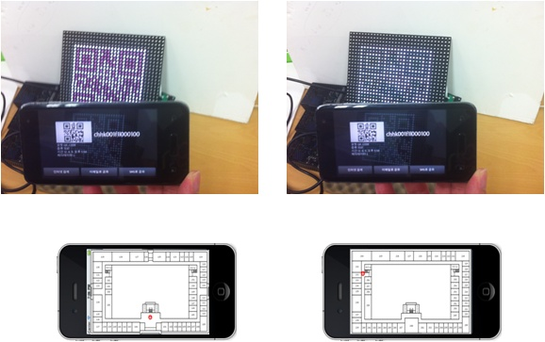
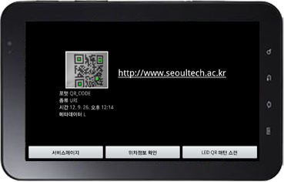
Doc: IEEE 802.15-14-0055-00-007a
LED Tag & ID information Recognition by Camera
Tx : LED Tag ( e.g. LED QR-Board)
Rx : Smart Phone Camera

Slide 4
Doc: IEEE 802.15-14-0055-00-007a
LED Tag & ID information Recognition by Camera
LED Tag of Display & Signage
Information
Tx : LED Tag of Lighting Sources(Display, Signage etc.)
Rx : Smart Phone Camera

Slide 5
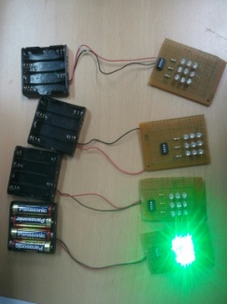
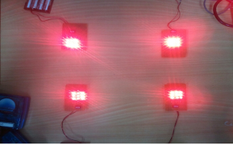
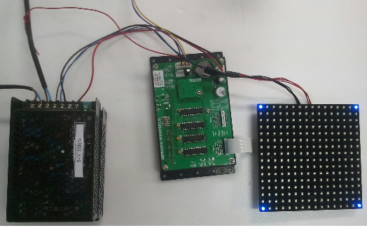
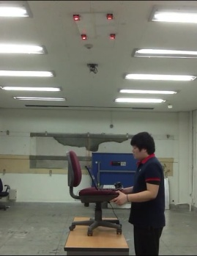
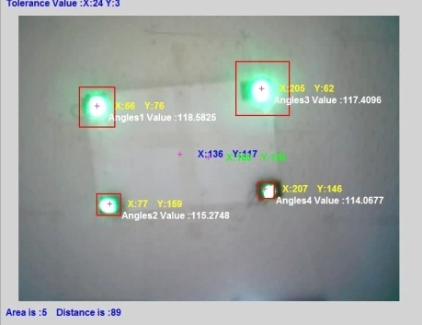
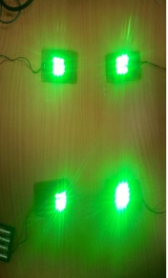
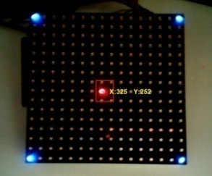
Doc: IEEE 802.15-14-0055-00-007a
LED Tag &Camera Positioning (CamPo) Technology
(LED lighting source and controller configuration for experiments of Indoor CamPo)
LED Tag or lighting Source : Positioning Information offering
Camera (e.g. Smart Device Camera) & App ; Positoning Data Acquisition
Slide 5

Slide 6
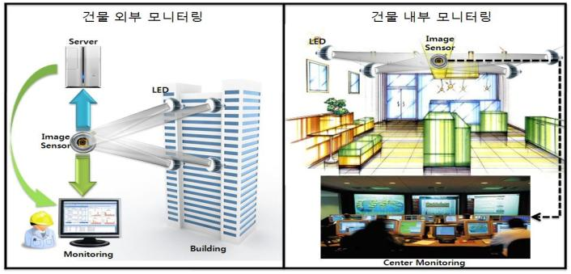
Jan 2014
Doc: IEEE 802.15-14-0055-00-007a
LED Tag & Smart Phone Camera based
Object Tracking & Facility Monitoring
Outdoor Building monitoring
Indoor Building monitoring
Outdoor Building monitoring
Indoor Building monitoring
Object (Light Tag) tracking using Camera Sensor & Moving light
LED Tag & Camera based Facility( e.g. Building ) monitoring
Slide 6

Slide 7
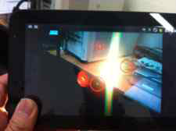
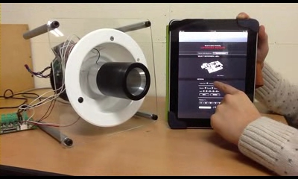
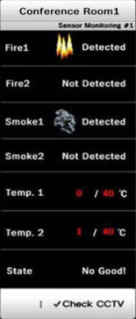
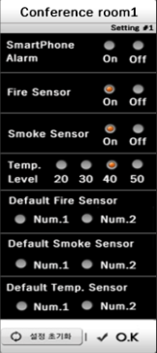
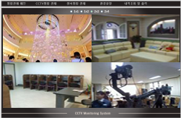
Jan 2014
Doc: IEEE 802.15-14-0055-00-007a
LED Tag & Smart Phone Camera based
Object Tracking & Facility Monitoring
Object (Light Tag) tracking using Camera Sensor & Moving light
Smart Device based Controller implementation
Slide 7

Slide 8
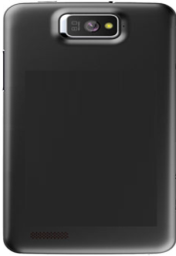
Doc: IEEE 802.15-14-0055-00-007a
Data Transmission by Smart Phone Components
Tx module: LED light
Rx module: Smart device Camera
Jaesang Cha, Seoul National Univ. of Science&Tech.

Slide 9
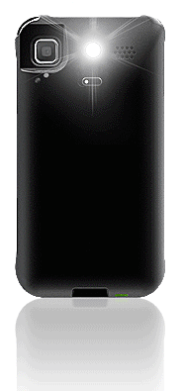
Doc: IEEE 802.15-14-0055-00-007a
Data Transmission by Smart Phone Components
RF : 3G/LTE, Wi-Fi, Blue-tooth etc.
LED communication
- Tx module: Smart Phone LED flash
- Rx module: Smart Phone Camera
RF + LED Com.
Smart Device LED Flash
Smart Device Camera
Hybird Tx: Smart Phone LED flash &/or RF (3G/LTE, Wi-Fi, Blue-tooth etc.)
Hybrid Rx : Smart Phone Camera &/or RF (3G/LTE, Wi-Fi, Blue-tooth etc.)
Jaesang Cha, Seoul National Univ. of Science&Tech.

Slide 10
Doc: IEEE 802.15-14-0055-00-007a
Data Transmission by Smart Phone Components
Smart Device LED Flash
Smart Device Camera
Tx module: LED flash of Smart Device(Phone/PAD)
Rx module: Camera module of Smart Device(Phone/PAD)
Jaesang Cha, Seoul National Univ. of Science&Tech.

Slide 11
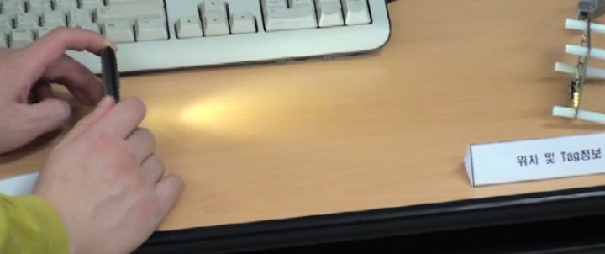
Doc: IEEE 802.15-14-0055-00-007a
Data Transmission by Smart Phone Components
LED flash Light Smart phone
Data recovery by PD
Tx module : LED flash light of Smart Devices
Rx module: PD

Slide 12
Doc: IEEE 802.15-14-0055-00-007a
Conclusion
We presented several technical topics & our research results for LED based OCC
Presented topic examples are mainly focused on LED-ID Tag & Smart Phone Camera applications.
Furthermore, more various technical topics will be studied for amendment of IEEE 802.15.7a

