Slide 1
Project: IEEE P802.15 Working Group for Wireless Personal Area Networks (WPANs)
Submission Title: Chinese Radio Regulation Discussion
Date Submitted: May 13, 2013
Source: Liang Li, Vinno; Arthur Astrin, Astrin Radio; Andy Bottomley, MicroSemi; Ken Mori; Panasonic.
Suite 202, Building D, No.2 Xinxi Lu, Beijing, China,
Voice: 1-949-813-7909, FAX: 1-949-813-7909,
E-Mail: liangli@vinnotech.com
Abstract: Tech Proposal for TG4n(MBAN) Task Group
Purpose: Outline accomplishments from the March 2012 meeting and planned tasks for this meeting.
Notice: This document has been prepared to assist the IEEE P802.15. It is offered as a basis for discussion and is not binding on the contributing individual(s) or organization(s). The material in this document is subject to change in form and content after further study. The contributor(s) reserve(s) the right to add, amend or withdraw material contained herein.
Release: The contributor acknowledges and accepts that this contribution becomes the property of IEEE and may be made publicly available by P802.15.

Slide 2
General View
This presentation summarizes the discussion around Chinese Radio Regulation:
15-12-0105-01-004n-Translation of
This major issues are
The spurious radiation emission on different bands
The bandwidth between spurious radiation and out of band radiation
The radiation power at upper/lower band limits.

Slide 3
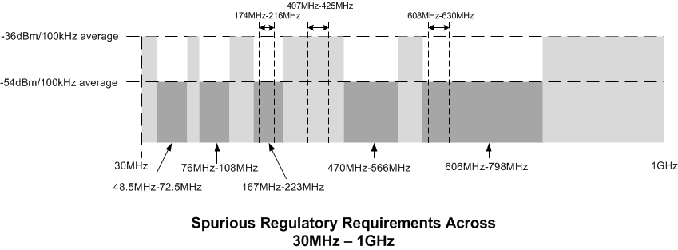
Chinese Medical Band Spectral Mask

Slide 4
Chart Explanation
Transmitter in transmission state at the maximum power the spurious power level should be:
Frequency range | Test bandwidth | Limit | Detection method
30MHz-1GHz | 100kHz (3dB) | －36dBm | Effective value
1GHz-40GHz | 1MHz (3dB) | －30dBm | Effective value
>40GHz | 1MHz (3dB) | －20dBm | Effective value
Transmitter in standby or idle state, the spurious power level should be:
Frequency range | Test bandwidth | Limit | Detection method
30MHz-1GHz | 100kHz(3dB) | －47dBm | Quasi-peak
>1GHz | 1MHz(3dB)

Slide 5
Chart Explanation
The spurious radiation emission of any Transmitter, in 48.5MHz-72.5MHz, 76MHz-108MHz, 167MHz-223MHz, 470MHz-566MHz or 606MHz-798MHz bands, should be less than -54dBm/100KHz

Slide 6
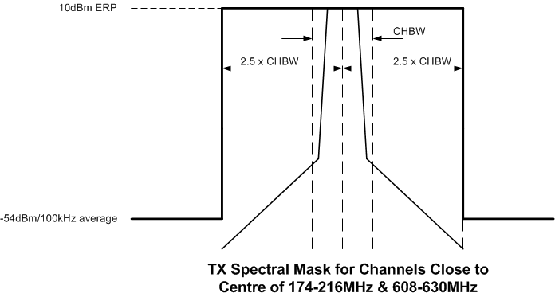
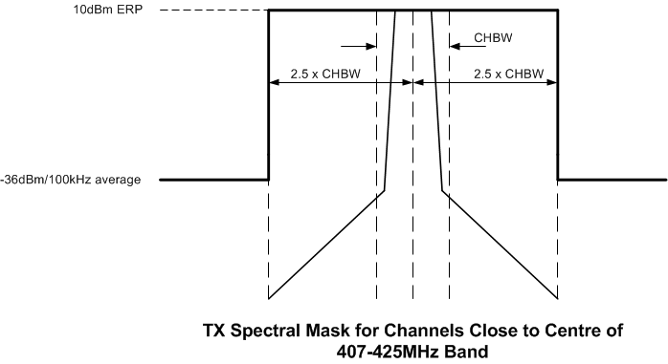
Chinese Medical Band Spectral Mask

Slide 7
Chart Explanation
CHBW: Channel Bandwidth.
2.5 x CHBW:
Spurious radiation emission limits (the demarcation between spurious radiation and out of band radiation is the bandwidth, which is ±2.5 multiple of operation channel band on carrier frequency)
Effective Value (EV):
Effective Value = Average Value

Slide 8
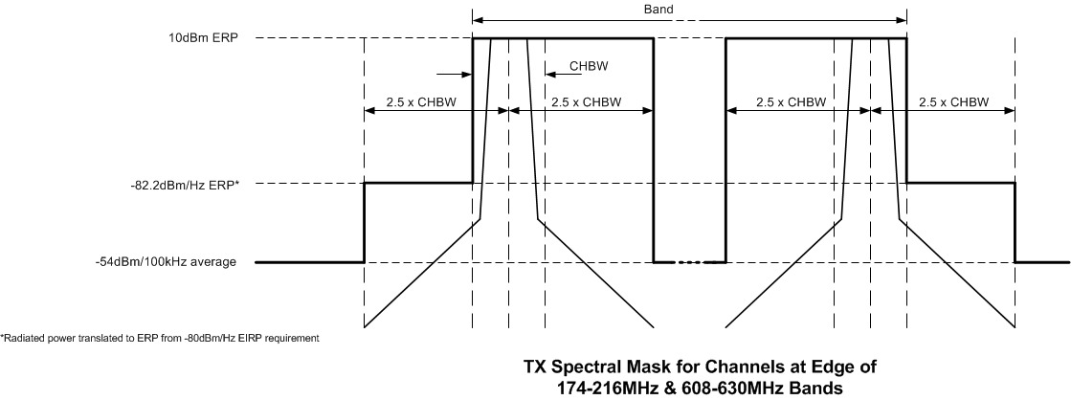
Chart Explanation

Slide 9
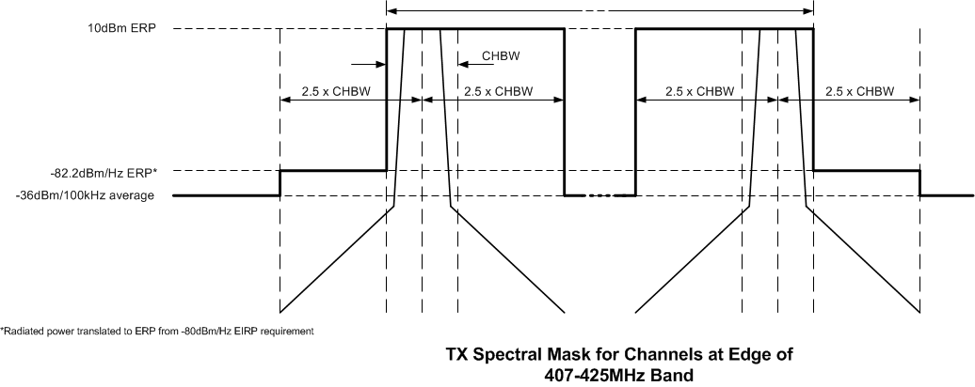
Chart Explanation

Slide 10
Chart Explanation
In any Transmitter state (max, idle or standby), for the frequency bands above 30 MHz, the radiation power at the upper/lower limits of the specified working frequency is no more than －80dBm/Hz (EIRP)
The upper/lower limits are (176, 214), (407, 425) and (608, 630) for Chinese medical bands.
-80dBm/Hz (EIRP) is equal to -82.2dBm/Hz (ERP)

