Slide 1
Project: IEEE P802.15 Working Group for Wireless Personal Area Networks (WPANs)
Submission Title: [A Use Case of Self-Organizing Wireless Network for Medical System]
Date Submitted: [13 May, 2013]
Source: [Shoichi Kitazawa] Company [ATR ]
Address [2-2-2 Hikaridai Seika, Kyoto 619-0288 Japan]
Voice:[+81-774-95-1511], FAX: [+81-774-95-1508], E-Mail:[kitazawa@atr.jp]
Re: []
Abstract: [This presentation proposed a use case of self-organizing wireless networks for medical system]
Purpose: [For discussion.]
Notice: This document has been prepared to assist the IEEE P802.15. It is offered as a basis for discussion and is not binding on the contributing individual(s) or organization(s). The material in this document is subject to change in form and content after further study. The contributor(s) reserve(s) the right to add, amend or withdraw material contained herein.
Release: The contributor acknowledges and accepts that this contribution becomes the property of IEEE and may be made publicly available by P802.15.

Slide 2
A Use Case of Self-Organizing Wireless Network for Medical System
Authors:

Slide 3
Contents
Motivations
An example of medical information system
Proposed system

Slide 4
Motivations
Various wireless systems are in operation in medical environments.
Requirements for the medical systems includes efficient radio resource utilization, scalability and ease of set-up.
Considering the requirements, self organizing wireless system is desired.

Slide 5
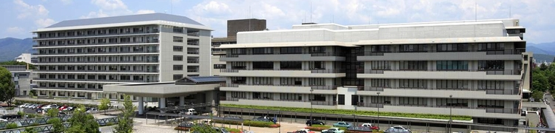
An Example of Medical Information System
Huge wireless medical information system throughout a hospital is employed
Kyoto University Hospital

Slide 6

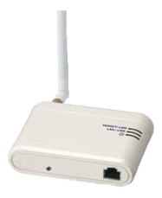


Scale of the Medical Information System
Prescription check system
1,500 Bluetooth barcode readers
Medical device network
system (experimental)
Outpatients navigation
system
600 Bluetooth access points (BT-AP)
Medical devices
2,700 Bluetooth navigation tablets
1,100 Bluetooth identification beacon
(BT-ID)
WiFi WLAN system
Database
1,000 Laptop PC
650 WiFi access points

Slide 7
Problems and Proposed Solutions
Problems
Hard to build and operate large scale wireless networks of autonomously operated devices.
Proposed solutions
Self-organizing wireless system
Spectrum sensing of whole band for searching vacant radio resources
Radio resource assignment and network topology management

Slide 8
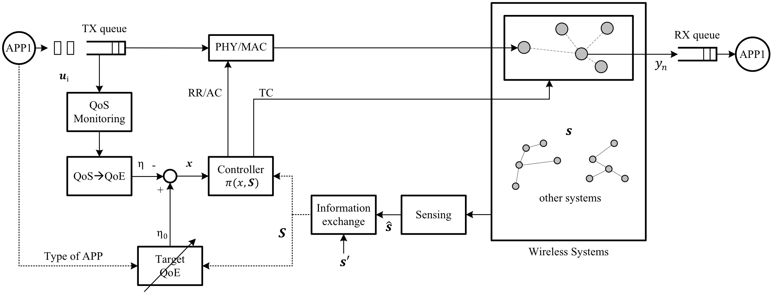
Architecture of Proposed System
Shares limited radio resources with various applications
Controls dynamically based on QoE
  The parameters of QoE f(x): data rate, latency, BER, priority, subjective assessment (i.e., mean opinion score)
TX
Wireless Communication environment
RX
TX Control
Measuring QoE from TX buffer
Difference of 2 QoEs
Topology Control
Radio resource information
estimated QoE
Target QoE
Guess QoS from Spectrum Sensing
QoE bases control
RR: Radio resource assignment, AC: Access control, TP: Topology control

Slide 9
Conclusions
Our proposed system is suitable for efficient use of spectrum resources in the medical environment.
This work is supported by the Ministry of Internal Affairs and Communications under a grant entitled "Research and development of dynamic reconfigurable M2M wireless network technology."

Slide 10
References
[1] Conceptual proposal of autonomously distributed wireless system based on dynamic multi-layer control for fair satisfaction of QoE, IEEE802.15-12/0603r1

