Slide 1
Project: IEEE P802.15 Working Group for Wireless Personal Area Networks (WPANs)
Submission Title: Large Volume ULP Applications
Date Submitted: 18 March 2013
Source: Ed Callaway; Company: Sunrise Micro Devices, Inc.
Address: 9181 Glades Road, Suite 125, Boca Raton, Florida 33434-3941, USA
Voice: +1-954-608-7537; E-Mail: ed@sunrisemicro.com
Source: David Flynn; Company: ARM, Ltd.
Address: 110 Fulbourn Road, Cambridge, GB-CB1 9NJ, Great Britain
Voice: +44 7747 482417; E-Mail: david.flynn@arm.com
Abstract: Description of large-volume ULP applications suitable for IEEE 802.15.4q.
Purpose: Response to 15.4q Call for Applications, doc.: IEEE 802.15-12-0685-01-004q.
Notice: This document has been prepared to assist the IEEE P802.15. It is offered as a basis for discussion and is not binding on the contributing individual(s) or organization(s). The material in this document is subject to change in form and content after further study. The contributor(s) reserve(s) the right to add, amend or withdraw material contained herein.
Release: The contributor acknowledges and accepts that this contribution becomes the property of IEEE and may be made publicly available by P802.15.

Slide 2
The Real Task Before Us Today
TG4q needs to identify a large market that cannot be met by even the most aggressive implementations of existing 15.4 standards.
If existing standards will do, people will use them for those applications.
Many of the applications presented to date do not pass this test.

Slide 3
The Smart Active Label
One application that does pass this test – a large, unmet market needing a ULP standard – is the so-called Smart Active Label, an active shipping label used to track packages and report status in real time.

Slide 4
A Smart Active Label
+
Conductive
Ink Antenna
Paper Battery
IC
-

Slide 5
Smart Active Label Volume
On an average day –
UPS delivers 15.8 million packages
FedEx delivers 3.3 million packages
USPS delivers 0.7 million packages
. . . or almost 20 million packages per day.
. . . And with increasing online sales, these numbers are increasing.

Slide 6
15.4q is Needed!
The Smart Active Label industry consortium (Wayback Machine ), is now inactive – due to lack of a low-cost, ULP technology.

Slide 7
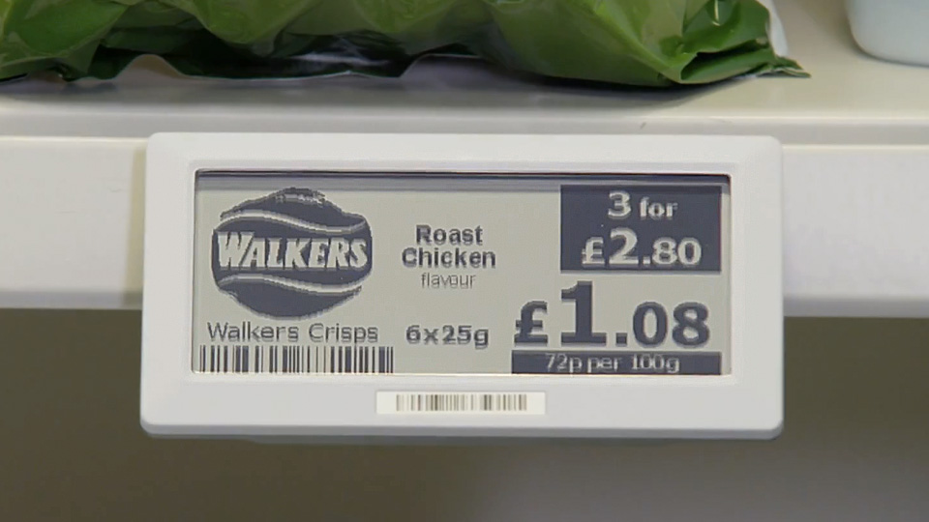
Shelf Labels
Store shelf labels represent another billion-unit opportunity, using similar technology

Slide 8
Summary
Smart Active Labels – for shipping and store shelves – represent a large, unmet market need ideal for 15.4q.

