Slide 1
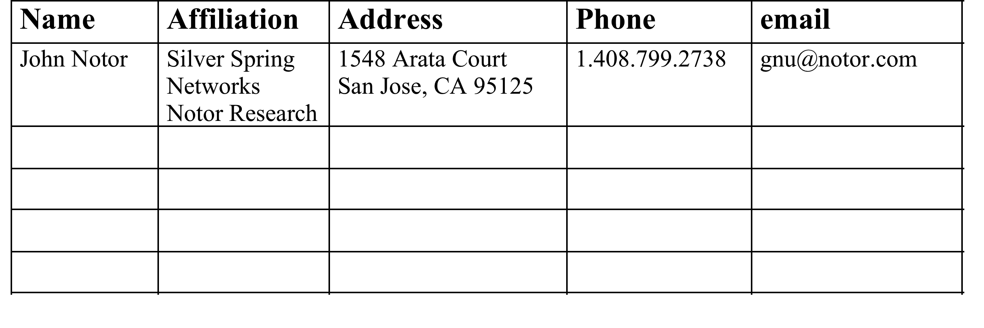
Liaison Report from 802.18
Date: November 15, 2012
Notice: This document has been prepared to assist IEEE 802.15. It is offered as a basis for discussion and is not binding on the contributing individual(s) or organization(s). The material in this document is subject to change in form and content after further study. The contributor(s) reserve(s) the right to add, amend or withdraw material contained herein.

Slide 2
Overview
This document summarizes the activities of the IEEE 802.18 Radio Regulatory Technical Advisory Group (RR-TAG) during the IEEE 802 January 2013 Interim Meeting at the Hyatt Regency Vancouver, Vancouver BC Canada.

Slide 3
FCC Documents Reviewed and Approved by the RR-TAG
The IEEE 802.16 WG drafted an update for external organizations, including the FCC, on the status of P802.16.3, which will be submitted to the EC for a 5 day review.
802.16 P802.16.3 Update.

Slide 4
ITU-R Documents from 802.16 Reviewed and Approved by the RR-TAG
The RR-TAG approved the following document from 802.16 for EC 5 day review and submission to ITU-R WP 5D:
18-12/118r4, “Draft LS to WP 5D: Comments on Working Doc toward a PDNR on the use of IMT for broadband PPDR”. Link: 18-12/118r4

Slide 5
802 Response to the 3.5 GHz NPRM
The RR-TAG worked with 802.11 and 802.22 to draft preliminary comments to the FCC 3.5 GHz NPRM.
The FCC NPRM can be found here: 3.5 GHz NPRM
The current draft comments can be found here: 3.5 GHz Comments
Work on this document will continue with teleconferences as follows:
Dates: Thursdays, January 24, January 31, and February 7.
Starting Times: 3 PM Pacific, 4 PM Mountain, 5 PM Central, and 6 PM Eastern.
Duration: 2 hrs.
The goal is to produce comments for review in a 10 day EC ballot, and submission to the FCC on or before February 20, 2013.

Slide 6
802 Reply Comments to the FCC TV Band Incentive Auction
IEEE 802 has produced comments to this NPRM, which will be filed with the FCC
The reply comment period ends on March 12, 2013, which is in the week before the IEEE 802 Plenary in Orlando in March.
The goal is to produce reply comments for this proceeding during teleconferences on TBD dates which will be reviewed by the EC during a 10 day ballot and submitted to the FCC.

