Slide 1
Project: IEEE P802.15 Working Group for Wireless Personal Area Networks (WPANs)
Submission Title: Detail Summary of Interference on Chinese Medical Bands
Date Submitted: August 12, 2012
Source: Ning Li, Shu Tul BUPT, Liang Li, Liang Zhang Vinno;
Suite 202, Building D, No.2 Xinxi Lu, Beijing, China,
Voice: 1-914-333-9687, FAX: 1-914-332-0615,
E-Mail: liangli@vinnotech.com
Abstract: Opening report for TG4n(MBAN) Task Group
Purpose: Outline accomplishments from the March 2012 meeting and planned tasks for this meeting.
Notice: This document has been prepared to assist the IEEE P802.15. It is offered as a basis for discussion and is not binding on the contributing individual(s) or organization(s). The material in this document is subject to change in form and content after further study. The contributor(s) reserve(s) the right to add, amend or withdraw material contained herein.
Release: The contributor acknowledges and accepts that this contribution becomes the property of IEEE and may be made publicly available by P802.15.

Slide 2
Informative Abstract
General View
Interference on 174-216MHz Band
Interference on 407-425MHz Band
Interference on 608-630MHz Band
Conclusion

Slide 3
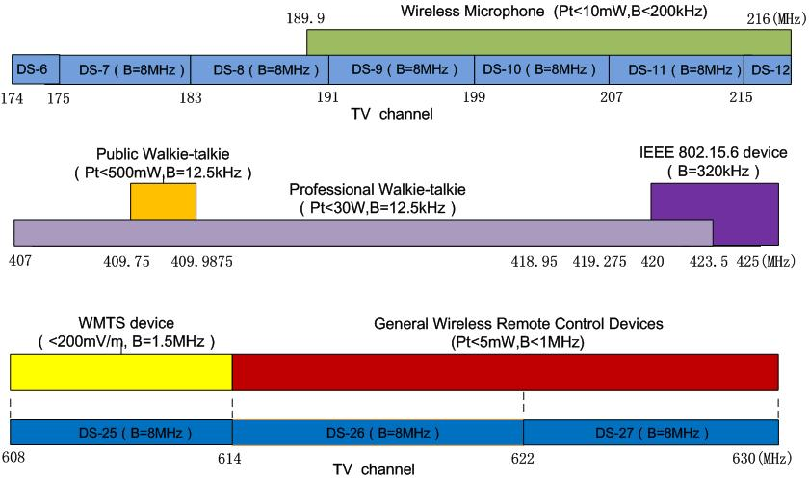
General View
All of usages on 174-216、407-425、608-630MHz Bands

Slide 4
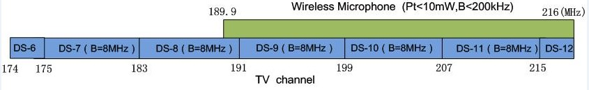
The usage on 174-216MHz Band
174-216MHz
VHF Radio and TV
Wireless Microphone

Slide 5
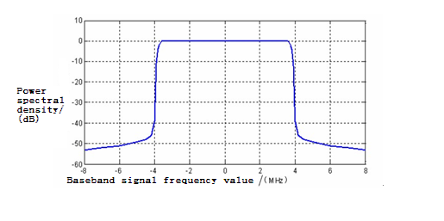
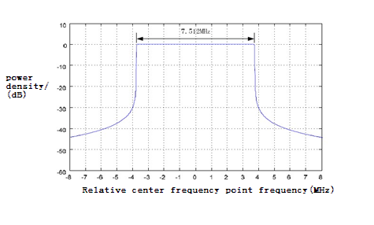
The Usage on 174-216MHz band
VHF Radio and TV
 | Channel | Standard
Digital radio and TV | DS-6：174-175MHz DS-7：175-183MHz DS-8：183-191MHz DS-9：191-199MHz DS-10：199-207MHz DS-11：207-215MHz DS-12：215-216MHz | DTMB(OFDM) | CMMB(OFDM)
Analog radio and TV |  | GB/T 14433-93 Color Radio and TV Coverage Network Technical requirements
Remark: The analog radio and TV will stop in 2015.

Slide 6
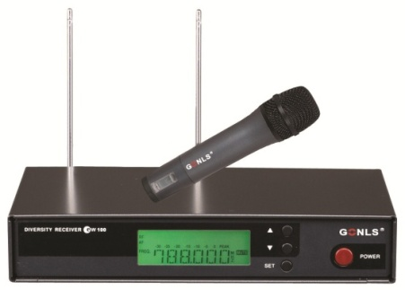
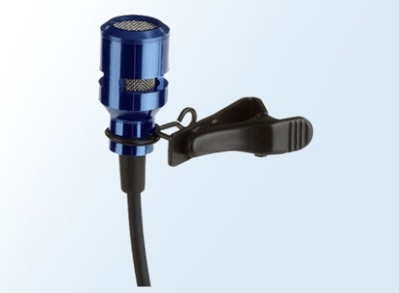
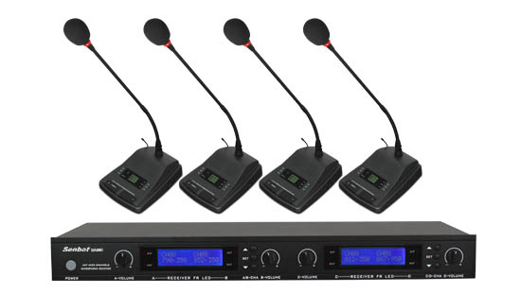
The Usage on 174-216MHz band
Wireless Microphone
Wireless Microphones on the market:
On Chinese Markets, More China's wireless microphones shifts from VHF to UHF(most 500-900MHz), especially in the high-end products.

Slide 7
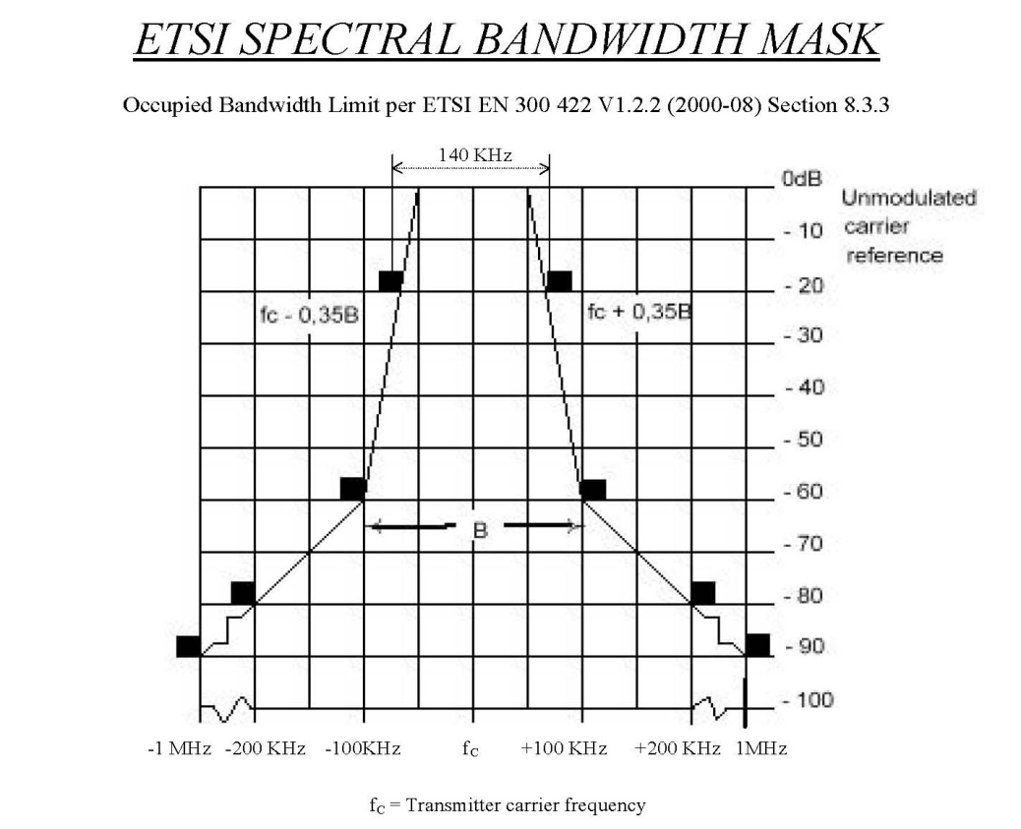
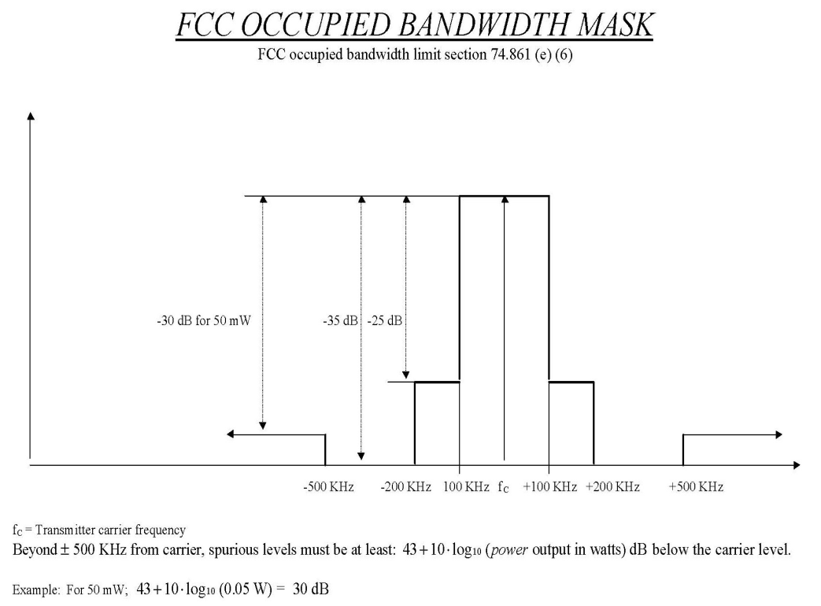
The Usage on 174-216MHz band
Wireless Microphone
Operation frequency 189.9-216MHz, Pt <10mW , Bandwidth<200kHz. But, there is no rule about PSD of wireless microphone in china ,so we refer bandwidth mask in America and Europe.

Slide 8
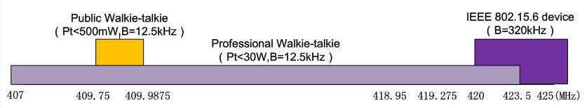
The Usage on 407-425MHz band
Interphone (Walkie-talkie)
IEEE 802.15.6 Devices
407- 425MHz

Slide 9
The Usage on 407-425MHz band
Interphone (Walkie-talkie)
Interphone | Different Frequency Bands | Dedicated interphone (Pt<30W) | 137-144、146-167、403-409.75、409.9875-423.5MHz
 |  | Public interphone (Pt<500mW) | 409.7500-409.9875MHz | Analog | Channel number:20 Operation frequency:409.7500-409.9875MHz Channel spacing:12.5kHz Modulation:8K5F3E
 |  |  |  | Digital | Channel spacing:12.5kHz 6.25kHz multi-access mode : FDMA/TDMA
 | Individual Technology | Analog interphone
 |  | Digital interphone Standards: | DMR（base on TDMA）、DPMR（base on FDMA）、DSRR ,P25 standard

Slide 10
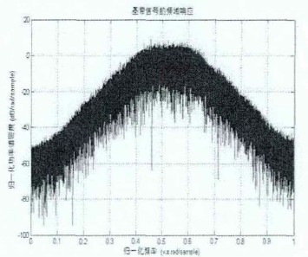
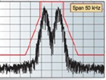
The Usage on 407-425MHz band
Interphone (Walkie-talkie)
DPMR ：
4FSK ， FDMA，B=6.25kHz
DMR ：
4CPFSK ， TDMA，B=12.5kHz

Slide 11
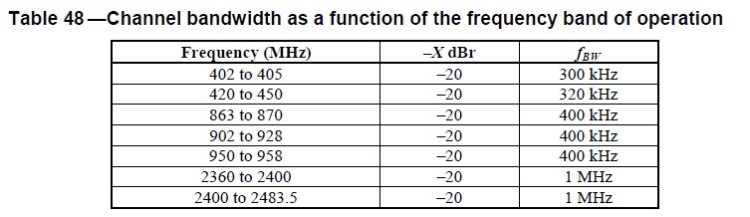
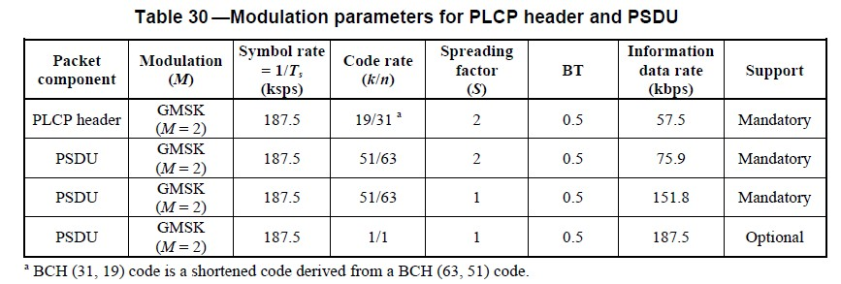
The Usage on 407-425MHz band
IEEE 802.15.6 devices（ Potential ）
Operation frequency and channel bandwidth
(section 8.8.1)
Modulation parameters
(Narrow Band PHY,420-450MHz)
(Section 8.1.2)

Slide 12
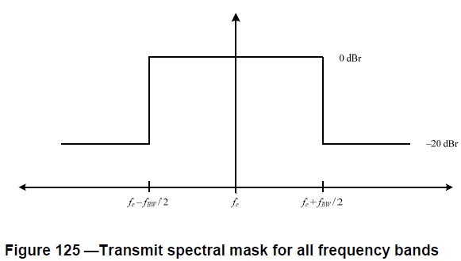
The Usage on 407-425MHz band
IEEE 802.15.6 devices（ Potential ）
The transmit spectral mask for narrow band PHY is : (Section 8.8.1)

Slide 13
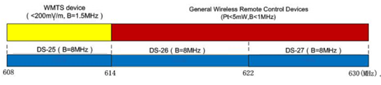
The Usage on 608-630MHz band
UHF radio and TV
WMTS devices
General Wireless Remote Control Devices
608-630MHz

Slide 14
The Usage on 608-630MHz band
UHF Radio and TV
 | Channel | Standard
Digital radio and TV | DS-25：608-614MHz DS-26：614-622MHz DS-27：622-630MHz | DTMB(OFDM) | CMMB(OFDM)
Analog radio and TV |  | GB/T 14433-93 Color TV Broadcast Coverage Network Technical Regulations
Remark: And China will stop the analog signal in 2015.

Slide 15
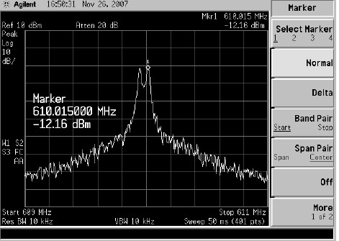
The Usage on 608-630MHz band
WMTS Standard（Potential）
WMTS :Wireless Medical Telemetry
WMTS devices need to get the FCC authorization to product and we don`t find this device using in China yet.
Parameters
Channel number | 4（608.0-609.5MHz、609.5-611.0MHz、611.0-612.5MHz、612.5-614.0MHz）
Channel Bandwidth | 1.5MHz
Modulation | No specified. The right Fig is FSK for example.

Slide 16
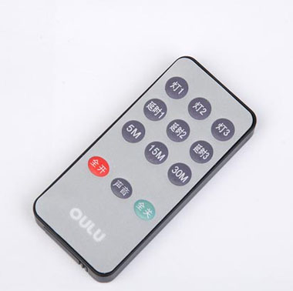
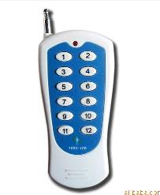
The Usage of 608-630MHz
General Wireless Remote Control Devices
General wireless remote control
devices on the market mainly
refers to the radio remote control
(RF Remote Control).
It has been widely used in garage
door ,electric gate, Barrier remote
control, burglar alarm, industrial
control and wireless intelligent
home field.

Slide 17
The Usage of 608-630MHz
General Wireless Remote Control Devices
operation frequency : 470-566MHz，614-787MHz
Pt: <5mW(e.r.p)
channel bandwidth : <1MHz
Modulation： No specified . There are different
modulations in varied products , FSK or ASK for example.
Most of the wireless remote control operation frequency in the Chinese market is in the 315MHz and 433MHz.

Slide 18
Conclusion
Main interference sources | radio and TV |  | Interphone、IEEE 802.15.6 devices
Less interference sources | Wireless microphone | WMTS devices | General wireless remote control devices

