Slide 1
Project: IEEE P802.15 Working Group for Wireless Personal Area Networks (WPANs)
Submission Title: [Overview of IG SRU Activities]
Date Submitted: [12 March, 2012]
Source: [Shoichi Kitazawa] Company [ATR ]
Address [2-2-2 Hikaridai Seika, Kyoto 619-0288 Japan]
Voice:[+81-774-95-1511], FAX: [+81-774-95-1508], E-Mail:[kitazawa@atr.jp]
Re: []
Abstract: [This document describes of activity of IG SRU.]
Purpose: [To introduce overview of IG SRU and some technical ideas for efficient spectrum use.]
Notice: This document has been prepared to assist the IEEE P802.15. It is offered as a basis for discussion and is not binding on the contributing individual(s) or organization(s). The material in this document is subject to change in form and content after further study. The contributor(s) reserve(s) the right to add, amend or withdraw material contained herein.
Release: The contributor acknowledges and accepts that this contribution becomes the property of IEEE and may be made publicly available by P802.15.

Slide 2
Overview of IG SRU Activities
Shoichi Kitazawa

Slide 3
IG SRU
The IG SRU (Spectrum Resources Utilization) started in November 2010.
  This IG based on presentation of “A Proposal Toward Better Use of Spectrum Resources in future WPAN(15-10-0739-01)” at September 2010.
The purpose of IG SRU are:
  To explore mechanism of efficient spectrum use in ISM band and unlicensed band.
  Discussing future WPAN system.

Slide 4
IG SRU Sessions
The IG SRU meeting is held every plenary meeting.
This time IG SRU hold a meeting on Thursday PM1 at Waikoloa2.
  1st version of technical document of IG SRU will be release this meeting.
Year | Month | Venue | Agenda | Closing Report | Minutes | Number of participant
2010 | November | Dallas | 15-10-0839-01 | 15-10-0924-01 | 15-10-0934-00 | 10
2011 | March | Singapore | 15-11-0159-01 | 15-11-0298-00 | 15-11-0440-00 | 8
 | July | San Francisco | 15-11-0456-00 | 15-11-0552-00 | 15-11-755-00 | 11
 | November | Atlanta | 15-11-0757-01 | 15-11-0830-00 | 15-12-0106-00 | 13
2012 | March | Waikoloa | 15-12-0107-00

Slide 5
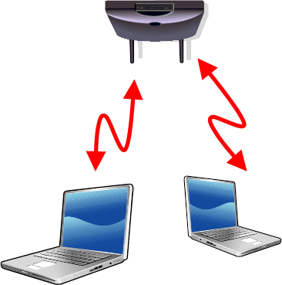
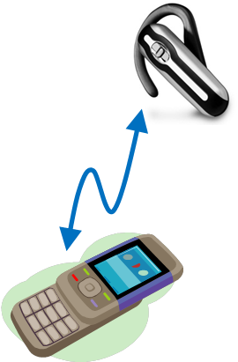
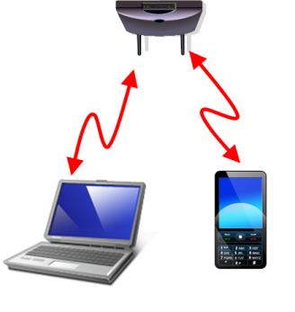
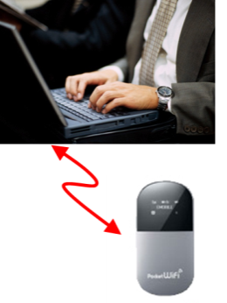
New technologies for future WPAN
The unlicensed band will be congested with transmission from various types of SRD’s. It will face a serious problem of inter-system interference.
  The CA document addresses coexistence of 802 wireless devices.
  The degradation of system performance has become obvious due to high inter-system interference.
The IG SRU (Spectrum Resource Utilization) chartered to explore mechanism of efficient spectrum use in ISM and unlicensed band.
  Utilization of unused spectrum resources

Slide 6
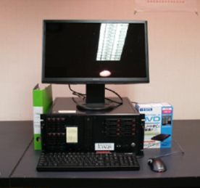
Current situation in 2.4GHz band
To confirm current situation in 2.4GHz ISM band, following locations were selected and measured by our developed measurement system and other commercial available measurement system.
  Airport
  Railroad station
  Conference room
  Residential area
  Hospital
Block diagram of measurement system

Slide 7
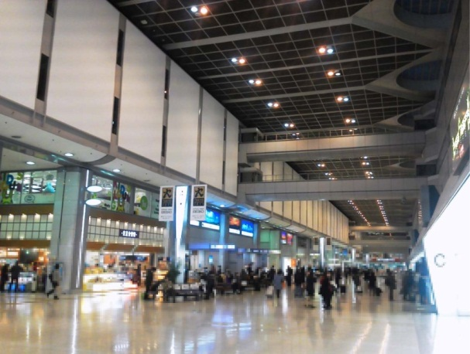
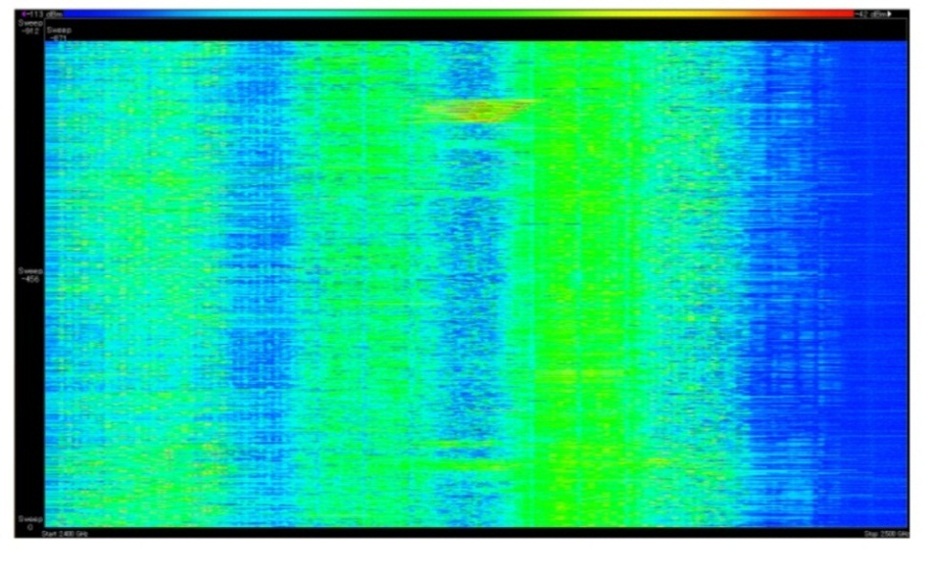
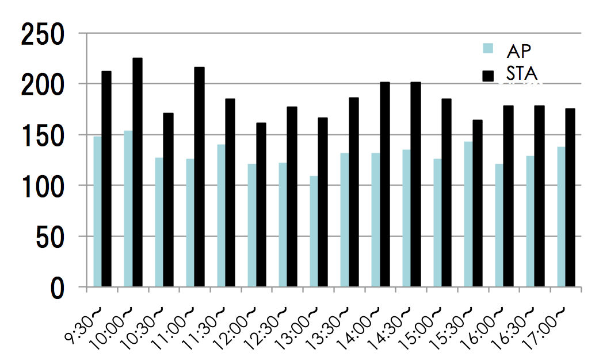
Airport
Haneda (Tokyo International Airport)
  61million passengers/Year
Large number of AP and STA were observed.
-114dBm
Signal strength
-34dBm
10:00
Time
10:15
2.4GHz
Frequency
2.5GHz
Number of AP and STA
Spectrogram

Slide 8
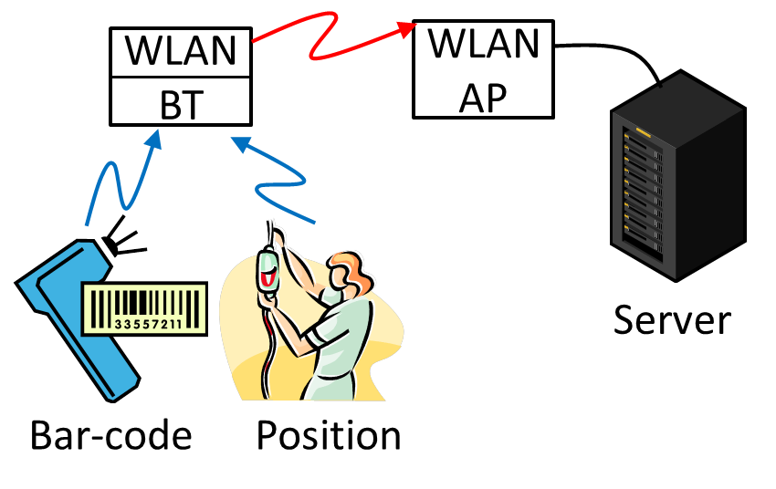
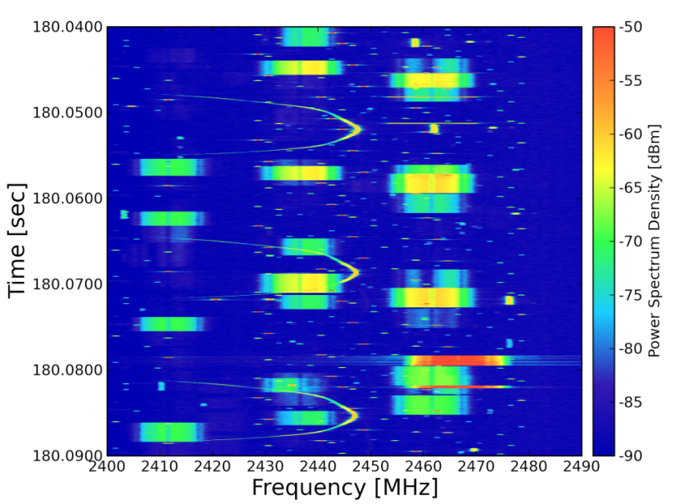
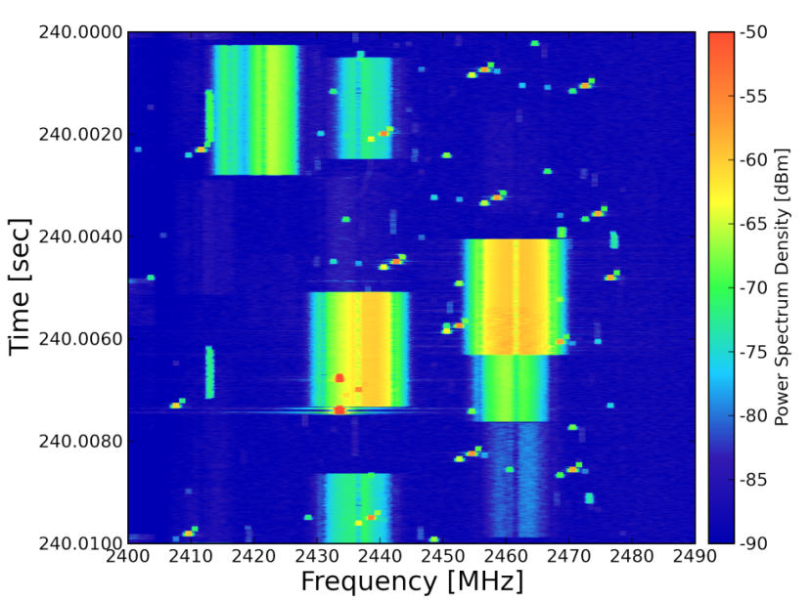
Hospital
Kyoto University Hospital
  Number of Beds:1121
  Bluetooth and WLAN are equipped in the hospital.
The ISM band is congested with WLAN, Bluetooth and Microwave oven.
Spectrogram

Slide 9
Related activities
V2V, V2I
Smart Antenna
DSA system

Slide 10
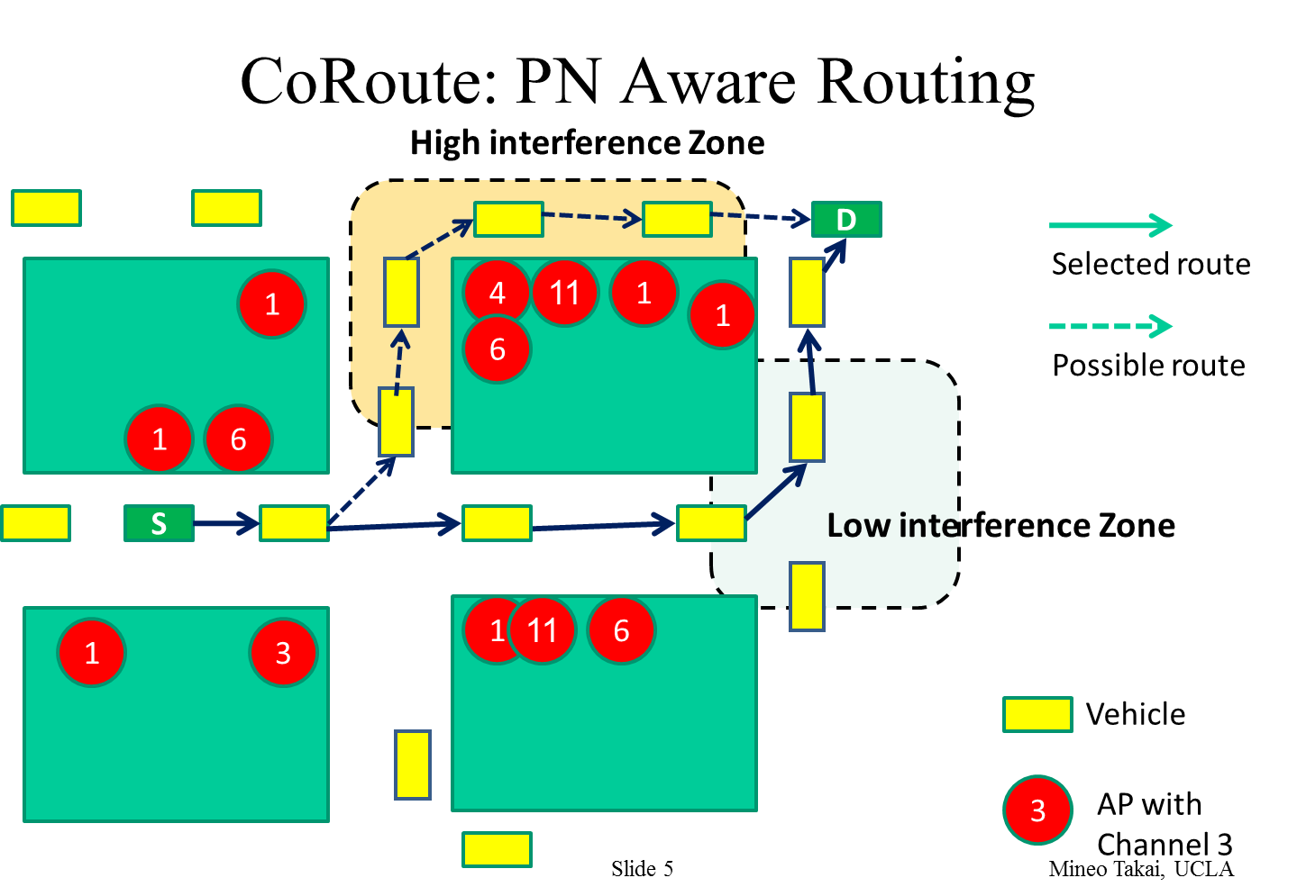
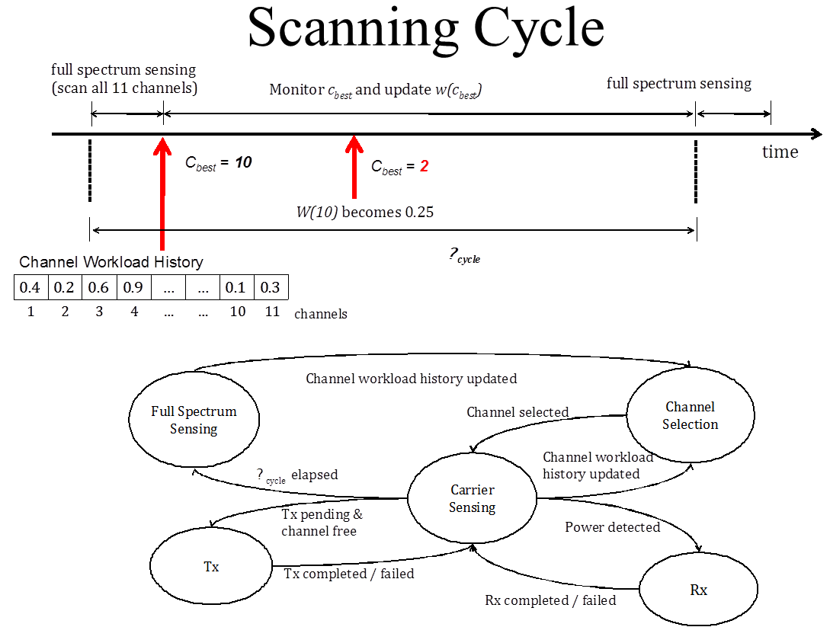
Intelligent Spectrum Sensing for vehicular Communications in the ISM Bands(15-11-0528) by Mineo Takai
Vehicle-to-Vehicle (V2V), Vehicle-to-Infrastructure (V2I) communications in the ISM band
Adopt a cognitive radio approach to avoid interfering and / or being interfered with other communications.
Channel workload estimation has been introduced.

Slide 11
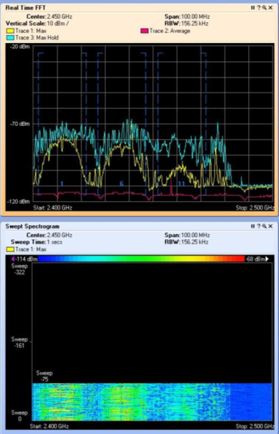
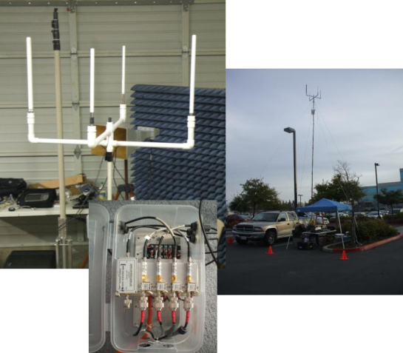
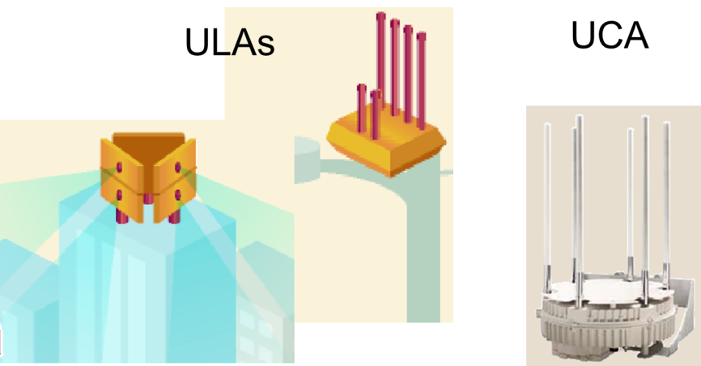
Smart Antenna Opportunities for Spectrum Resource Usage Improvements (15-11-0817) by Bob Conley
Measurement results of 2.4GHz ISM band were shown.
To avoid interference, “Smart Antenna” using array configurations were proposed.

Slide 12
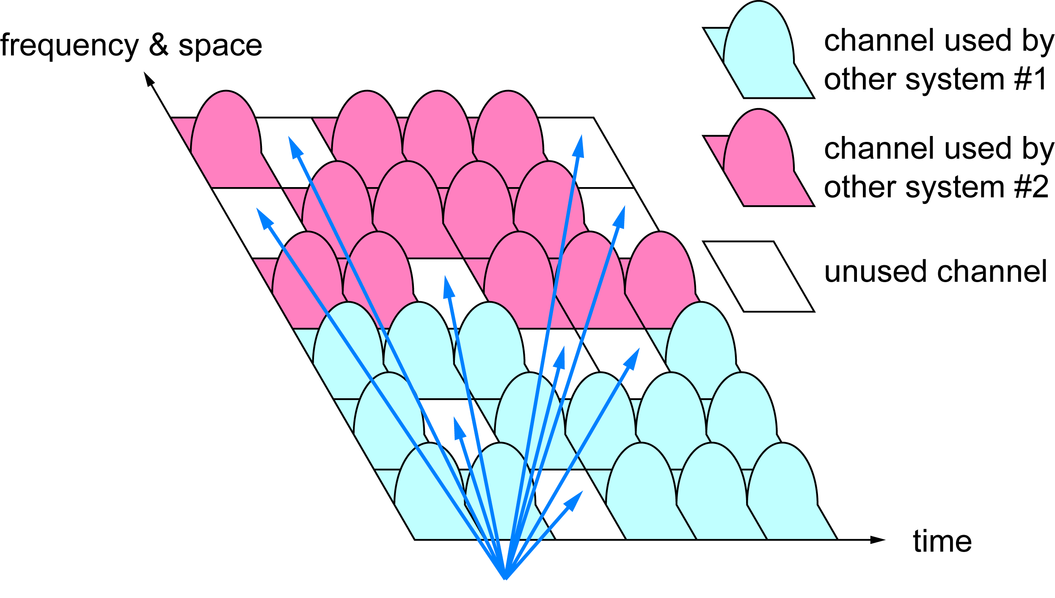
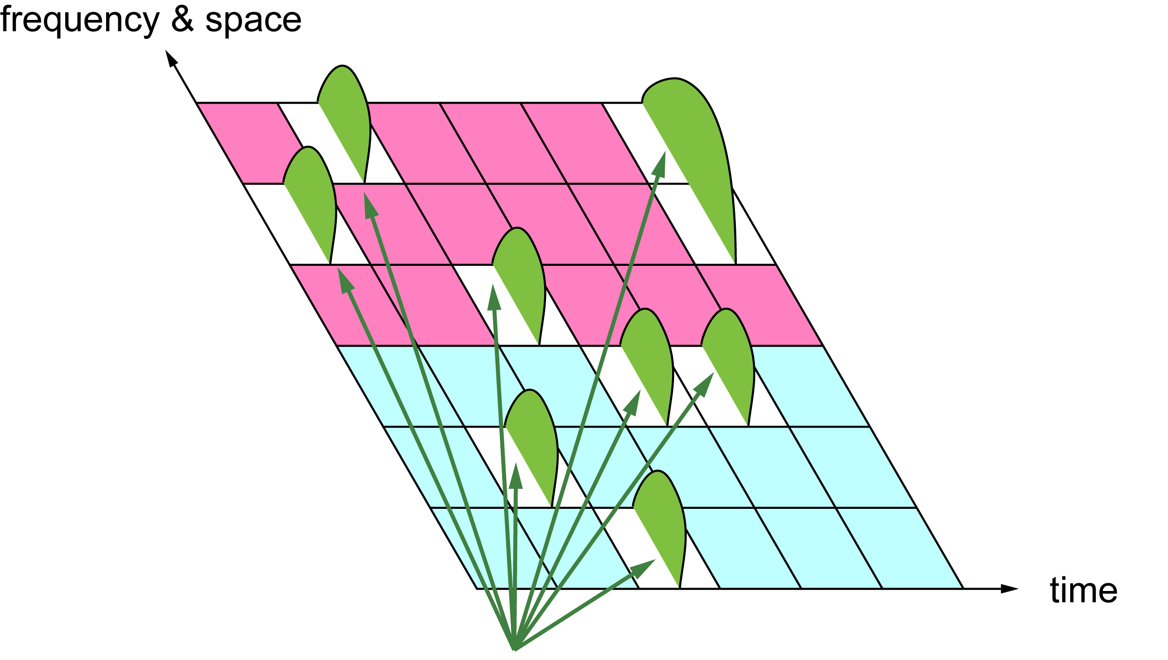
System concept of DSA (15-11-016) by Shoichi Kitazawa
To realize efficient use of spectrum, Dynamic Spectrum Access/Assignment (DSA) was proposed.
The DSA system transmits its own traffic over fragmented unused radio resources detected by spectrum sensing.
Detecting unused spectrum resources (white space)
by spectrum sensing.
Initiating new transmission on the detected white space by generating arbitrary signal spectrum.
Acknowledgment
This work is supported by the Ministry of Internal Affairs and Communications under a grant “Research and development on radio resource control technologies among multiple radio systems on same frequency band.”

Slide 13
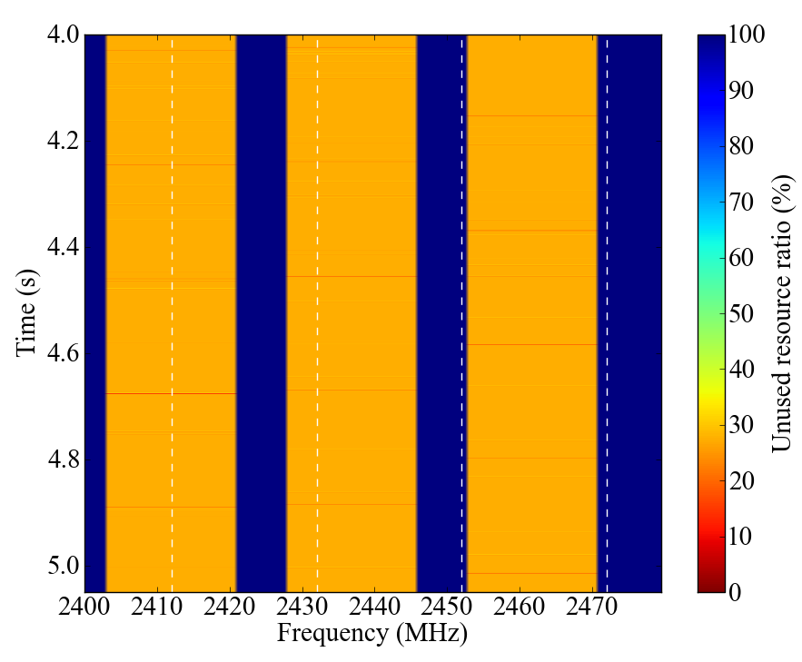
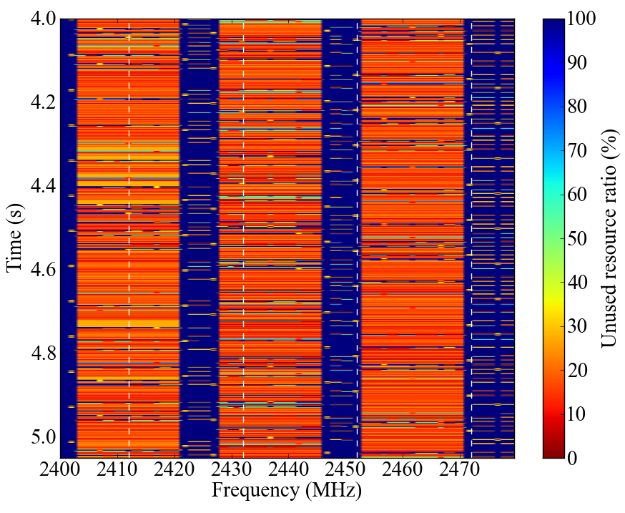
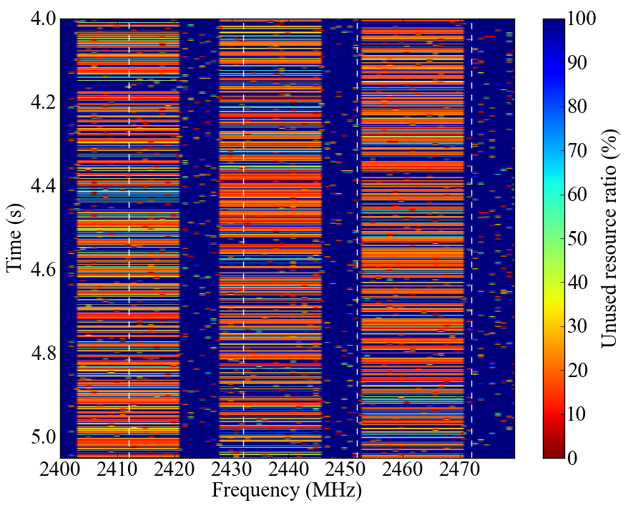
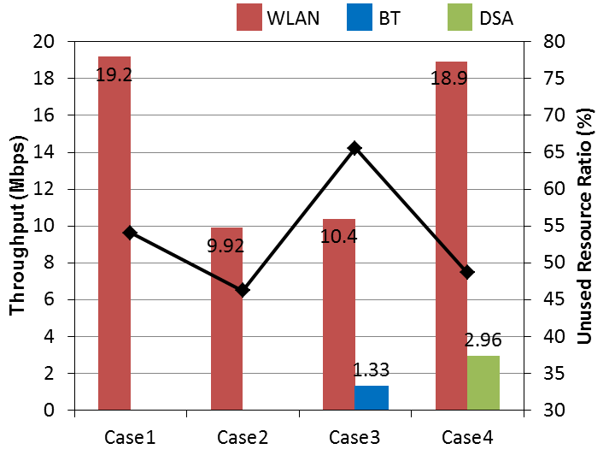
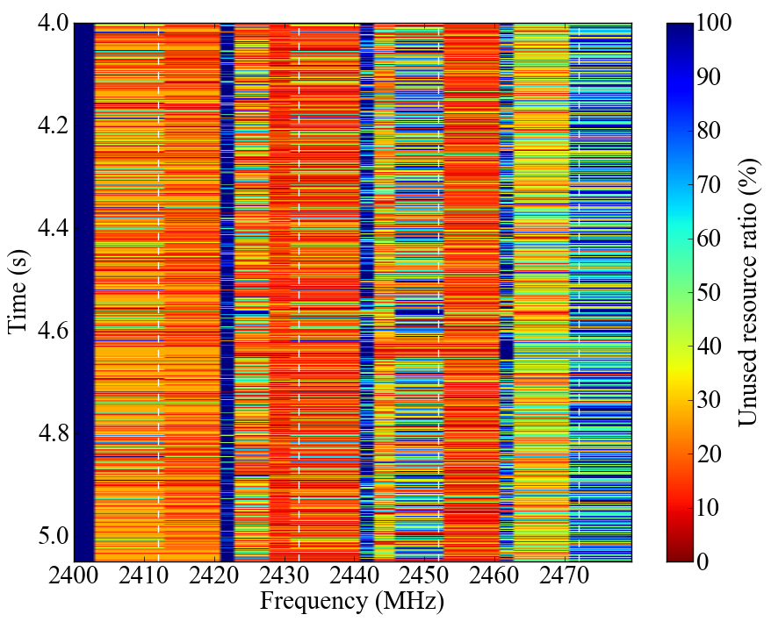
Simulation results
The DSA gives only small impact to other system.
The area total throughput is better than other scenarios.
WLAN 3BSS+DSA 4pairs
WLAN 3BSS
WLAN 3BSS+ 4BSS
WLAN 3BSS+BT 4pairs

Slide 14
Conclusions
Measured results of 2.4GHz ISM band show that a congestion situation has already occurred.
  In the near future, more congestion situation will be expected.
  Three kinds of contributions regarding efficient use of spectrum are introduced.
  The IG SRU would like to solicited more contribution about this topic.

Slide 15
Contributors
Authors / Contributors
Name | Company | email
Shoichi Kitazawa | ATR | kitazawa@atr.jp
Satoshi Tsukamoto |  | tsukamoto@atr.jp
Tomohiro Miyasaka |  | miyasaka@atr.jp
Takahiro Maeda |  | maeda@atr.jp
Kohji Ohshima |  | k_ohshima@atr.jp
Kazuto Yano |  | kzyano@atr.jp
Tomohiro Oka |  | to.oka@atr.jp
Narihiro Nakamoto |  | nakamoto_n@atr.jp
Akira Utsumi |  | utsumi@atr.jp
Haruo Noma |  | noma@atr.jp
Masashiro Uno |  | uno@atr.jp
Kiyoshi Kobayashi |  | kobayashi@atr.jp
Mineo Takai | UCLA Computer Science Department | mineo@cs.ucla.edu
Jitin Bajaj
Wooseong Kim
Brian Choi
Mario Gerla
Bob Conley | Eigen Wireless | bconley@eigenwireless.com
Steven Schennum | Gonzaga University | schennum@gonzaga.edu

Slide 16
Technical Contribution
Doc No. | Auther | Affiriation | Tittle | Meeting
15-10-886-00 | Shoichi Kitazawa | ATR | Experimental results of High traffic-load situation | Dallas
15-11-0161-00 | Shoichi Kitazawa | ATR | System concept of DSA | Singapore
15-11-0162-01 | Shoichi Kitazawa | ATR | Home monitoring applications | Singapore
15-11-0508-00 | Shoichi Kitazawa | ATR | Current situation in 2.4GHz ISM band | San Francisco
15-11-0528-00 | Mineo Takai | UCLA | Intelligent Spectrum Sensing for vehicular Communications in the ISM Bands | San Francisco
15-11-0764-00 | Shoichi Kitazawa | ATR | Performance simulation of DSA system | Atlanta
15-11-0817-01 | Bob Conley | Gonzaga University Eigen Wireless | Smart Antenna Opportunities for Spectrum Resource Usage Improvements | Atlanta
15-12-0xxx-01 | Shoichi Kitazawa | ATR | Technical Document | Big Island

