Slide 1
Project: IEEE P802.15 Working Group for Wireless Personal Area Networks (WPANs)
Submission Title: Usage Cases for Peer Aware Communications
Date Submitted:
Source: Sunggeun Jin and Jinkyeong Kim
Address: sgjin@etri.re.kr
Re:
Abstract:
Purpose:
Notice: This document has been prepared to assist the IEEE P802.15. It is offered as a basis for discussion and is not binding on the contributing individual(s) or organization(s). The material in this document is subject to change in form and content after further study. The contributor(s) reserve(s) the right to add, amend or withdraw material contained herein.
Release: The contributor acknowledges and accepts that this contribution becomes the property of IEEE and may be made publicly available by P802.15.
Slide 1

Slide 2
Outline
Examples of Services
  Services in close proximity
  Intelligent guide
  Wireless display
  User and/or service findings
  Wireless egg
  Wireless Ethernet adapter
Implementation
  PAC functions
    Dynamic Scalability of Broad Range of Link Rates
    Fast

Slide 3
Examples of Services
Slide 2

Slide 4

Services in Close Proximity
Features
  Direct communications without coordination
Service requirements
  Gaming – realtime communications with multiple users
  Chatting and messenger services – irregular short message transmissions
  File transfers – reliable large volume data transmissions

Slide 5

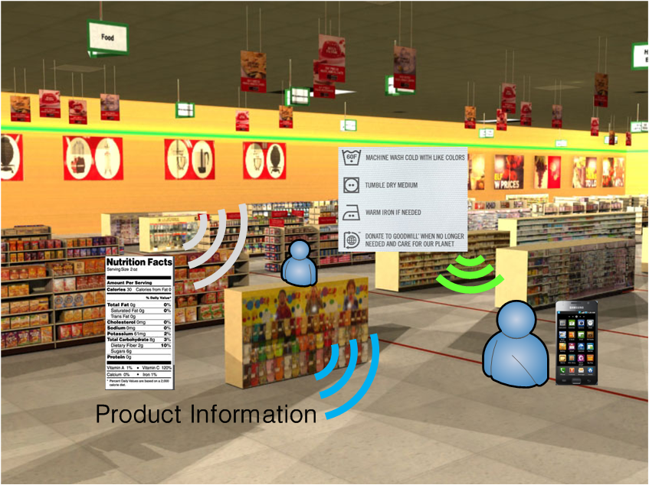
Intelligent Guide
Features
  User and/or product on display recognition
  Fast setup for communications
  Fast movement detection
Services
  Automatic narration
  Product information broadcastings
  Experience of sample video or audio clips
  Advertisements with personalized information – coupon, mileage
Notes:
http://trendland.net/2011/01/03/phillips-de-pury-virtual-gallery-tour/#

Slide 6
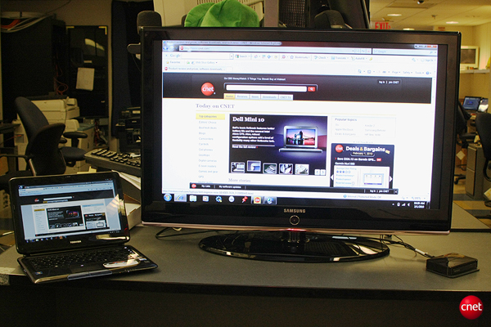
Wireless Display
Features
  High throughput is necessary
Services
  Watching high definition video clips with multiple screens
  Presentations through a projector without a cable

Slide 7



User and/or Service Findings
Social
Personal
Intimate
Features
  Searching user or service beyond device’s wireless coverage
  Multi-hop communications may be helpful for the service findings
Services
  Finding services – A user can search what he/she wants to be serviced with in a wide area

Slide 8
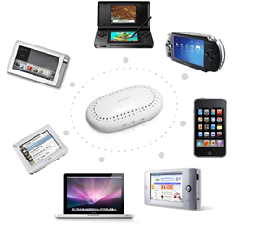
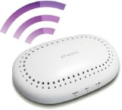
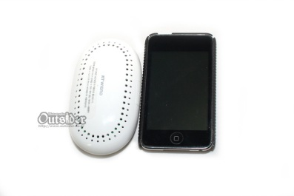
Wireless Egg
Features
  Wireless egg is a kind of bridging service between mobile devices and cellular networks such as LTE or WiMax
  Providing wireless connectivity for mobile devices without bothering WiFi
Services
  It is possible to provide high throughput wireless Internet services as an alternative of WiFi

Slide 9




Wireless Ethernet Adaptor
Features
  Wireless ethernet adaptor is a kind of bridging service between Ethernet ports in Desktop PC, Notebook PC, Ethernet Hub, or Ethernet Port
  Providing high throughput wireless connectivity by avoiding the crowded WiFi frequency bands
Services
  It can use for point-to-point Ethernet cable replacement as an alternative of wifi

Slide 10
PAC Functions
Slide 2

Slide 11
PAC Functions
Main distinct identities
  Coverage extension by using multi-hop
  High precision location services
  High speed ( > 300 Mbps ) throughput with low power consumption
  Paging (wake-up) services
  Dynamic routing protocols for walking users
  Group Communications
Implementation
  One standard/PHY/MAC/chip solution to support above features
  Not combination of existing technologies into a combo chip
  Physical layer to enable multiple data rates
  MAC layer operation in fully distributed manner

Slide 12
Dynamic Scalability of Broad Range of Link Rates
Different QoS requirements in personal space
  Heterogeneous services requiring different types of resources to support its own QoS
  Fast transfers of data file and multimedia
  High data rate and energy efficiency
  Dynamic link rate adaptation for different features of services
Link rates change and flexible frame structure
  Sufficiently high link rate: 20Mbps ~ at least 300 Mbps
  Adaptive resource allocation for different services
  New frame structure to accommodate services with different QoS

Slide 13
Fast Association and Group Communications
Instantaneous connection establishment
  Seamless mobility without service interruption
  Fast neighbor devices discovery
  Dynamic and automatic connection/disconnection
  Fast synchronization for PAC devices in distributed manner
Group communications
  Dynamic grouping of devices without service interruption
  Based on fast association and synchronization

