Slide 1
Project: IEEE P802.15 Working Group for Wireless Personal Area Networks (WPANs)
Submission Title: IEEE Body Area Network Diabetes - July 11
Date Submitted: July 21, 2011
Source: Darrell M. Wilson, MD
Contact: Darrell M. Wilson, MD (Stanford)
Voice: +1 650 704-2517, E-Mail: dped.stanford.edu
Re: IEEE Body Area Network Diabetes - July 11
Abstract: IEEE Body Area Network Diabetes - July 11.
Purpose: To summarize diabetes research
Notice: This document has been prepared to assist the IEEE P802.15. It is offered as a basis for discussion and is not binding on the contributing individual(s) or organization(s). The material in this document is subject to change in form and content after further study. The contributor(s) reserve(s) the right to add, amend or withdraw material contained herein.
Release: The contributor acknowledges and accepts that this contribution becomes the property of IEEE and may be made publicly available by P802.15.

Slide 2
IEEE Body Area Network
Diabetes - July 11
Darrell M. Wilson, MD
dwilson@stanford.edu
dped.stanford.edu

Slide 3
Goals
Review diabetes for a few minutes
Discuss current conventional treatment approaches
Discuss cut-edge approaches include closed loop systems and there problems

Slide 4
Goals
What “we” envision as Body Area Network upsides for diabetes
What “we” envision as important features/functional aspects to such a network
Regulatory issues
Q and A

Slide 5
Diabetes Mellitus Major Forms
Insulin dependent
IDDM
Juvenile onset
Brittle
Type 1
Non-insulin dependent
NIDDM
Adult onset
Type 2
Atypical Diabetes
Minor forms

Slide 6
What’s New in Type 2?
Epidemic of Type 2
“Atypical” diabetes
  Type 2 with an edge
    sometimes presenting with DKA
Related to obesity

Slide 7
Obesity Trends* Among U.S. Adults
BRFSS, 2009
(*BMI ≥30, or ~ 30 lbs. overweight for 5’ 4” person)
No Data <10% 10%–14% 15%–19% 20%–24% 25%–29% ≥30%

Slide 8
Genetics
Environmental
triggers
Insulitis
Type 1 Diabetes
Diabetes Exposure
Eye
Complications
Renal
Complications
Large
Vessels

Slide 9
Honeymoon

Slide 10
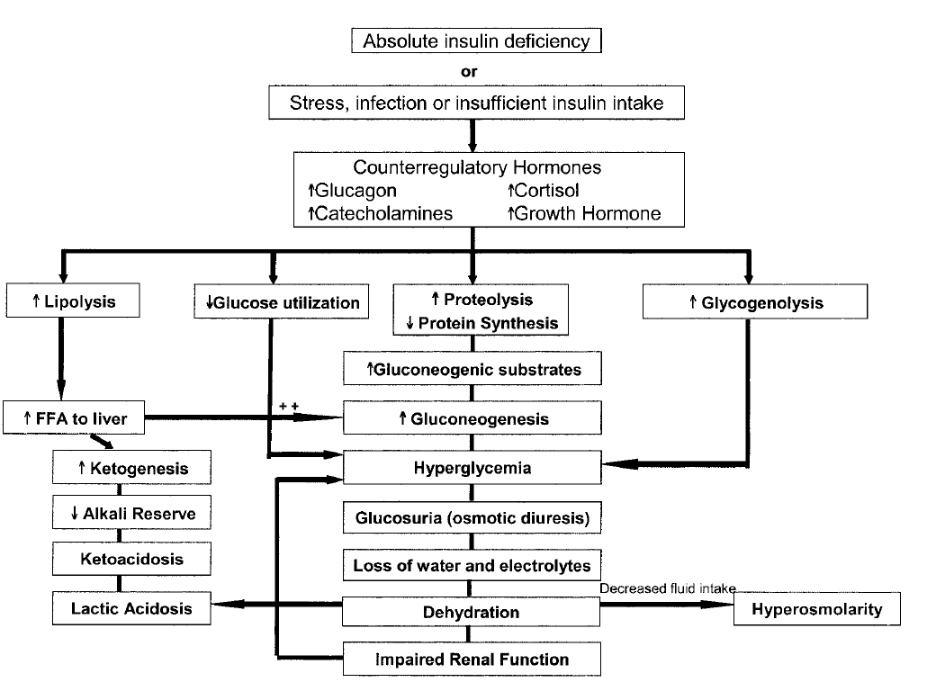
Diab Care 29:1150, 2006
Travis, DM in Children, MPCP#29, 1987

Slide 11
Diabetes Impact
Type 1 ~ 800,000 to 1,000,000
  ~120,000 < 20 years of age
Type 2 ~ 7 million
  another ~ 7 million undiagnosed
  Prevalence
    1.3% 18-44 years of age
    6.2% 45-65 years of age
    10.4% 65-74 years of age

Slide 12
Costs Continue to Increase (U.S.)
(in Billions of Dollars)
Diabetes Care 26:917-932, 2003

Slide 13
Single Subject without DM
Mazze DTT 2008

Slide 14
Single Subject With DM
Mazze DTT 2008

Slide 15
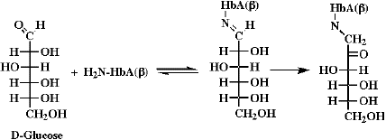
Hemoglobin A1c
http://www.cem.msu.edu/~cem252/sp97/ch18/ch18s20.GIF

Slide 16
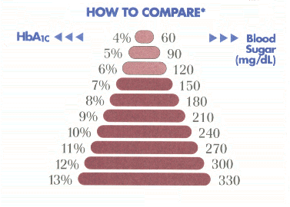
Hemoglobin A1c
http://home.comcast.net/~creationsunltd/images/comparebsandhga1c.gif

Slide 17
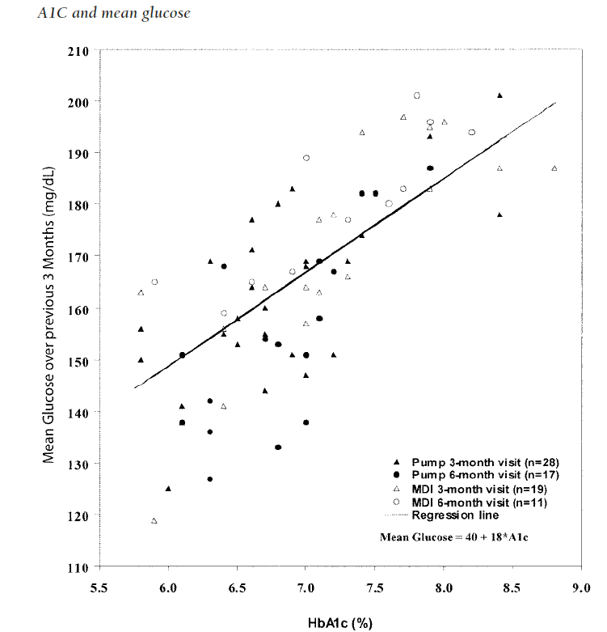

Slide 18

DCCT
DCCT NEJM, 329:977,1993

Slide 19
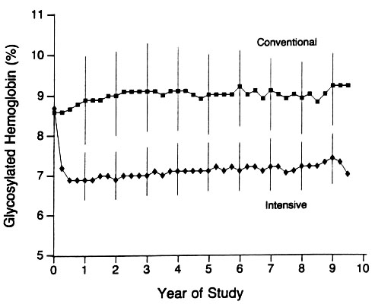
Glucose Control
Glycosylated Hemoglobin
DCCT NEJM, 329:977,1993

Slide 20
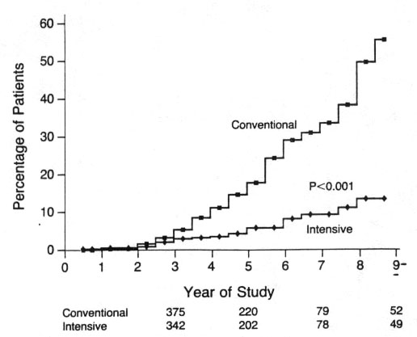
Retinopathy
Primary Prevention
DCCT NEJM, 329:977,1993

Slide 22
Average Daily Risk Range
Kovatchev

Slide 23
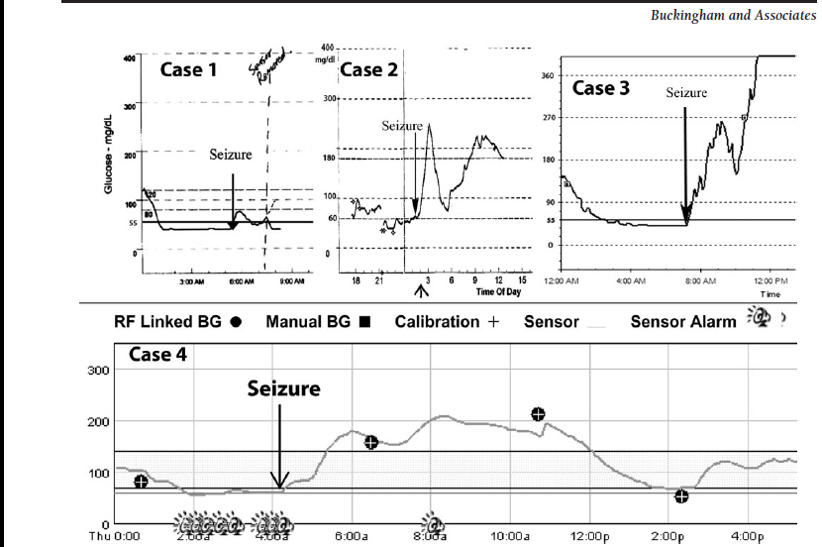
Buckingham Diab Care 2008

Slide 24
17 yo Female, A1c 6.2
36,000 nights in JDRF RCT, 176 subjects
Hypoglycemia occurred 8.5% of nights
    (2 consecutive CGM readings < 60 mg/dl)
Mean duration 81 minutes
  For 23% duration was at least 2 hours
  For 11% duration was at least 3 hours
Seizure

Slide 25
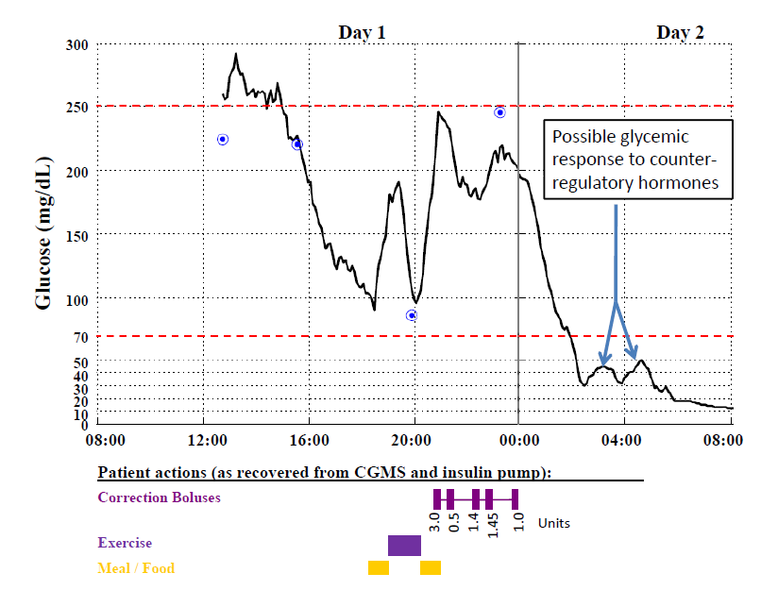
‘DEAD-IN-BED’ SYNDROME
Tanenberg, Endocr Pract 2009; 15:1-13

Slide 26
Dead in Bed
Tattersall, Diabet Med 8:49, 1991
Thordarson, Diabet Med 12: 782, 1995
Koltin, Ped Diabetes 9:504, 2008
Secrest, Diabet Med 28: 293, 2011
Account for 3 – 6% of deaths in patients with diabetes < 40 years old
Age range 7-43 years
Incidence ≈ 17-60/100,000 patient years
  About 35-130 deaths/year in US

Slide 27
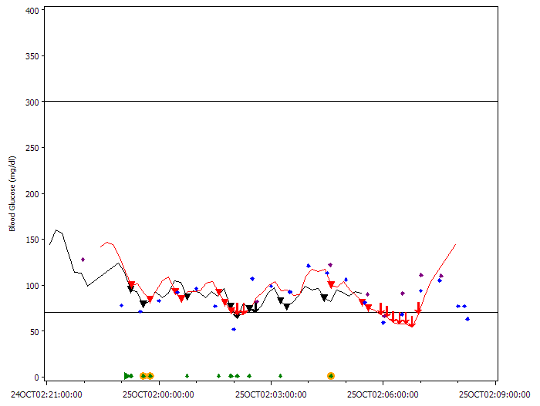
Response to Videotaped Nocturnal Alarms
Buckingham, DTT 7:440, 2005
Children 4-17 years old awoke to 29% of all alarms
Awoke to 40% of first alarms
Awoke to 28% of subsequent alarms
23 Alarms
3 child awakenings – Orange
10 parent awakenings-Green

Slide 28
Insulin Action Curves

Slide 29
Four Shots

Slide 30
Pumps
What do they do?
Basal(s) rates
Meal boluses
Correction bolus
What don't they do?
Still open loop
Require a great deal of attention to detail

Slide 31
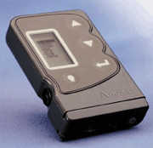
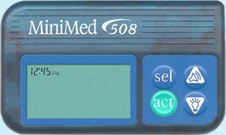
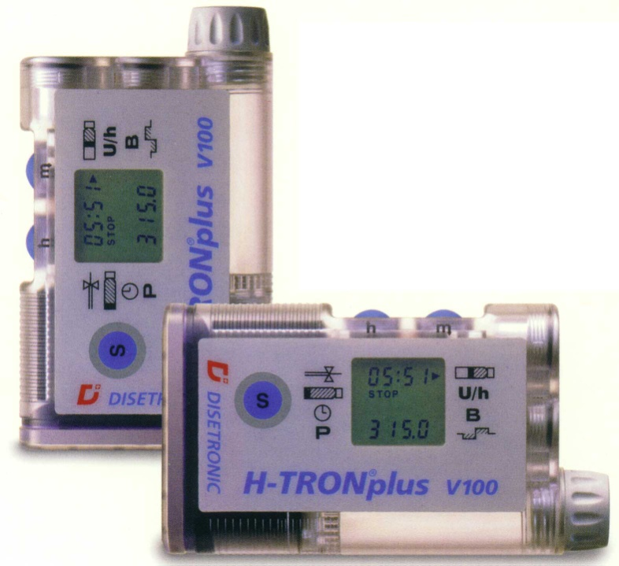
Pumps

Slide 32
Pump Example

Slide 33
How to Select the Correct Amount of Insulin
Good carbohydrate counting
  Frequently in error
Using pumps
  Use the calculators/wizards
Using injections
  Use a discrete plan
Adjusting for exercise
Bedtime snacks

Slide 34
Insulin Variability
Heinemann DTT 4:673, 2002

Slide 35
Maximizing Bolus Delivery
Getting the Bolus
The price of a missed bolus is high
Burdick Peds 113:211e, 2004

Slide 36
Kinetics vs Dynamics

Slide 37
Sensor Lag

Slide 38
Feature Summary
 | Paradigm 722 | DexCom 7-plus | Navigator
Rate of change arrows | Yes | Yes | Yes
Projected low alarm | No | No | Yes
Days of wear | 5 | 7 | 5
Ability to download | Yes | Yes | Yes
Ability to integrate with pump | Yes (MiniMed) | Yes (Animas) | Pending (Cozmo)

Slide 39
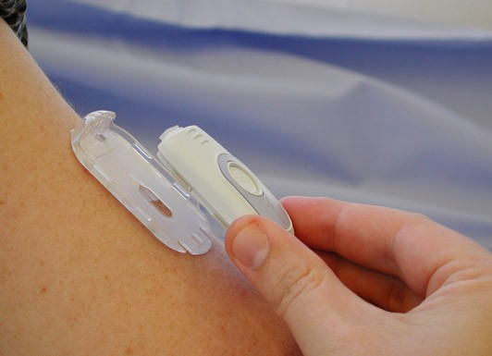
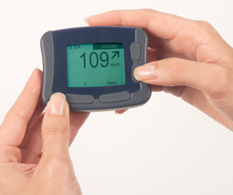
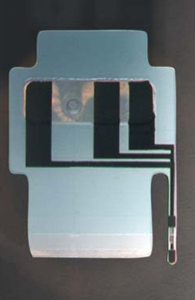
FreeStyle Navigator™
Continuous Glucose Monitor
Transmitter
Receiver
Sensor/Sensor Mount

Slide 40
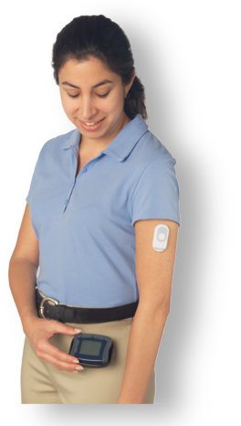
FreeStyle Navigator™ System
Intended Features
  Home continuous monitoring system.
  3-day sensor continuously measures glucose
  Transmitter sends updated glucose reading every minute
  Alarms for hi/lo glucose
  Alarms for projected hi/lo glucose
  On-board trend and statistical reporting
  Event entry (food, insulin, meds, exercise, etc)
  60-day memory & upload to computer
  Traditional glucose meter built in
    System calibration
    Backup glucose meter

Slide 41

Pilot Study to Evaluate the Navigator in Children with T1D
30 children with T1D
HA1c 7.1 ± 0.6%
Smart pumps
Ask to wear sensor daily
Algorithm based adjustments of insulin infusion rates

Slide 42
Trend Arrows
Navigator
MiniMed
>2 (mg/dL)/min
1 to 2 (mg/dL)/min
-1 to 1 (mg/dL)/min
-1 to -2 (mg/dL)/min
< -2 (mg/dL)/min
Updated every minute
Updated every 5 minutes

Slide 43
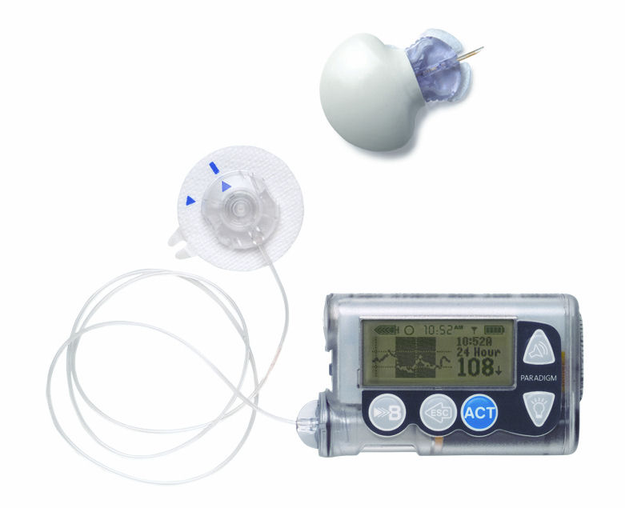
MiniMed Paradigm REAL-Time with
new, smaller MiniLinkTM Transmitter
http://www.childrenwithdiabetes.com/continuous.htm

Slide 44
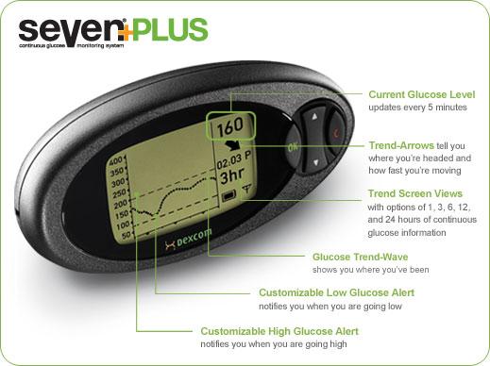
http://www.dexcom.com/products

Slide 45
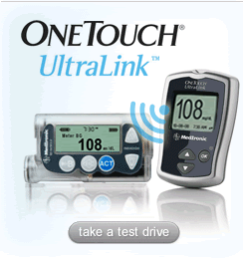
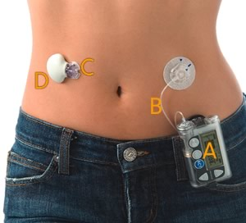
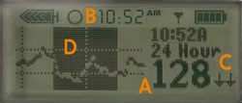
MiniMed Paradigm REAL-Time Insulin Pump and Continuous Glucose Monitoring System

Slide 46
Results
Change in glycated hemoglobin

Slide 47

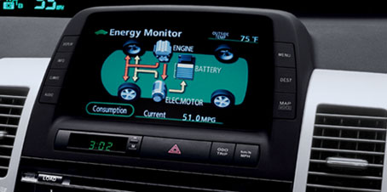
Sensors are a behavior modification tool!

Slide 48
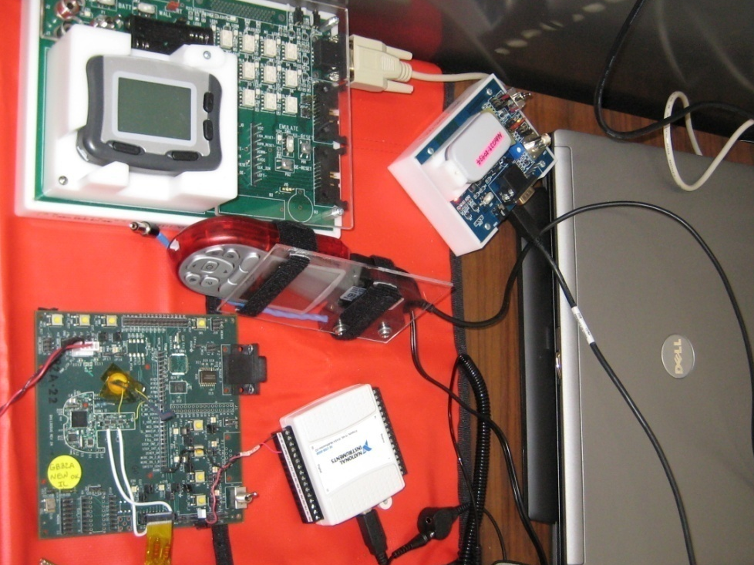

Slide 49
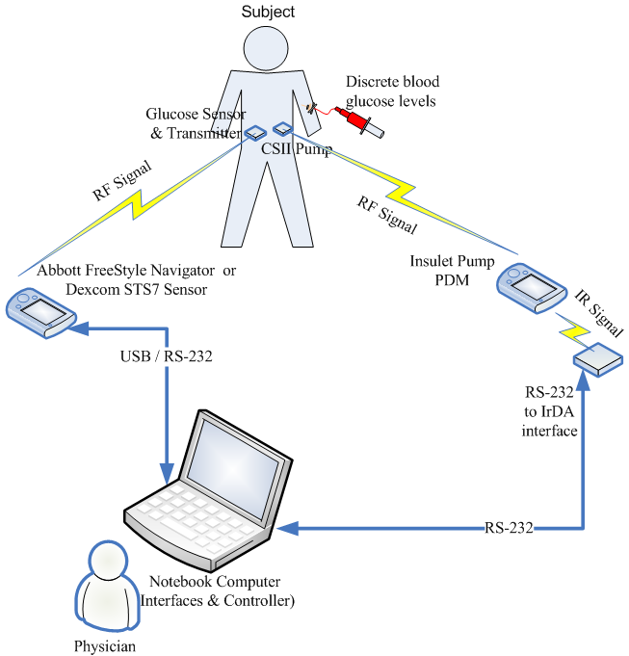
Artificial Pancreas (β-cell)
Artificial Pancreas Software (APS) Features:
  Communication with sensors & pumps
  Modularity, Plug-and-Play (PnP)
  Human Machine Interfaces (HMIs)
  Physician control
  Data storage
  Audio & Visual alarms
  Standalone application
  Data recording
  Safety and redundancy
Notes:
49

Slide 50

Proportional-Integral-Derivative (PID) Control
Error = setpoint – measured output
= desired glucose – measured glucose
Manipulated
Input (insulin)
Proportional
gain
Integral time
Derivative time
Integral “windup” can lead to postprandial hypoglycemia
Many possible tuning procedures

Slide 51
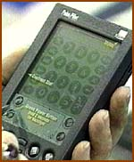
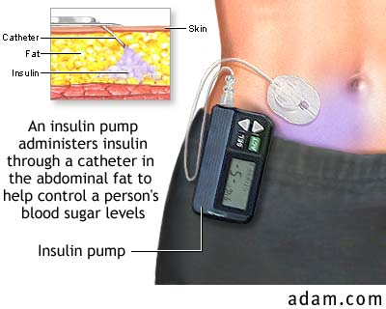
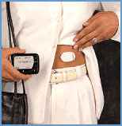

Internal Model Control (IMC)
manipulated input
(insulin infusion)
measured
output (glucose)
glucose setpoint
y
r
u
sensor
Controller
(approximate
“model inverse”)
pump
subject
~
+
y
_
Insulin-
Glucose
Model
Sensor
Model
model-
predicted
output
Estimates of other variables (possible)
model-reality mismatch

Slide 52
Closed-loop vs. hybrid control
 | Mean | Nocturnal | Peak PP
Full CL | 156 (149-163) | 109 (87-131) | 232 (208-256)
Hybrid | 135 (129-141) | 114 (98-131) | 191 (168-215)

Slide 53
Steps to Artificial Pancreas
Passive – Warning only
  High and Low alerts
  Predictive high and low alerts
Minimally Active – Emergency action
  Temporarily stop insulin for low glucose
    Fail safe
Active
  Urgent action, Treat to range
  Full control

Slide 54
Preventing Nocturnal Hypoglycemia with a Partial Closed Loop System
Stanford: B. Buckingham, Darrell Wilson, Fraser Cameron, P. Clinton, Kimberly Caswell
Barbara Davis Center: H. Peter Chase, Erin Cobry, Victoria Gage
UCSB: Frank Doyle, Eyal Dassau
Rensselaer Polytechnic Institute: Wayne Bequette, Hyunjin Lee
Acknowledgments:
Juvenile Diabetes Research Foundation (JDRF) grants
# 22-2006-1107 and 22-2007-479

Slide 55
Algorithm Prediction of Hypoglycemia
(2/5) ~50 min, ~115 mg/dL
(3/5) ~45 min, ~108 mg/dL
(5/5) ~35 min, ~100 mg/dL
Buckingham
55

Slide 56
Regulatory item 1
FDA and LGS – Veo
  Many countries, not the US

Slide 57
What we would like to see in a Body Area Network
A stable, company neutral system to reliably exchange data among diabetes related devices
  Glucose meters
  Glucose sensors
  Insulin infusion devices
  Control algorithm devices (if not embedded)

Slide 58
What we would like to see in a Body Area Network
A stable, company neutral system to reliably exchange data among diabetes related devices
  External alarms
  Activity monitors
  GPS
  Phone
  External communication devices
  Ear buds?

Slide 59
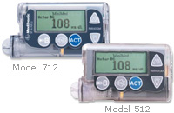
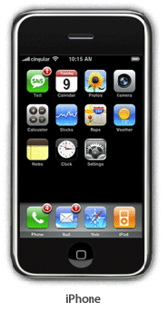
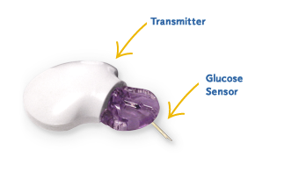
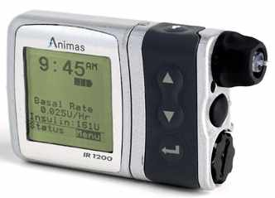
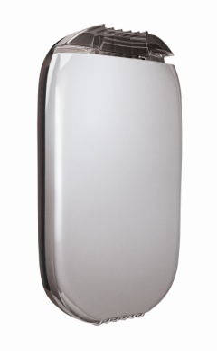
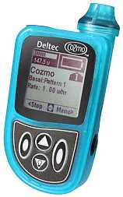
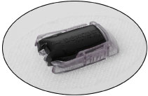
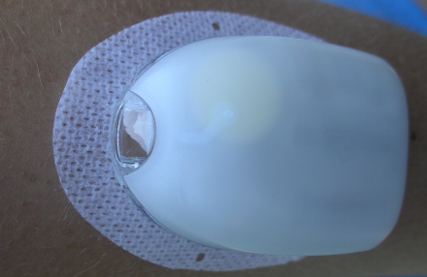

The All-In-One Device
Buckingham

Slide 60

What we would like to see in a Body Area Network
Transmission of data that will control an active device
Note the difference – NOT just a sensor network
  Insulin infusion devices
  Insulin infusion algorithm
NOW we are infusing insulin, a potential lethal medicine

Slide 61
What we would like to see in a Body Area Network
High security
High specificity

Slide 62
What we would like to see in a Body Area Network
Bidirectional communications between devices with confirmation and error checking
Reasonable transmission range
  thru the body at least
Monitoring of BAN status
Fails safely with clear warnings
Management/limit of interacting of devices

Slide 63
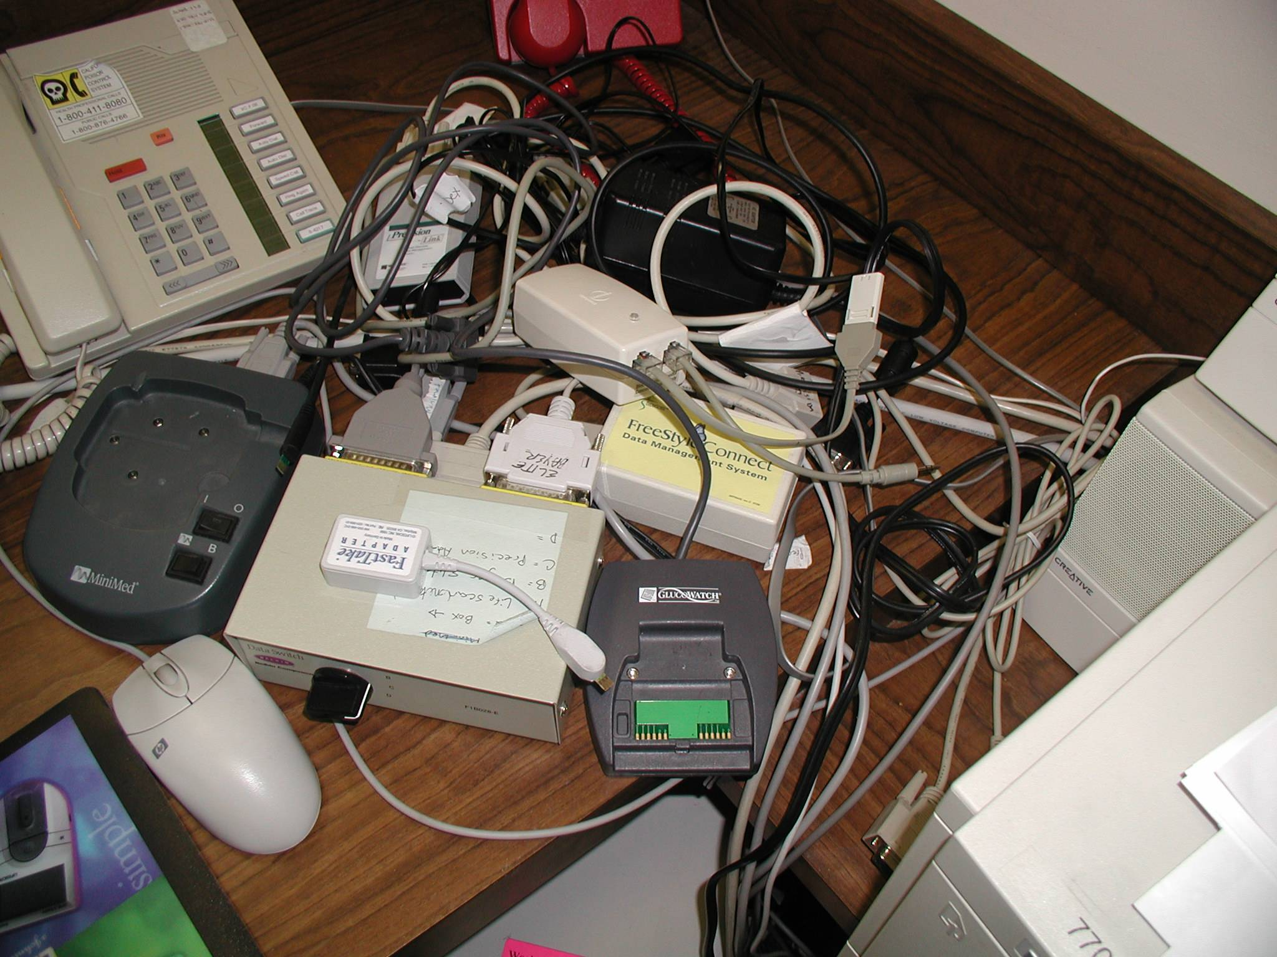
What we would like to see in a Body Area Network
Easily interrogated (downloadable)
  Cell phone, internet

Slide 64

What we would like to see in a Body Area Network
Privacy and safety
Privacy vs safety
Systematic “attacks” vs “HCP” control
Personal “attacks” vs Personal control
http://www.nicolejohnson.com/website/images/baby2.jpg
1999

Slide 65
FDA Disclosures
I’m an academic involved in clinical research that can intersect with the FDA
  IDE – investigational device exemptions
    A discussion all in itself
I don’t work for the FDA
  Other side
I don’t work for a device/software company whose products require FDA approval

Slide 66
Assumptions
As I understand it, you are developing a communication standard
Those that will use this standard will, for significant medical uses, need FDA approval

Slide 67
Regulatory
FDA approval
  Medical Device Definition
    Medical devices range from simple tongue depressors and bedpans to complex programmable pacemakers with micro-chip technology and laser surgical devices.
  "an instrument, apparatus, implement, machine, contrivance, implant, in vitro reagent, or other similar or related article, including a component part, or accessory which is:
http://www.fda.gov/medicaldevices/deviceregulationandguidance/overview/classifyyourdevice/ucm051512.htmp

Slide 68
Regulatory
  …..
  intended for use in the diagnosis of disease or other conditions, or in the cure, mitigation, treatment, or prevention of disease, in man or other animals, or
  intended to affect the structure or any function of the body of man … and which does not achieve any of it's primary intended purposes through chemical action ….[not just a drug - different dept]
http://www.fda.gov/medicaldevices/deviceregulationandguidance/overview/classifyyourdevice/ucm051512.htmp

Slide 69
Regulatory
Recent good news Feb. 14, 2011
FDA finalizes regulation for certain software, hardware used with medical devices
Rule provides more predictable path to market
The rule classifies these products, known as Medical Device Data Systems or MDDS, as Class I or low-risk devices, making them exempt from premarket review but still subject to quality standards
http://www.fda.gov/NewsEvents/Newsroom/PressAnnouncements/ucm243283.htm

Slide 70
Regulatory
Medical Device Data Systems are off-the-shelf or custom hardware or software products used alone or in combination that display unaltered medical device data, or transfer, store or convert medical device data for future use, in accordance with a preset specification.
Examples of MDDS products include: devices that collect and store data from a blood pressure cuff for future use or that transfer thermometer readings to be displayed at a nursing station for future use.
http://www.fda.gov/NewsEvents/Newsroom/PressAnnouncements/ucm243283.htm

Slide 71
Regulatory
Premarket approval (PMA) is the FDA process of scientific and regulatory review to evaluate the safety and effectiveness of Class III medical devices.
Class III devices are those that support or sustain human life, are of substantial importance in preventing impairment of human health, or which present a potential, unreasonable risk of illness or injury.

Slide 72
Guidances
“Guidance for the Content of Premarket Submissions for Software Contained in Medical Devices”
  http://www.fda.gov/downloads/MedicalDevices/DeviceRegulationandGuidance/GuidanceDocuments/ucm089593.pdf 5/11/05

Slide 73
Guidances
“Guidance for Industry, FDA Reviewers and Compliance on Off-The-Shelf Software Use in Medical Devices”
  http://www.fda.gov/downloads/MedicalDevices/DeviceRegulationandGuidance/GuidanceDocuments/ucm073779.pdf (issued 9/9/1999)

Slide 74
Guidances
“General Principles of Software Validation; Final Guidance for Industry and FDA Staff” (issued 1/11/2002)
  http://www.fda.gov/downloads/MedicalDevices/DeviceRegulationandGuidance/GuidanceDocuments/UCM085371.pdf

Slide 75
Guidances
“Guidance for Industry. Cybersecurity for Networked Medical Devices Containing Off-The-Shelf (OTS) Software”. (issued 1/14/05)
  http://www.fda.gov/downloads/MedicalDevices/DeviceRegulationandGuidance/GuidanceDocuments/ucm077823.pdf

Slide 76
More
IEC 62304:2006 (Medical device software – Software life-cycle processes)
ISO 14971:2000 (Medical devices - Application of risk management to medical devices).

Slide 77
EMC and Wireless Technology
Many CGM devices use wireless technology to upload the sensor signal to the receiver. The following information should be included in your submission:
Then many pages…

Slide 78
A. Electromagnetic Compatibility (EMC). Explain what was tested and why, the modes and functions tested and why, the configurations used for such testing and why, and the pass/fail criteria for these functions or modes. This should include a brief summary of all device functional modes, how EMC has been addressed for each mode, and a brief description of the test protocol and results. This information should address the following points.
i. A clear summary of all EMC testing (emissions and immunity) of this device with the test results and data to support their claims for immunity to electromagnetic interference (EMI).
ii. A brief explanation of how each EMC test was performed and how the testing for each mode addresses the risks for EMI and demonstrates EMC to the claimed levels. This should include a brief explanation of how the testing addresses connections to the patient, alarms, and the time for the device to perform its function.
iii. References to appropriate EMC testing standards such as the IEC 60601-1-2 standard. If there were any deviations from the referenced standards or modifications to the device under test these must be explained and justified.
iv. The pass/fail criteria for each of the EMC tests, how these were quantified and measured, and justifications for these criteria.
v. If there were any modifications to the device in order to pass any of the EMC tests then the sponsor should provide brief summary explanations of the modification and a clear statement that all modifications will be incorporated into all production units.

Slide 79
B. Device EMC labeling. The EMC related labeling recommended in the FDA recognized IEC 60601-1-2 standard should be part of the device labeling. In addition, the labeling should be clear about risks for patients and to other devices and what can be done if electromagnetic interference affects are encountered.
Additionally, if the device system contains or is linked via any wireless technology connections to other devices or systems, then the following points should also be addressed.
C. Device description regarding wireless technology: Provide a description of all RF wireless technology used in the device system including specifications for the operating frequencies, operating distances and ranges, and device system wireless functions and capabilities. The labeling for each device system component incorporating wireless technology should contain a summary of this information as well.
D. Address safety and effectiveness concerns involving the wireless technology, which are largely outside the scope of the IEC 60601-1-2 standard for EMC. This includes the following areas with testing and information that describes: the device wireless specifications and characteristics, the device functions and associated risks, testing results, and acceptable tolerances for: data integrity (ensuring proper wireless function), data latency (ensuring functions occur in a timely fashion), coexistence with other RF wireless (see point 3 for details), EMC of the wireless signals, and data security. A brief summary of the testing and results should include the following points:
i. Provide detailed information on the RF wireless technology implemented on the device, including: transfer power, RF frequency (and scheme), modulation, data rate, data flow, protocol, security. The information should indicate whether other devices (medical or non-medical) can operate on the same network.
ii. Summary of claims for the device wireless function and performance, including safeguards and redundancy. The claims should be related to the risks for the device functions and their failure.
iii. A summary of all wireless data integrity, coexistence, EMC, and security testing of this device, with justifications for what was done, test results and data to support all claims, and the pass/fail criteria.

Slide 80
E. Wireless coexistence. Wireless coexistence is the ability of one system to perform a task in a given shared environment where other systems have an ability to perform their tasks and may or may not be using the same set of rules. To address this concern the sponsor should speak to the likelihood of other wireless devices operating in the same vicinity as the device and perform reasonable testing with such devices. In addition, if the sponsor foresees multiple devices to be operated in the same vicinity then multiple devices should also be included in this testing. A brief summary of the wireless coexistence testing should include the following points.
i. Describe all devices or equipment to be included in the coexistence test plan and justify their choice and how they represent a worst case scenario. Include all pertinent information such as transfer power, frequency (and scheme), modulation, data rate, data flow, protocol, and security for all the interfering devices.
ii. Provide the pass/fail criteria for the device and the interfering devices with justifications on how these criteria were chosen and how they will be quantified and measured. Important parameters to keep in mind while testing are data integrity and latency.
ii. Explain how the wireless coexistence testing was performed and how the testing addresses the potential risks from other wireless devices. Important parameters include separation distances, number of interferers, test configuration and location, and orientation.
F. Wireless labeling. Labeling for medical devices and systems incorporating wireless technology should include a description of the wireless technology and information about how the system should be configured and operated with details such as the needed quality of service, security requirements, and how to deal with risks and problems that may arise. This information should be added to the labeling for the device system.

Slide 81
EMC and Wireless Technology
So how will FDA look at an “open” network?
How will device companies form their applications to the FDA?
Will there need to be procedures
  Restricting interactions between some devices?
  Sort of a VPNish system?

Slide 82
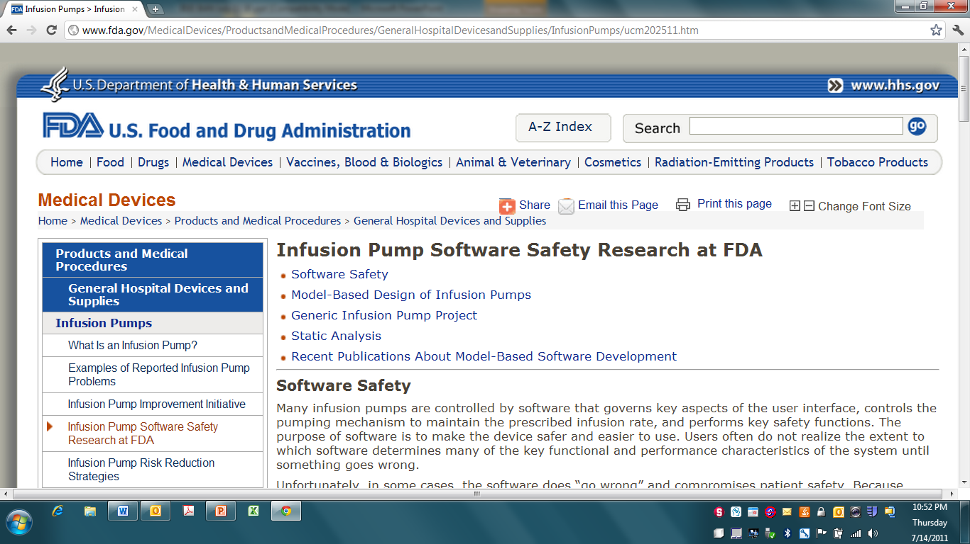
http://www.fda.gov/MedicalDevices/ProductsandMedicalProcedures/GeneralHospitalDevicesandSupplies/InfusionPumps/ucm202511.htm

Slide 83
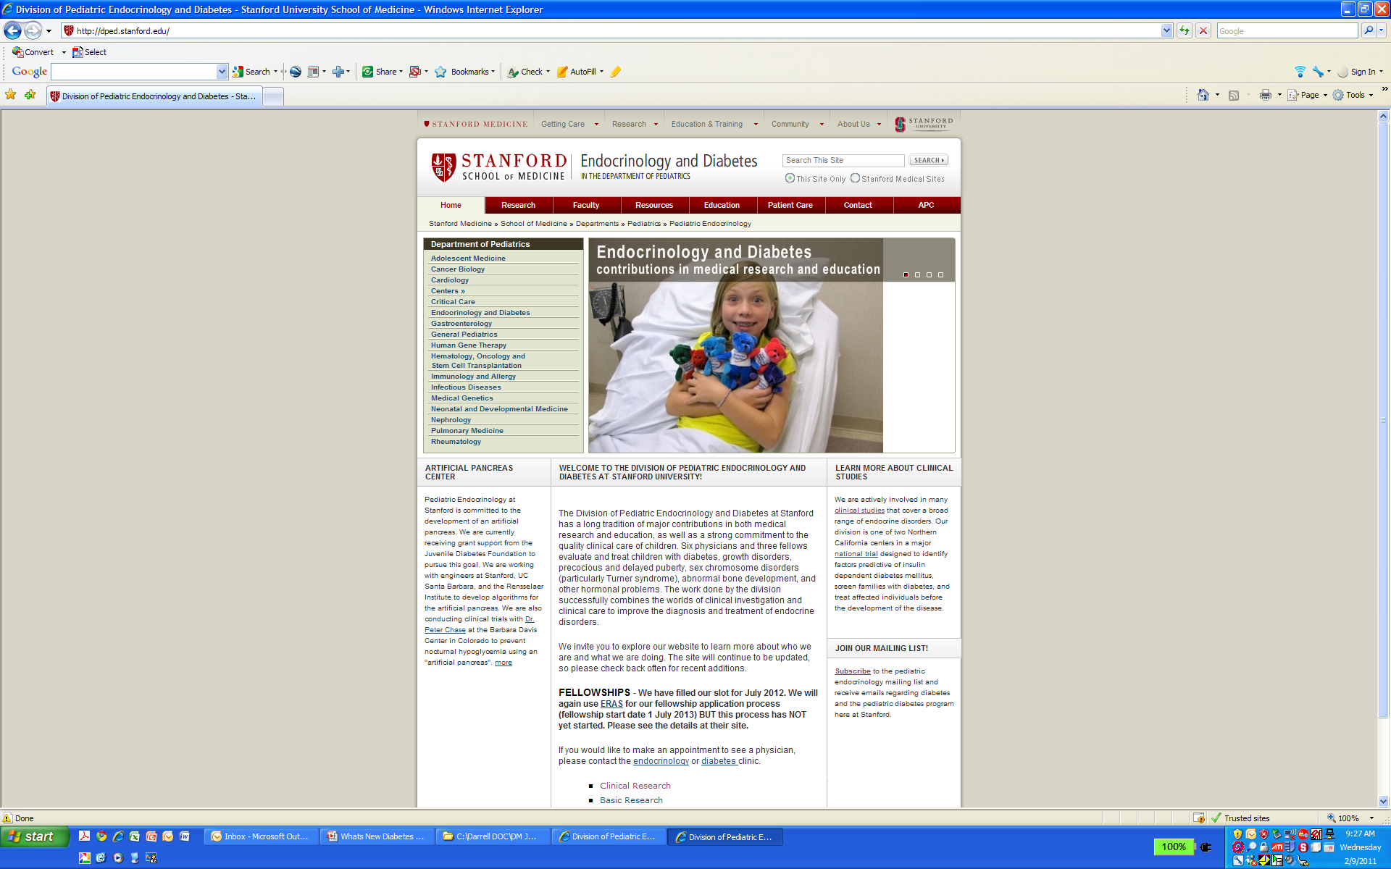
dped.stanford.edu

Slide 84
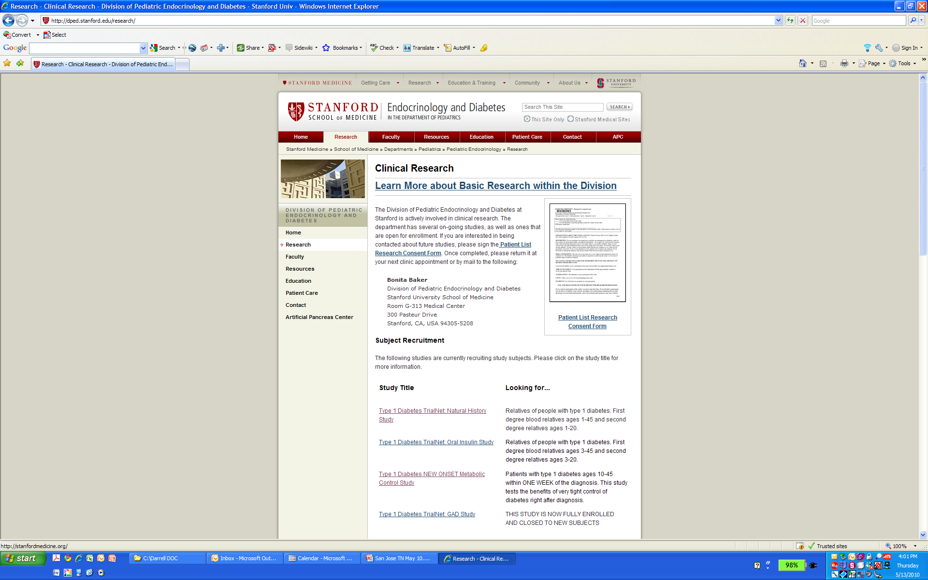
dped.stanford.edu

Slide 85
What we would like to see in a Body Area Network
And of course
  Adopted by all
  Cheap
  Low energy requiring
  Long lasting
  Green
  Easy to use while safe and secure

Slide 86
Thanks!

