Slide 1
Project: IEEE P802.15 Working Group for Wireless Personal Area Networks (WPANs)
Submission Title: [Current situation in 2.4GHz ISM band]
Date Submitted: [18 July, 2011]
Source: [Shoichi Kitazawa] Company [ATR]
Address [2-2-2 Hikaridai Seika, Kyoto 619-0288 Japan]
Voice:[+81-774-95-1511], FAX: [+81-774-95-1508], E-Mail:[kitazawa@atr.jp]
Re: []
Abstract: [In order to understand congestion situation in 2.4GHz ISM band, spectrum use at Airport and home environment has been taken.]
Purpose: [For discussion]
Notice: This document has been prepared to assist the IEEE P802.15. It is offered as a basis for discussion and is not binding on the contributing individual(s) or organization(s). The material in this document is subject to change in form and content after further study. The contributor(s) reserve(s) the right to add, amend or withdraw material contained herein.
Release: The contributor acknowledges and accepts that this contribution becomes the property of IEEE and may be made publicly available by P802.15.

Slide 2
Current situation in 2.4 GHz ISM band
Authors:

Slide 3
Introduction
2.4GHz ISM band is getting more and more crowded.
We have reported high traffic load situation in anechoic chamber. (15-10-0886 )
To understand current situation in 2.4GHz ISM band, measurement of spectrum use at hotspot and home environment was carried out.

Slide 4
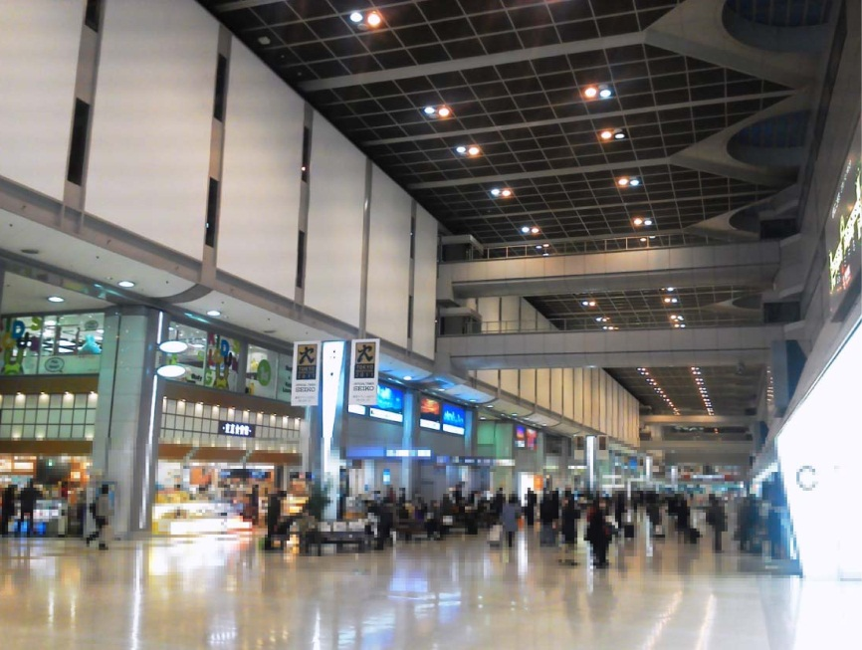
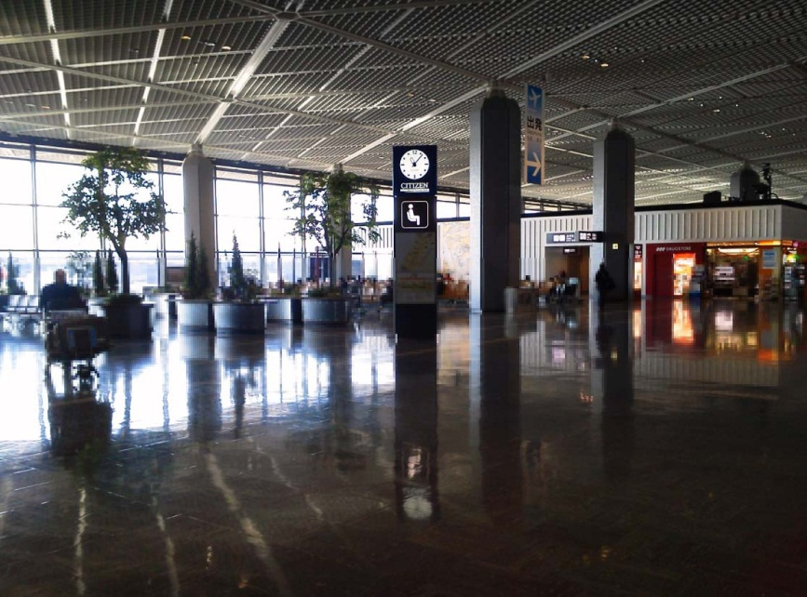
Airport environment
Two places(Haneda and Narita Airport) were selected for measurement of the ISM band.
Haneda Departure Lobby
Narita Departure Lobby

Slide 5
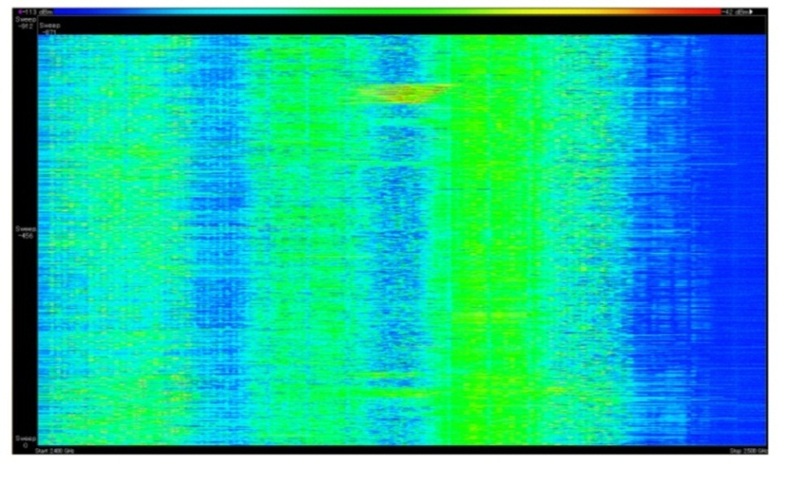
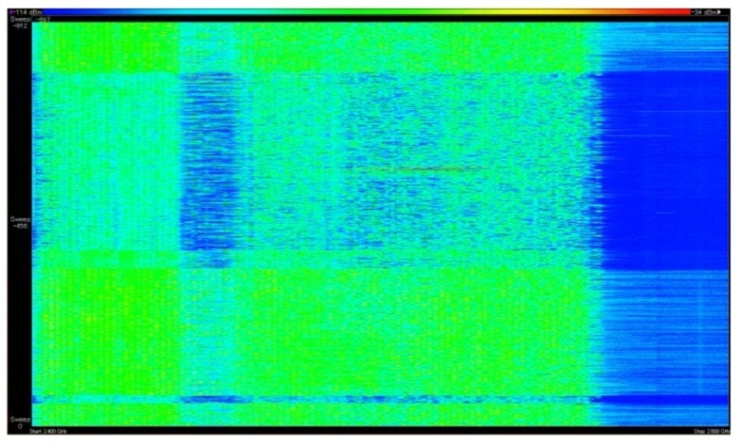
Measurement results at Airport
3 channels have been continuously used by WLAN.
Sometimes other channel was used.
-114dBm
Signal strength
-34dBm
-114dBm
Signal strength
-34dBm
10:00
16:00
Time
Time
10:15
16:15
2.4GHz
Frequency
2.5GHz
2.4GHz
Frequency
2.5GHz

Slide 6
Home environment
There are about 20 homes and apartment houses within a 50 meter radius.

Slide 7
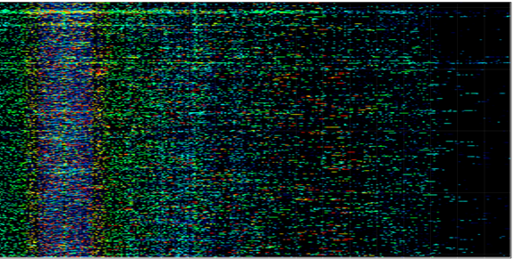
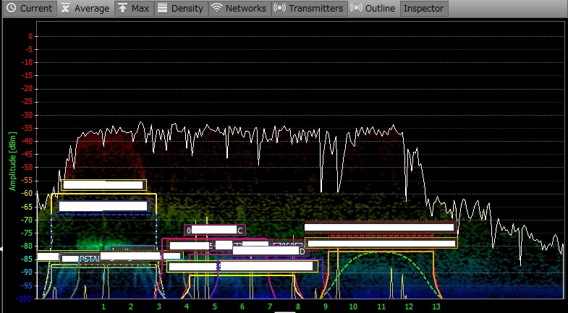
Measurement results at
Home environment
There was not high traffic load at this time.
Various systems were observed.
  WLAN 15 AP’s at CH1, 2, 5, 6, 7, 11.
  FH systems (codeless telephone and other system)
23:50
23:40
Max Hold
23:30
23:20
23:10
2.4GHz
Frequency
2.48GHz
20 minutes snapshot

Slide 8
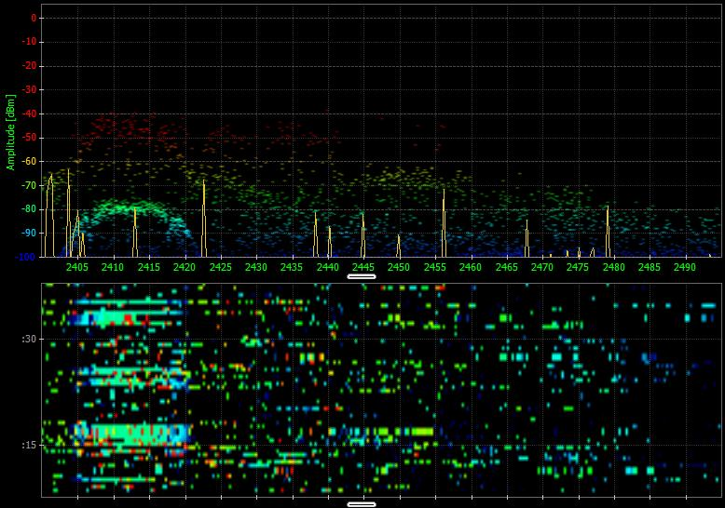
Measurement results at
Home environment (cnt’d)
30 sec
30 second snapshot

Slide 9
Conclusions
High traffic situation were observed in hotspot area.
In a home environment, many WLAN and other FH systems were operated. And the congestion situation was observed.
A technology for better use of spectrum resources is required for future WPAN system.
Acknowledgment
This work is supported by the Ministry of Internal Affairs and Communications under a grant “Research and development on radio resource control technologies among multiple radio systems on same frequency band.”

