Slide 1
Project: IEEE P802.15 Working Group for Wireless Personal Area Networks (WPANs)
Submission Title: [System concept of DSA]
Date Submitted: [7 Mar, 2011]
Source: [Shoichi Kitazawa, Kazuto Yano, Yasuo Suzuki, Kohji Ohshima, Narihiro Nakamoto, Masahiro Uno and Masazumi Ueba] Company [ATR]
Address [2-2-2, Hikaridai Seika, Kyoto, 619-0288, JAPAN]
Voice:[+81 774951511], FAX: [+81 774951508], E-Mail:[kitazawa@atr.jp]
Abstract: [This presentation describes a system concept of DSA.]
Purpose: [For information.]
Notice: This document has been prepared to assist the IEEE P802.15. It is offered as a basis for discussion and is not binding on the contributing individual(s) or organization(s). The material in this document is subject to change in form and content after further study. The contributor(s) reserve(s) the right to add, amend or withdraw material contained herein.
Release: The contributor acknowledges and accepts that this contribution becomes the property of IEEE and may be made publicly available by P802.15.

Slide 2
System concept of DSA
Shoichi Kitazawa
Kazuto Yano
Yasuo Suzuki
Kohji Ohshima
Narihiro Nakamoto
Masahiro Uno
Masazumi Ueba
(ATR)

Slide 3
Introduction
We proposed DSA (dynamic spectrum access) system at WNG meeting at Waikoloa 2010.
This contribution explains following content.
  Concept
  Features
  Simulation
  QoS coordinator

Slide 4
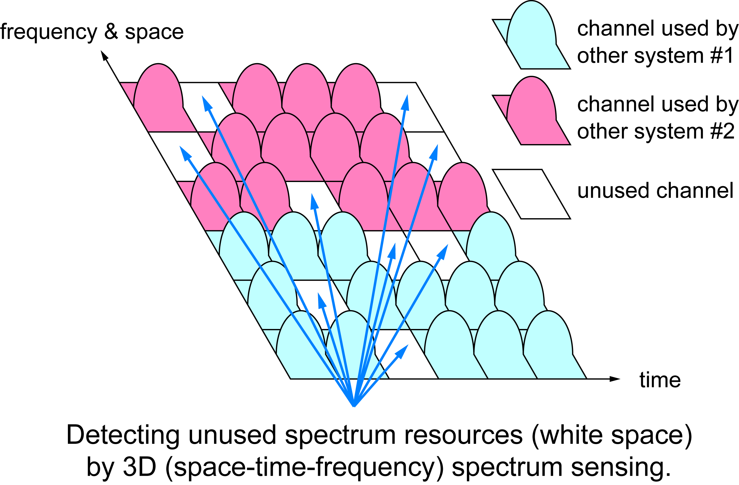
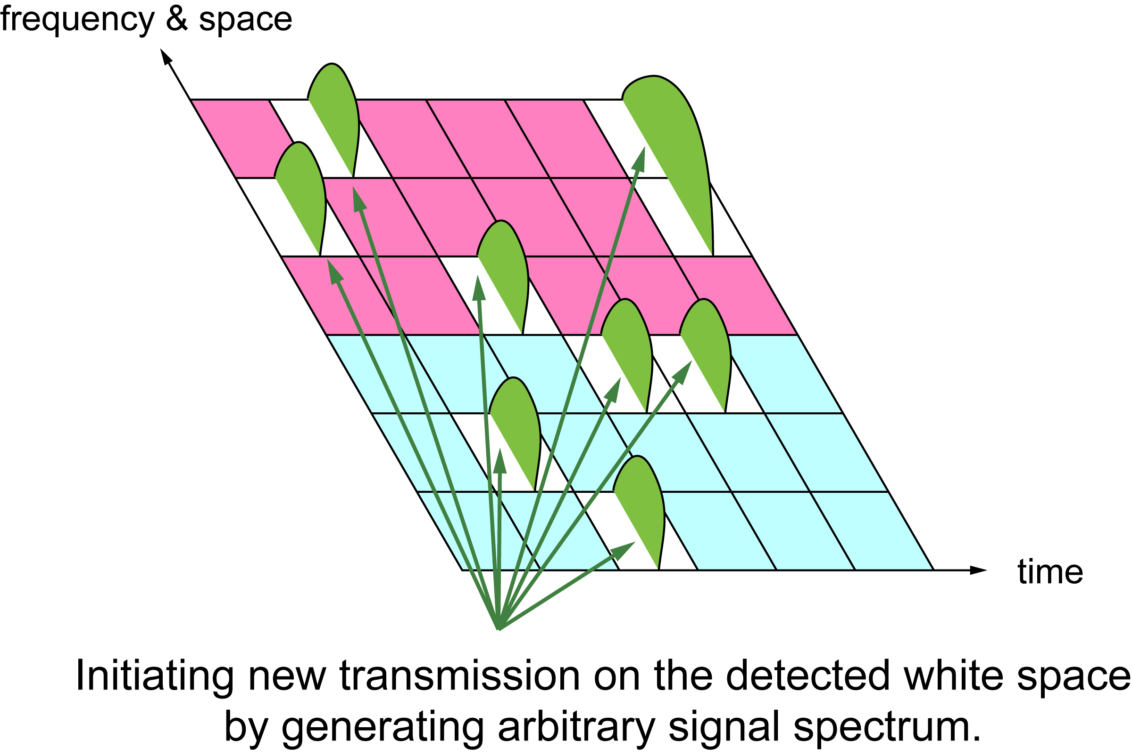
Concept of proposed DSA
DSA system transmits its own traffic over fragmented unused radio resources detected by spectrum sensing.
It shares radio resources, managing the influence on other wireless system.

Slide 5
Features of DSA system
The system consisting of an access point (AP) and mobile stations (MS).
For efficient spectrum use and low overhead,
  Carrier sense to avoid interference to/from the other radio systems, but without random back-off (fixed-length quiet time)
  Connection-oriented MAC protocol
  TDMA (polling) with DSA forming time frame and slots
  Using a Common Control Channel (CCH) with frequency hopping (FH) for link establishment
The system control priority of its own traffic.
  Changing its sensing parameters

Slide 6
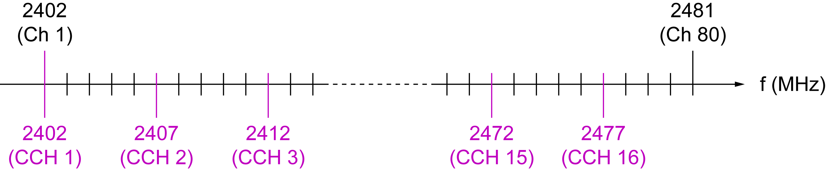
Frequency Channel Plan in 2.4 GHz Band
DCH and CCH
  Data link channel (DCH) is formed of one or several frequency channels.
  Common control channel (CCH) hops on predetermined subset of frequency channels.
Frequency Channel
  80 channels of 1MHz separation for DCH at, (2401+ i ) MHz, i=1, 2, ... , 80
  16 channels of 5MHz separation for CCH hopping at, (2402+ 5(j-1) ) MHz, j=1, 2, ... , 16

Slide 7
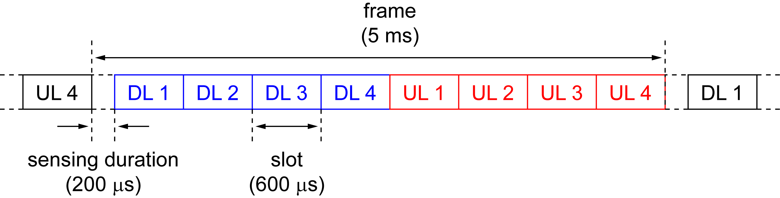
Frame Configuration for CCH
March 2011
Frame and CCH hopping period of 5ms
Sensing and guard duration (quiet time) of 200 μs
4+4 slots TDMA-TDD
slot 1– slot 3 for frequency channel negotiation of DCH at each polling
slot 4 for broadcasting, paging, link/connection request, and etc.

Slide 8
Simulation
We evaluated the effect of DSA system in multiple wireless systems by PHY/MAC cross-layer simulations.
Performance index
  MAC throughput
Focused parameter
  Radio resource usage policy of DSA system including CS;
  “Modest” / ”Greedy”
DSA policy | Resource Reservation (later) | CS calculation | CS threshold
“Modest” | OFF | last value | variable
“Greedy” | ON | max hold | variable

Slide 9
Evaluation scenario
10 m x 10 m area
IEEE 802.11g ERP-OFDM DCF
  3 WLAN BSSs (1,5,9 ch)
1 Bluetooth piconet (Not AFH)
1 DSA group (AP and MS)
High load traffic
10m
10m
DSA
WLAN
Bluetooth

Slide 10
DSA system settings
Frame structure
  4 slots for both DL and UL
  CS period ahead a frame
Logical channel
  4 slot of Data Channel (DCH)
  1 slot of Control Channel (CCH)
Resource reservation function
  AP transmits reservation signal
  over vacant DCH in DL to reduce
  DCH collisions in UL transmission
AP
MS
carrier sense
DL CCH
DL DCH (reservation)
UL DCH

Slide 11
Results “Modest” policy (1/2)
DSA system increases total throughput.
System total throughput gain
+1.2 Mbps | 10.7 %

Slide 12
Results “Modest” policy (2/2)
Throughput proportion of DSA and WLAN
changes with CS thresholds.
CS threshold | Proportion of WLAN & DSA: WLAN DSA
-91 dBm | 84 % | 16 %
-88 dBm | 81 % | 19 %
-84 dBm | 77 % | 23 %

Slide 13
Results “Greedy” policy (1/2)
Total throughput increases than that in modest policy.
System total throughput gain
+2.6 Mbps | 22.8 %

Slide 14
Results “Greedy” policy (2/2)
Throughput proportion becomes higher in DSA and
lower in WLAN than in modest policy.
CS threshold | Proportion of WLAN & DSA: WLAN DSA
-91 dBm | 57 % | 43 %
-88 dBm | 54 % | 46 %
-84 dBm | 47 % | 52 %

Slide 15
Better use of spectrum resources in ISM band
Filling a fragment unused spectrum resources.
  ⇒ Increase of total throughput in the band
The system transmit own required QoS as much as possible without deterioration of required QoS of other systems.
  ⇒ Need to define radio resource usage policy

Slide 16
DSA system advantages
The system can increase total amount of system throughput.
  switch its priority of channel access by changing radio resource usage policy
  ability to control inter-system priority in ISM band
The DSA system has potential as a QoS coordinator.

Slide 17
Conclusions
System concept of DSA is proposed.
  Frequency channel plan
  Frame configuration
Simulation results shows
  DSA system can improve total system throughput.
  DSA system has the ability to control inter-system priority in ISM band as a QoS coordinator.
Acknowledgment
This work is supported by the Ministry of Internal Affairs and Communications under a grant “Research and development on radio resource control technologies among multiple radio systems on same frequency band.”

Slide 18
References
15-10-0739r1 A Proposal toward Better Use of Spectrum Resources in future WPAN
15-10-0886r0 Experimental results of High traffic-load situation

