Slide 1
Project: IEEE P802.15 Working Group for Wireless Personal Area Networks (WPANs)
Submission Title: [ Proposed OFDM Comment Resolution Responses]
Date Submitted: [ September 2010 ]
Source: [Wei An¹, Sangsung Choi², Cheolho Shin², Khurram Waheed³, Emmanuel Monnerie⁴, Charles Razzell⁵, Rishi Mohindra⁵, Partha Murali⁶, Steve Jillings⁷, Tim Schmidl⁸, Shusaku Shimada⁹]
Company: [Analog Devices, Inc.¹, Electronics and Telecommunications Research Institute (ETRI)², Freescale Semiconductor³, Landis+Gyr⁴, Maxim Integrated Products⁵, Redpine Signals Inc.⁶, Semtech⁷, Texas Instruments⁸, Yokogawa Co.⁹]
E-Mail: []
Re: [ TG4g comment resolution for LB #51 ]
Abstract:
Purpose: Provide data to assess likely robustness of the proposed OFDM pilot scheme
Notice: This document has been prepared to assist the IEEE P802.15. It is offered as a basis for discussion and is not binding on the contributing individual(s) or organization(s). The material in this document is subject to change in form and content after further study. The contributor(s) reserve(s) the right to add, amend or withdraw material contained herein. Release: The contributor acknowledges and accepts that this contribution becomes the property of IEEE and may be made publicly available by P802.15.
Notes:
doc.: IEEE 802.15-<doc#>
<month year>
<author>, <company>
Page 1

Slide 2
Background
A number of key themes are addressed in these proposed comment resolutions.
The purpose and intent of these responses is to provide the best technical solution to issues that have been raised during comment resolution.
In cases where the best technical solution is believed to be that provided by the existing text, a reject response is proposed, with applicable detailed reasoning.
In cases where an improvement is believed to be feasible, a modification to the draft text is proposed.

Slide 3
Interleaver Design
Comments 1404 and 1410 are proposed to be accepted in principle. Define a PIB attribute phyOFDMInterleaving which indicates the interleaving depth to be used for the OFDM header and payload.
Devices shall be capable of supporting an interleaving depth of one symbol which is associated with a value of zero for the PIB attribute phyOFDMInterleaving. Devices may support an interleaving depth of the number of symbols equal to the frequency domain spreading factor which is associated with a value of one for the PIB attribute phyOFDMInterleaving. The frequency domain spreading factor can be one, two or four.

Slide 4
Interleaver Design
15/09/2010
Propose to accept in principle comments 1041, 1064, 1409, 1411.
When PIB attribute phyOFDMInterleaving = 0, the Ncbps is defined as the the number of coded bits per symbol before any frequency spreading. Ncbps is defined in Section 6.12b.2.9. Move the definition of Ncbps to Section 6.12b.2.4. Table 75i is to be deleted because the Ncbps is already defined in the text. The text should state that Nrow = 12.
When PIB attribute phyOFDMInterleaving = 1, the Ncbps defined in Section 6.12b.2.4 the formulas defined in Section 6.12b.2.9 should be changed as ‘15-10-0423-01-004g’
For the second equation of the interleaver (21o) change “where i = 0, 1, 2, …, Ncbps.” to “where i = 0, 1, 2, …, Ncbps-1.”
Insert at the beginning of the section 6.12b.2.4 Interleaver, “We shall denote by k the index of the coded bit before the first permutation; i shall be the index after the first and before the second permutation, and j shall be the index after the second permutation, just prior to modulation mapping.”
Slide 4

Slide 5
Clarification of STF and LTF
Comment 964 (propose to accept in principle):
After “The following subclauses define the fields for the OFDM PHY PPDU, as was previously shown in Figure 26d.” insert: Definitions are provided in the frequency domain for the Short Training Field (STF) and Long Training Field (LTF). In each case, a normative set of operations is specified to transform the frequency domain fields to the time domain and to insert prescribed repetitions or cyclic prefixes of these time domain sequences.
Change: “6.3.4a.1 Short Training field for OFDM” to “6.3.4a.1 Short Training Field (STF)”
Raise “Frequency Domain STF:” to a heading at level 5 (6.3.4.a.1.1)
Raise corresponding “Time Domain STF Generation:” to a heading at level 5 at top of page 39 (6.3.4.a.1.2)
Change “6.3.4a.2 Long Training field for OFDM” to “6.3.4a.2 Long Training Field (LTF)”
Raise “Frequency Domain LTF:” to a heading at level 5 (6.3.4.a.2.1)
Raise corresponding “Time Domain LTF Generation:” to a heading at level 5 (6.3.4.a.2.2) at line 13 of page 42.

Slide 6
Clarification of STF
Comments 974, 975:
Commenters wrote: “Scaling factor should be sqrt(14/4) instead of sqrt(14/6)”
Resolution: propose to accept in principle. The number of used tones in table 29.d should be in the denominator of the scaling factor, and 6 tones are used so no change is required.
Comments 996, 997:
Commenter wrote: “The STF allocation for Mode 4 is incorrect. To get 1/4 symbol repetitions, subcarriers at -4 and +4 should be set to zero”
Zeroing out those tones will not change the repetition period. The figure 27e should be updated to show that Options 4 and 5 have a repetition period of half a symbol
Resolution: propose to accept in principle. Figure 27e should be updated to show that Options 4 and 5 have a repetition period of a half symbol.

Slide 7
Clarification of STF
Comment 1010:
Commenter wrote: “How robust is each of the STF's in relation to the data transmission at the most robust rate? How does multipath and fading affect its performance? Provide data to show that the reliability of the STF in relation to the reliability of the data at the lowest data rate in the agreed channels”
Propose to accept in principle: Consider that there are 4 repetitions of the STF and therefore the detection of the presence or absence of the STF is a 1-bit decision having the energy of 4 OFDM symbols (480 μs). Considering that the lowest data rate in any mode is 50kbps, there are always at least 24 bits in any 4-OFDM symbol period (480 * 0.05). Thus the Eb/No available for burst detection is 24 times higher (14dB) than that that provided for the most robust modulation schemes, even before any STF power boost is applied (15.75 dB if power boost is considered). No change required.

Slide 8
Example of OFDM Packet Option 2, QPSK ½ Rate, 72 octets Payload
STF
LTF
Header + Payload
PAPR : 1.8dB 3dB 8.8dB
Relative
Average Power: +1.9dB 0dB 0dB

Slide 9
Power Boosting
Comments 1005, 1007, 1009, 1011, 1014, 1028
Proposed Resolution: Accept in principle. The STF PAPR is several dB lower than the payload PAPR. Even with a power boost on the STF, the max power during the STF is still lower than the max power during the payload. Simulations have been conducted to verify. The value of 1.94dB corresponds to 20*Log(1.25), which is easy to implement. No change required.

Slide 10
STF Inversion
15/09/2010
Slide 10
K. Kim, S. Kim, Y. Cho, and Y. Ahn, “Synchronization and cell-search technique using preamble for OFDM cellular systems,” IEEE Transactions on Vehicular Technology, Vol 56, No. 6, November 2007, pp. 3469-3485 shows the inverting the last part of the preamble aids the receiver in finding the frame timing. See Figures 1 and Figure 5.
Propose to accept in principle comments 976, 977, 979, 980, 981. Define the STF inversion as the last half of the last STF symbol. Options 4 and 5 have a repetition period of one-half STF symbol, so inverting the last half of the last STF symbol allows the receiver to perform the same functionality for all options.
Propose to accept in principle comments 993 and 994. The technical justification is given, so no change is required.

Slide 11
Adequacy of LTF for Channel Estimation
15/09/2010
The LTF consists of 2 identical OFDM symbols with known values in all active sub-carriers.
Frequency domain low pass filtering of the channel estimate allows the SNR or the channel estimate to be improved by a linear factor of 4. Given that there are two channel estimation symbols, the available improvement factor is 8.
When demodulating non-spread symbols the SNR ratio of the reference symbols to the information bearing symbols is 8:1, when demodulating 4x frequency repetition MCS schemes the SNR ratio is 2:1. If differential detection were used, the ratio would by 1:1 (3dB loss).
Conclusion: the worst case SNR of reference symbols is at least twice as high as the information bearing symbols, considering the 4x frequency repetition case. There is no need to add additional channel estimation symbols.
Propose to accept in principle comment 992. The requested justification of 2 LTF symbols is given above, so no change is required. Propose to reject comment 989 with the above rationale.
Slide 11

Slide 12
Starting State for Convolutional Encoder
We need to make it explicit that the convolutional encoder starts at the all-zeros state.
Propose to accept in principle comments 1056, 1065. Insert text in section: 6.12b.2.3 Forward error correction (FEC)
The convolutional encoder shall use the industry-standard generator polynomials, g0 = 133 and g1 = 171, of rate R = 1/2, as shown in Figure 65o, and shall be initialized to the all zeros state before encoding the PHY header and then reset to the all zeros state before encoding the PSDU.

Slide 13
Sampling and carrier frequency
15/09/2010
Slide 13
Sampling and carrier frequency is derived from same clock as in 802.11
Propose to accept in principle comment 1521. The receiver can take advantage of the information that the sampling clock and carrier frequency are related because they are derived from the same clock. No change required.

Slide 14
Mandatory Mode
15/09/2010
Slide 14
Propose to accept in principle comments 1341,1342, 1343, 1344, 1345, 1346, 1669. All devices supporting a particular option (1,2,3 or 4) shall support all BPSK and QPSK MCS levels for that option. All 16-QAM MCS levels are optional.

Slide 15
Scrambling before or after channel coding?
In the tradition of 802.11a/g/n the current draft has specified scrambling to be done as the first step before channel coding. Some have advocated that the scrambler operation should take place after the channel coding.
Many convolutional codes are white (see Mannerkoski, J.; Koivunen, V.; , "Autocorrelation properties of channel encoded sequences-applicability to blind equalization," Signal Processing, IEEE Transactions on , vol.48, no.12, pp. 3501- 3507, Dec 2000).
Our particular ½-rate convolutional mother code is white also.
The remaining operations of puncturing and interleaving cannot possibly cause coloring or correlation.
Conclusion: there is no theoretical reason to move the whitening scrambler to the output of the channel encoder.
Propose to reject comment 1381.

Slide 16
Scrambler definition
15/09/2010
Slide 16
Reuse scrambler that is defined for FSK
Propose to accept in principle comments 1035, 1037, 1379, 1380, 1434, 1435, 1436, 1437, 1438, 1444, 1445, 1446, 1447, 1448, 1449 and to use the scrambler described in Slide 5 of 15-10-0417-00-004g-comment-resolutions-for-ofdm-scrambler-and-HCS.ppt

Slide 17
EVM
15/09/2010
Propose to accept in principle comments 1334, 1511, 1512, 1514, 1516, 1518, 1520, 1523
Use EVM requirements given below for MR-OFDM
The relative constellation RMS error averaged over subcarriers, symbols, and packets shall not exceed
MCS | RMS error
MCS0 | -10dB
MCS1 | -10 dB
MCS2 | -10 dB
MCS4 | -10 dB
MCS6 | -13 dB
MCS7 | -16 dB
MCS8 | -19 dB
Slide 17

Slide 18
Sensitivity
15/09/2010
Propose to accept in principle comments 1451, 1452, 1453, 1454, 1455, 1460, 1461
Use sensitivity requirements given below for MR-OFDM:
 |  | Sensitivity Option 1 | Sensitivity Option 2 | Sensitivity Option 3 | Sensitivity Option 4 | Sensitivity Option 5
MCS0 | BPSK 1/2 rate coded and 4x frequency repetition | -103 dBm | -105 dBm
MCS1 | BPSK 1/2 rate coded and 2x frequency repetition | -100 dBm | -103 dBm | -105 dBm
MCS2 | QPSK 1/2 rate coded and 2x frequency repetition | -97 dBm | -100 dBm | -103 dBm | -105 dBm
MCS3 | DCM QPSK 1/2 rate coded | -94 dBm | -97 dBm | -100 dBm | -103 dBm
MCS4 | QPSK 1/2 rate | -94 dBm | -97 dBm | -100 dBm | -103 dBm
MCS5 | DCM QPSK 3/4 rate coded |  | -94 dBm | -97 dBm | -100 dBm | -103 dBm
MCS6 | QPSK 3/4 rate coded |  | -94 dBm | -97 dBm | -100 dBm | -103 dBm
MCS7 | 16-QAM 1/2 rate coded |  | -91 dBm | -94 dBm | -97 dBm | -100 dBm
MCS8 | 16-QAM 3/4 rate coded |  |  | -91 dBm | -94 dBm | -97 dBm
Slide 18

Slide 19
Pilot tone simulation
15/09/2010
Flat fading
Doppler fading
5us
TU
Slide 19
Simulated the proposal in 15-10-0474-01-004g-comment-resolutions-for-ofdm-scattered-pilots.ppt for Option 2.
Channel model used is TU where first path is flat fading and second path has Doppler fading.
It does not make sense to add Doppler fading to all paths since both transmitter and receiver are stationary. If all paths are fading then a long interleaver and outer code are needed because otherwise if a single OFDM symbol is in a fade the packet would be lost.

Slide 20
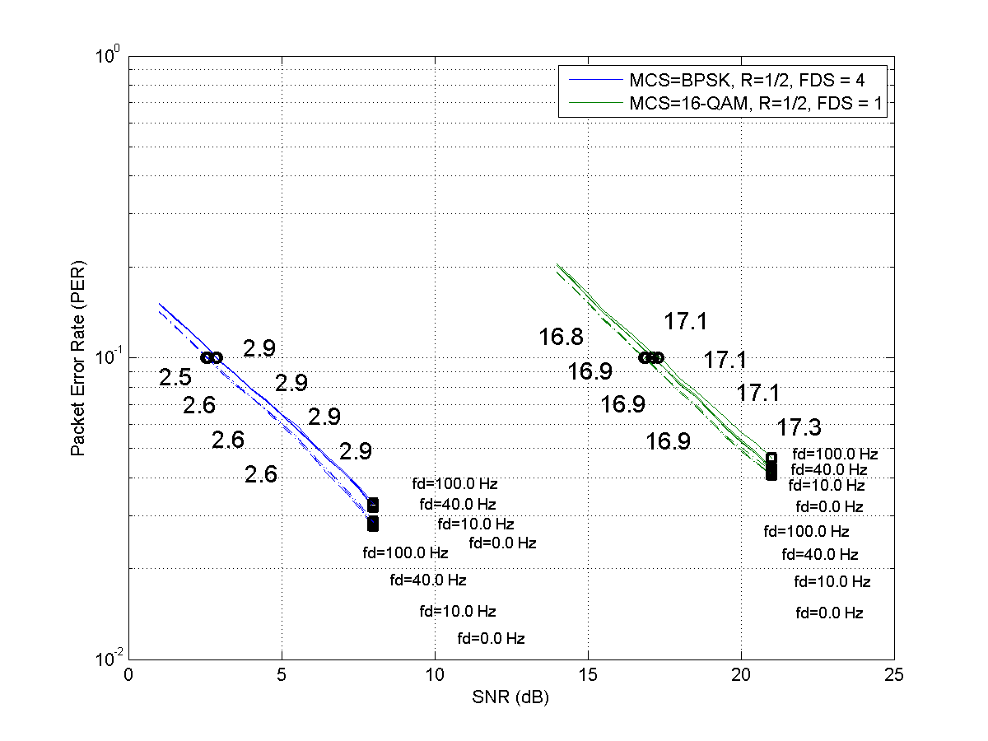
Pilot tone performance
15/09/2010
Solid line denotes PER with
actual channel estimation
Dash-dot line denotes PER with
ideal channel estimate
Slide 20

Slide 21
Pilot tones
Propose to accept in principle comments 1420, 1421, 1422. Pilot tones have been shown to perform well. No change required.
Propose to accept in principle comment 1423. The pilot tones have been shown to perform well, so adopt pilot patterns given in slides 4 to 8 of 15-10-0474-01-004g-comment-resolutions-for-ofdm-scattered-pilots.ppt

Slide 22
Option 5
15/09/2010
There have been several comments that there are too many options.
Propose to accept in principle comments 1371, 1372. Option 5 is to be removed from the MR-OFDM specification.
Propose to accept in principle comments 1414, 1415, 1416, 1417 to change Nrow=4 for Option 5. When Option 5 is removed, the correction is not needed. No change required.
Slide 22

Slide 23
PIB Attribute for header MCS
15/09/2010
Adding a PIB attribute to allow the header to be transmitted in an MCS other than the lowest MCS adds complexity to the system. Propose to reject comments 807, 808, 809, 810, 1042, 1043, 1044, 1066, 1067, 1068.
Slide 23

Slide 24
DCM
15/09/2010
Propose to accept in principle comments 1373, 1374, 1375, 1376, 1377, 1378, 1382, 1388, 1390. DCM is to be removed from the MR-OFDM specification. The MCS levels are to be renumbered starting from 0 excluding the DCM MCS levels.
Slide 24

Slide 25
PIB Attribute phySymbolsPerOctet
15/09/2010
Propose to accept in principle comments 1137, 1138, 1139, 1140, 1141 with the following changes:
The number of symbols per Octet depends on MCS level and the OFDM option, as represented in the following table :
phySHRDuration, in the case of MR-OFDM SUN = 6 symbols
In table 23, add the following PIB attribute: phyPHRDuration . In the case of MR-OFDM SUN, it is 3 symbols for OFDM Option 1, 6 symbols for OFDM Option 2, 3 and 4
In 7.4.2, add the following:
in the case of SUN MR-OFDM: macAckWaitDuration = aUnitBackoffPeriod + aTurnaroundTime + phySHRDuration + phyPHRDuration + 6 ⋅ phySymbolsPerOctet
In table 23, for phyMaxFrameDuration, add the following:
in the case of SUN MR-OFDM: phySHRDuration + phyPHRDuration + ceiling([aMaxPHYPacketSize + 1] x phySymbolsPerOctet
Slide 25

Slide 26
Thank you

