Slide 1
Project: IEEE P802.15 Working Group for Wireless Personal Area Networks (WPANs)
Submission Title: Overview of Dynamic DSSS Proposal 802.15.4TG4g SUN
Date Submitted: 6 July, 2009
Source: David Howard, Ted Myers, On-Ramp Wireless, Inc.,
Address: 16885 West Bernardo Drive, Suite 255, San Diego, CA 92127, USA
Voice: +1-858-592-6008, FAX: +1-858-592-6009,
E-Mail: david.howard@onrampwireless.com, ted.myers@onrampwireless.com
Re: TG4g Call For Proposals, document number IEEE 15-09-356-004g
Abstract: Overview of the On Ramp Proposal (doc# 15-09-0307-00-004g), including a DSSS PHY where dynamic receive sensitivity, allowing up to 187dB of allowable path loss, and a multiple access option that reduces battery consumption. Testing in real world metropolitan and plant environments validate key performance parameters.
Purpose: This document is intended as an overview of the On Ramp Wireless’ proposal for addressing the requirements of the TG4g standard.
Notice: This document has been prepared to assist the IEEE P802.15. It is offered as a basis for discussion and is not binding on the contributing individual(s) or organization(s). The material in this document is subject to change in form and content after further study. The contributor(s) reserve(s) the right to add, amend or withdraw material contained herein.
Release: The contributor acknowledges and accepts that this contribution becomes the property of IEEE and may be made publicly available by P802.15.

Slide 2
Outline
Requirements of 15.4g
PAR
PG&E presentation (15-08-0297)
Details of Dynamic DSSS proposal
TX/RX architecture
System Parameters
Performance results
Link budget, sensitivity, system performance in multi-path
Summary and conclusions

Slide 3
Requirements
PAR
Data rate at least 40kbps
Optimal energy efficient link margin
Connectivity to at least one thousand direct neighbors
Minimal infrastructure
Reach every node in the network
Long range point to point reduces cost
PG&E presentation (15-08-0297)
Coverage probability: 100%
Capacity requirements are in 10’s of kbps
High link margin is a fundamental design criteria to reach every node in the network with 100% coverage probability and minimal infrastructure

Slide 4
Proposed Dynamic DSSS Physical Layer
More details about the Dynamic DSSS Physical Layer can be found in the latest version of 15-09-0307-00-004g

Slide 5
Overview of Dynamic DSSS Proposal
PHY is optimized for wireless meters:
Very large link margin: up to -146dBm sensitivity– allows connection to the hard to reach meters – minimal infrastructure
Scalable data rates: 30bps –250 kbps - allows for tradeoff of range vs. rate
Support for multiple frequency bands of operation
PHY solution enables very low-power consumption
Large link margin allows longer range and no hops in the mesh – ideal for battery operated gas and water meters
Lower cost and lower power consumption power amplifiers
Simple and low complexity modulation parameters:
Alternative multiple access scheme allows reading 1000 meters at the same time
Support for world-wide operation
Europe and Asia require lower transmit power that reduces link margin

Slide 6
Example TX architecture
Data stream
Convolution encode
And interleave
D-BPSK
Modulate
PN
Spread
Analog
RF
Add some details on encoder, spreader

Slide 7
Example RX architecture
Analog
RF
PN
Despread
D-BPSK
Demodulate
Convolution decode
And de-interleave
Data stream

Slide 8
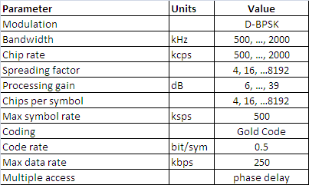
Dynamic DSSS Examples for 2.4 GHz
Slide 8

Slide 9
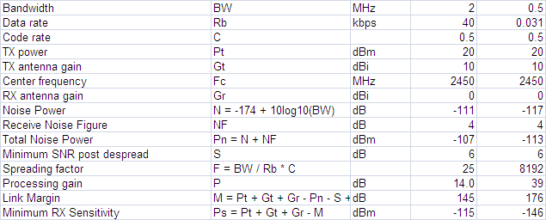
Link budget and receiver sensitivity
Up to 1.8 miles at 2.4GHz and 2.79 miles at 900MHz in Okumura-Hata suburban model, 1.5m antenna height

Slide 10
Summary
PHY has been designed to provide a very high link margin, low-power, low-complexity solution
PHY supports:
Scalable data rates from 30bps to 250 kbps
A maximum range of 1.8 miles at 2.4GHz, 2.79 miles at 900MHz (Okumura-Hata model), 1.5m antenna height
PHY complies with world-wide regulations
Dynamic DSSS offers the best solution for hard to reach meters to allow 100% coverage and for battery operated gas meters

