Slide 1
Adaptive dRU Allocation for Range Station-Aware Power Boosting in 6 GHz
Date: 2025-10-14
Authors:
Name | Affiliations | Address | Phone | email
Haji. M. Furqan | VESTEL
Shaima Abidrabbu
Salim Yahya
Sawaira R. Ali
Basak Ozbakish

Slide 2
Introduction (1)
Efficient utilization of 6GHz spectrum and achieving reliable communication in 6GHz band is one of the key objectives for 11bn UHR system. In 6GHz two main power modes have been introduced: ​
Standard Power (SP) ​
Indoor and outdoor applications​.
For SP APs it is required to operate with AFC, to mitigate 6GHz Wi-Fi from interfering with incumbent services.​
Low Power Indoor (LPI) ​
For indoor applications​ and does not require AFC​.
For LPI mode, the PSD limitations are very tough​.
dRU has been considered from different perspectives such as:
dRU Spreading BW and RU Sizes [1], [2] , [3] , [4] , [5]
Operation modes for dRU [6], [7]
Tone planning and pilot design for dRU [8], [9], [10], [11], [12], [13], [14], [15], [16], [17], [18], [19], [20], [21], [22]

Slide 3
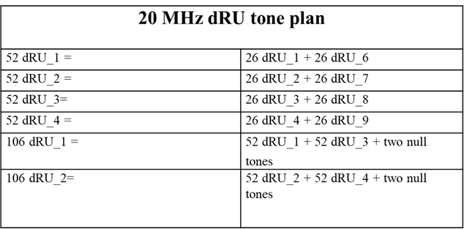
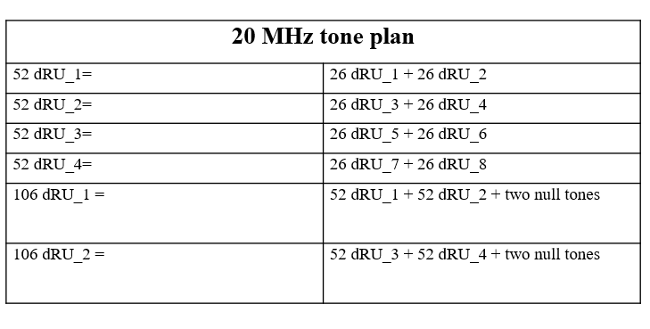
dRU in literature (1)
1. Maximizing power boost
Two approaches have been considered to distribute the tones between the users based on the dRU approach; maximum and minimum.
“The use of dRUs can result in low efficiency if a few users with small dRUs are allocated to a large bandwidth. A mechanism to define few dRU combinations to be allocated to a STA not requiring a power boost should be introduced.”-CID 2795 Recap (Clause 38.3.2.1)
Sparse dRU allocations → underutilized spectrum.
No flexibility in adapting to user heterogeneity.
No mechanism exists for adaptive per-STA dRU assignment that accounts for:
Range/distance from AP
QoS requirements (latency, reliability, throughput)
Device capabilities (antennas, TX power, MLO support)
This results in power inefficiency and underutilization of the 6 GHz band.
2. Less power boost
Notes:
There is no in between.

Slide 4
Proposed Adaptive dRU Allocation
In the literature, there is no defined adaptive allocation mechanism for dRU assignment. Therefore, in this contribution, a framework for mapping STA range to have adaptive dRU assignment is proposed.
Specifically, AP collects per-STA information about the range of each STAs.
Far STA → fewer tones/MHz → higher boost.
Near STA → more tones/MHz or RRU → avoid surplus boost.
QoS-critical STA → tailored allocation (latency/reliability/throughput).
The proposed adaptive dRU framework ensures sufficient but not excessive power boosting by matching allocations to STA range. This improves coverage for far STAs under 6 GHz PSD limits, while enhancing energy efficiency and reducing interference for near STAs.

Slide 5
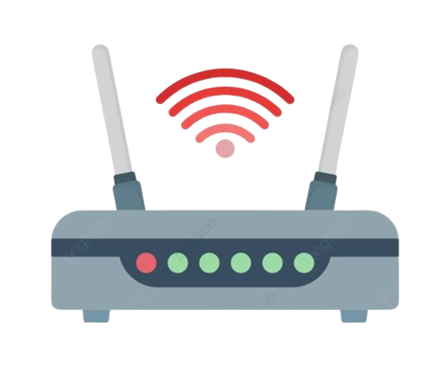



Example 1: Three-User Case
Consider a scenario with three users located at different distances from the AP. Under the proposed framework, each user is assigned a dRU adaptively, ensuring sufficient (but not excessive) power boosting.
User 1 (farther from AP): Allocated fewer tones per MHz, resulting in higher power boost to compensate for path loss.
User 2 (mid-range): Allocated tones proportional to its distance, avoiding the excessive boosting observed in prior approaches, while still ensuring sufficient link reliability.
User 3 (closer to AP): Allocated tones to match its range, avoiding both surplus boosting (wasted power) and insufficient boosting (coverage gaps) that occur in extreme-case methods from the literature.
This adaptive allocation ensures balanced and efficient power boosting across users, improving performance compared to fixed or extreme-case designs.
low
large
middel
User-3
User-2
User-1

Slide 6
Further aspects on the proposed approach
Instead of fixing the number of tones or applying maximum boosting, the system dynamically assigns tones for each user based on QoS requirements. This ensures that users receive only the level of boosting necessary to achieve reliable communication.
In existing methods, maximum boosting is often applied indiscriminately, which leads to wasted power for users with favorable channel conditions. Therefore, the proposed approach explicitly avoids this inefficiency.
The scheme allows seamless switching/flexibility between RRU and dRU:
If a user does not require additional boosting, it can be scheduled on a RRU.
If power boosting is required, the system can allocate a dRU tailored to that user’s requirements.
The allocation decision is not based solely on distance; it considers multiple factors such as QoS requirements.
Power is allocated only where needed, reducing overall energy consumption.
Notes:
SNR, interference levels, and traffic requirements.
The mechanism adapts to heterogeneous user conditions without requiring extreme-case designs.

Slide 7
Summary
In this contribution, we propose an adaptive dRU allocation framework that assigns tones based on user range.
The proposed approach ensures each user receives only the required power boost, improving energy efficiency and interference mitigation by avoiding both surplus and insufficient boosting.
In particular, we address power inefficiency in 6 GHz arising from underutilized or static dRU assignments by enabling adaptive power boosting tailored to user conditions.
Several factors can be also considered such as QoS requirements, and other TBD parameters.

Slide 8
REFERENCES
[1]:“Distribution bandwidth of DRU”, IEEE 802.11-23/2200r0
[2]:“Follow Up on High Level Thoughts on DRU Design”, IEEE 802.11-24/0500r0
[3]:“Further Thoughts on Dru”, IEEE 802.11-24/0014r0
[4]:“Distribution Bandwidth within 80 MHz for DRU”, IEEE 802.11-24/0766r1
[5]:“Discussion on Distribution Bandwidth of DRU”, IEEE 802.11-24/0801r1
[6]:“Hybrid PPDU and Distribution Bandwidth for DRU” , IEEE 802.11-24/0400r0
[7]:“High-Level Perspectives on Distributed Tone RU for 11bn”, IEEE 802.11-23/2020r0
[8]:“20 MHz Tone Plan and Pilot Design for DRU”, IEEE 802.11-24/0402r0
[9]:“DRU Tone Plan for 11bn”, IEEE 802.11-24/468r0
[10]:“Pilot Design Considerations for dRU”, IEEE 802.11-24/0501r0
[11]:“dRU Signaling for UHR”, IEEE 802.11-24/1117r0
[12]:“CFO Impact and Pilot Design for dRU Follow up”, IEEE 802.11-23/1447r0
[13]:“Principle and Methodology for dRU Tone Plan Design”, IEEE 802.11-23/2021r0
[14]:“A dRU Design Approach for 20 MHz”, IEEE 802.11-24/0078r1
[15]:“20 MHz Tone Plan and Pilot Design for DRU”, IEEE 802.11-24/0402r1
[16]:“DRU Tone Plan for 11bn”, IEEE 802.11-24/468r1
[17]:“Pilot Design Considerations for dRU”, IEEE 802.11-24/0501r2
[18]:“Thoughts on DRU Pilot”, IEEE 802.11-23/0728r2
[19]:“20 MHz Tone Plan and Pilot Design for DRU Follow Up”, IEEE 802.11-24/0767r0
[20]:“On the Pilot Tone Allocations in DRU”, IEEE 802.11-24/0769r0
[21]:“Discussions on DRU pilot design principles”, IEEE 802.11-24/0800r2
[22]:“Tone distribution in DRUs”, IEEE 802.11-24/0814r0

Slide 9
Straw Poll
Do you support adding the proposed adaptive dRU tone allocation mechanism, where the allocation may consider the STA’s range to enhance 6 GHz operation efficiency?
  Yes
  No
  Abstain or More Discussion needed

