Slide 1
Discussion on Co-SR Signalling
Date: 2025-10-09
Authors:
Name | Affiliation | Address | Phone | email
Ke Zhong | Ruijie Networks Co., Ltd. |  |  | zhongke@ruijie.com.cn
Fachang Guo

Slide 2
Abstract
Introduction
Discussion on Co-SR Signalling
Conclusion

Slide 3
Introduction
In PAR of IEEE P802.11bn, the Ultra High Reliability (UHR) capability is defined to offer improved rate-vs-range performance, lower latency, and reduced power consumption for AP and STA, compared to Extremely High Throughput (EHT) MAC/PHY operation [1].
The objective of coordinated spatial reuse (Co-SR) is to allow more efficient medium usage by concurrent transmissions from multiple APs using transmit power control [2].
Per Draft 1.0, the Co-SR Trigger frame shall contain the following information [2]:
Co-SR Trigger frame information in the Draft 1.0:
— The duration of the data PPDU transmitted by the Co-SR coordinating AP and the duration of the data PPDU transmitted by the Co-SR coordinated AP, which shall be the same.
— The transmit power limit of the Co-SR coordinated AP. The value of the transmit power limit shall not be lower than the value indicated by the Co-SR coordinated AP in the MAPC Negotiation Request frame or MAPC Negotiation Response frame during the MAPC agreement establishment procedure as defined in 37.15.2.2.2 (Co-SR negotiation).
— The transmit power of the Co-SR coordinating AP.
— The PHY version of the data PPDU transmitted by the Co-SR coordinating AP and the PHY version of the data PPDU transmitted by the Co-SR coordinated AP.

Slide 4
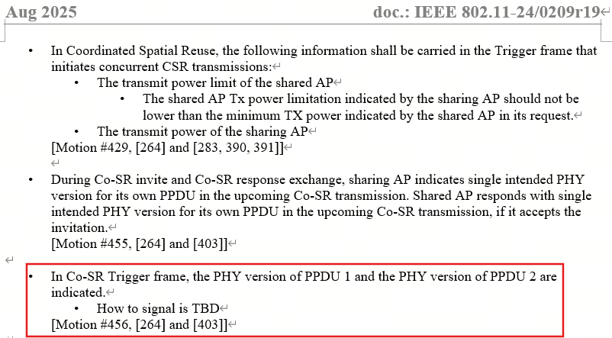
Current Co-SR Signalling – Recap [2],[3]
The Draft 1.0 specifies that the Co-SR Trigger frame shall include the PHY version of the data PPDU transmitted by the Co-SR coordinating AP and the PHY version of the data PPDU transmitted by the Co-SR coordinated AP [2].
However, how to indicate/signal the PHY version of the data PPDU transmitted by the Co-SR coordinating AP and the PHY version of the data PPDU transmitted by the Co-SR coordinated AP is not provided [3].
How to signal is TBD

Slide 5
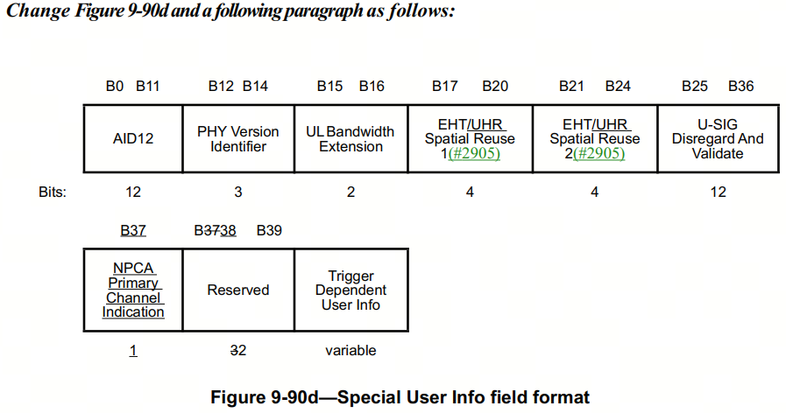
Discussion on Co-SR Signalling
We propose three potential solutions for indicating/signalling the PHY version of the data PPDU transmitted by the Co-SR coordinating AP and the PHY version of the data PPDU transmitted by the Co-SR coordinated AP in Trigger frame:
Potential solution 1: Re-design/Re-purpose of the 3-bit PHY Version Identifier in the Special User Info field of the Co-SR Trigger Frame.
Directly indicates the combination of the PHY version of the data PPDU transmitted by the Co-SR coordinating AP and the PHY version of the data PPDU transmitted by the Co-SR coordinated.
Or, separately indicates the PHY version of the data PPDU transmitted by the Co-SR coordinating AP and the PHY version of the data PPDU transmitted by the Co-SR coordinated.
Potential solution 2: Utilize the two reserved bits in the Special User Info field of the Co-SR Trigger frame.
Directly indicates the combination of the PHY version of the data PPDU transmitted by the Co-SR coordinating AP and the PHY version of the data PPDU transmitted by the Co-SR coordinated.
Or, separately indicates the PHY version of the data PPDU transmitted by the Co-SR coordinating AP and the PHY version of the data PPDU transmitted by the Co-SR coordinated.
Potential solution 3: Use both the PHY Version Identifier and Reserved field in the Special User Info field of the Co-SR Trigger frame for simultaneous indication/signalling.
The PHY Version Identifier indicates PHY version of the data PPDU transmitted by the Co-SR coordinating AP as per the existing definition, while the re-defined Reserved bits are used to indicate the PHY version of the data PPDU transmitted by the Co-SR coordinated AP.

Slide 6
Conclusion
This contribution proposes three potential solutions to indicate/signal the PHY version of the data PPDU transmitted by the Co-SR coordinating AP and the PHY version of the data PPDU transmitted by the Co-SR coordinated AP in Trigger frame.
Potential solution 1: Re-design/Re-purpose of the 3-bit PHY Version Identifier in the Special User Info field of the Co-SR Trigger Frame.
Directly indicates the combination of the PHY version of the data PPDU transmitted by the Co-SR coordinating AP and the PHY version of the data PPDU transmitted by the Co-SR coordinated.
Or, separately indicates the PHY version of the data PPDU transmitted by the Co-SR coordinating AP and the PHY version of the data PPDU transmitted by the Co-SR coordinated.
Potential solution 2: Utilize the two reserved bits in the Special User Info field of the Co-SR Trigger frame.
Directly indicates the combination of the PHY version of the data PPDU transmitted by the Co-SR coordinating AP and the PHY version of the data PPDU transmitted by the Co-SR coordinated.
Or, separately indicates the PHY version of the data PPDU transmitted by the Co-SR coordinating AP and the PHY version of the data PPDU transmitted by the Co-SR coordinated.
Potential solution 3: Use both the PHY Version Identifier and Reserved field in the Special User Info field of the Co-SR Trigger frame for simultaneous indication/signalling.
The PHY Version Identifier indicates PHY version of the data PPDU transmitted by the Co-SR coordinating AP as per the existing definition, while the re-defined Reserved bits are used to indicate the PHY version of the data PPDU transmitted by the Co-SR coordinated AP.

Slide 7
Straw Poll 1
Do you agree to include the following into the 11bn SFD for indicating/signalling the PHY version of the data PPDU transmitted by the Co-SR coordinating AP and the PHY version of the data PPDU transmitted by the Co-SR coordinated AP?
Re-design/Re-purpose of the 3-bit PHY Version Identifier in the Special User Info field of the Co-SR Trigger Frame.
Yes:
No:
Abstain:

Slide 8
Straw Poll 2
Do you agree to include the following into the 11bn SFD for indicating/signalling the PHY version of the data PPDU transmitted by the Co-SR coordinating AP and the PHY version of the data PPDU transmitted by the Co-SR coordinated AP?
Utilize the two reserved bits in the Special User Info field of the Co-SR Trigger frame.
Yes:
No:
Abstain:

Slide 9
Straw Poll 3
Do you agree to include the following into the 11bn SFD for indicating/signalling the PHY version of the data PPDU transmitted by the Co-SR coordinating AP and the PHY version of the data PPDU transmitted by the Co-SR coordinated AP?
Use both the PHY Version Identifier and Reserved field in the Special User Info field of the Co-SR Trigger frame for simultaneous indication/signalling.
Yes:
No:
Abstain:

Slide 10
References
[1] IEEE 802.11-23/0480r3, UHR proposed PAR, Laurent Cariou (Intel)
[2] IEEE P802.11bnTM/D1.0
[3] IEEE 802.11-24/0209r19, Specification framework for TGbn, Ross Jian Yu (Huawei)

