Slide 1
Discussion on ST Preparation Procedure
Date: 2025-9-30
Authors:
Name | Affiliations | Address | Phone | email
Hang Yang | Ruijie Networks Co., Ltd. |  |  | yanghang1@ruijie.com.cn
Ke Zhong | Ruijie Networks Co., Ltd. |  |  | zhongke@ruijie.com.cn
Hui Che | Ruijie Networks Co., Ltd. |  |  | chehui@ruijie.com.cn
Fachang Guo

Slide 2
Background
In TGbn, the ST preparation procedure is considered as an important phase in seamless roaming, which is designed to minimize the time of connection loss. The ST preparation includes the following:
  - Transfer or renegotiation of the context related to the non-AP MLD to the candidate target AP MLD
  - Setting up the links with the candidate target AP MLD
  If no ST execution request is received, the candidate target AP MLD will maintain the links and context until the timeout[1].
In [1][2], the non-AP MLD is allowed to request preparation with multiple target AP MLDs using separate link Reconfiguration Req./Resp. exchange.
In [1][3], the Max Number Of Prepared Target AP MLDs is introduced in Draft 1.0 to control the APs’ number during multiple preparations. However, the further details of multiple preparations and the Max Number Of Prepared Target AP MLDs are still unclear due to lack of consensus.

Slide 3




Problem Statement
Baseline: If the number of prepared target AP MLDs for a non-AP MLD has reached the Max Number Of Prepared Target AP MLDs, further preparation requests from this non-AP MLD would be rejected by the current AP MLD.
Situation:
  Firstly, the non-AP MLD at the edge of BSS may request preparation with Target AP1 and Target AP2, and reach the limit of Max Number Of Prepared Target AP MLDs.
  Then, the non-AP MLD is moving toward Target AP3, but it cannot successfully request preparation with Target AP3.
  What is non-AP MLD supposed to do? Is there no choice but to wait for the timeouts to run out with AP1 and AP2?
AP1
Target AP2
Preparation
Preparation
Target AP1
Non-AP MLD
Preparation
Current AP
STA Movement
  Issue: When the number of prepared target AP MLDs reached the limit, non-AP MLD could not request preparation with more suitable target APs.
Max Number of Prepared Target AP MLDs = 2
Target AP3
AP2

Slide 4
Solution 1: Preparation Cancel Frame
SMD
Non-AP MLD
Current AP MLD
Target AP MLD1
Target AP MLD2
Max Number of Prepared Target AP MLDs = 1
ST Preparation Request
(with Target AP MLD1)
A method should be defined to allow non-AP MLD to cancel the preparation with the previously prepared target AP MLD.
The non-AP MLD may use an explicit Preparation Cancel Frame to request to cancel preparation with a selected target AP MLD.
  In this way, non-AP MLD may first send a signal to cancel the previous ST preparation and then request a new ST preparation.
Context transfer
+Links add
3ST Preparation Response
Reach the Max Number
STA Moving to AP2
Want to prep. with AP2
ST Preparation Cancel Request
(with Target AP MLD1)
Context delete
+ Links delete
Confirm Frame
ST Preparation Request
(with Target AP MLD2)
Context transfer + Links add
3ST Preparation Response

Slide 5
SMD
Solution 2: Preparation Cancel Indication
Non-AP MLD
Current AP MLD
Target AP MLD1
Target AP MLD2
Max Number of Prepared Target AP MLDs = 1
ST Preparation Request
(with Target AP MLD1)
Context transfer
+Links add
The non-AP MLD may also include both the previous ST preparation cancel indication and the new ST preparation request indication in one frame, e.g., the UHR Link Reconfiguration Request frame (Type=ST preparation).
  In this way, the non-AP MLD may indicate which previously prepared target AP MLD should be replaced by the new target AP requested in this ST preparation request frame.
3ST Preparation Response
Reach the Max Number
STA Moving to AP2
Want to prep. with AP2
ST Preparation Request
(with Target AP MLD2)
(Including the Preparation Cancel
Indication with Target AP MLD1)
Context delete
+ Links delete
Context transfer + Links add
3ST Preparation Response
Pros: Both solution 1 and solution 2 are determined by the non-AP MLD, offering high flexibility during the ST preparation phase.
Cons: They may increase the complexity of non-AP MLD in tracking previously and newly prepared target AP MLDs.

Slide 6
Solution 3: The “FIFO” scheme
SMD
Non-AP MLD
Current AP MLD
Target AP MLD1
Target AP MLD2
Max Number of Prepared Target AP MLDs = 1
ST Preparation Request
(with Target AP MLD1)
Context transfer
+Links add
When the current AP MLD receives an ST preparation request from a non-AP MLD which has reached the maximum number of prepared target AP MLDs, it removes the oldest prepared target AP before adding new target APs.
  Pro：Current AP MLD can easily implement this by checking the timeout timer of previously prepared target APs.
  This solution is the simplest if SMD-ME allows only one prepared target AP during the ST preparation phase.
  Neg：The oldest prepared target AP MLD may not be the least appropriate prepared AP.
3ST Preparation Response
STA Moving to AP2
STA has reached to the Max Number
ST Preparation Request
(with Target AP MLD2)
Remove the oldest prepared target AP MLD
Context delete
+ Links delete
Context transfer + Links add
3ST Preparation Response

Slide 7
SMD
Solution 4: The Preference field
Non-AP MLD
Current AP MLD
Target AP MLD1
Target AP MLD2
Max Number of Prepared Target AP MLDs = 1
The Preference field could be introduced into ST preparation. The non-AP MLD may carry the Preference field of the requested target AP MLD in the preparation request frame.
When the number of prepared target AP MLDs exceeds the limit, the AP with the lowest Preference field value will be removed.
Note: If all the target APs are selected from the recommendation and their Preference fields are already present in the Neighbor Report, the extra field carried in the preparation request frame may be omitted.
ST Preparation Request
(with Target AP MLD1, Preference value=128)
Context transfer
+ Links add
3ST Preparation Response
STA Moving to AP2
STA has reached to the Max Number
ST Preparation Request
(with Target AP MLD2,
Preference value=255)
Remove the prepared target AP with lowest preference field value
Context delete
+ Links delete
Context transfer + Links add
3ST Preparation Response

Slide 8
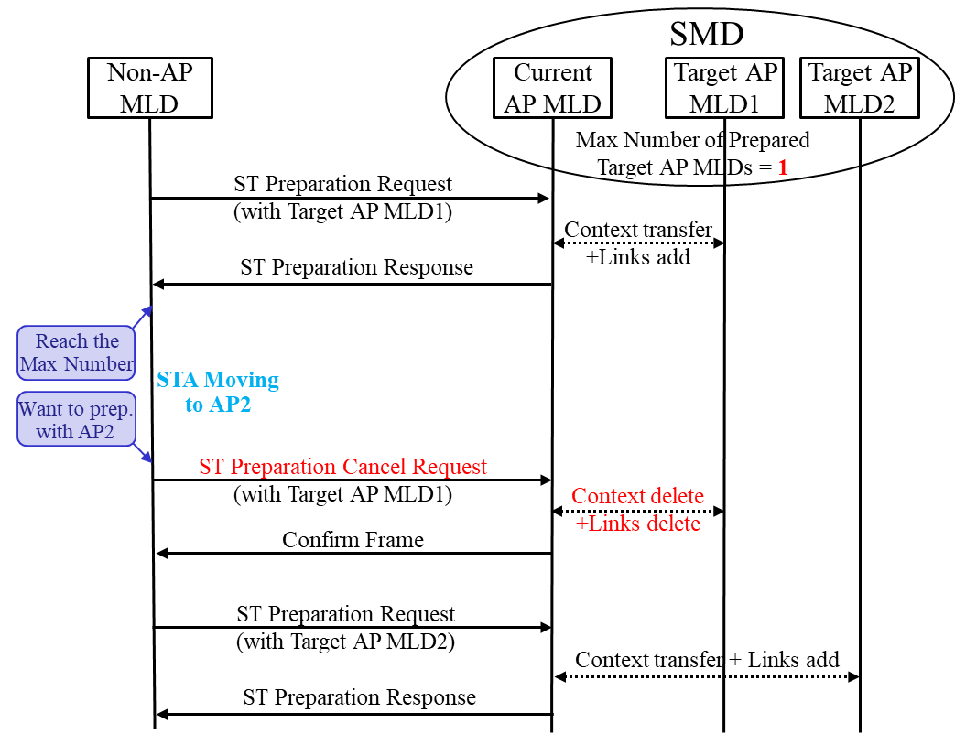
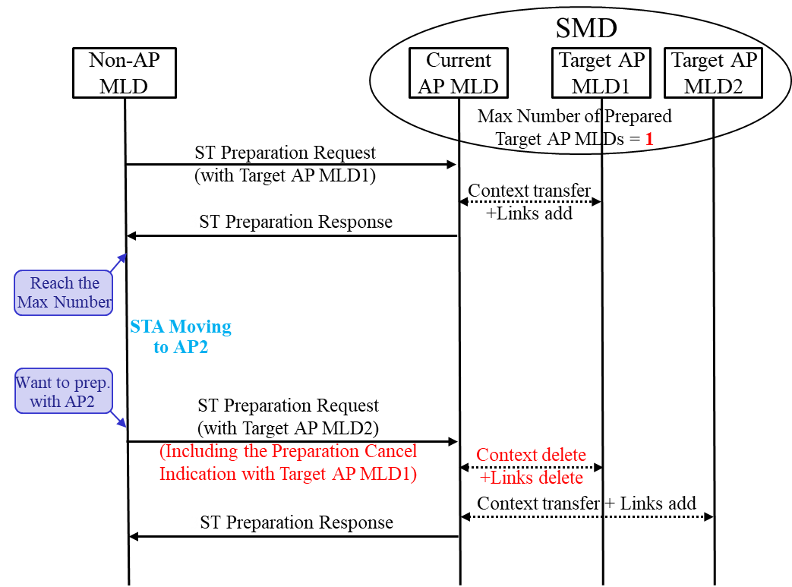
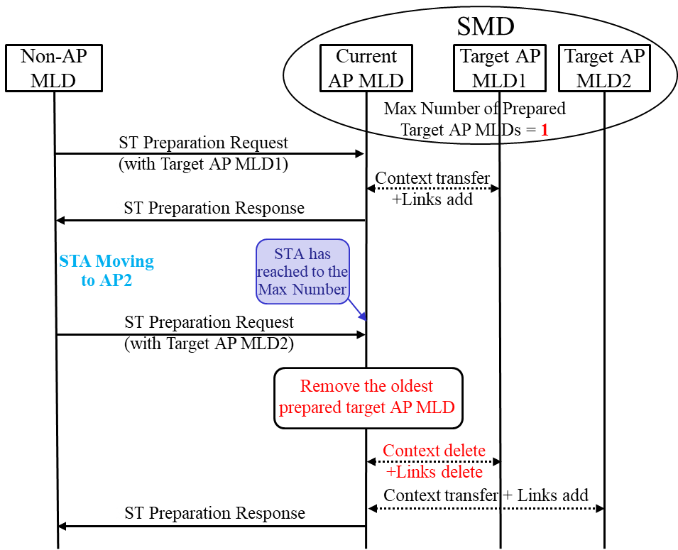
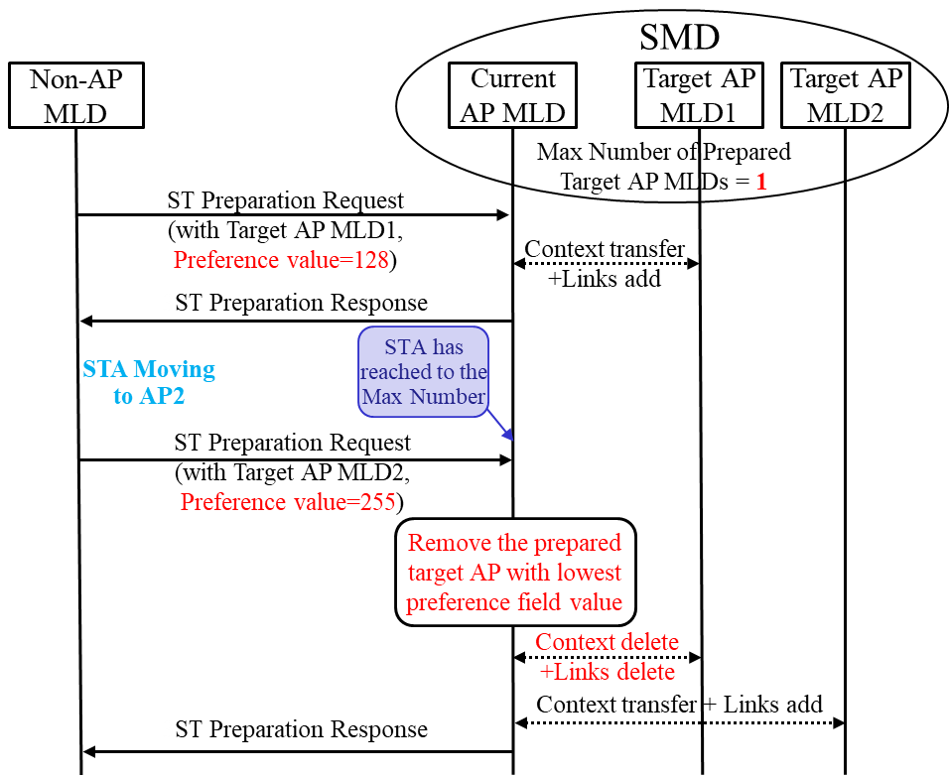
Solution 1: Preparation Cancel Frame
Solution 2: Preparation Cancel Indication
Solution 3: The “FIFO” scheme
Solution 4: The Preference field

Slide 9
Summary
In this contribution, we discussed the details on ST preparation phase:
  During ST preparation, a non-AP MLD that has reached the maximum number of prepared target AP MLDs is unable to request preparation with more suitable target APs.
  Four solutions are proposed in this contribution as following:
    1. Preparation Cancel Frame: Defines an explicit preparation cancel frame in ST preparation.
    2. Preparation Cancel Indication: The non-AP MLD indicates the removed target AP MLD when requesting a new one within the same frame .
    3. “FIFO” scheme: Removes the oldest prepared target AP MLD when the limit is exceeded.
    4. Preference field: Removes the target AP MLD with lowest Preference field value when the limit is exceeded.

Slide 10
Straw Poll 1
Do you agree that if the number of prepared target AP MLDs for a non-AP MLD has reached the Max Number of Prepared Target AP MLDs, the further ST preparation request from this non-AP MLD would be rejected by the current AP MLD?

Slide 11
Straw Poll 2
Do you agree that more schemes in ST preparation phase should be considered in order to increase the flexibility of the non-AP MLD in selecting the best target AP MLD?

Slide 12
References
[1] Draft P802.11bn_D1.0
[2] IEEE 802.11-24/0656r3, Seamless Roaming Signaling Details
[3] IEEE 802.11-25/1101r9, 11bn PDT-CR MAC Seamless Roaming (Part 5)

