Slide 1
802.15 Liaison Report – Sept 2025
Date: 2025-07-10
Authors:
Details by 802 activity are available here: https://mentor.ieee.org/802-ec/dcn/22/ec-22-0061-02-00EC-rolfe-affiliations-by-802-activity.pdf

Slide 2
Abstract
Overview of current activities in WG15.

Slide 3
Working Group 15 September Agenda
Agenda:
https://mentor.ieee.org/802.15/dcn/25/15-25-0413-03-0000-sept-2025-802-15-agenda.xlsx
WG opening report:
https://mentor.ieee.org/802.15/dcn/25/15-25-0414-03-0000-sept-2025-802-15-opening-report.pptx

Slide 4
Subgroup Closing Reports
Title | URL
TG15.6ma Closing Report for | https://mentor.ieee.org/802.15/dcn/25/15-25-0492-01-006a-tg15-6ma-closing-report-for-september-2025.pptx
SCM Agenda, Opening and Closing Report | https://mentor.ieee.org/802.15/dcn/25/15-25-0475-01-0mag-scm-agenda-opening-and-closing-report-september-2025.pptx
TG4ab May Closing Report | https://mentor.ieee.org/802.15/dcn/25/15-25-0504-02-04ab-september-closting-report.pptx
TG4ac May Opening and Closing Report | https://mentor.ieee.org/802.15/dcn/25/15-25-0446-02-04ac-september-opening-and-closing.pptx
TG4ad Agenda, Opening and Closing Report | https://mentor.ieee.org/802.15/dcn/25/15-25-0434-01-04ad-tg4ad-agenda-opening-and-closing-report-september2025.pptx
TG4ae (ASCON) Opening and Closing | https://mentor.ieee.org/802.15/dcn/25/15-25-0444-02-04ae-september-opening-and-closing.pptx
IG Access agenda opening and closing report and Minutes | https://mentor.ieee.org/802.15/dcn/25/15-25-0474-02-acss-ig-access-september-meeting-slides-and-closing-report.pptx
TG9A Opening and Closing report | https://mentor.ieee.org/802.15/dcn/25/15-25-0445-02-009a-september-opening-and-closing.pptx
TG16me Revision to 802.16-2017 report | https://mentor.ieee.org/802.15/dcn/25/15-25-0503-01-16me-sept-2025-meeting-closing-report.pptx
IEEE 802.15 IG NG-OWC Closing Report | https://mentor.ieee.org/802.15/dcn/25/15-25-0494-00-07ma-ieee-802-15-ig-ng-owc-closing-report-sept-2025.pptx

Slide 5
Subgroup Closing Reports
Title | URL
IG Next Generation Optical | https://mentor.ieee.org/802.15/dcn/25/15-25-0494-01-07ma-ieee-802-15-ig-ng-owc-closing-report-sept-2025.pptx
IG Surface Wave Communications | https://mentor.ieee.org/802.15/dcn/25/15-25-0456-01-swcs-ig-swc-sept-2025-slide-deck.pptx

Slide 6
802.15 Overview
Wireless Specialty Networks Active standards:
802.15.3 - no active projects but a bunch of really cool stuff
802.15.4 - many current projects (see next slide)
802.15.6a Body Area Networks: Initial SA ballot completed, comment resolution
802.15.9a KMP Transport, extensions to key management: Initial SA ballot complete, first SA recirculation to commence soon
802.16.me Revision of 802.16-2017 – Just getting started
Interest Group Access: Focusing on analysis of current mechanisms in the standard (IEEE Std 802.15.4); exploring enhancements to Spectrum Resource Measurement features in the current standard
Interest Group NG-OWC: the next generation for optical wireless communication
Interest Group SWC: Surface Wave Communication
SC THz: No meeting this session

Slide 7
Standing Committee, Maintenance
Maintains internal support documents such as WG Operations manual, editor’s guide, motion templates, checklists and supporting material
Maintains “bug list” for each standard as input to the revision projects
Reviews PARs and provides comments for other WGs
Considers and responds to comments received on 802.15 PARs
This session:
No PARs to review
Began consideration of the next revision to 802.15.4 (Rev-mf)
Updated WG sample motion templates
Editorial corrections to operations manual

Slide 8
802.15.4 Projects
802.15.4ab Next Generation UWB: Second WG recirculation
802.15.4ac Enhanced Privacy: Initial WG ballot compete, recirculation to start RSN
802.15.4ad Next Generation SUN PHYs: Pre-draft, technical contributions and proposals, merging and converging
802.15.4ae ASCON light weight encryption extension for 802.15.4: Completed WG ballot, initial SA ballot to commence after November plenary

Slide 9
802.15.4ab Next generation UWB: Amendment to IEEE Std 802.15.4-2024 (rev E)
Recirculation comment resolution in progress
Closing report: https://mentor.ieee.org/802.15/dcn/25/15-25-0504-02-04ab-september-closting-report.pptx
Current status: First RC complete; second RC to commence RSN
Action | Date
Approve comment resolutions and RC2 | 18-Sep-2025
Start RC2 | 20-Sep-2025
Close RC2 | 5-Oct-2025
Resolve comments | 7-Oct-2025
Start RC3 | TBD
Close RC3 | TBD
Start Nov Plenary | 10-Nov-2025

Slide 10
802.15.4ac Enhanced Privacy
This amendment specifies modifications to the IEEE Std 802.15.4 medium access control (MAC) specification to specify mechanisms that address and improve user privacy. These mechanisms include randomized addresses, and exchanges that support session continuity. This amendment maintains backward compatibility with the base standard.
State: Initial SA ballot complete, 1st SA recirc to commence shortly
Opening and closing report: https://mentor.ieee.org/802.15/dcn/25/15-25-0446-02-04ac-september-opening-and-closing.pptx

Slide 11
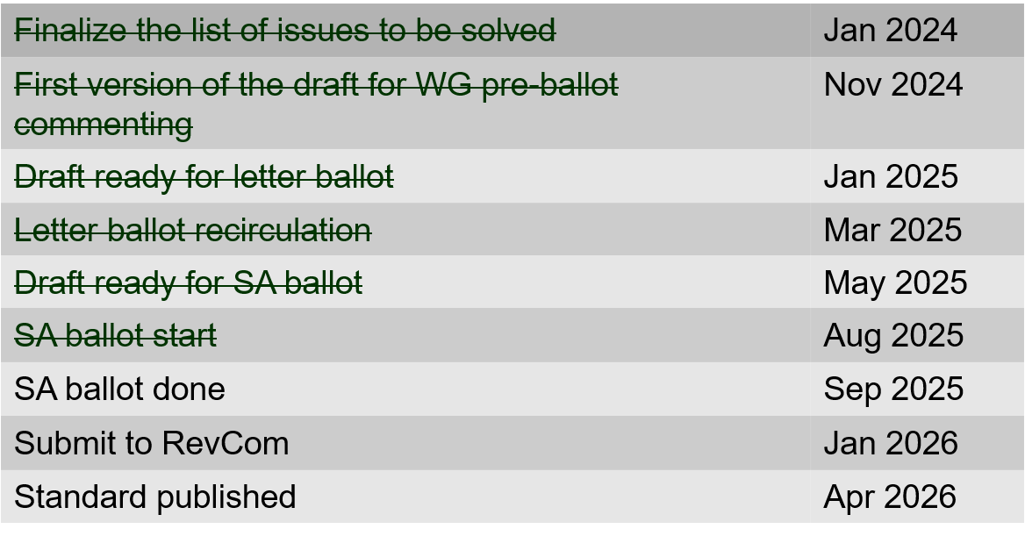
802.15.4ac Enhanced Privacy Timeline

Slide 12
802.15.4ad Next Generation SUN PHYs
Developing enhancements to the 802.15.4 SUN PHYs (FSK, OFDM)
State: pre-draft development
Meeting goals: Merge and converge technical proposals
Closing report: https://mentor.ieee.org/802.15/dcn/25/15-25-0434-01-04ad-tg4ad-agenda-opening-and-closing-report-september2025.pptx
Accomplished:
Approval of July session minutes
Presentations (see next page)
Agreed baselines for OFDM-LR and OFDM-HR
September meeting minutes posted as 15-25-452-00-04ad

Slide 13
802.15.4ad Timeline
2024
November: Approve Technical Guidance Document
Call for proposals issued
2025
January: Hear initial proposals
March: Hear updated proposals
March to May – 2 conference calls
Simulation results of remaining proposals not yet provided
Prepare table of proposals for analysing against technical guidance document
May: Hear final proposals
May to July – 2 conference calls
Simulation results and proposal categorisation.
July: Heard final proposals. Categorized and summarized proposals
July – September: Merging proposals
September: Select OFDM LR and HR baseline
October conf call
November: goals – to finalise OFDM preamble – be ready to start drafting OFDM LR and HR , Merge FSK proposals – ready for baseline.

Slide 14
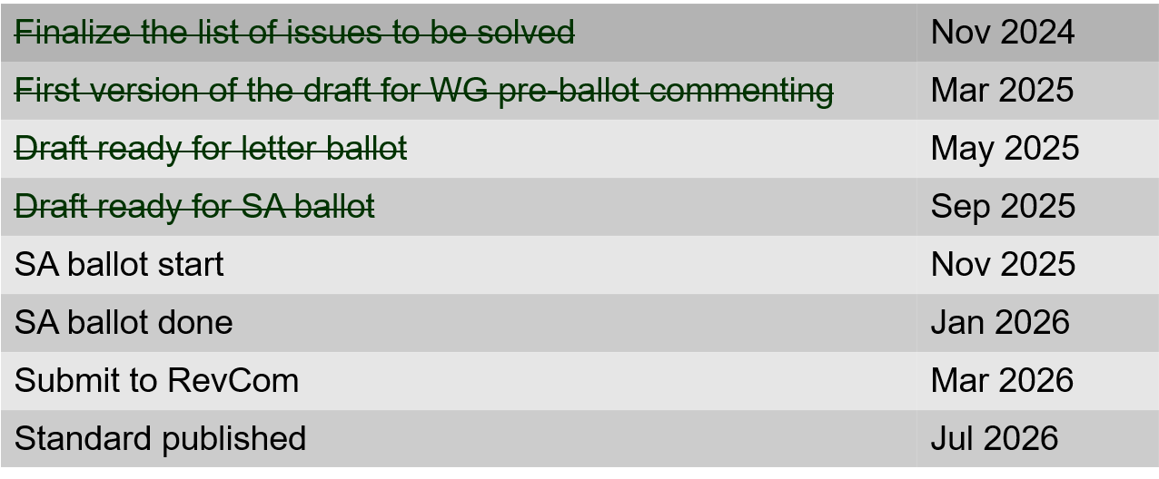
802.15.4ae (ASCON) ASCON light weight encryption extension for 802.15.4
Meeting achievements
Completed final WG recirculation
Draft ready for SA ballot
SA Ballot to start following Nov plenary
Closing report: https://mentor.ieee.org/802.15/dcn/25/15-25-0444-02-04ae-september-opening-and-closing.pptx

Slide 15
802.15.6ma
Competed first SA ballot
Resolved SA ballot comments
Initiate SA recirc (RSN)
Closing report: https://mentor.ieee.org/802.15/dcn/25/15-25-0492-01-006a-tg15-6ma-closing-report-for-september-2025.pptx

Slide 16
TG 6ma Timeline(expected)
Final SB recirculation, if required. Submission to RevCom
Jan 2026
Tech Req Doc July 2022
Presentation of proposals
May 2023
Comment Resolutionfor LB210
Nov. 2024
Comment Resolutionfor LB212
March 2025
Comment Resolutionfor LB217
May
2025
Comment Resolution for LB217
July
2025
SA Ballot
Sept
2025
WG PreBallot submission for Draft2.5 August 2024
Revcom Approve
March 2026
SA recirculation if required
Oct 2025
^{Draft V1,18 Com}
May. 2024
Recirculation (LB212)
Jan. 2025
RevcomSubmission
Feb. 2026
TRD,CMD
Call Proposals Sept 2022
Std. Draf V1.9 Proposals
Nov. 2023
Comment Resolution fo Draft v2.3 on WG for PreBallot July 2024
1st Letter Ballot(LB210)
Sept. 2024
2nd Recirculation (LB217)
April 2025
3rd Recirculation (LB)
June 2025
Unconditional approval for Standard Association Ballot (SA)
July 2025
Request EC approval for SA Ballot
Nov. 2026
Comment Resolution for SA Ballot
Oct. 2025
Notes: SASB/RevCom scheduled for 2024 a guess

Slide 17
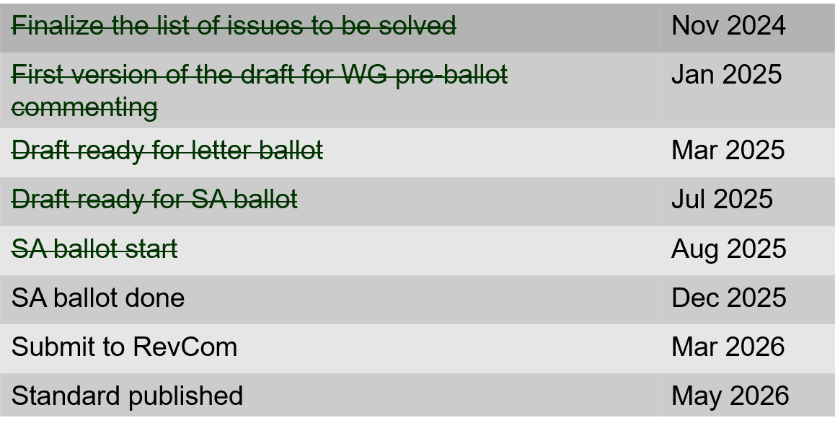
802.15.9a KMP Transport
Extensions to key management: extending to support EDHOC
Processed all standard association ballot comments
Prepared draft for recirculation
Form a CRG
Start recirculation ballot after this session
Opening and closing report: https://mentor.ieee.org/802.15/dcn/25/15-25-0445-02-009a-september-opening-and-closing.pptx

Slide 18
IG Access
Agenda, closing report and minutes: https://mentor.ieee.org/802.15/dcn/25/15-25-0474-02-acss-ig-access-september-meeting-slides-and-closing-report.pptx
Presentations:
Effect of using different CCA Modes and different ED Threshold in suspendable CSMA-C https://mentor.ieee.org/802.15/dcn/25/15-25-0455-02-acss-effect-of-using-different-cca-modes-and-different-ed-threshold-in-suspendable-csma-ca.pptx
Enhancement of SRM for Adapting Coexisting Environments https://mentor.ieee.org/802.15/dcn/25/15-25-0457-03-acss-enhancement-of-srm-for-adapting-coexisting-environments.pptx
November:
Follow-up with additional contributions
Consider preparing a technical report for the WG

Slide 19
TG16me Revision of 802.16-2017
Revision to 802.16
Includes rollup of 16t
Roll-up preparation underway
Heard additional technical contributions
Closing report: https://mentor.ieee.org/802.15/dcn/25/15-25-0503-01-16me-sept-2025-meeting-closing-report.pptx

Slide 20
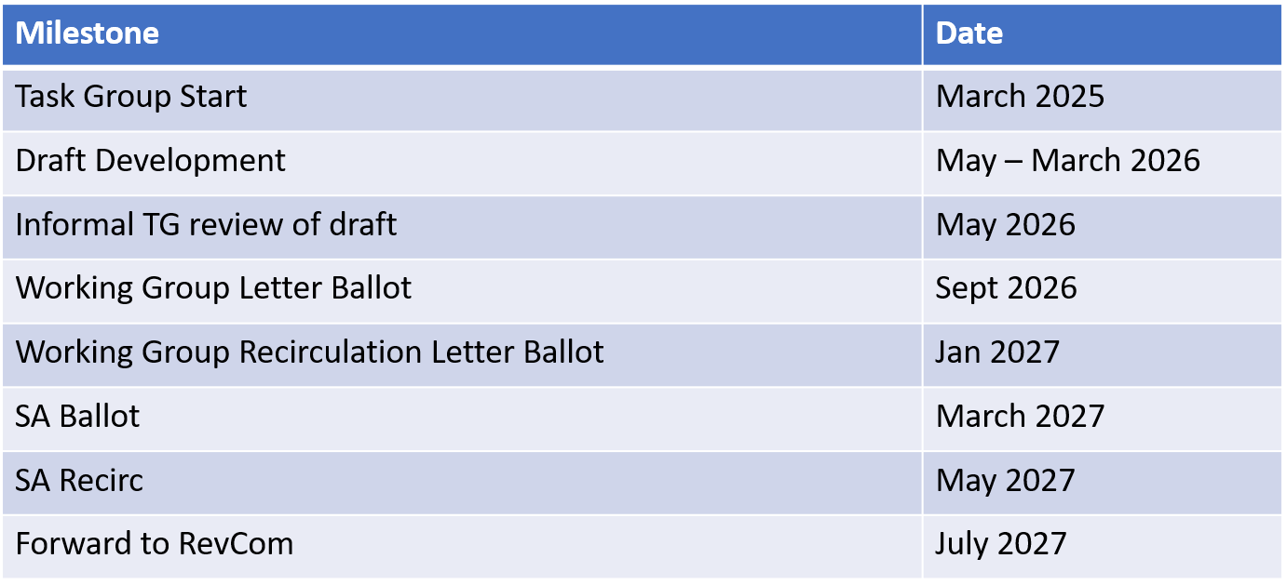
TG16me Revision Project Timeline

Slide 21
Interest Group Next Generation Optical Wireless Communication (NG-OWC)
IG NG-OWC Closing Report: https://mentor.ieee.org/802.15/dcn/25/15-25-0494-01-07ma-ieee-802-15-ig-ng-owc-closing-report-sept-2025.pptx
Session objectives and accomplishments:
Heard ten contributions related to the future of next generation OWC(OCC, FSO) technology
Extended Call for Applications on IG NG-OWC by Nov. meeting
Invite contributors:
IEEE 802.15 IG NG-OWC (OCC or FSO) Extended Call For Applications
https://mentor.ieee.org/802.15/dcn/25/15-25-0162-02-07ma-ieee-802-15-ig-ng-owc-call-for-applications.doc

Slide 22
Interest Group Surface Wave Communication (SWC)
IG SWC Opening and Closing Report: https://mentor.ieee.org/802.15/dcn/25/15-25-0456-01-swcs-ig-swc-sept-2025-slide-deck.pptx
Technical Contributions:
Surface-Wave Communication: Rethinking the Future of Wireless Communications, 15-25-0440-01
The Use cases for Metal Surface Magnetic Communications(MSMC) in ship, 15-25-443-01
Preliminary Surface-wave Propagation Characteristics in metal-rich environments, 15-25-0450-00
Proposal for a PHY frame considering the effect of metal structures on surface wave propagation characteristics, 15-25-0442-01
Next Steps:
Define use-cases
Define channel models / describe channel characteristics
Show feasibility and market demand
Plan: WNG presentation in January 2026

