Slide 1
Coexistence behavior observations of example device NB operation in the 5 / 6 GHz bands
Date: 2025-09-17
Authors:

Slide 2
Introduction
There is considerable debate regarding the need for and/or efficacy of Coexistence mechanisms for the operation of Narrowband systems in Unlicensed bands
For example, the discussions in the 802.15.4ab group
To better understand the coexistence behavior of devices that include narrowband operation in the 5 GHz and/or 6 GHz band, we analyzed the behavior of an ‘Off the shelf’ commercial product (Multimedia Device with ‘BT-like’ NB FH Communications Link)
Device was identified based on a search of the FCC database for 6 GHz capable NB devices and paired with accompanying earbuds.
We analyzed system performance (audio quality, throughput and latency) in multiple scenarios where there are fully overlapping networks
We also baselined the performance of audio streaming over Wi-Fi (instead of NB) in a similar set up. No degradation was observed
In situations where active sharing by the Multimedia Device with NB link was required, coexistence behavior was inadequate, impacting NB audio quality and throughput & latency of the overlapping Wi-Fi network
Disclaimer: The test results presented in this contribution were obtained using a commercially available product acquired through standard retail channels. The product functionality and behavior referenced is identified solely for the purpose of documenting the test conditions and results and does not imply endorsement by IEEE or any affiliated entity.

Slide 3
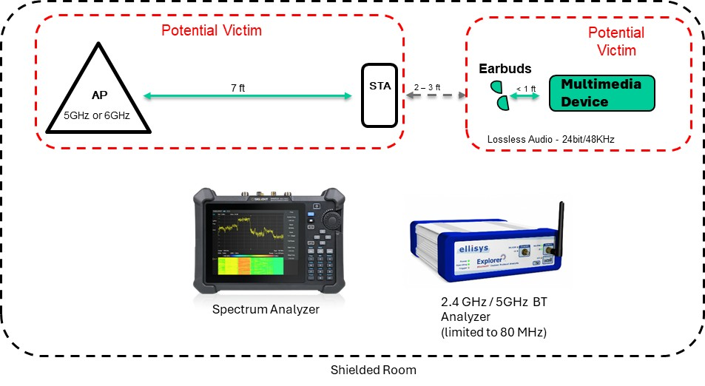
Test Set Up
Impact of Wi-Fi on audio quality when using NB for audio in 5 GHz spectrum
Wi-Fi traffic starts and ends while audio is playing from Multimedia Device to Earbuds
Impact of using NB for audio in 5 GHz on Wi-Fi throughput
Audio starts playing from Multimedia Device to Earbuds while there is Wi-Fi traffic in the same channel / frequency range
Frequency use is observed using a spectrum analyzer
MOS audio quality is approximate
UDP throughput is measured in a test tool

Slide 4
Observations on frequency band usage of the Device Under Test (NB)
Initial audio connection is made using the 2.4 GHz band
Afterward all packets sent in 5 GHz (except some LE packets in the 2.4 GHz band)
Audio traffic is using 5 GHz with frequency hopping covering 123 MHz
Spans 5.727 to 5.850 GHz range with lower usage at the edges
No usage of the 6 GHz band was observed

Slide 5
5 GHz Wi-Fi (160 MHz bandwidth) and NB Audio Scenarios Analyzed
Series of analyses focused on behavior and performance in a true spectrum sharing setting:
Full Buffer (FB), 40 Mbps and other traffic loads, 160 MHz Wi-Fi operation in UNII-3 Ch 163:
Wi-Fi spans from 5.735 GHz to 5.895 GHz
Observed NB operation spans from 5.727 GHz to 5.850 GHz
(i.e. 8 MHz has no overlap)
Scenario
1 | Impact of FB Wi-Fi operation on NB audio with a 30 seconds time overlap. Observed audio quality and NB device behavior
2 | Impact of NB audio operation on FB Wi-Fi throughput with a 25 seconds time overlap. Observed Wi-Fi throughput over time
3 | Impact of 40 Mbps* Wi-Fi operation on NB audio with a 30 seconds time overlap. Observed audio quality and NB device behavior
4 | Impact of NB audio operation on 40 Mbps* Wi-Fi throughput with a 30 seconds time overlap. Observed Wi-Fi throughput and latency over time
* In addition to a 40 Mbps Wi-Fi traffic load, we analyzed: 80, 160, 320, 640, 1280 Mbps

Slide 6

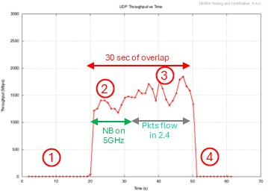
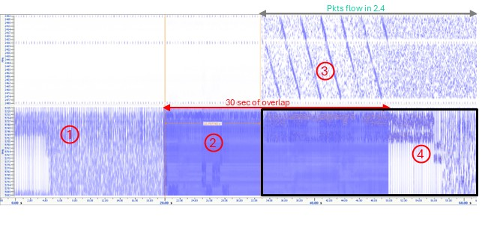
Scenario 1. Impact of Wi-Fi operation on NB audio
NB audio starts, no Wi-Fi traffic, audio quality is good
20 seconds later, Wi-Fi traffic started. NB audio traffic remained on 5 GHz (for ~12 seconds). audio quality degrades – due to collision of Wi-Fi and NB audio packets
After ~12 seconds, observed audio mostly transitioned to 2.4 GHz (noticed ~1 sec of silence in between), though some NB packets still seen in 5 GHz. Audio quality is now very glitchy & almost not acceptable
Audio quality recovers (perceived quality is slightly inferior compared to start of the test) when the Wi-Fi throughput traffic stopped
Audio stays on 5 and 2.4 GHz until Earbuds are disconnected and connected again
Full 60 seconds audio recording

Slide 7
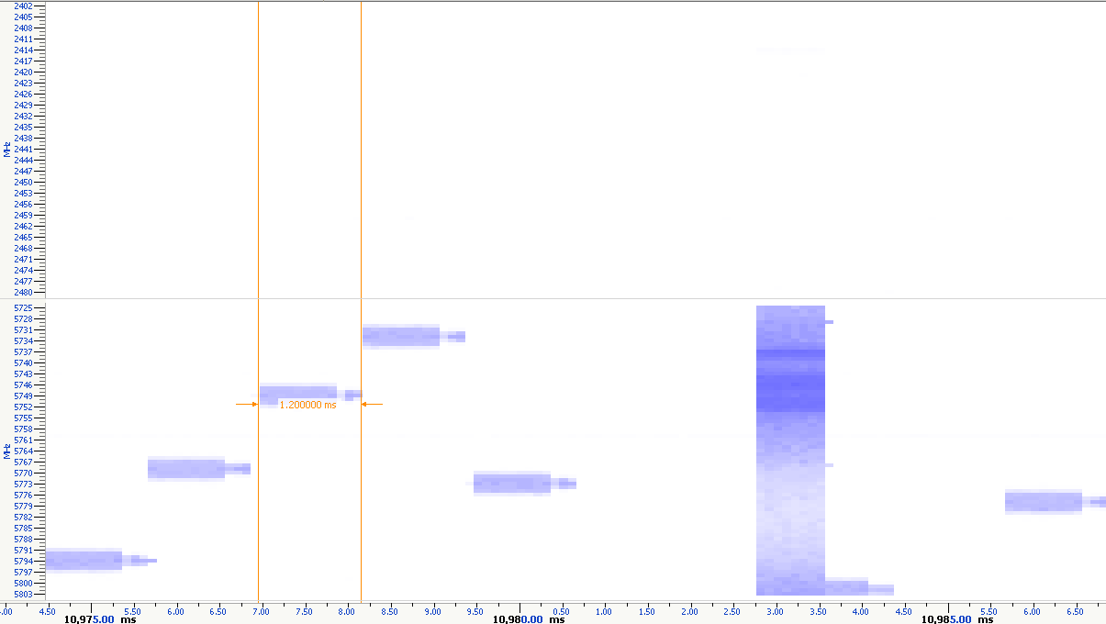
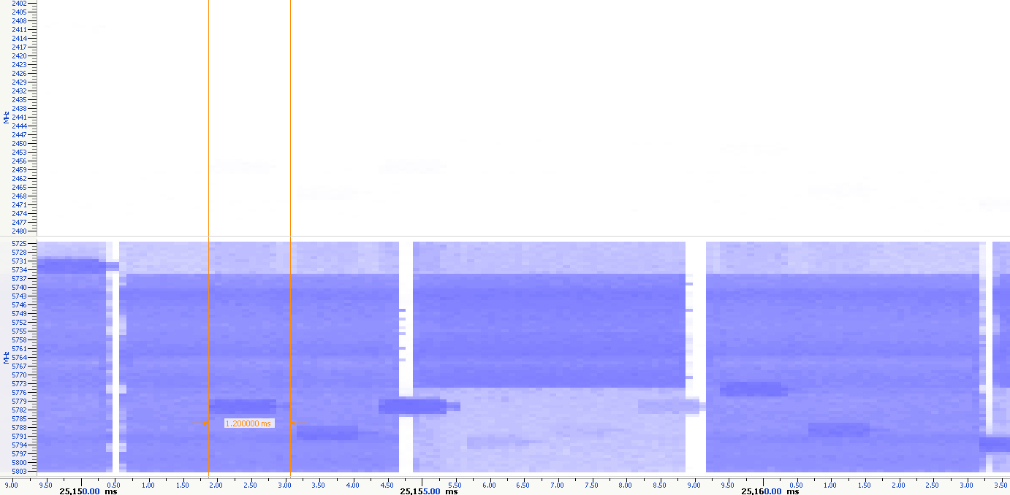
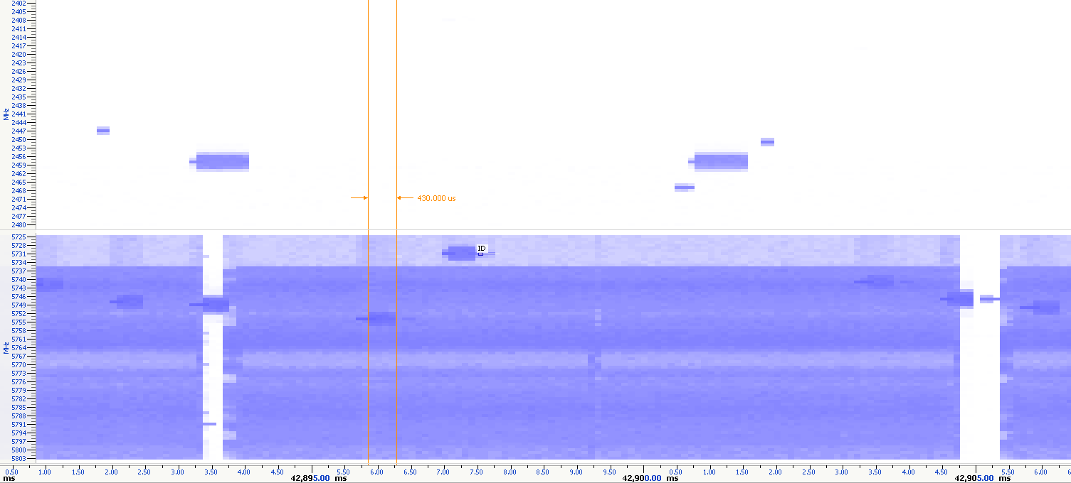
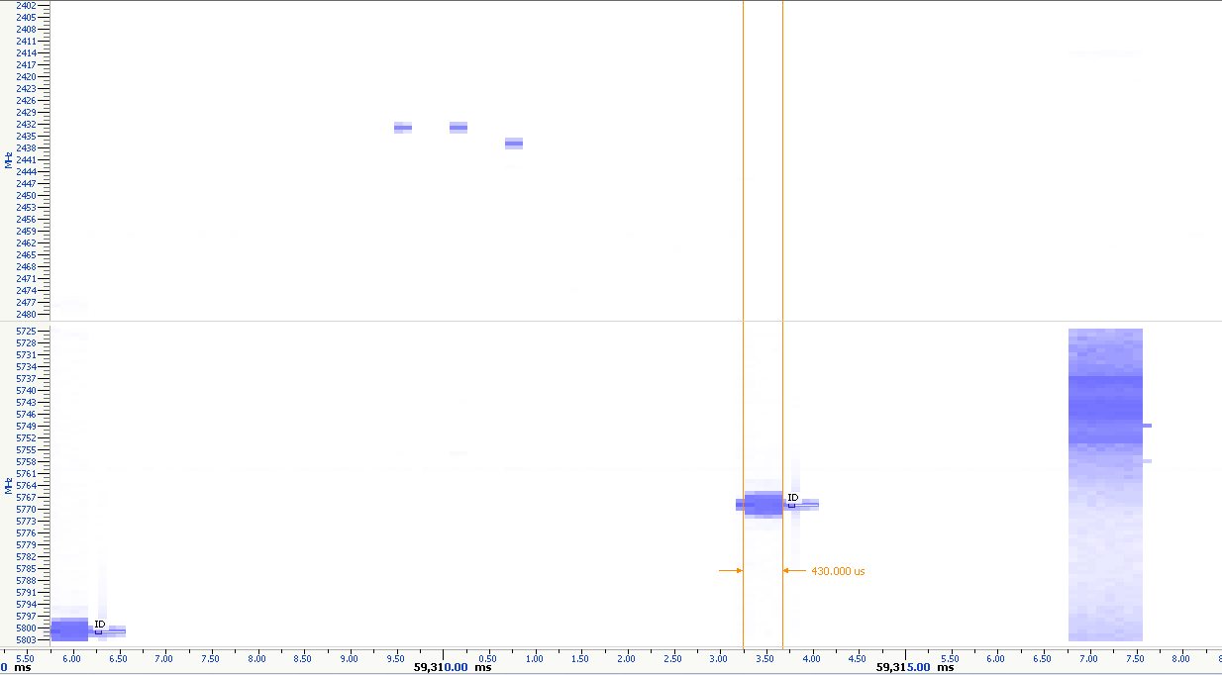
Scenario 1. Perceived MOS in four segments
1. NB audio, no Wi-Fi (20 sec)
Audio is clear (MOS: 4.5)
2. Wi-Fi starts, NB still on 5 GHz (~12 sec)
Audio has noise (MOS: 2.6 – 3.2)
3. Wi-Fi traffic continued. Audio transitions to 2.4GHz after ~12 secs. Some audio activity remains on 5 GHz
Audio distorted (MOS: 2.6 – 3.2)
4. NB audio continued on both 2.4 and 5 GHz after Wi-Fi traffic stopped (15 sec)
Audio recovers (MOS: 4.0)

Slide 8
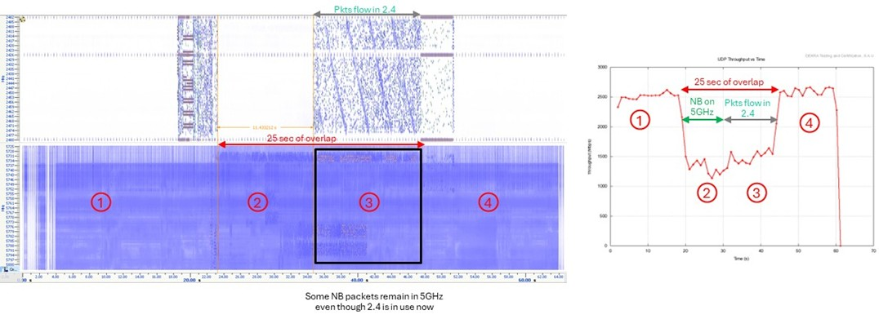
Scenario 2. Impact of NB audio operation on Wi-Fi Throughput
UDP Wi-Fi traffic started. Peak Data Rate ~2.5 Gbps
After 20 seconds, started NB audio (Earbuds connected) → Observed audio packets using 5 GHz & highly significant Wi-Fi throughput degradation
~12s later audio packets mostly transitioned to 2.4 GHz (some NB packets still flow on 5 GHz). Wi-Fi throughput still impacted
When audio stops and Earbuds are disconnected, Wi-Fi throughput recovers fully

Slide 9
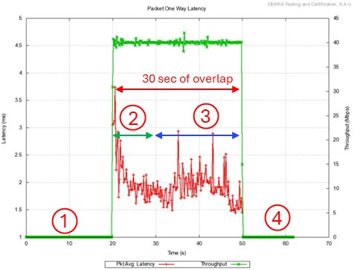
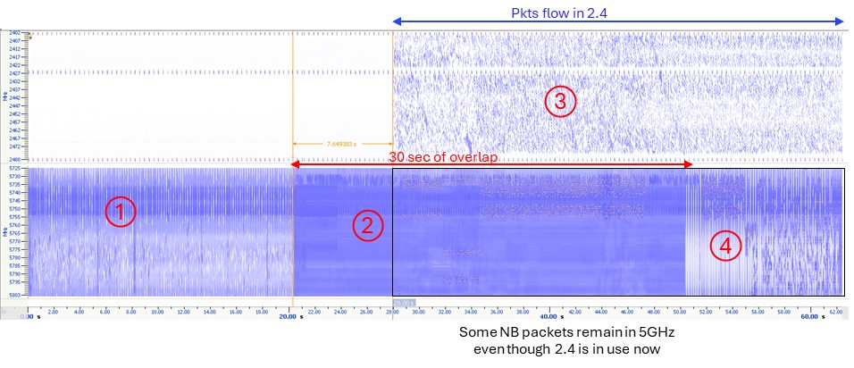
Scenario 3. Impact of 40 Mbps* Wi-Fi operation on NB device behavior
NB audio starts, no Wi-Fi traffic, audio quality is good
20 seconds later, Wi-Fi traffic started. NB audio traffic remained on 5 GHz (for ~8 seconds). Audio quality degrades with faint noise in the background
After ~8 seconds, observed audio mostly transitioned to 2.4 GHz (noticed ~1 sec of silence in between), though some NB packets still seen in 5 GHz. Audio quality is now mostly recovered
Audio quality recovers (perceived quality is slightly inferior compared to start of the test) when the Wi-Fi throughput traffic stopped
Audio stays on 5 and 2.4 GHz until Earbuds are disconnected and connected again
Full 60 seconds audio recording
Audio MOS scores by time segment:
4.5
3.8
4.0
4.0
* Note: 40 Mbps Wi-Fi throughput out of 2500 Mbps maximum would represent a 1.6% Wi-Fi duty cycle

Slide 10
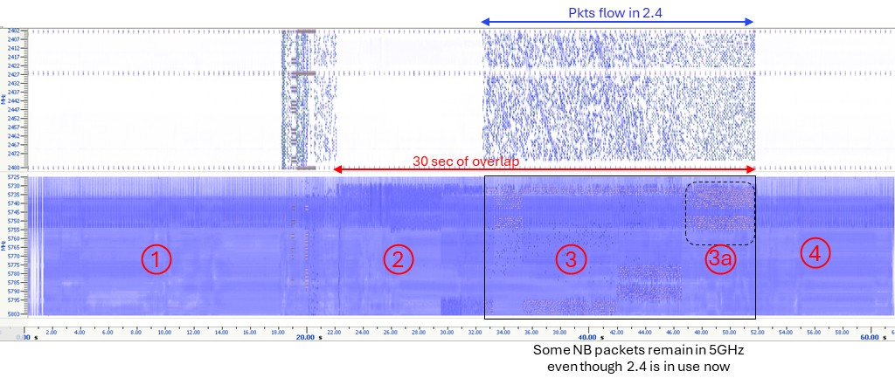
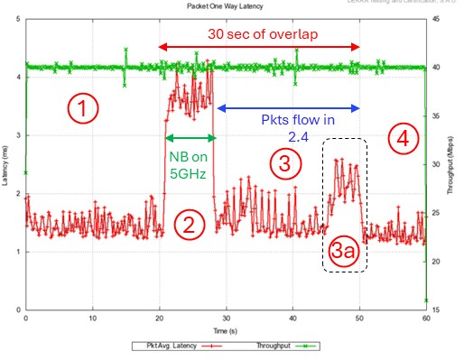
Scenario 4. Impact of NB Operation on 40 Mbps Wi-Fi
UDP Wi-Fi traffic started, throughput 40 Mbps, average latency ~1.5 ms
After 20 seconds, started NB audio (Earbuds connected) → Observed audio packets using 5 GHz, no impact on Wi-Fi throughout but average latency observed increasing to ~3.5 ms
~10s later audio packets mostly transitioned to 2.4 GHz (some NB packets still flow on 5 GHz). Wi-Fi throughput remains not impacted, and average latency goes down to ~1.8 ms 3a. At this point latency went up to 2.5 ms due to NB packets in 5 GHz being on the primary Wi-Fi channel
When audio stops and Earbuds are disconnected, Wi-Fi latency recovers fully

Slide 11
5 GHz Overlapping Wi-Fi FB and Wi-Fi Streaming Audio Scenarios Analyzed
To baseline performance of LBT operation, coexistence between a network of streaming audio over Wi-Fi and a full buffer (FB) Wi-Fi OBSS network was analyzed by observing impact on audio quality and throughput.
Scenario
5 | Impact of overlapping network Wi-Fi operation on streamed audio, audio quality analyzed
6 | Impact of streamed audio on Wi-Fi throughput, impact of throughput over time was analyzed (without and with co-channel audio streaming)

Slide 12
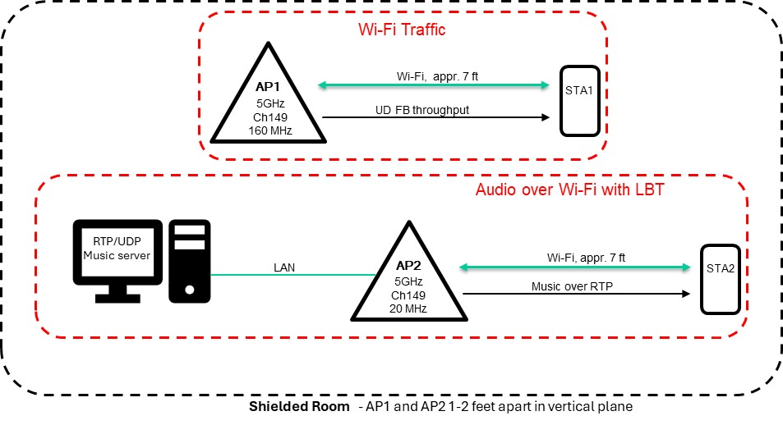
Test Set Up for Scenarios 5 & 6 – Audio Streaming over Wi-Fi baselining

Slide 13
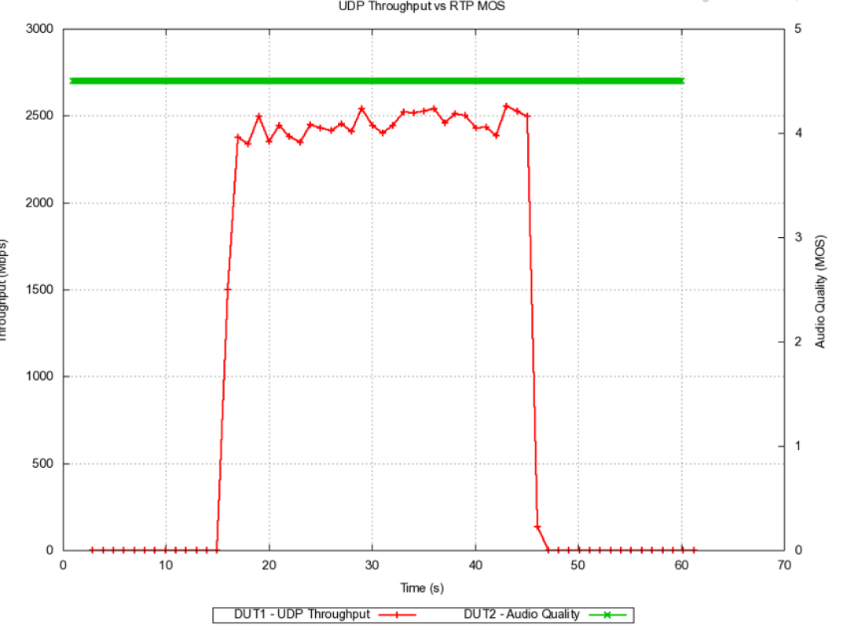
Scenario 5. Impact of Overlapping Network Wi-Fi operation on streamed audio, audio quality analyzed
Streamed audio over RTP on AP2, quality 4.5 MOS
15 sec later, UDP full buffer starts on an OBSS AP1
Wi-Fi maintains peak performance (~2.5 Gbps)
No impact on audio quality
Full 60 seconds audio recording

Slide 14
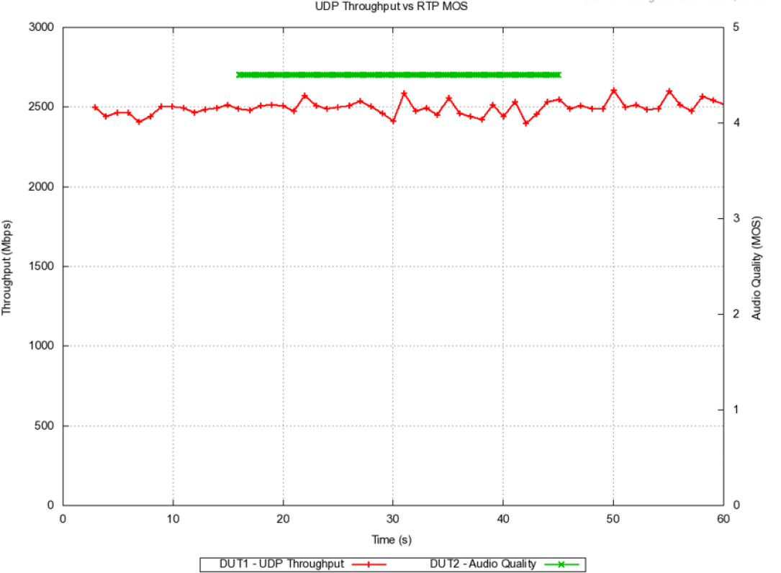
Scenario 6. Impact of Wi-Fi streamed audio on Overlapping Wi-Fi Network
UDP full buffer starts on AP1
15 seconds later, music starts streaming over RTP on OBSS AP2
Wi-Fi maintains peak performance (~2.5 Gbps)
No impact on audio quality

Slide 15
Conclusions
Upper Band NB communication for the Product Under Test is mainly in UNII-3 between frequencies 5.727 GHz to 5.850 GHz (123 MHz frequency span) for audio connection between Multimedia Device and Ear Buds
If Wi-Fi and NB occupy the same spectrum, severe impact is seen in Wi-Fi data throughput (~50%) and in NB audio quality in case of full buffer Wi-Fi throughput testing
The device under test starts to use the 2.4 GHz band as well for NB Traffic, however audio quality suffers
Even in the case of a very light Wi-Fi load (40 Mbps), NB audio quality is impacted, and NB device starts to use the 2.4 GHz band
The NB coexistence mechanism implemented appears to be inadequate for effective sharing of the same spectrum in dense deployment scenarios, even in lightly loaded cases
There is an apparent risk to NB audio quality
Running audio type traffic with LBT (Wi-Fi) on a 20 MHz OBSS link shows no noticeable degradation of Wi-Fi throughput of the 160 MHz link, while audio quality remains good

Slide 16
Potential Next Steps
Further coexistence protocol behavior analysis with other existing commercially available products?
Coexistence impact in scenarios with multiple devices?
Coexistence measurement campaigns comparing channel access protocol options in early High Band BT implementations?
Other?

