Slide 1
Multi-optical bands and MLO
Sept 2025
Date: 2025-07-17
Authors:
Name | Affiliations | Address | Phone | email
Mohamed Islim | pureLiFi |  |  | Mohamed.Islim@purelifi.com
Cheng Chen | pureLiFi |  |  | Cheng.Chen@purelifi.com
Mostafa Afgani | pureLiFi |  |  | Mostafa.Afgani@purelifi.com

Slide 2
Abstract
Sept 2025
This presentation include
- Discuss multiple optical band ELC use cases and the associated technical challenges
- Discuss MLO use cases
- Comparison between utilising MLO and spatial multiplexing for multi optical bands ELC.

Slide 3
Do we need multi-optical band ELC support?
Sept 2025
In underwater communications, visible light optical band (400 nm – 600 nm) is the only feasible option (11-24/1928). IR optical bands cannot propagate well.
Utilising the Visible light optical band beside any of the other optical bands require Visible light uplink support which is undesired for end users.
There are use cases where WDM is useful within the same optical band such as the green and blue optical bands support for the underwater applications (11-25/830). These can be enabled using either MLO or MIMO.
The NIR (800 nm - 100 nm) band has been utilised in IEEE 802.11bb and demonstrated in consumer, industrial, and defence applications (11-25/143).
The main motivation behind the support of the SWIR band (1200 nm – 1600 nm) in ELC is to support defence applications, using any other optical band beside SWIR will increase the probability of detection and interception (11-25/1360).

Slide 4
What about NIR+SWIR?
Sept 2025
The use of NIR + SWIR in industrial or consumer use-cases is possible technically.
However, this is unlikely to due to a few reasons:
SWIR components are more expensive and have technical challenges such as smaller size detector and lower APD gain compared to NIR detectors.
System with OFEs of different wavelengths is generally more complex to design and implement (different material technology).
There are more efficient ways to form orthogonal channels in the space, intra-optical band wavelength, and frequency domains.

Slide 5
Technical challenges to consider when discussing multiple optical bands support in ELC
Sept 2025
The multiple optical band transceivers are based on different material technologies (GaN and Si for VIS, GaAs and Si for NIR, InGaAsa and InP for SWIR).
Increased signalling and channel mapping complexity: the group has discussed two vehicles that could enable multi-optical band ELC support
Fixed and unique channel mapping (11-25/1076).
Flexible mapping with channel information conveyed in MAC (11-25/1648).
Increases the burden of implementation
Require a common channel to establish bootstrapping
Stringent requirement on the RF to IF signal converters

Slide 6
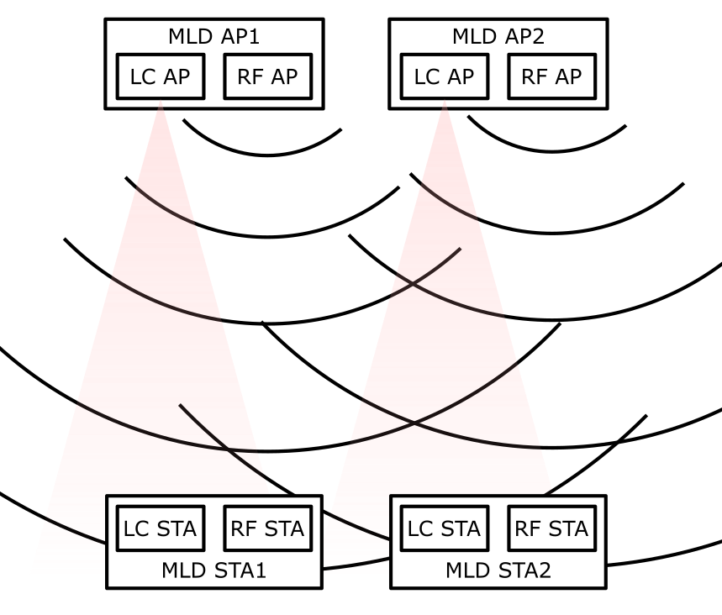
ELC MLO use cases
Sept 2025
There is a clear use case for MLO between RF links and ELC links
In the case of heavy traffic wireless broadband services, ELC links experience less contention and can achieve high data rate, while links on RF channels are more congested but ensure link reliability.
There is no clear use case for MLO between ELC links with multiple optical bands
The propagation characteristics of optical signals in free space varies little with wavelength for short range link (<100 m). Little wavelength diversity gain can be explored.
For simply boosting aggregate achievable data rate, WDM within the same optical band or forming multiplexing channels by exploring other dimensions (frequency/space) offer most efficient alternatives.

Slide 7
Multi-optical bands MLO impact on channel mapping
Sept 2025
If the use of the three optical bands is defined mainly upon 6GHz WiFi band, MLO between them is not supported by the practically implemented protocol. Most of the MLO happens among different WiFi bands (2.4 GHz, 5 GHz and 6 GHz).
To increase PHY layer data rate, multi-link multi-radio (MLMR) MLO is required, since it enables simultaneous use of multiple radios on different channels.
Multi-link single-radio (MLSR) does not increase PHY rate, but it improves MAC-layer performance by reducing latency, improving reliability, and maintaining throughput under congestion or interference, which is not the typical scenario for ELC
Discovery and management frame transmission has to rely on a 5 GHz/2.4 GHz channel via on-channel tunnelling (OCT), so there has to be a 5GHz/2.4 GHz channel (20 MHz minimum) besides the 6GHz band channels
5 GHz channel and 6 GHz channel are mapped to different frequency range in IF as specified in 802.11bb channelisation.

Slide 8
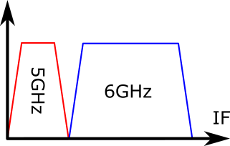
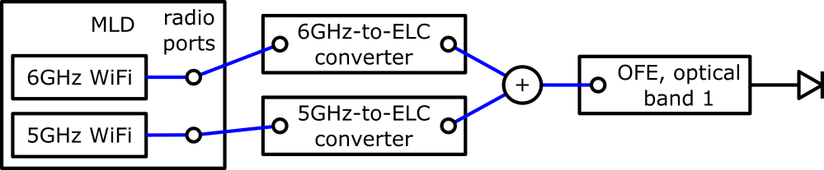
Multi-optical bands MLO
Baseline scenario with 1 OFE and a dual-band multi-link device (MLD) with 2 radios
Discovery and management frame transmission has to rely on a 5GHz/2.4GHz channel.
5GHz channel and 6GHz channel are mapped to different frequency range in intermediate frequency (IF) as specified in 802.11bb channelisation.
Achievable data rate: 320MHz link 1SS + 160MHz link with 1SS

Slide 9
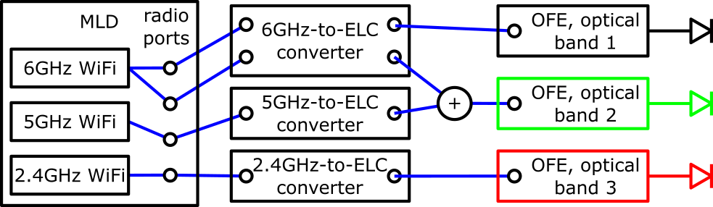
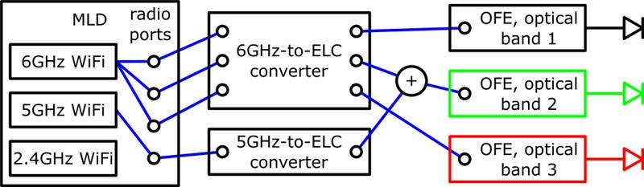
Multi-optical bands MLO vs. Multi-optical bands spatial multiplexing
Sept 2025
Scenario with 3 OFE of different optical bands and a tri-band MLD with 4 radios
Data rate with MLO prioritised: 2SS 320MHz link + 1SS 160MHz link + 1SS 40MHz link
Data rate with spatial multiplexing prioritised: 3SS 320MHz link + 1SS 160MHz link
MLO prioritised:
Spatial multiplexing prioritised:

Slide 10
Multi-optical bands MLO vs. Multi-optical bands spatial multiplexing
Sept 2025
Regardless MLO or spatial multiplexing, the maximum number of parallel data transmission channels are mainly restricted by the number of WiFi radios.
With the same number of WiFi radios, maximum number of MLO links is three and the maximum bandwidth on 5GHz and 2.4GHz bands are 160MHz and 40MHz, respectively.
Diversity gain is also achievable via MIMO scenario with number of SS smaller than the MIMO channel size.

Slide 11
Summary
Sept 2025
Multi-optical band support offers little benefit; wavelength diversity is weak for short-range links.
SWIR support is mainly defense-driven; NIR+SWIR offers little value when compared to stand-alone NIR.
ELC links are less contended and thus offers higher-throughput; RF links are more congested but more reliable; MLO can enable us to have support both links in 11br.
Complexity vs. benefit trade-off: multi-band MLO ELC adds significant overhead without clear use cases.
Utilising the wavelength, space, and frequency multiplexing is more efficient for boosting data rates.

