Slide 1
Considerations on DBE Mechanism
Date: 2025-09-xx
Authors:
Name | Affiliations | Address | Phone | Email
Shravan Kumar Kalyankar | Huawei |  |  | kalyankar.shravan.kumar@huawei.com
Huang Lei
Rojan Chitrakar
Yunbo Li

Slide 2
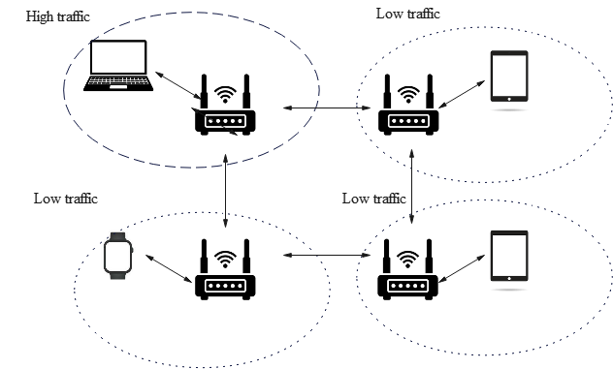
Background: DBE
Motivation: In a dense enterprise network, AP channel widths are typically 20 MHz or 40 MHz to minimize inter-BSS contention. In an coordinated AP scenario, to address high traffic demand at one of the APs, where the neighboring APs have low traffic, the AP experiencing high traffic load may expand the operating bandwidth.
Fig. 1. Motivation for DBE.
References:
Maximizing channel bandwidth in dense AP deployments, Malcolm Smith, Cisco Systems, Jan 2024.
Dynamic Bandwidth Selection Signaling Details, Binita Gupta, Cisco Systems, Oct. 2024.
Dynamic Bandwidth Expansion (DBE) Operation and Signaling Details, Binita Gupta, Cisco Systems, Mar. 2025.

Slide 3
Background: DBE
37.x Dynamic bandwidth expansion (DBE)
Dynamic bandwidth expansion (DBE) is a mode of operation that allows a UHR AP to dynamically enable operation with an expanded bandwidth that is greater than its BSS bandwidth and up to the AP’s maximum supported bandwidth for DBE, for UHR non-AP STAs that support DBE mode. When an AP is operating with an expanded operating bandwidth, the expanded bandwidth is referred to as the DBE bandwidth and the DBE mode is enabled on the AP. When an AP is no longer operating with expanded bandwidth greater than the BSS bandwidth, DBE mode becomes disabled on the AP.
When DBE mode is enabled, the DBE bandwidth can be changed to another DBE bandwidth value that is greater than the BSS bandwidth. The BSS primary channel does not change when the DBE mode is enabled, the DBE bandwidth is changed or the DBE mode is disabled. When an AP has the DBE mode enabled, the non-AP STAs that do not support DBE mode continue to operate with the BSS bandwidth.
References: PDT-MAC-DBE

Slide 4
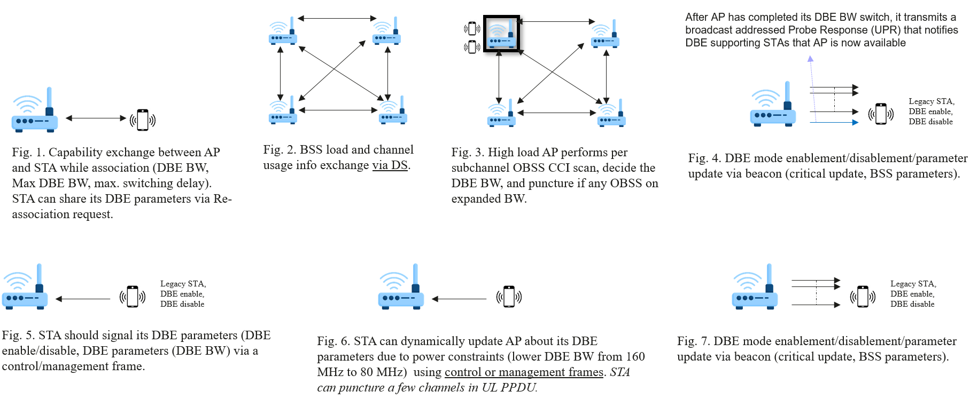
Coordinated DBE Mechanism

Slide 5
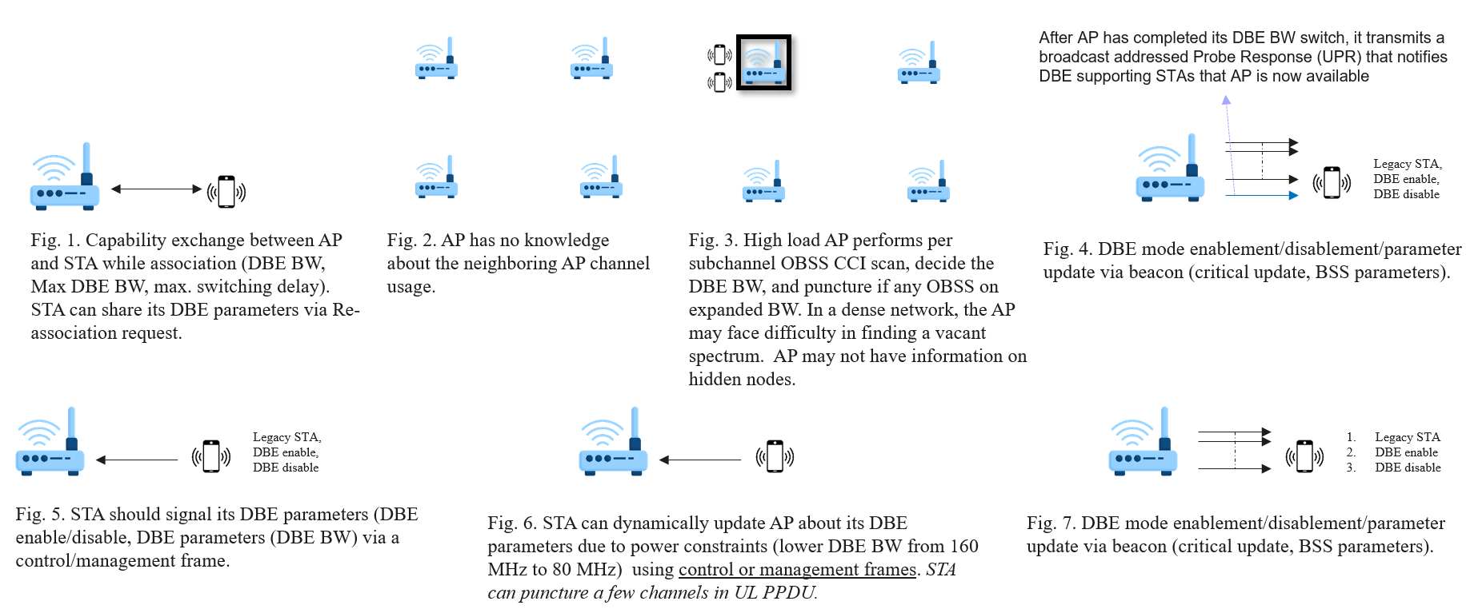
Uncoordinated DBE Mechanism (Problem)

Slide 6
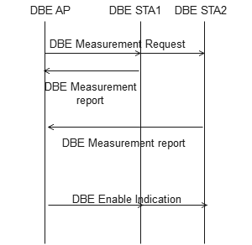
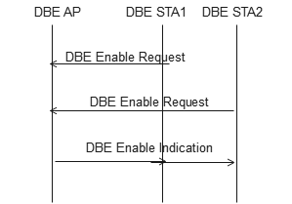
Uncoordinated DBE Mechanism (Solution)
Enable Un-coordinated DBE Mechanism after a DBE measurement mechanism,
  AP send a DBE measurement request to the DBE STAs to report the neighboring AP channel load.
  STA include the DBE measurement report in an DBE enable request (OMP request).
Fig. 8: AP initiated STA feedback.
Fig. 9: STA Triggered DBE Mechanism.

Slide 7
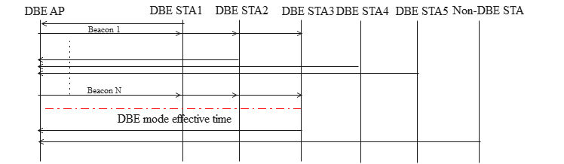
DBE Signaling (Problem)
Problem:
To make DBE AP aware of DBE STA status (DBE enable/disable), every DBE STA is expected to send an explicit indication to DBE AP. Explicit indication of STAs on whether they can participate in DBE mode (DBE mode enable/disable) at a time after receiving DBE mode enablement from a beacon frame would result in severe contention among the DBE enabled STAs, especially when there are large number of DBE STAs.
Three different ways of DBE STA status indication are presented below,
Fig. 10. Several ways of STA sending an indication to AP. However, severe contention may occur especially after STAs receive the Beacon 1 with AP’s DBE enablement indication.

Slide 8
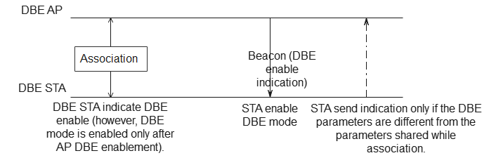
DBE Signaling (Solution)
Proposal:
Introducing an initial status of DBE mode can avoid unnecessary explicit DBE STA indication.
DBE STA will indicate the DBE mode status while association (initial status).
DBE STA will enable the DBE mode only after receiving the DBE enablement indication from the AP (i.e., DBE STA will not enable the DBE mode until the DBE AP send the enablement indication, however, the DBE STA initial status indicates that the DBE mode of the STA is enabled).
DBE STA will send an explicit indication after receiving the DBE mode enablement indication from the AP only if there is any change in the DBE parameters of the STA.
DBE mode effective time
Fig. 11. DBE STA initial status indication while association.
Note: This proposal introduces an approach to indicate STAs initial willingness to participate in the DBE mechanism.

Slide 9
    Summary
In this contribution, we explored potential challenges in implementing DBE mechanisms.

Slide 10
References
Maximizing channel bandwidth in dense AP deployments, Malcolm Smith, Cisco Systems, Jan 2024.
Dynamic Bandwidth Selection Signaling Details, Binita Gupta, Cisco Systems, Oct. 2024.
Dynamic Bandwidth Expansion (DBE) Operation and Signaling Details, Binita Gupta, Cisco Systems, Mar. 2025.
PDT-MAC-DBE
PDT-MAC-DBE-part 2

Slide 11
Straw Poll 1
Do you support to include a DBE measurement mechanism before enabling the DBE mode in un-coordinated networks?
  Y/N/A

Slide 12
Straw Poll 2
Do you support to include DBE mode initial status and share this information with the DBE AP while association?
  Y/N/A

