Slide 1
Authz-ID
Date: 2025-09-16
Authors:

Slide 2
Abstract
Introduction of a new encrypted KDE for a STA to declare what group it belong to, allowing the Authenticator to group STAs, independently on the authentication type (PSK, SAE, .1X, etc.)

Slide 3
Use Cases
There is a growing market demand to have both Passphrase and 802.1X Authentication available on the same (B)SSID
Within a single (B)SSID, there is a need to group and apply policy to a subset of devices
Examples
Home use case – grouping a subset of IoT devices per device or per function (e.g., door locks, children devices. etc)
Multi-dwelling unit (Dorm etc) – all of the devices in one apartment off a shared WLAN

Slide 4
Technical Problem
Passphrase (PSK or SAE) networks combine authentication and authorization within the same construct – if I know the password I get access to the network, and there is no ability to differentiate/group devices and apply policy (other than MAC Address or using password identifiers)
There is no current mechanism that enables “grouping” of devices across authentication types (PSK, SAE, 802.1X) – with RCM (now on commercial devices) it is impossible to do this via MAC Address

Slide 5
Authorization Element (AuthZ-ID)
Decoupling authentication to the wireless network from authorization in an ESS
Could also be used across multiple authentication mechanisms (OWE, PSK, SAE, .1X etc)
Authorization Element is a new encrypted KDE sent in 4WHS-M2 from non-AP STA to AP protecting the element from passive observation
The AuthZ Element contains proof of knowledge of the “AuthZ-ID” which is a word/phrase/designator used to “group” and then apply policy to a set of devices:
“Living Room”
“my devices”
“11122233344”

Slide 6
Authorization Element (cont.)
The AP applies a policy/grouping to those non-AP STAs that share the same AuthZ-ID. A group of STAs owned by the same entity and sharing the authorization identifier allows adding each device to the same group/policy (across multiple authentication mechanisms)
The AP may apply an AuthZ-ID specific GTK to each of the non-AP STAs in the group providing multicast security segmentation.
Behavior when the non-AP STA does not send an Authorization Element or an Authorization Element is sent with an unknown AuthZ-ID
The non-AP STA may be allowed network access with a default policy as if it were using just the PSK/PassPhrase to get on the Network with a default GTK (legacy STA behavior)
The AP may refuse the non-AP STA access to the network without a valid Auth-ID

Slide 7
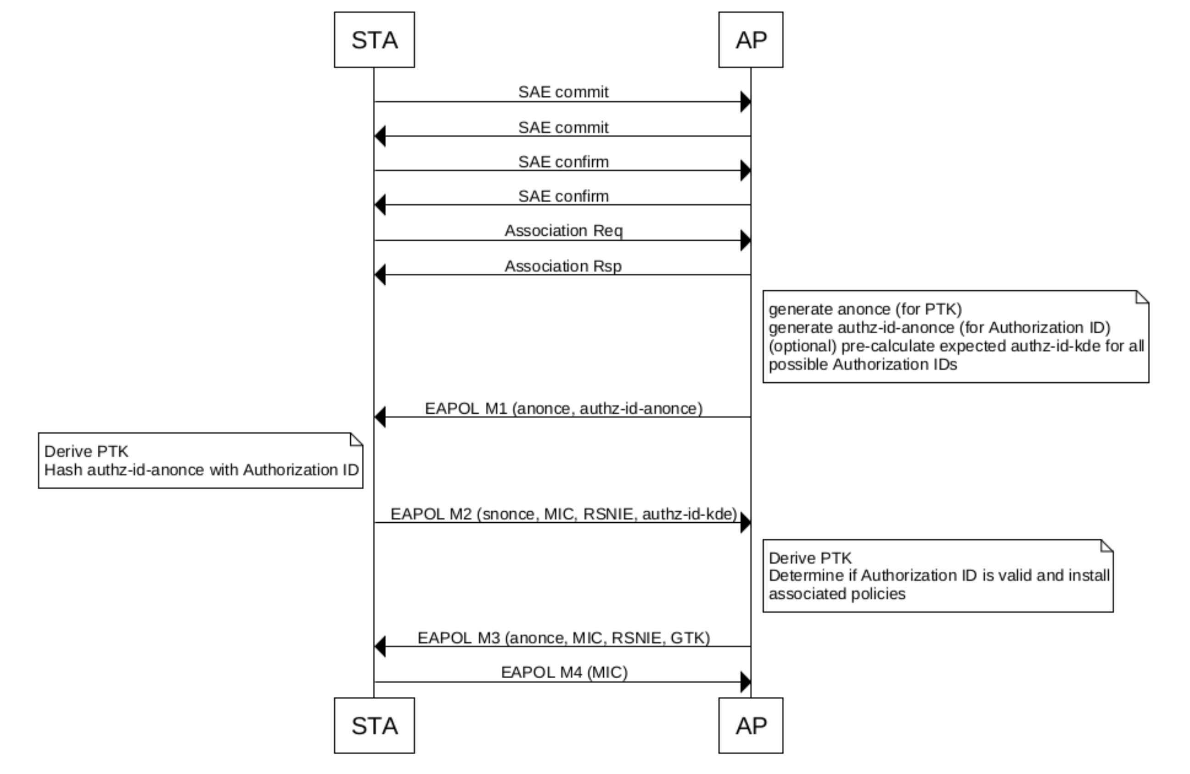
4-way Handshake messages (over-simplified)
STA/AP go through Authentication process and generate PMK
Message 1: AP->STA
Authenticator sends EAPoL KDE containing new element indicating support for AuthZ Element
Authenticator sends an authz-id-anonce.
Message 2:
Supplicant sends Authenticator S-Nonce and may send encrypted KDE containing the AuthZ-ID anonce with the AuthZ-ID (opt-in)
Between M2&M3 – Authenticator determines “policy/grouping” for STA based on inclusion of AuthZ-ID
Authenticator can now generate PTK (GTK and IGTK if needed)
After finding the matching AuthZ-ID the Authenticator will do one of the following:
Success: apply specific group policies
Missing AuthZ-ID: apply default group policies
Failure (invalid AuthZ-ID): apply default group policy or deny access (deauth)
Message 3:
GTK, IGTK delivered to Supplicant encrypted with PTK
Authenticator may deliver a AuthZ-ID specific GTK or a default GTK
Message 4:
Supplicant informs authenticator that keys have been installed

Slide 8
Authz-ID & Privacy
Privacy compliant: The exchanged KDEs does not contain the AuthZ ID, but only a proof of knowledge and are encrypted so eavesdroppers can't decode them. There is no other trace of AuthZ IDs in other exchanges.

Slide 9
Summary
Authz-ID seamlessly integrates with any “authentication” mechanism
Does not require changes to any current authentication protocol (802.11 or EAP)
Satisfies the requirement to apply policy/group devices within a network
Maximizes interoperability
Allows legacy devices or devices that do not support Auth Element to connect to the network
Offers an independent capability to generate multiple GTKs, enabling robust multicast security segmentation

Slide 10
Backup – FAQ (1/4)
How is this different from 802.11bh Device Identifier?
DeviceID identifies a single device, AuthZ-ID identifies the group identifier shared by a group of devices that belong to the same group and to whom the same policies should be applied.
DeviceID for a single device changes at each association, AuthZ-ID is likely to be the same until manually changed by an admin.
AuthZ-ID allows new devices in the correct group without previous onboarding

Slide 11
Backup – FAQ (2/4)
How do you prevent malicious probing of the AuthZ-ID (STA repeatedly trying different values)?
STA sends the AuthZ ID during the EAPOL exchange: if authentication fails, AuthZ ID is never sent (only authenticated station can really do malicious probing)
STA trying random AuthZ ID would not know if that worked or not.
STA would have to go through the full 4WHS multiple times. The AP should see the same STA attempting the 4WHS multiple times in succession and deny the STA access (Policy on the AP)

Slide 12
Backup – FAQ (3/4)
How do you prevent this from being a tracking mechanism (Group of one device)?
The exchanged KDEs never contain the AuthZ ID, but only a proof of knowledge. There is no other trace of AuthZ IDs in other exchanges.

Slide 13
Backup - FAQ (4/4)
Why don’t we just use password identifiers and do the mapping with .1X on the network?
Password identifiers are only available for SAE. Authz ID could be used on top of any authentication that includes a EAPOL exchange (PSK, .1X, etc.)
Mapping on the network introduces complexity on Radius/infrastructure:
Radius solicited for each SAE/PSK connection
Mapping certificate/policy, password identifier/policy needed
AuthZ-ID offers the possibility to map different devices that authenticate with the same credentials to different groups (for example personal phone vs work laptop in an enterprise context)

Slide 14
Straw Poll 1
Do you support introducing the Authz-ID element into 802.11?
Yes
No
Abstain

Slide 15
Straw Poll 2
What group do you think this proposal could fit in?
TGbi
TGmf
TGbt
Other
None

