Slide 1
Unified Channel Model: Targeted New Features
Date: 2025-09-15
Authors:
Name | Affiliations | Phone | email
Volker Jungnickel | Fraunhofer HHI | +49 162 2552756 | volker.jungnickel@hhi.fraunhofer.de
Stephan Jaeckel | SJC / Fraunhofer HHI | +49 30 60980512 | jaeckel@sjc-wireless.com

Slide 2
Abstract
This contribution provides an initial list of targeted new features and requirements for the Unified Channel Model. It is intended as a starting point for further discussion in the group.

Slide 3
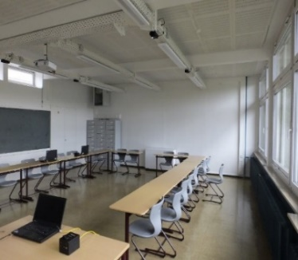
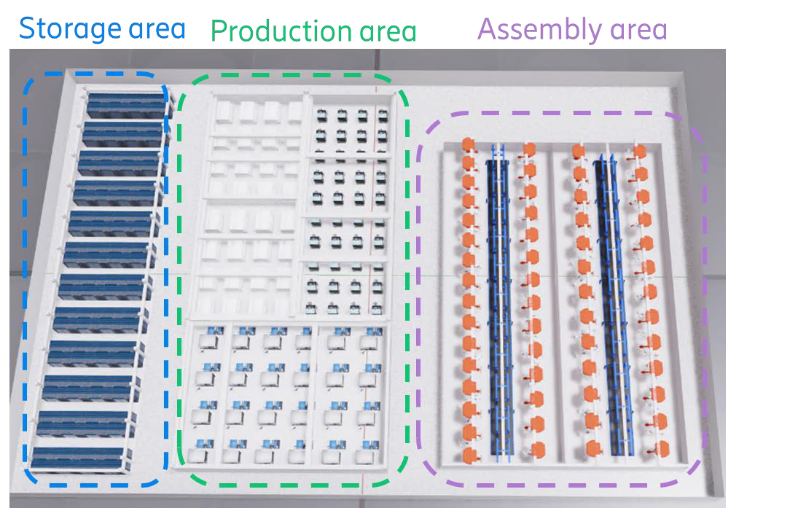
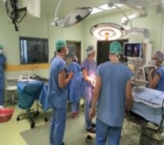
Use cases and scenarios
Hotspot scenarios
  in conference-/classrooms
  dual 5/60 GHz coverage in industry [12]
  hospital (4K video from endoscope to screen)
  others tbd.
Can be addressed by network densification: Embedded high-band APs
  below-7 GHz APs (every 10-20 m) plus mm-wave/optical APs (every room)
Demonstrate the performance gain
  offloading synergy: enhanced rates for both, below-7 GHz and high-band STAs
  low latency: higher bands are less congested

Slide 4
UCM: Relevant reference scenarios
Open list of reference scenarios
Single family home
Multi-dwelling building
Open plan office
Industrial / factory hall
Large indoor area (hotel lobby, mall/exhibition)
Open outdoor area (fixed wireless access, wireless-to-the-home)
…
Selection criteria are
Relevance for the market
Measurement data should be (made) available
Channel statistics reflects critical cases properly
….

Slide 5
UCM: New features for consideration
Unified modeling approach across a frequency range from 1 to 60 GHz and optical bands
correlated large-scale fading for multiple RF and optical bands (shadowing, LOS blocking)
correlated small-scale-fading across multiple RF bands
→ Support for multi-link operation (MLO).
Spatial consistency for multiple stations
flexible antenna modeling, incl. polarization and beamforming, separately for each band
cross-talk modeling between co-located and distributed antennas
Support for MU-MIMO with multiple AP
…

