Slide 1
Unified Channel Model:
Requirements and Targeted Features
Date: 2025-09-15
Authors:
Name | Affiliations | Phone | email
Stephan Jaeckel | SJC / Fraunhofer HHI | +49 30 60980512 | jaeckel@sjc-wireless.com
Volker Jungnickel | Fraunhofer HHI | +49 162 2552756 | volker.jungnickel@hhi.fraunhofer.de

Slide 2
Abstract
This contribution provides an initial list of requirements and targeted new features for the Unified Channel Model. It is intended as a starting point for further discussion by the group.

Slide 3
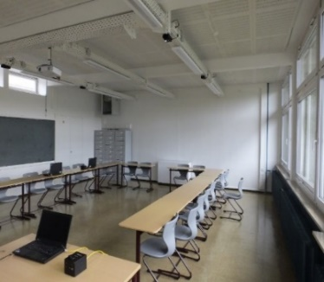
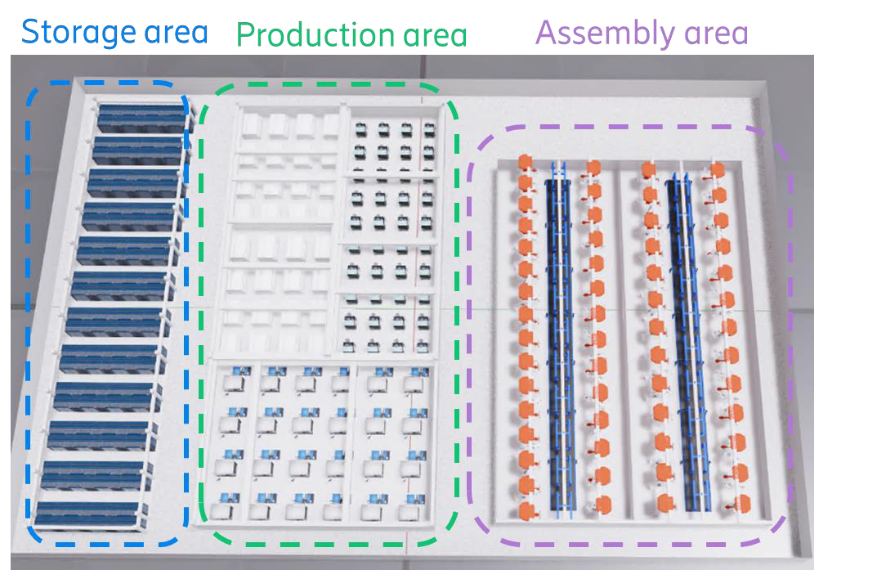
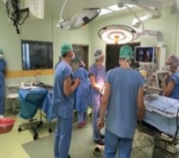
Use cases and scenarios
Hotspot scenarios
  in conference-/classrooms
  dual 5/60 GHz coverage in industry [12]
  hospital (4K video from endoscope to screen)
  others tbd.
Can be addressed by network densification: Embedded high-band APs
  below-7 GHz APs (every 10-20 m) plus mm-wave/optical APs (every room)
Demonstrate the performance gain
  offloading synergy: enhanced rates for both, below-7 GHz and high-band STAs
  low latency: higher bands are less congested

Slide 4
UCM: Reference Scenarios
Single Family House
Multi-Dwelling Unit
Open-plan Office
Large indoor area: Hotel lobby, Mall/Exhibition
Industrial / Factory
Open Outdoor Area (e.g. for Fixed Wireless Access)
….
This is an open list for reference scenarios. Measurement data should be available to parameterize the channel model.

Slide 5
UCM: Targeted New Features
Unified modeling approach across a frequency range from 1 to 60 GHz + optical bands
Correlated large scale fading for all bands
Correlated small-scale-fading across multiple radio frequency bands
Support for Multi-link operation
Spatial consistency for multi-AP operation
Flexible antenna modelling, incl. polarization and beamforming, separately for each band
…

Slide 6
UCM: Technical Requirements
Space-time characteristics of the propagation channel (basic requirement)
Support beam forming with steerable directional antennas on both TX and RX sides with no limitation on the antenna technology
Account for polarization characteristics of antennas and signals
Proper description of SU-MIMO, MU-MIMO and distributed MIMO modes
Support for non-stationary and mobility effects
Spatial consistency across multiple stations
Support for multiple frequency bands in the range from sub-7 GHz , mm-Wave, and optical bands
…

