Slide 1
An Improved PQC PAKE
Date: 2025-08-25
Authors:

Slide 2
Introduction
This proposal introduces a PQC PAKE method to:​
In association scenarios:
Simplify the procedure of the PQC password authentication and key exchange.​
In pre-association scenarios:
Enable PQC password authentication and key exchange with the PASN framework.

Slide 3
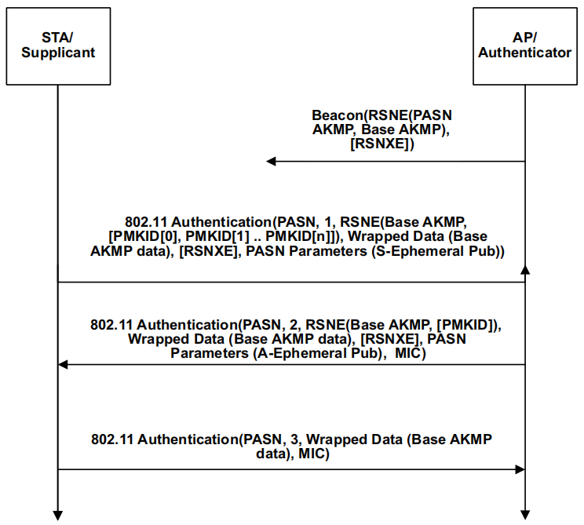
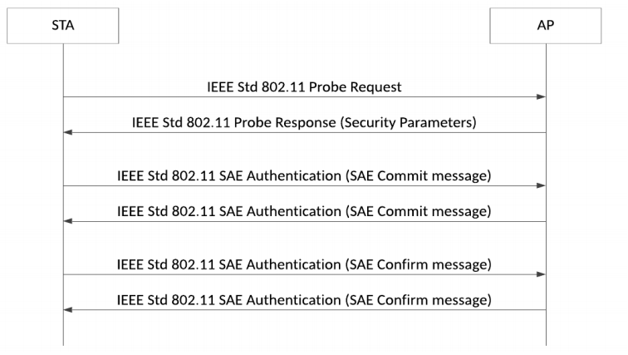
Recap: 802.11 legacy PAKE and PASN
SAE: Core PAKE in 802.11 with 4 frames (no order required in confirm).
PASN: Supplements SAE as base AKMP in pre-association security with 3-message authentication frame exchange.

Slide 4
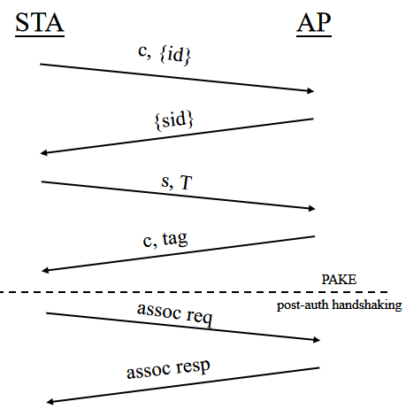
Motivation
In [3] and [4], OQUAKE was introduced as a promising PQC PAKE mechanism in 802.11.
Four message exchange in order:
  two message to generate fsid,
  two message exchange of NoIC.
Provable security.
Requires key confirmation step.
Something need to be solved:
Cannot be encapsuled into PASN framework as base AKMP.
Redundancy of the first two message.
PMK
PMK

Slide 5
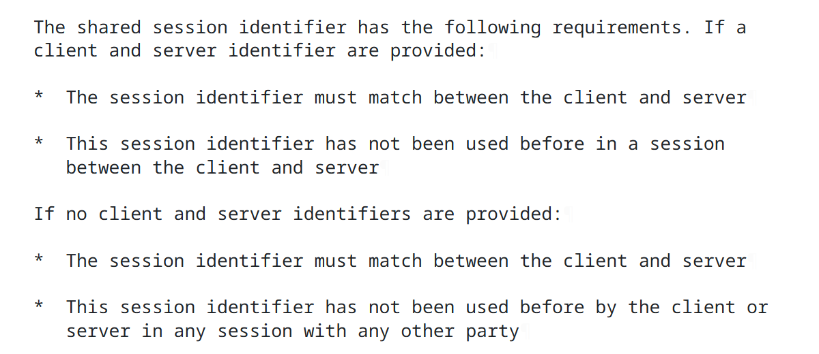
Solution: Session Identifier Flexibility
According to IETF RFC 9807 and draft-vos-cfrg-pqpake-00, STA can generate session identifier, as long as:
The session identifier is consistent between STA and AP;
The session identifier has not been used before in a session between STA and AP.
Solution:
Let STA generate sid.
One frame can be saved in identity exchange and fsid generation.

Slide 6
Example——PQC PAKE with 3 Frames
STA
AP
spk, pwd
ssk, pwd
sc, sK = KEM.Encaps(spk)
ke = KDF(sK, “string”)
sid = rand()
Auth-1[sc, {identity 1,sid}ke]
sK = KEM.Decaps(sc, ssk)
ke = KDF(sK, “string”)
fsid ← (sid, identity 1, identity 2)
(sk, pk) ← KEM.KeyGen()
r ← random
Z = kemeleon_encode(pk)
(s, T) ← 2F(pwd,fsid, r, pk)
Identity Exchange
and
fsid Generation
Auth-2[{identity 2}ke, s, T]
fsid ← (sid, identity 1,identity 2)
((r, Z) = 2F⁻¹(pwd, s, T)
pk = kemeleon_decode(Z)
(c, K) ← KEM.Encaps(pk)
tag ← H_{tag}(fsid, pwd, pk, s, T, c, K)
PMK←KDF(K,c,s,T,pk,pwd,fsid)
NoIC Exchange
Auth-3[c, tag]
K ← KEM.Decaps(sk, c)
tag ← H_{tag}(fsid, pwd, pk, s, T, c, K)
PMK←KDF(K,c,s,T,pk.pwd,fsid)

Slide 7
Scenario 1——PQC PAKE in PASN
STA
AP
Auth-1[PASN,1,RSNE,RSNXE,Wrapped Data(Message-1 with {identity,sid}spk),
PASN Parameters]
Auth-1[PASN, 1, RSNE, RSNXE, Wrapped Data ({identity 1, sid}ke), PASN Parameters]
Auth-2[PASN,2,RSNE,RSNXE,Wrapped Data(Message-2 with s, T, MIC-1),
PASN Parameters]
Auth-2[PASN, 2, RSNE, RSNXE, Wrapped Data ({identity 2}ke, T), PASN Parameters]
Auth-3[PASN, 3, RSNE, RSNXE, Wrapped Data (c, tag), PASN Parameters]

Slide 8
Scenario 2——PQC PAKE and Association
STA
AP
Auth-1[{identity 1,sid}ke)]
Auth-2[{identity 2}ke, T]
Association Request[c, tag,
Key Confirm 1]
Association Response[Key Confirm 2]
K ← KEM.Decaps(sk, c)
PMK←KDF(K,c,s,T,pk.pwd,fsid)

Slide 9
Summary
Proposed a 3-frame PQC PAKE method to simplify password authentication.​
Realized 5-frame key exchange in association scenarios.
Realize 3-frame key exchange in unassociation scenarios by combining PASN framework.

Slide 10
Reference
[1] RFC9807. “The OPAQUE Augmented Password-Authenticated Key Exchange (aPAKE) Protocol”.
[2] draft-vos-cfrg-pqpake-00. “Hybrid Post-Quantum Password Authenticated Key Exchange”.
[3] 25/1108r3. “PQC Protocol Definitions”.
[4] 25/0770r1. “A PQC PAKE”.

Slide 11
Straw Poll 1
Do you agree to define PASN with PQC PAKE?
Y:
N:
A:

Slide 12
Straw Poll 2
Do you agree to use a unified 3-frame exchange method for password authentication in both association and pre-association scenarios?
Y:
N:
A:

Slide 13
THANK YOU ☺

