Slide 1
IMMW Range Extension Follow-up
Date: 2025-09-15
Authors:

Slide 2
Introduction
In contribution [1], the problem of the limited range of a mmWave link before the establishment of beamforming was presented
Two of the ELR PPDU features were proposed in [1] for extending the range for IMMW PPDUs
  CFO Precorrection + Preamble power boost
  Lower bandwidth/upclocking number
In this contribution, we investigate further and present simulation results to verify the proposed solutions

Slide 3
  Background Problem
Even if most management and control signaling is offloaded to the sub‑7 GHz link, mmWave signaling (e.g., light beacons, beam training frames) may still be required before beamforming, but is constrained by limited coverage
Tgbq may not define a control mode PPDU format [2] or an enhanced range PPDU
Beam training procedure
Beamformed
11ad
11ad AP
Control PPDU
…
SC PPDU
11ad
11ad STA
Control PPDU
BA
Sub 7 GZ
Sub-7 GHz signaling to initiate mmWave beam training
mmWave
AP1
PPDU
60 GHz downlink
Link1
(sub 7 GHz)
PPDU
…
11bq
STA1
×
×
Link2
(mmWave)
AP2
PPDU
×
STA2
PPDU
Beam training procedure failure

Slide 4
Solution 1
CFO pre-correction and preamble power boost can provide the mmWave range extension and can reduce the gap between the sub-7 GHz and 60 GHz operating range
Sub-7 GHz signaling to initiate mmWave link transmission
Beam training procedure failure
AP1
PPDU
60 GHz downlink
Link1
(sub 7 GHz)
PPDU
…
STA1
mmWave
AP2
×
×
Link2
(mmWave)
w/o precorrection
PPDU
×
STA2
PPDU
Range extension
AP1
PPDU
60 GHz downlink
Link1
(sub 7 GHz)
…
STA1
PPDU
Beamformed
Link2
(mmWave)
AP2
PPDU
SC PPDU
STA2
w precorrection
PPDU
BA
CFO precorrected
LSTF | LLTF
U-SIG | IMMW SIG | IMMW STF | IMMW LTF | Data | PE
Power boosted LSTF and LLTF

Slide 5
Solution 1
Sub-7 GHz link may be leveraged for pre-correcting IMMW PPDU, for example
  By transmitting clock drift information over the sub‑7 GHz link to assist CFO estimation for the IMMW link
  If driven by the same reference clock, the mmWave and sub-7 GHz CFOs may be correlated
Precorrection based on sub-7 GHz link
Link1
(sub 7 GHz)
AP1
PPDU
…
STA1
PPDU
Beamformed
Link2
(mmWave)
AP2
PPDU
SC PPDU
STA2
PPDU
BA
CFO precorrected

Slide 6
Solution 2
Low-bandwidth (40/80 MHZ) PPDU offers better receiver sensitivity before beam training, thereby extending the operating range
  With CFO precorrection, the impact of ICI can be negligible
Sub-7 GHz signaling to initiate mmWave link transmission
Beam training procedure failure
AP1
PPDU
60 GHz downlink
Link1
(sub 7 GHz)
PPDU
…
STA1
AP2
×
×
Link2
(mmWave)
PPDU
×
STA2
PPDU
mmWave
AP1
PPDU
60 GHz downlink
Link1
(sub 7 GHz)
…
STA1
PPDU
Beamformed
Range extension
Link2
(mmWave)
AP2
PPDU
SC PPDU
STA2
PPDU
BA
20/40 MHz PPDU

Slide 7
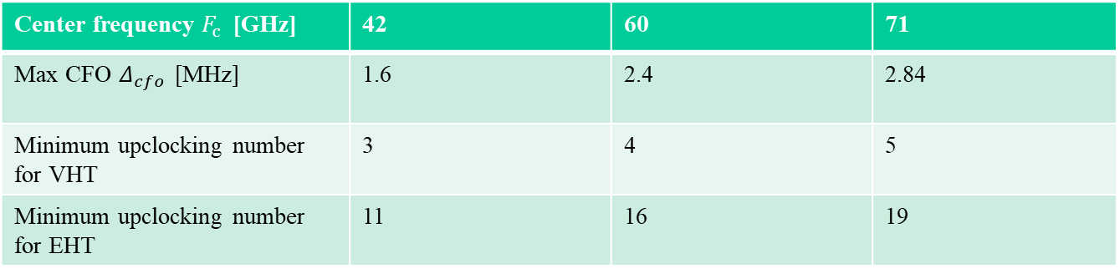

CFO Consideration Across mmWave Band
It was suggested in [3] that the upclocking rate should be at least 5 for VHT numerology to support coarse CFO estimation for 71 GHZ
In general, max CFO $Δ_{cfo,max }=40ppm⋅F_{c} GHz$
To avoid phase wrapping in LSTF, frequency spacing $Δ_{f }>0.5Δ_{cfo}$
Center frequency $F_{c}$ [GHz] | 42 | 60 | 71
Max CFO $Δ_{cfo }$ [MHz] | 1.6 | 2.4 | 2.84
Minimum upclocking number for VHT | 3 | 4 | 5
Minimum upclocking number for EHT | 11 | 16 | 19

Slide 8
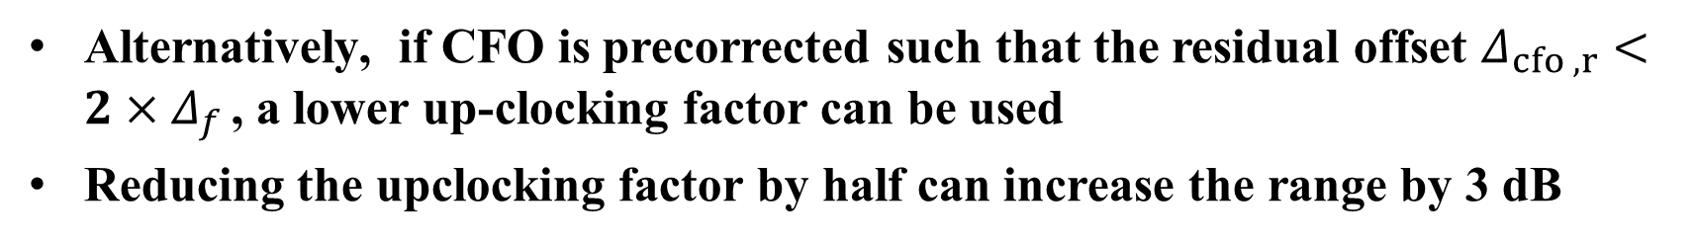
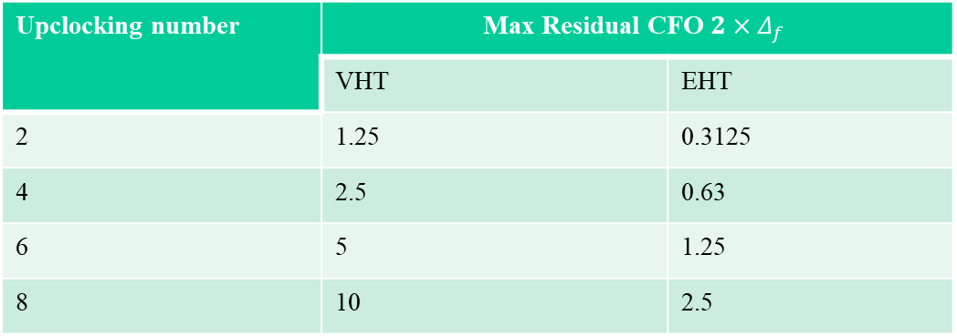
CFO Consideration Across MmWave Band
Alternatively, if CFO is precorrected such that the residual offset $Δ_{cfo ,r}<2×Δ_{f }$, a lower up-clocking factor can be used
Reducing the upclocking factor by half can increase the range by 3 dB
Upclocking number | Max Residual CFO $2×Δ_{f }$
 | VHT | EHT
2 | 1.25 | 0.3125
4 | 2.5 | 0.63
6 | 5 | 1.25
8 | 10 | 2.5

Slide 9
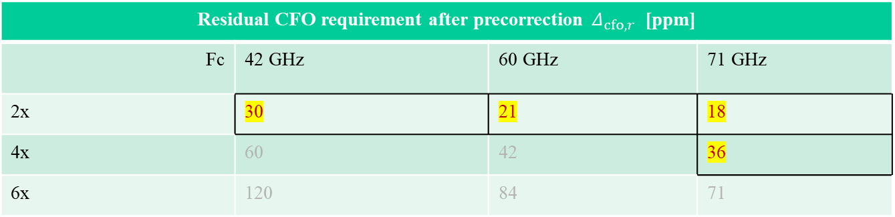
CFO Consideration Across MmWave Band
For 40 ppm max CFO, the residual offset needed to enable lower upclocking number is given below in terms of ppm:
Residual CFO requirement after precorrection $Δ_{cfo,r}$ [ppm]
Fc | 42 GHz | 60 GHz | 71 GHz
2x | 30 | 21 | 18
4x | 60 | 42 | 36
6x | 120 | 84 | 71
Upclocking number

Slide 10
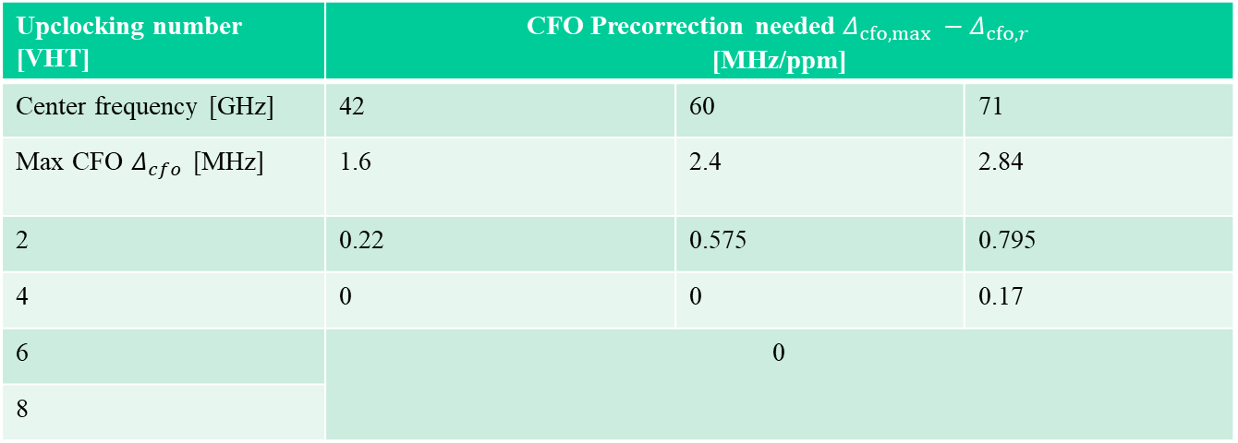
CFO Consideration Across MmWave Band
For 40 ppm CFO, the precorrection needed to enable lower upclocking number is given below:
Upclocking number [VHT] | CFO Precorrection needed $Δ_{cfo,max }−Δ_{cfo,r}$ [MHz/ppm]
Center frequency [GHz] | 42 | 60 | 71
Max CFO $Δ_{cfo }$ [MHz] | 1.6 | 2.4 | 2.84
2 | 0.22 | 0.575 | 0.795
4 | 0 | 0 | 0.17
6 | 0
8

Slide 11
Simulation Parameters
Parameter | Description
MCS | MCS 0,3
Base bandwidth | 80MHz
CP length | 0.2us
Channel model | 802.11ay channel model (open hotspot)
TX/RX | 1T1R
Fc | 60,71 GHz
Channel coding | LDPC
Packet size | 1000bits
Phase noise model | Model [3]
CFO | +-20

Slide 12
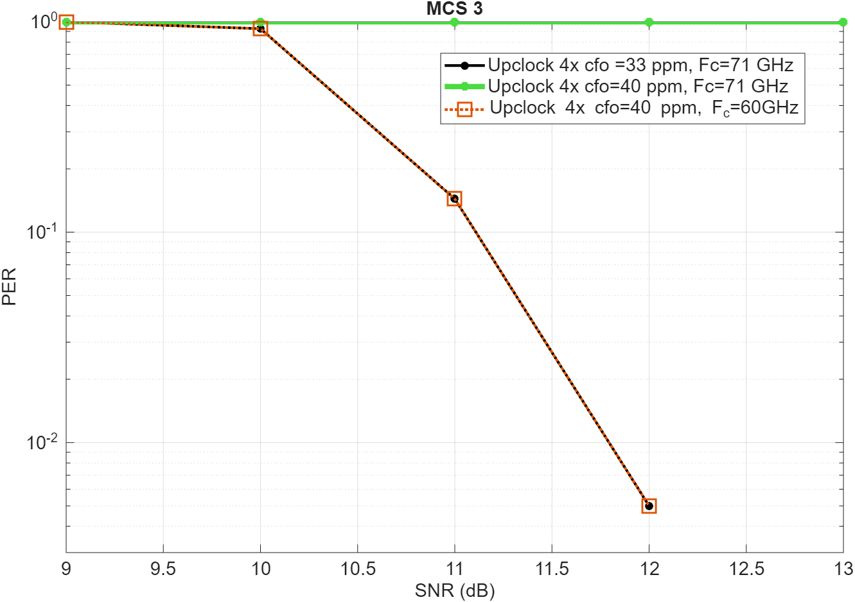
PER Results
PER results shows that if CFO can be precorrected within 33 ppm,
4x upclocking factor can work in 71 GHz center frequency

Slide 13
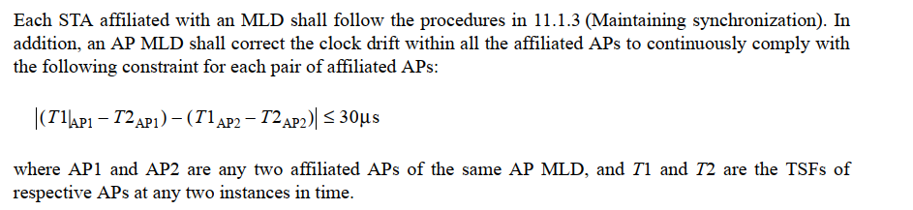
Clock-drift Constraint for MLDs
ELR PPDU can rely on the sub-7 beacons for CFO precorrection, but the mmWave link may not define a beacon
The current standard [35.3.1] already defines a clock drift constraint for Multi-Link Devices (MLDs), requiring the drift between two affiliated APs to be ≤ 30µs
A similar or tighter clock drift constraints between sub7 and mmWave AP MLDs can ensure that Sub-7 GHz beacons/signals may be used for CFO precorrection in the mmWave link

Slide 14
Summary
We discussed how coarse CFO precorrection can enable lower upclocking number/ low bandwidth to achieve a longer range
We provided simulation results to compare different numerology with and without CFO correction

Slide 15
Straw Poll #1
Do you support having an residual CFO requirement in 11bq?

Slide 16
Straw Poll #2
Do you support having an option to enable lower upclocking numbers in 11bq?

Slide 17
Straw Poll #3
Do you support having a clock drift constraint between mmWave and sub-7 GHz AP?

Slide 18
References
[1] IMMW Range Extension, https://mentor.ieee.org/802.11/dcn/25/11-25-1332-01-00bq-immw-range-extension.pptx
[2] 11-25-0360-00-00bq-high-level-thoughts-on-immw-phy-design
[3] 11-09-0296-16-00ad-evaluation-methodology

Slide 19
Appendix

