Slide 1
Introducing the Unified Channel Model TIG
Date: 2025-09-15
Authors:
Name | Affiliations | Phone | email
Volker Jungnickel | Fraunhofer HHI | +49 162 2552756 | volker.jungnickel@hhi.fraunhofer.de
Stephan Jaeckel | SJC / Fraunhofer HHI | +49 30 60980512 | jaeckel@sjc-wireless.com

Slide 2
Abstract
Motivation
Multilink operation across sub‑7 GHz, mm-wave, and optical bands create the need for a multi‑band channel model in IEEE 802.11.
Intended Use
Channel models enable fair performance comparisons between individual proposals.
They help to demonstrate the potential of next‑generation 802.11 technologies to end users.
Contribution
Unified model to generate spatially consistent channels across all targeted bands.
Built on already available models (i.e., for sub-7 GHz / 60 GHz / optical).

Slide 3
UCM Motivation
Wi-Fi 7 (IEEE Std 802.11be-2024) introduced multi-link operation (MLO) enabling devices to utilize multiple bands (2.4, 5, 6 GHz) concurrently to facilitate higher throughput, improved reliability and reduced latency.
Multi-AP coordination is currently developed by TGbn to reduce interference and support advanced use cases (Industry 4.0, TSN).
In addition, new bands are being introduced in mm-wave (TGbq) and optical spectrum (TGbr), all reusing sub-7 GHz baseband technology.
Current Wi-Fi channel models do not support the combined use of sub-7 GHz, mm-wave and optical bands at the same location.
Channels for different APs are generated independently, leading potentially to less realistic results for MLO, and using MU-MIMO, Coordinated Multi-AP etc..
There is a fundamental lack of spatial consistency.

Slide 4
Recap of existing models:
TGn/ac/ax model (2.4 or 5 GHz) [1] – [4]
Extension of traditional single-input single-output (SISO) channel models (Medbo, 1998)
  Multiple antenna (MIMO) models are based on the cluster model (Saleh, Valenzuela, 1987)
Channel is modelled by 2 to 6 clusters each having:
  Power and delay of each tap in a particular cluster
  Angular spread (AS), angle-of-arrival (AoA), and angle of departure (AoD) values
  “Bell” shaped Doppler spectrum
Channel matrix H fully describes propagation channel between TX and RX antennas
  Besides i.i.d. matrix, uses correlation matrix based on the power angular spectrum (PAS)
  Additional model for cross-polarization discrimination (XPD) for antennas with different polarizations
Model parameters customize channel models for various scenarios (e.g. office, open space, etc.)

Slide 5
Recap of existing models:
TGad/ay model (60 GHz) [5]
Provides accurate space-time characteristics of the propagation channel at 60 GHz
  Support beamforming with steerable directional antennas on both TX and RX, no limitation on antennas
  Account for polarization characteristics of antennas and signals
  Support non-stationarity characteristics of the propagation channel due to people moving in the area
  Proper description of SU- and MU-MIMO modes
Ultra Short Range (USR) mmWave communication (TGay)
  Based on existing TGad models for 60 GHz
  ray-tracing simulations and measurements provided by the MiWEBA EU-Japan joint project
TGad covers conference room and living room scenarios
TGay covers a very wide variety of indoor and outdoor applications

Slide 6
Recap of existing models:
QuaDRiGa (0.1 - 100 GHz) [6] – [8]
Active development since 2010 (based on WINNER+ code)
  Open-source: http://quadriga-channel-model.de (incl. regular updates)
  Reference implementation for various 3GPP and ETSI models
3D modeling approach (placement of scatterers in 3D coordinate system, 3D antennas)
  Geometric polarization propagation model for co-/cross-polarized antenna arrays
  Spatially correlated large and small-scale fading
  Deterministic time evolution of impulse response incl. dual-mobility
Support for multiple frequency bands up to 100 GHz
  Up to 300 MHz bandwidth from 0.45-6 GHz carrier frequency
  Up to 2 GHz bandwidth at mm-wave frequencies
Wide range of propagation scenarios: indoor, outdoor, macro, pico, femto, relay, industrial and satellite
Extensively tested against measurements in indoor and outdoor environments

Slide 7
Recap of existing models:
TGbb model for optical bands [9]
TGbb channel models
Link level model (11-18/1582r3)
  scenarios are manually defined in 3D, CIR are created by ray tracing (using Zemax)
  realistic 3D models are not considered, complex due to ray tracing in time domain
  support of MIMO and mobility, but just single snapshots at a given configuration
  tradeoff between model accuracy and computational complexity
  validated by preliminary measurements (11-20/1234r0)
  used in simulations to compare PHY proposals (11-19/1054r2 and 11-19/1566r3)
System level model (11-19/0187r4)
  based on LOS only, NLOS is considered negligible
  never been used since TGbb made no changes to the MAC

Slide 8
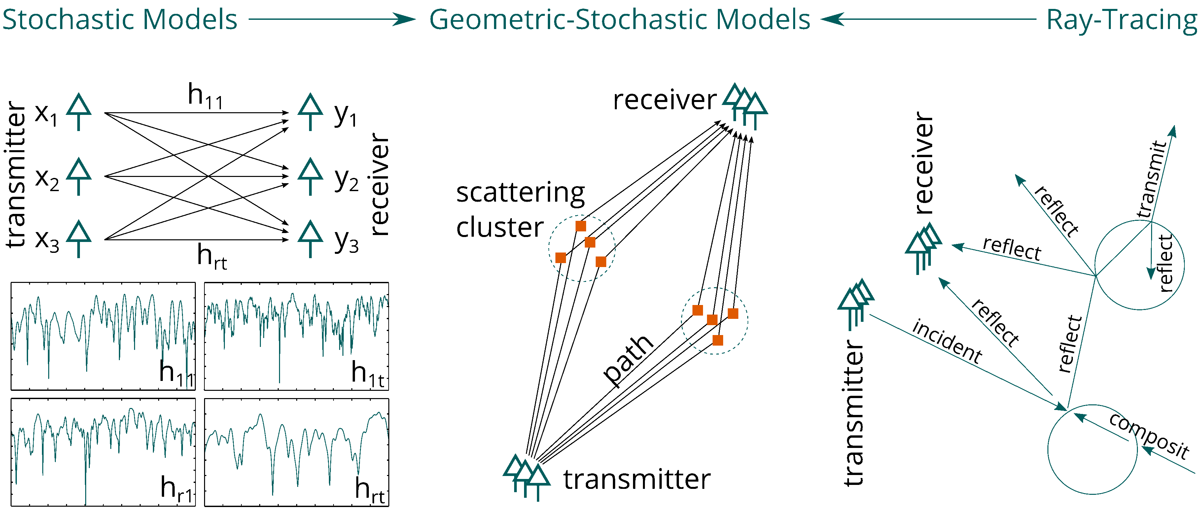
Summary on existing models:
Types of Channel Models
TGn/ac/ax
TGad/ay/QuaDRiGa
TGbb

Slide 9
Limitations of existing 802.11 models
Lack on integration of features
  tapped-delay line models for TGn vs. accurate space-time characteristics in TGay, TGbb
Multi-band operation is not foreseen
  i.e. there are different models for different bands
  use cases/scenarios cannot be easily combined
TGn/ac/ax models do not natively support system-level simulations
  has to be agreed upon/added on top of the model
Models are not spatially consistent
  not suitable for site-specific simulations (e.g., for multi-AP operation)
  do not reflect correlation between different bands
  do not correctly model the MIMO correlation for different user positions

Slide 10
Open software available
Standards validation and fair benchmarking:
  Open-source channel models enable all IEEE 802.11 members to validate performance claims and ensure fair, reproducible benchmarking across proposed technologies.
Accelerated consensus through agreed-upon models:
  Transparent models promote collaborative validation and faster decisions.
Following software is available:
  QuaDRiGa was developed at Fraunhofer HHI, written in MATLAB
  Source code is open: http://quadriga-channel-model.de
  Licence restricts commercial use (e.g., in products, but it is free for standardization)
  Quadriga-Lib is a C++ library implementing many channel-model tools using a free License:
  http://quadriga-lib.org
  New optical wireless model (open approach like QuaDRiGa is intended, details to be discussed)

Slide 11
Charter of the UCM TIG
The UCM TIG charter is to
discuss use cases and requirements,
develop a Unified Channel Model (UCM) and
enable performance comparison of proposals for multilink operation (MLO) across sub‑7 GHz / mm-wave / optical bands.
The goal of the UCM TIG is to
deliver a channel model that is spatially consistent across sub-7 GHz / mm-wave / optical bands,
builds on already available and verified models,
can be implemented using open software, and
is well documented.

Slide 12
References
[1] V. Erceg, L. Schumacher, P. Kyritsi, et al., “TGn Channel Models,” doc. 11-03/940r4, May 2004.
[2] A. Maltsev, et al., “802.11ac Channel Model Addendum,” IEEE doc. 11-09/0308r12, Mar. 2010.
[3] G. Breit, H. Sampath, S. Vermani, et al., “TGac Channel Model Addendum,” doc. 11-09/0308r12, Mar. 2010.
[4] Jianhan Liu “TGbe Channel Model Document,” IEEE 802.11 Wireless LANs, doc. 11-21/0288r1, Mar. 2021.
[5] A. Lomayev, J. G. Andrews, D. F. O'Brien, D. S. Shum, and D. S. B. Weiss, “Channel Models for IEEE 802.11ay,” doc. 11-15/1150r0, Nov. 2015.
[6] S. Jaeckel, S., L. Raschkowski, F. Burkhardt, L. Thiele “Efficient Sum-of-Sinusoids based Spatial Consistency for the 3GPP New-Radio Channel Model” Proc. IEEE Globecom Workshops '18, 2018.
[7] S. Jaeckel, N. Turay, L. Raschkowski, L. Thiele, R. Vuohtoniemi, M. Sonkki, V. Hovinen, F. Burkhardt, P. Karunakaran, T. Heyn. “Industrial Indoor Measurements from 2-6 GHz for the 3GPP-NR and QuaDRiGa Channel Model” Proc. IEEE VTC'19 Fall, 2019.
[8] S. Jaeckel, L. Raschkowski, F. Burkhardt, L. Thiele “A Spatially Consistent Geometric D2D Small-Scale Fading Model for Multiple Frequencies” Proc. IEEE VTC Fall '19, 2019
[9] M. Uysal, F. Miramirkhani, T. Baykas, N. Serafimovski, and V. Jungnickel, “IEEE 802.11bb Reference Channel Models for Indoor Environments,” doc. 11-18/1582r2, Sept. 2018.
[10] S. M. Mana et al., "LIDAR-Assisted Channel Modelling for LiFi in Realistic Indoor Scenarios," in IEEE Access, vol. 10, pp. 59383-59399, 2022.
[11] QuaDRiGa Channel Model: https://quadriga-channel-model.de
[12] C. Petterson: IMMW Ray-Tracing Propagation in a Large Factory, doc. 11-25/0824r0
[13] V. Jungnickel, V. Pohl, S. Nonnig and C. von Helmolt, "A physical model of the wireless infrared communication channel," in IEEE JSAC , vol. 20, no. 3, pp. 631-640, April 2002
[14] S. M. Mana, P. Hellwig, J. Hilt, P. W. Berenguer and V. Jungnickel, "Experiments in Non-Line-of-Sight Li-Fi Channels," 2019 Global LIFI Congress (GLC), Paris, France, 2019.
[15] S. M. Mana, K. G. K. Gabra, S. M. Kouhini, P. Hellwig, J. Hilt and V. Jungnickel, "An Efficient Multi-Link Channel Model for LiFi," 2021 IEEE 32nd Annual International Symposium on Personal, Indoor and Mobile Radio Communications (PIMRC), Helsinki, Finland, 2021.

