Slide 1
A Spatially Consistent Small-Scale Fading Model for Multiple Frequency Bands
Date: 2025-09-17
Authors:
Name | Affiliations | Phone | email
Stephan Jaeckel | SJC / Fraunhofer HHI | +49 30 60980512 | jaeckel@sjc-wireless.com
Volker Jungnickel | Fraunhofer HHI | +49 162 2552756 | volker.jungnickel@hhi.fraunhofer.de

Slide 2
Abstract
Provide an accessible, tutorial-style introduction to geometric stochastic channel modeling (GSCM)
Content Overview:
  Fundamentals of GSCM: geometry-based approach to multipath modeling.
  Large-scale fading: pathloss, shadowing, and spatial consistency concepts.
  Small-scale fading: multipath clusters, Doppler, and delay spreads.
  Polarization modeling: cross-polar components and depolarization effects.
  Spatial correlation & Sum-of-Sinusoids method: generating correlated fading fields.
  Station mobility: time evolution and trajectory-based channel updates.
Takeaways
  Understanding of how spatially consistent and realistic channels are generated.
  Practical insight into using models like 3GPP TR 38.901 and QuaDRiGa for simulation studies.

Slide 3
Available Models
IEEE Models:
  TGn/ac/ax model (2.4 or 5 GHz) – docs. 11-03/940r4, 11-09/0308r12, 11-14/0882r4
  TGad/ay model (60 GHz) – doc. 11-15/1150r9
  TGbb model for optical bands - doc. 11-18/1582r4
3GPP Models:
  ITU-R M.2135 (2D, based on WINNER-2, 1-6 GHz)
  3GPP TR 38.901 v19.0 (3D, 0.5-100 GHz) – Macro, Micro, Office
  3GPP TR 36.777 v15.0 (3D, 0.5-100 GHz) – Aerial Vehicles
  3GPP TR 37.885 v15.3 (3D, 0.5-100 GHz) – V2X Sidelink
  3GPP TR 38.811 v15.4 (3D, 2 and 28 GHz) – Non-terrestrial Networks (NTN)
QuaDRiGa (0.1 to 100 GHz), Open-Source

Slide 4
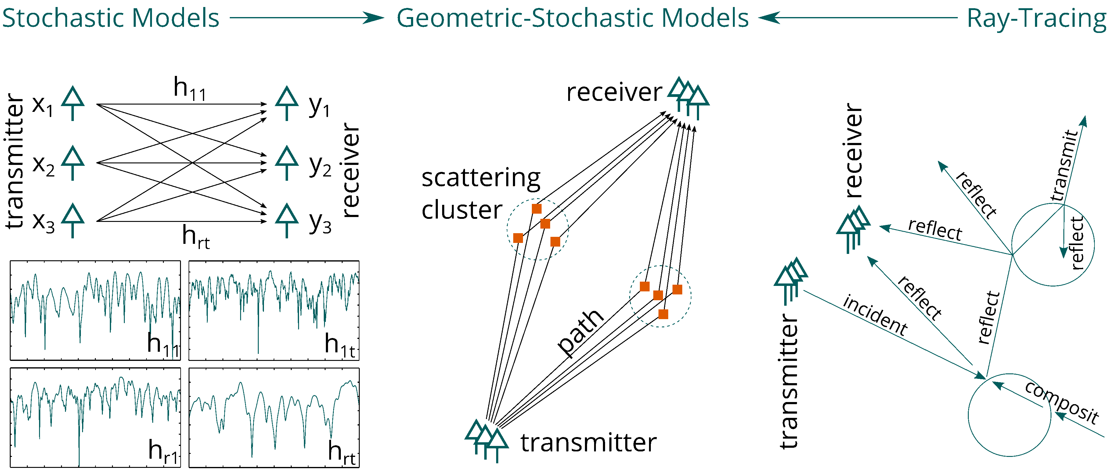
Types of Channel Models
TGn/ac/ax
TGad/ay/QuaDRiGa
TGbb

Slide 5
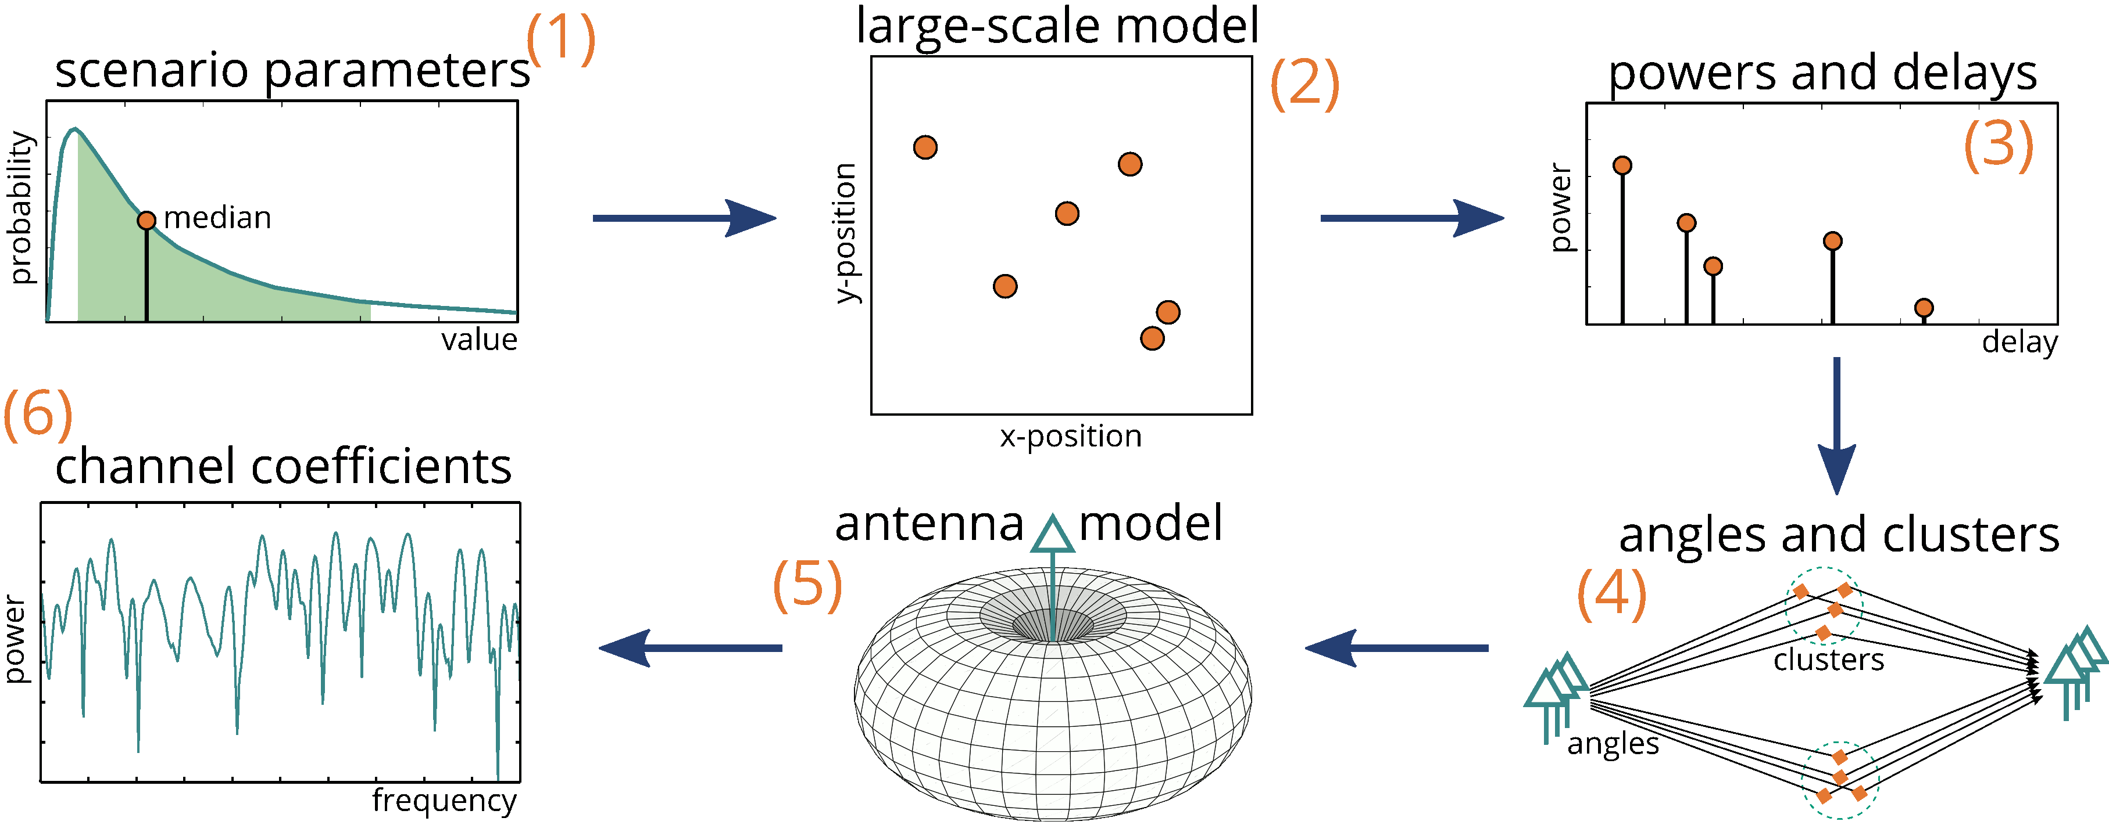
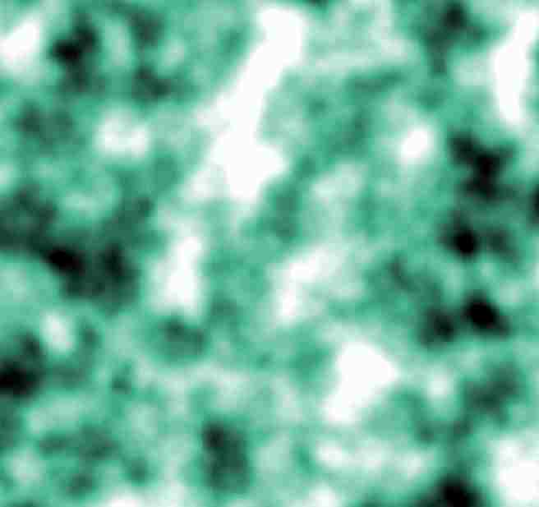
How Geometric-Stochastic Models Work

Slide 6
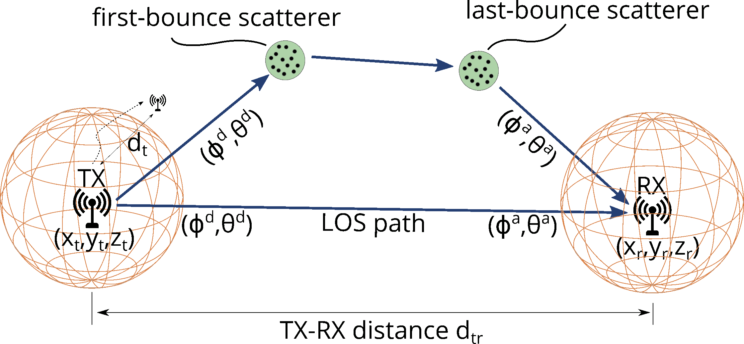
Small-Scale-Fading Model
Multiple transmitters and receivers
3D-coordinates (x_{t},y_{t},z_{t}), (x_{r},y_{r},z_{r})
Signal path consists of:
  departure direction
  first-bounce scatterer (FBS)
  last-bounce scatterer (LBS)
  arrival direction
Dual-mobility and spatial consistency
= anything to anything communication
Spatially correlated random processes [*]
4 steps: delays, angles, powers, spreads
[*] Jaeckel, S.; Raschkowski, L.; Burkhardt, F. & Thiele, L. “Efficient Sum-of-Sinusoids based Spatial Consistency for the 3GPP New-Radio Channel Model” Proc. IEEE Globecom Workshops '18, 2018

Slide 7
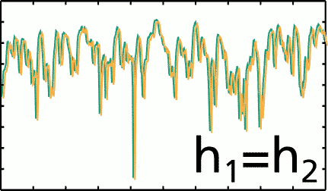
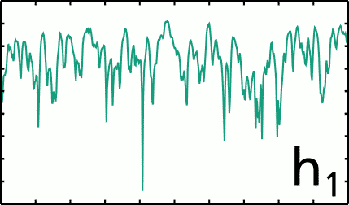


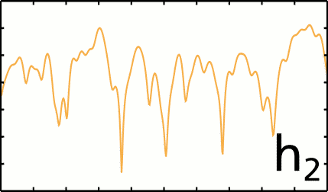

Spatial Consistency
In a spatially consistent propagation channel propagation phenomena do not vary greatly over time and location.
h₁
h₂
h₂

Slide 8
Sum-of-Sinusoids Model
Spatially correlated random processes
Represents spatially correlated fading as a sum of multiple sinusoids
Produces a stationary Gaussian process with specified autocorrelation.
Efficiently generates samples along a spatial trajectory (e.g., user movement, station placement).
Computationally efficient: avoids large covariance matrix decompositions.
Used in performance evaluation of MIMO systems, beamforming, and channel estimation.
Suitable for large-scale system-level simulations (e.g., 5G/6G network planning).

Slide 9


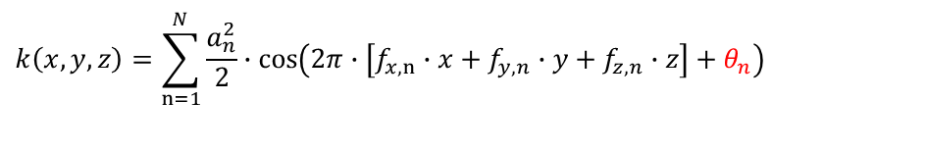
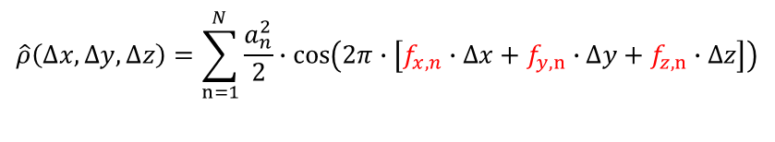
Sum-of-Sinusoids Model
Needed!
Definition
SOS Model:
Generation of Normal-distributed parameters
$$ρ\left(d\right)=\exp\left(−\frac{d}{d_{λ}}\right)$$
$$\hat{ρ}\left(∆x,∆y,∆z\right)=\sum_{n=1}^{N}{\frac{a_{n}^{2}}{2}∙cos\left(2π∙\left[f_{x,n}∙∆x+f_{y,n}∙∆y+f_{z,n}∙∆z\right]\right)}$$
Autocorrelation Function ACF (1D)
3D-ACF of SOS-Method
$$𝒰(0,2π)$$
$$k\left(x,y,z\right)=\sum_{n=1}^{N}{\frac{a_{n}^{2}}{2}∙cos\left(2π∙\left[f_{x,n}∙x+f_{y,n}∙y+f_{z,n}∙z\right]+θ_{n}\right)}$$
[*] M. Patzold, U. Killat, and F. Laue, “A deterministic digital simulation model for suzuki processes with application to a shadowed Rayleigh land mobile radio channel,” IEEE Transactions on Vehicular Technology, vol. 45, no. 2, pp. 318–331, May 1996

Slide 10
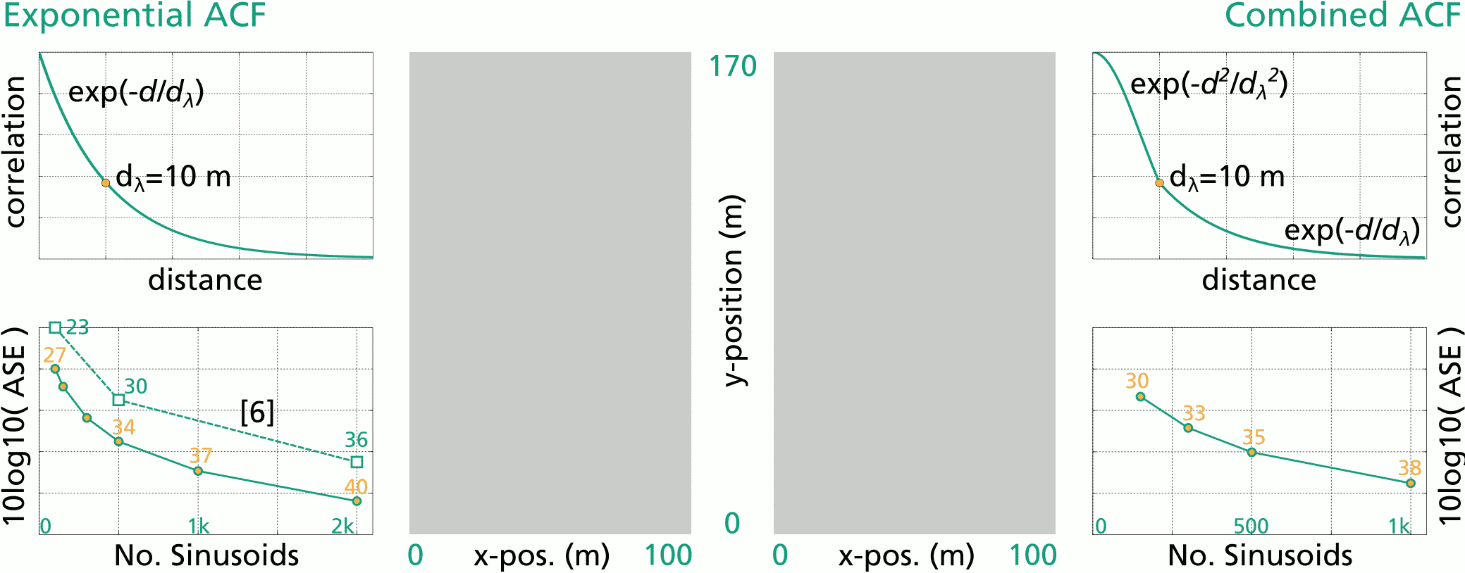
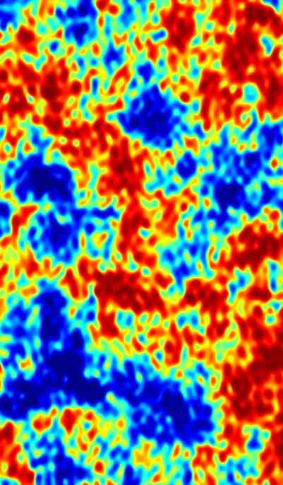
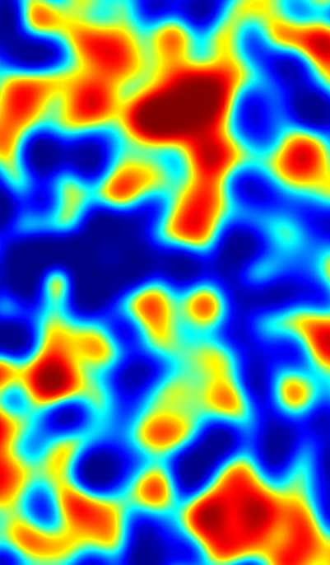
Sum-of-Sinusoids Model
Examples

Slide 11
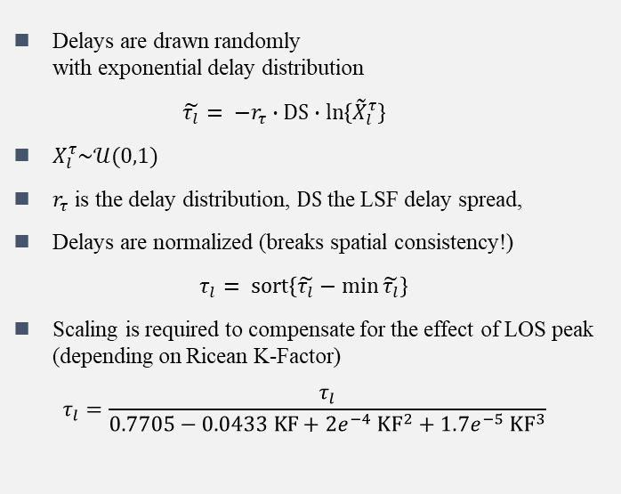
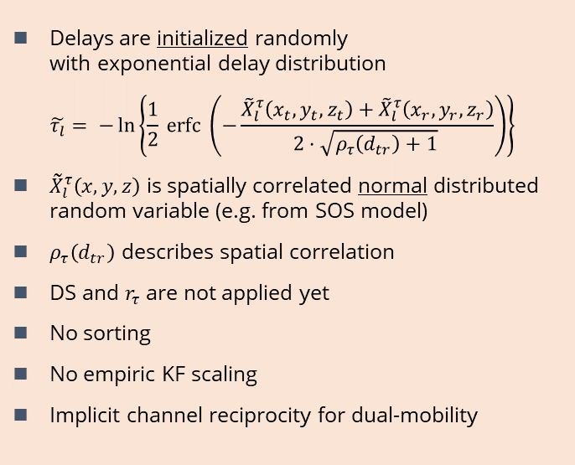
SSF Model – Delays
Delays are drawn randomly
with exponential delay distribution
$$\tilde{τ_{l}}= −r_{τ}∙DS∙\ln\left\{{\tilde{X}}_{l}^{τ}\right\}$$
$X_{l}^{τ}\sim 𝒰(0,1)$
$r_{τ}$ is the delay distribution, $DS$ the LSF delay spread,
Delays are normalized (breaks spatial consistency!)
$$τ_{l}= \operatorname{sort}\left\{\tilde{τ_{l}}−\min{\tilde{τ_{l}}}\right\}$$
Scaling is required to compensate for the effect of LOS peak (depending on Ricean K-Factor)
$$τ_{l}=\frac{τ_{l}}{0.7705−0.0433 KF+2e^{−4} {KF}^{2}+1.7e^{−5} {KF}^{3}}$$
3GPP TR 38.901
Delays are initialized randomly
with exponential delay distribution
$$\tilde{τ_{l}}= −\ln\left\{\frac{1}{2} erfc \left(−\frac{{\tilde{X}}_{l}^{τ}\left(x_{t}, y_{t}, z_{t}\right)+{\tilde{X}}_{l}^{τ}\left(x_{r}, y_{r}, z_{r}\right)}{2·\sqrt{ρ_{τ}\left(d_{tr}\right)+1} }\right)\right\}$$
${\tilde{X}}_{l}^{τ}\left(x,y,z\right)$ is spatially correlated normal distributed random variable (e.g. from SOS model)
$ρ_{τ}\left(d_{tr}\right)$ describes spatial correlation
DS and $r_{τ}$ are not applied yet
No sorting
No empiric KF scaling
Implicit channel reciprocity for dual-mobility
QuaDRiGa

Slide 12
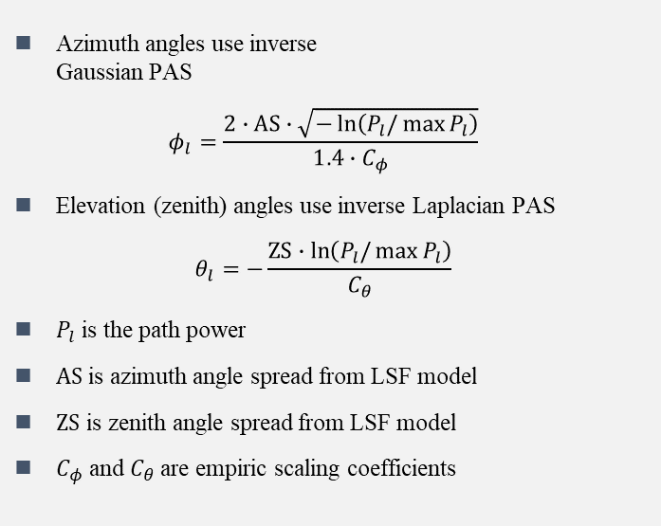
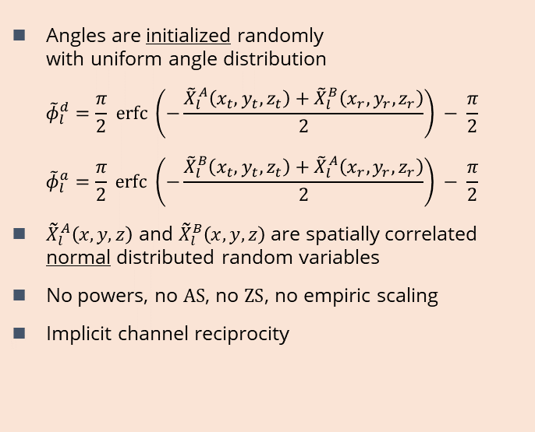
SSF Model – Angles
Azimuth angles use inverse
Gaussian PAS
$$φ_{l}=\frac{2∙AS∙\sqrt{−\ln\left(P_{l}/\max{P_{l}}\right)}}{1.4∙C_{φ}}$$
Elevation (zenith) angles use inverse Laplacian PAS
$$θ_{l}=−\frac{ZS∙\ln\left(P_{l}/\max{P_{l}}\right)}{C_{θ}}$$
$P_{l}$ is the path power
$AS$ is azimuth angle spread from LSF model
$ZS$ is zenith angle spread from LSF model
$C_{φ}$ and $C_{θ}$ are empiric scaling coefficients
Angles are initialized randomly
with uniform angle distribution
$${\tilde{φ}}_{l}^{d}=\frac{π}{2} erfc \left(−\frac{{\tilde{X}}_{l}^{A}\left(x_{t}, y_{t}, z_{t}\right)+{\tilde{X}}_{l}^{B}\left(x_{r}, y_{r}, z_{r}\right)}{2}\right) − \frac{π}{2}$$
$${\tilde{φ}}_{l}^{a}=\frac{π}{2} erfc \left(−\frac{{\tilde{X}}_{l}^{B}\left(x_{t}, y_{t}, z_{t}\right)+{\tilde{X}}_{l}^{A}\left(x_{r}, y_{r}, z_{r}\right)}{2}\right) − \frac{π}{2}$$
${\tilde{X}}_{l}^{A}\left(x,y,z\right)$ and ${\tilde{X}}_{l}^{B}\left(x,y,z\right)$ are spatially correlated normal distributed random variables
No powers, no $AS$, no $ZS$, no empiric scaling
Implicit channel reciprocity
3GPP TR 38.901
QuaDRiGa

Slide 13
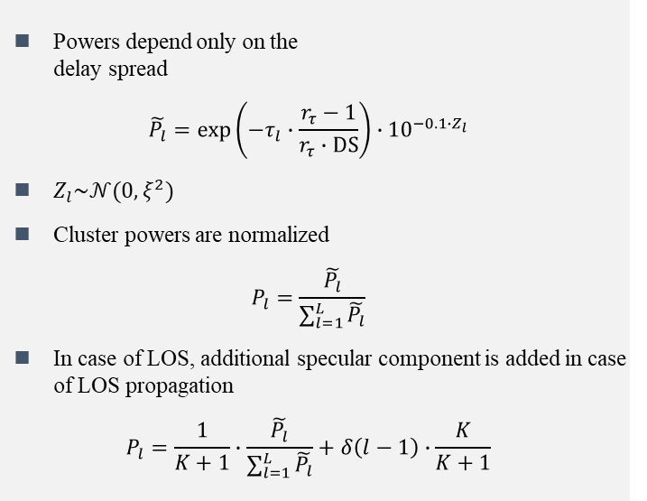
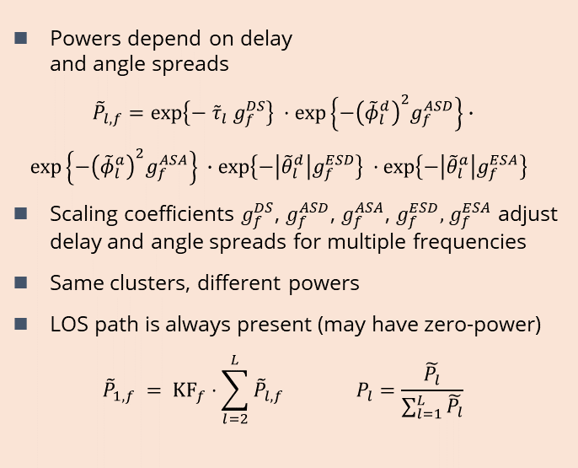
SSF Model – Cluster Powers
Powers depend only on the
delay spread
$$\tilde{P_{l}}=\exp\left(−τ_{l}∙\frac{r_{τ}−1}{r_{τ}∙DS}\right)∙{10}^{−0.1∙Z_{l}}$$
$Z_{l}\sim 𝒩(0,ξ^{2})$
Cluster powers are normalized
$$P_{l}=\frac{\tilde{P_{l}}}{\sum_{l=1}^{L}{\tilde{P_{l}}}}$$
In case of LOS, additional specular component is added in case of LOS propagation
$$P_{l}=\frac{1}{K+1}∙\frac{\tilde{P_{l}}}{\sum_{l=1}^{L}{\tilde{P_{l}}}}+δ\left(l−1\right)∙\frac{K}{K+1}$$
3GPP TR 38.901
Powers depend on delay
and angle spreads
$${\tilde{P}}_{l,f}=\exp\left\{−{ \tilde{τ}}_{l} g_{f}^{DS}\right\} ·\exp\left\{−{\left({\tilde{φ}}_{l}^{d}\right)}^{2}g_{f}^{ASD}\right\}∙$$
$$\exp\left\{−{\left({\tilde{φ}}_{l}^{a}\right)}^{2}g_{f}^{ASA}\right\} ∙\exp\left\{−\left|{\tilde{θ}}_{l}^{d}\right|g_{f}^{ESD}\right\} ·\exp\left\{−\left|{\tilde{θ}}_{l}^{a}\right|g_{f}^{ESA}\right\}$$
Scaling coefficients $g_{f}^{DS}$, $g_{f}^{ASD}$, $g_{f}^{ASA}$, $g_{f}^{ESD},$ $g_{f}^{ESA}$ adjust delay and angle spreads for multiple frequencies
Same clusters, different powers
LOS path is always present (may have zero-power)
$${\tilde{P}}_{1,f} = {KF}_{f}⋅\sum_{l=2}^{L}{{\tilde{P}}_{l,f}} P_{l}=\frac{\tilde{P_{l}}}{\sum_{l=1}^{L}{\tilde{P_{l}}}}$$
QuaDRiGa

Slide 14
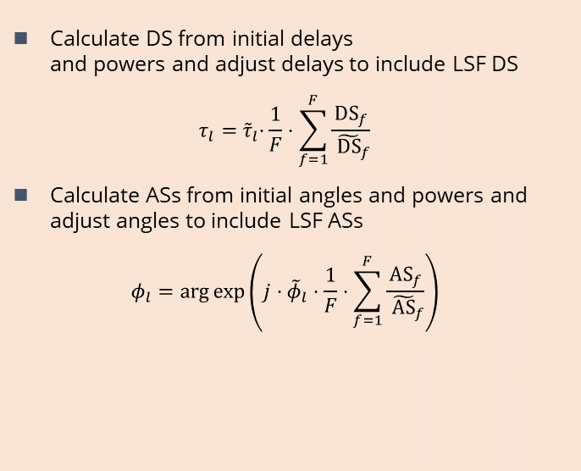
SSF Model – Delay and Angle Spreads
Calculate DS from initial delays
and powers and adjust delays to include LSF DS
$$τ_{l}={ \tilde{τ}}_{l}⋅\frac{1}{F}⋅\sum_{f=1}^{F}{\frac{{DS}_{f}}{{ \tilde{DS}}_{f}}}$$
Calculate ASs from initial angles and powers and adjust angles to include LSF ASs
$$φ_{l}=\arg{exp\left(j⋅{\tilde{φ}}_{l}⋅\frac{1}{F}⋅\sum_{f=1}^{F}{\frac{{AS}_{f}}{{ \tilde{AS}}_{f}}}\right)}$$
Final values are already included
Output of the SSF model may not match the LSF model (only distributions agree)
QuaDRiGa
3GPP TR 38.901

Slide 15
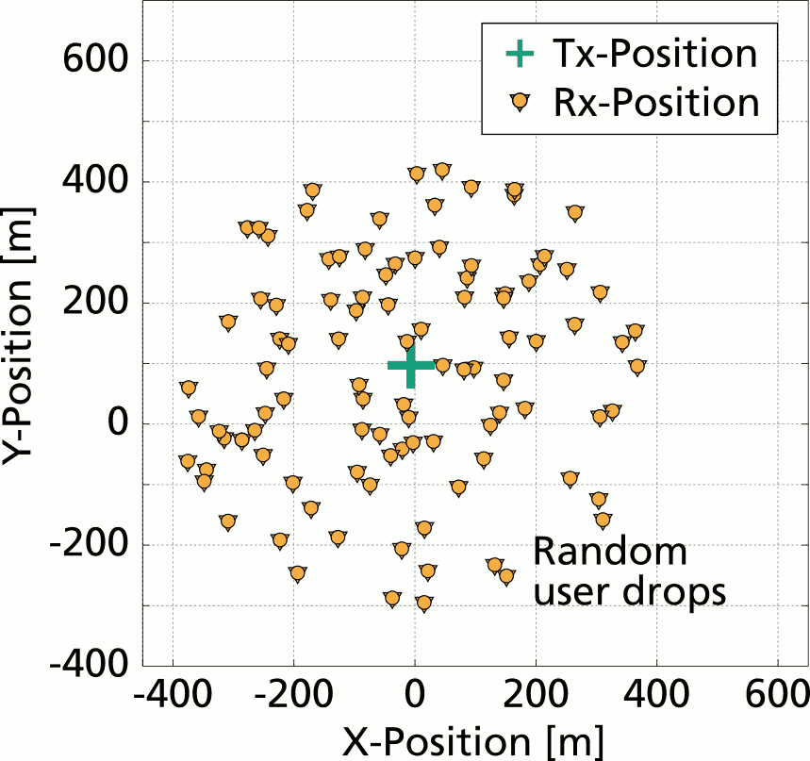
Evaluation Method
Generate random MT positions
Use 3GPP LSF model to generate DS, ASs and KF
  3GPP TR 38.901 UMi scenario [*]
  LOS and NLOS propagation conditions
  3 frequencies: 1 GHz, 6 GHz, and 60 GHz
Use new SSF model to generate delays, angles and path-powers → generate channel coefficients
Calculate DS and ASs from channel coefficients
Compare results with LSF output
[*] 3GPP TR 38.901 v15.0.0; “Study on channel model for frequencies from 0.5 to 100 GHz”; 2018

Slide 16
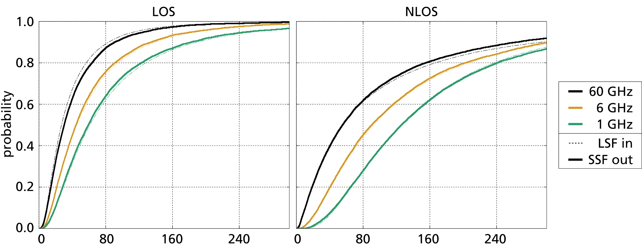
Results
Delay Spread (DS)
Delay Spread [ns]
Delay Spread [ns]

Slide 17
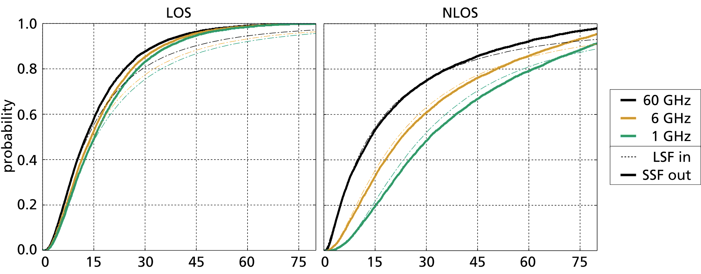
Results
Azimuth of Departure Angular Spread (ASD)
Offset for large ASs
Angular Spread [deg]
Angular Spread [deg]

Slide 18
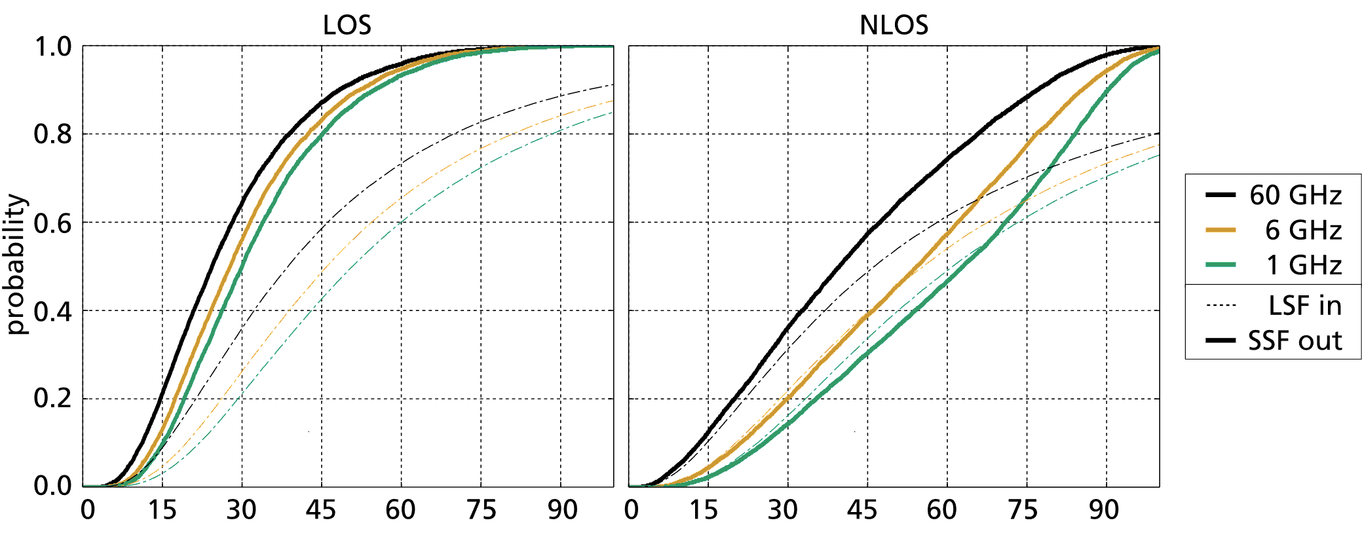
Results
Azimuth of Arrival Angular Spread (ASA)
LOS output median ~ 30°
Angular Spread [deg]
Angular Spread [deg]

Slide 19
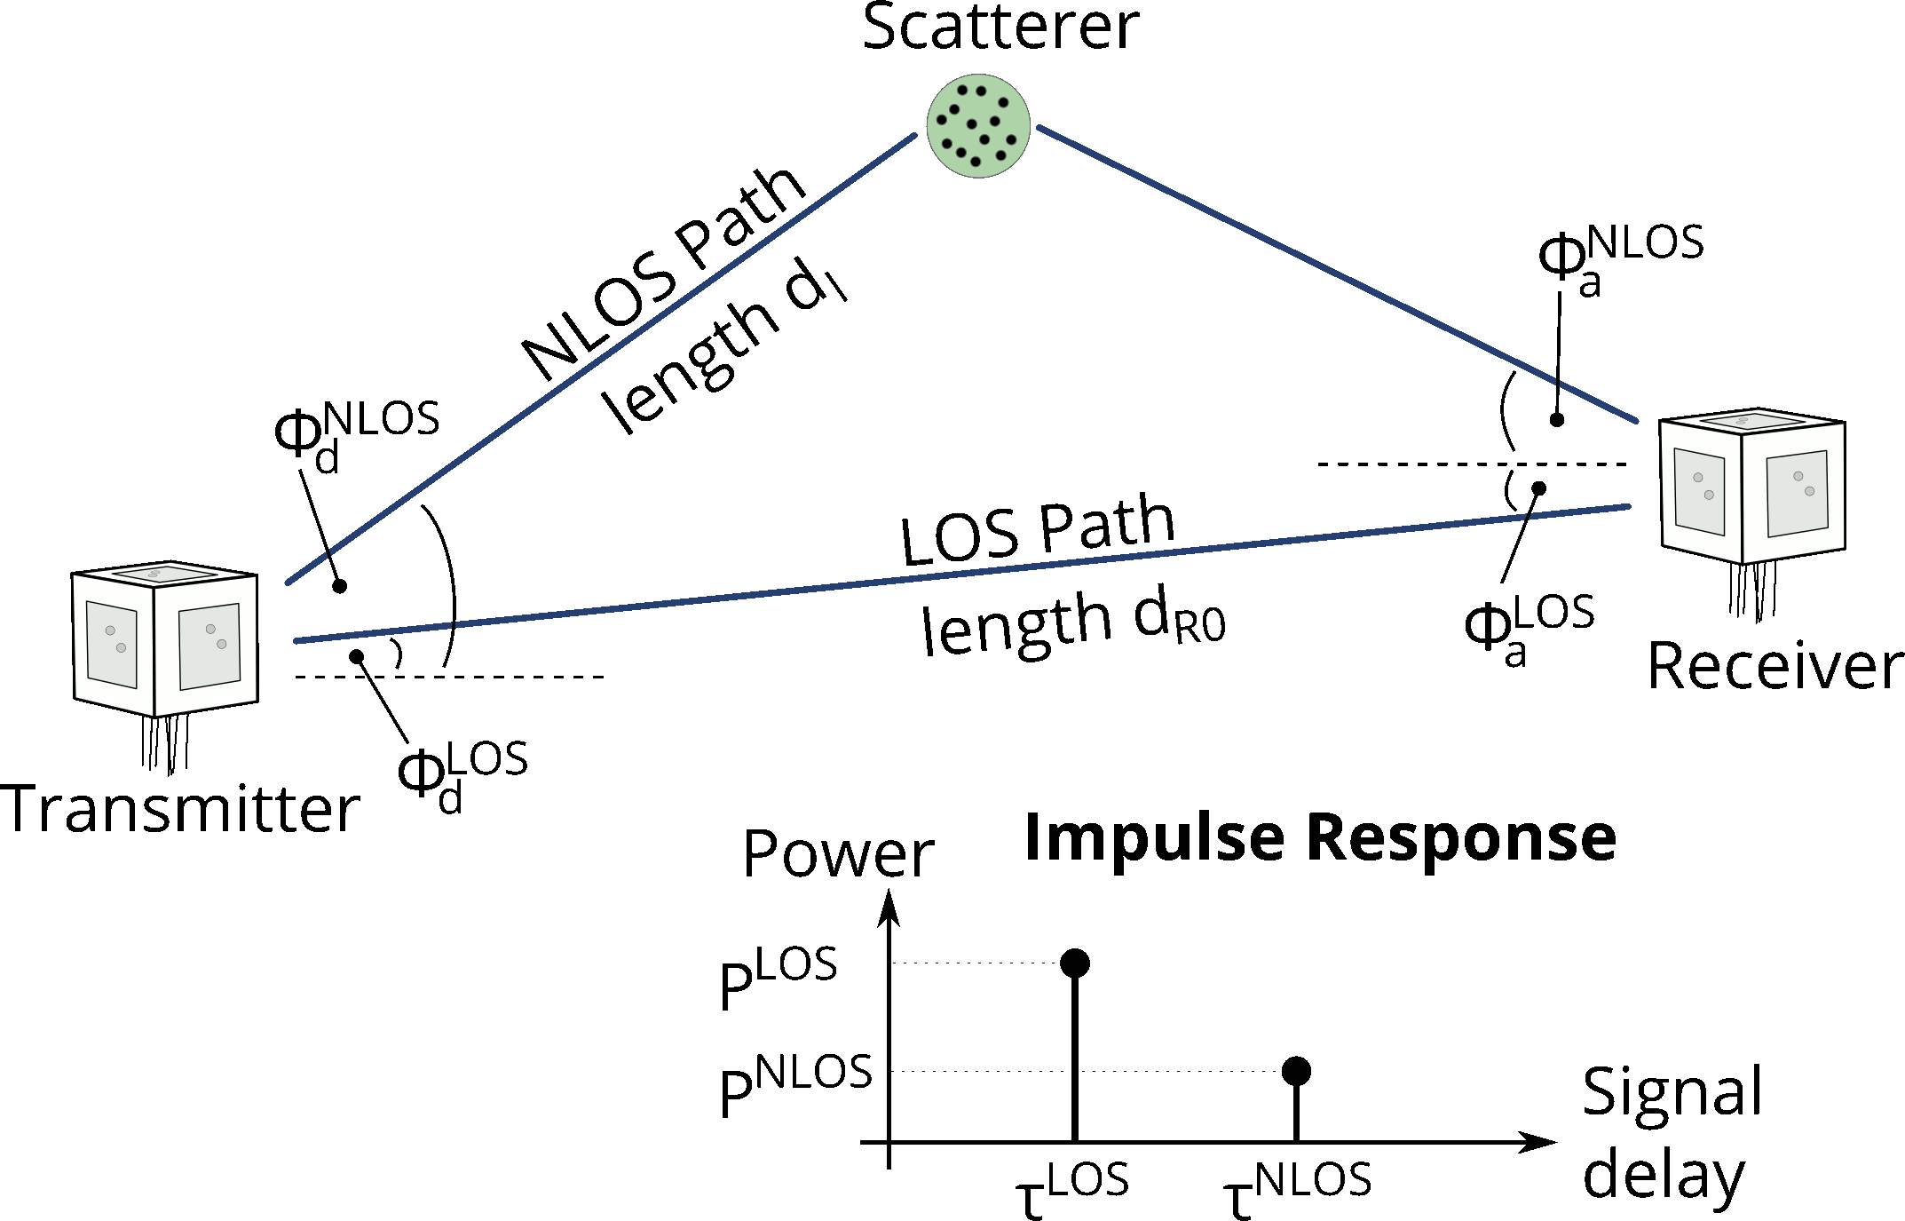
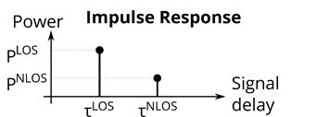
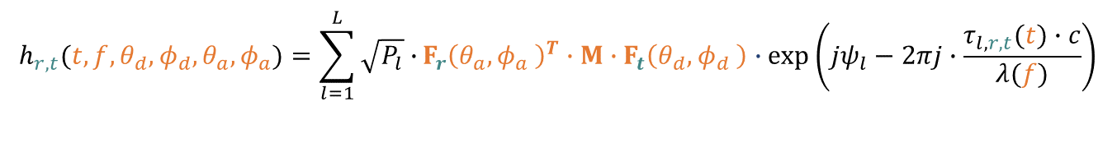


MIMO Model
$$F_{t}\left(θ_{d},φ_{d} \right)$$
$$F_{r}\left(θ_{a},φ_{a} \right)$$
L Taps
Tap Delay
$$h_{r,t}(t,f,{θ_{d},φ_{d},θ}_{a},φ_{a})=\sum_{l=1}^{L}{\sqrt{P_{l}}∙}F_{r}{\left(θ_{a},φ_{a} \right)}^{T}∙M∙F_{t}\left(θ_{d},φ_{d} \right)∙\exp\left({jψ}_{l}−2πj∙\frac{τ_{l,r,t}(t)∙c}{λ(f)}\right)$$
MIMO Channel
Matrix H
Tap
Power
Receive
Antenna
Transmit
Antenna
Phase
Offset
Frequency
Offset
Polarization

Slide 20
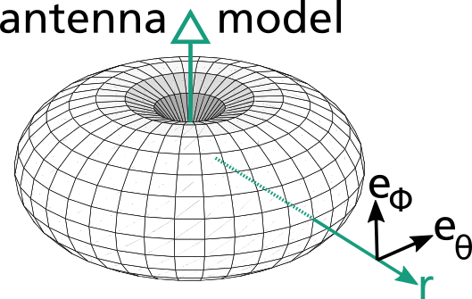

Polarization model
Power
Amplitude of a path
$$g=\sqrt{P}⋅{\left(F_{r}\right)}^{T}⋅M⋅F_{t}⋅e^{−j\frac{2π}{λ}⋅d}$$
WINNER / 3GPP / IEEE polarization model
$M_{\text{NL}\text{OS}}=\left(\begin{matrix}Z_{θθ} & \sqrt{1/XPR}{∙Z}_{θφ} \\ {\sqrt{1/XPR} ∙Z}_{φθ} & Z_{φφ}\end{matrix}\right)$
$$Z \sim exp\left\{𝒰(−π,π)\right\}$$
Phase
Receive Antenna Model
Polarization Change

Slide 21
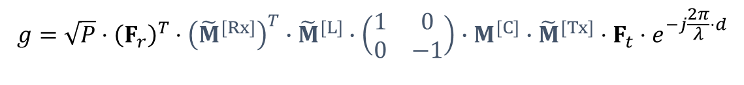
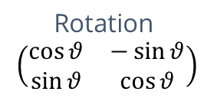
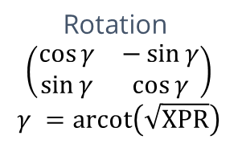
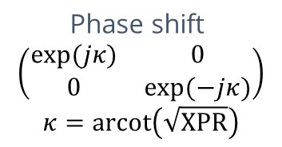
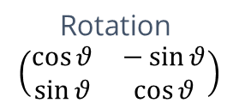
Polarization model (new)
Linear transformations
$$g=\sqrt{P}⋅{\left(F_{r}\right)}^{T}⋅{\left({\tilde{M}}^{[Rx]}\right)}^{T}∙{\tilde{M}}^{[L]}∙\left(\begin{matrix}1 & 0 \\ 0 & −1\end{matrix}\right)∙M^{[C]}∙{\tilde{M}}^{[Tx]}⋅F_{t}⋅e^{−j\frac{2π}{λ}⋅d}$$
Mirror
Rotation
$$\left(\begin{matrix}\cos{θ} & −\sin{θ} \\ \sin{θ} & \cos{θ}\end{matrix}\right)$$
Rotation
$$\left(\begin{matrix}\cos{θ} & −\sin{θ} \\ \sin{θ} & \cos{θ}\end{matrix}\right)$$
Rotation
$$\left(\begin{matrix}\cos{γ} & −\sin{γ} \\ \sin{γ} & \cos{γ}\end{matrix}\right)$$
$$γ =arcot\left(\sqrt{XPR}\right)$$
Phase shift
$$\left(\begin{matrix}\exp{(jκ)} & 0 \\ 0 & \exp{(−jκ)}\end{matrix}\right)$$
$$κ=arcot\left(\sqrt{XPR}\right)$$
Notes:
$θ$ = theta
Φ = phi
ϴ = theta
$κ$ = kappa
$γ$ = gamma

Slide 22
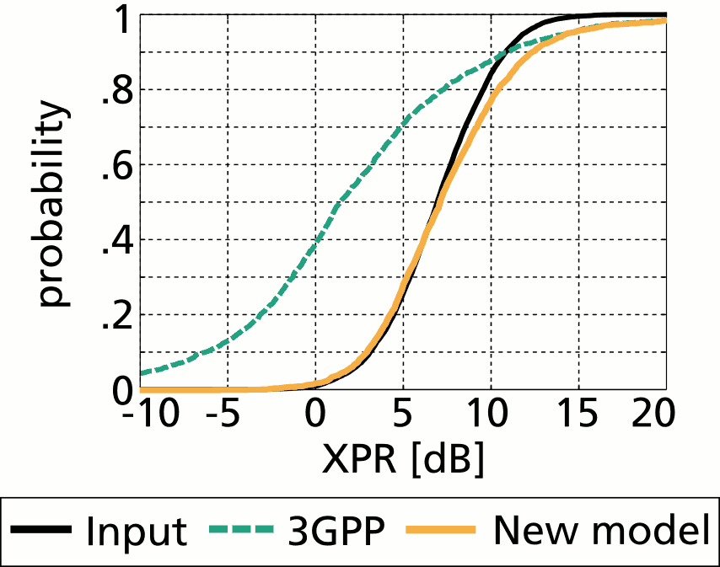
Polarization model
Comparison
Impact
  Correct XPR for circular polarization
  (→ satellite and air-to-ground communication)
  Change antenna orientations at model runtime (→ virtual field trials)
Jaeckel, S.; Börner, K.; Thiele, L. & Jungnickel, V.; "A Geometric Polarization Rotation Model for the 3-D Spatial Channel Model"; IEEE Trans. Antennas Propag., 2012, 60, 5966-5977

Slide 23
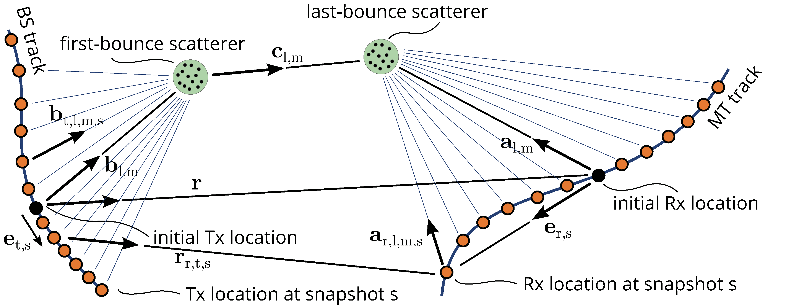
Dual-Mobility Outlook

Slide 24
Conclusions
Small-scale-fading (SSF) model to support:
  Spatial consistency
  Simultaneous mobility of the transmitter and receiver
  Simultaneous simulation of multiple frequencies
Sum-of-Sinusoids
  Efficient method to generate spatially correlated random processes
  Used for both, LSF and SSF
Polarization and MIMO models
Seamless integration with existing models
Open-source implementation available

Slide 25
Appendix

Slide 26
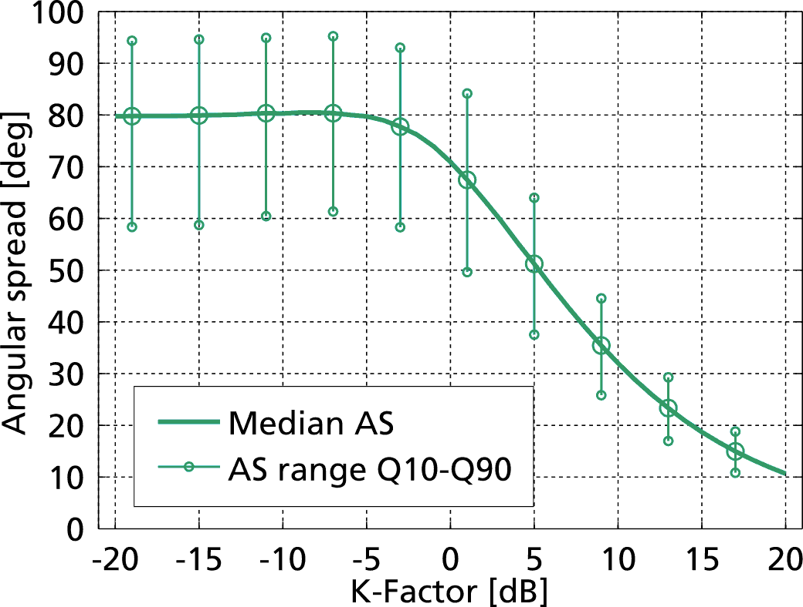
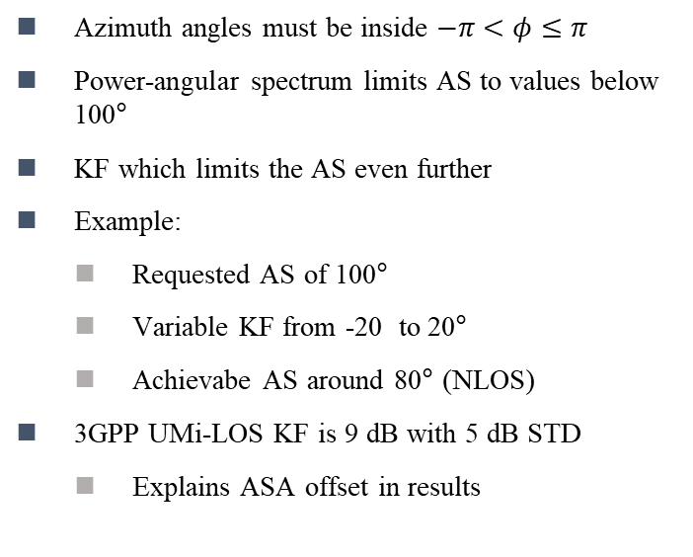
Results
Maximal Angular Spread
Azimuth angles must be inside $−π<φ≤π$
Power-angular spectrum limits AS to values below 100°
KF which limits the AS even further
Example:
  Requested AS of 100°
  Variable KF from -20 to 20°
  Achievabe AS around 80° (NLOS)
3GPP UMi-LOS KF is 9 dB with 5 dB STD
  Explains ASA offset in results
LOS Output Median ~ 30°

Slide 27
Scaling coefficients
Delays
Angles

