Slide 1
LTF Design for Co-SR Channel Estimation
Date: 2025-09-12
Authors:

Slide 2
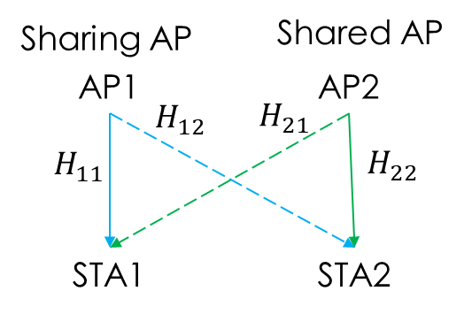
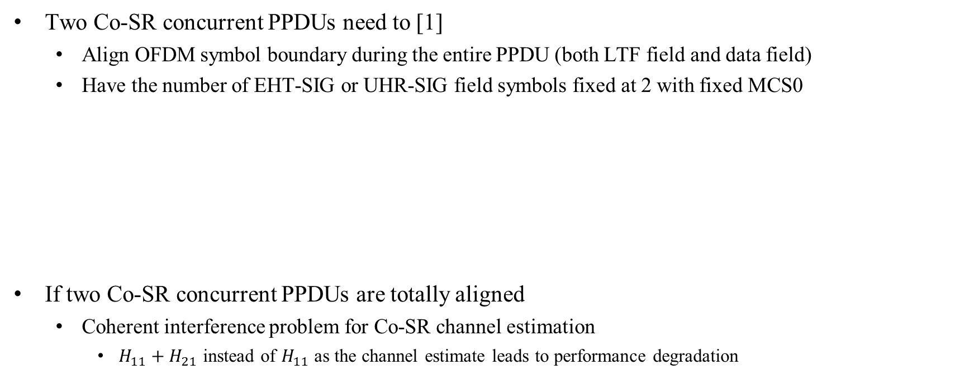
Introduction
Two Co-SR concurrent PPDUs need to [1]
  Align OFDM symbol boundary during the entire PPDU (both LTF field and data field)
  Have the number of EHT-SIG or UHR-SIG field symbols fixed at 2 with fixed MCS0
If two Co-SR concurrent PPDUs are totally aligned
  Coherent interference problem for Co-SR channel estimation
    $H_{11}+H_{21}$ instead of $H_{11}$ as the channel estimate leads to performance degradation
EHT MU PPDU
L-STF
L-LTF
L-SIG
RL-SIG
U-SIG1
U-SIG2
EHT-SIGs
EHT-STF
EHT-LTFs
Data
PE
L-STF
L-LTF
L-SIG
RL-SIG
U-SIG1
U-SIG2
UHR-SIGs
UHR-STF
UHR-LTFs
Data
PE
UHR MU PPDU

Slide 3
Proposed Solutions
MU-MIMO LTFs [2]
  LTFs for the two transmissions are spatial domain multiplexed
    AP1 and AP2 use different spatial stream indexes for UHR/EHT-LTF
    For example, AP1 uses spatial streams 1 and 2 while AP2 uses spatial streams 3 and 4
  Pros
    Completely orthogonal -> best channel estimation performance
    Symbol boundaries fully aligned
    All (same) LTF+GI combinations supported
  Cons
    Extra LTF symbols

Slide 4
Design Details Based on MU-MIMO LTFs
This contribution intends to investigate design details that are needed to enable the MU-MIMO LTF approach
  To obtain a clearer picture on what more essential design/signaling changes are needed and whether they are feasible in terms of implementation impact
Basic assumptions
  EHT non-AP STAs are oblivious of whether a PPDU is a Co-SR transmission or not
  UHR non-AP STAs are aware of whether a PPDU is a Co-SR transmission or not and whether they are receiving from the sharing AP or the shared AP
  Both UHR APs know the PPDU formats of the two concurrent Co-SR transmissions through the PHY version exchange in the Co-SR Invite/Response frames and the final indications in the Co-SR Trigger frame
    EHT+EHT
    EHT+UHR/UHR+EHT
    UHR+UHR

Slide 5
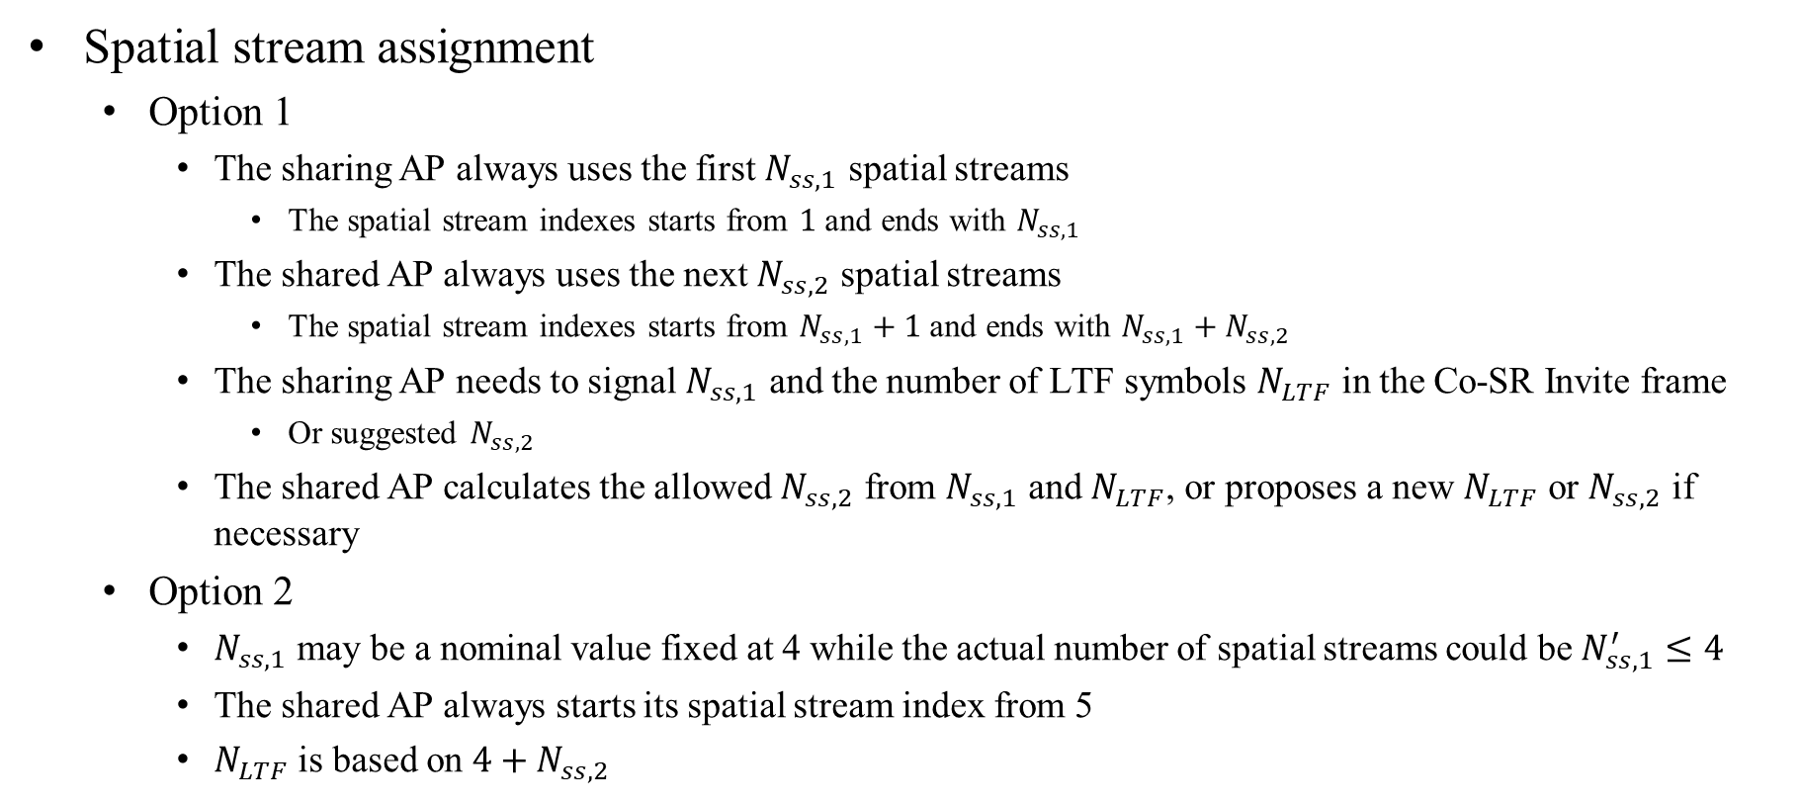
Mode 1: EHT+EHT – (1)
Spatial stream assignment
  Option 1
    The sharing AP always uses the first $N_{ss,1}$ spatial streams
      The spatial stream indexes starts from $1$ and ends with $N_{ss,1}$
    The shared AP always uses the next $N_{ss,2}$ spatial streams
      The spatial stream indexes starts from $N_{ss,1}+1$ and ends with $N_{ss,1}+N_{ss,2}$
    The sharing AP needs to signal $N_{ss,1}$ and the number of LTF symbols $N_{LTF}$ in the Co-SR Invite frame
      Or suggested $N_{ss,2}$
    The shared AP calculates the allowed $N_{ss,2}$ from $N_{ss,1}$ and $N_{LTF}$, or proposes a new $N_{LTF}$ or $N_{ss,2}$ if necessary
  Option 2
    $N_{ss,1}$ may be a nominal value fixed at 4 while the actual number of spatial streams could be $N_{ss,1}^{′}≤4$
    The shared AP always starts its spatial stream index from 5
    $N_{LTF}$ is based on $4+N_{ss,2}$

Slide 6
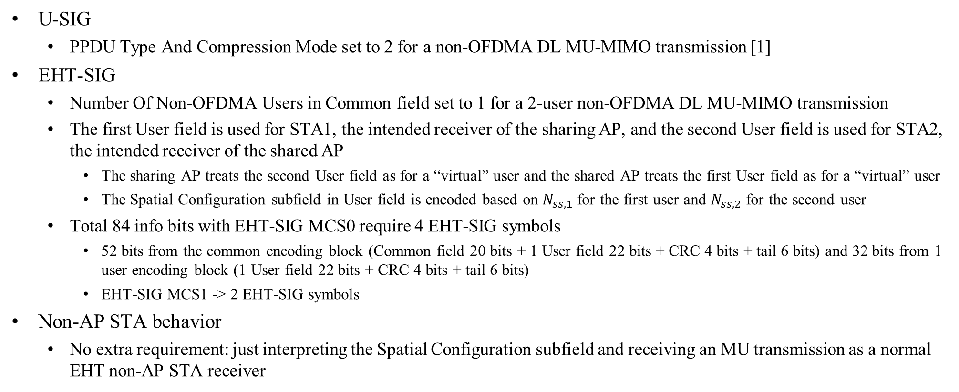
Mode 1: EHT+EHT – (2)
U-SIG
  PPDU Type And Compression Mode set to 2 for a non-OFDMA DL MU-MIMO transmission [1]
EHT-SIG
  Number Of Non-OFDMA Users in Common field set to 1 for a 2-user non-OFDMA DL MU-MIMO transmission
  The first User field is used for STA1, the intended receiver of the sharing AP, and the second User field is used for STA2, the intended receiver of the shared AP
    The sharing AP treats the second User field as for a “virtual” user and the shared AP treats the first User field as for a “virtual” user
    The Spatial Configuration subfield in User field is encoded based on $N_{ss,1}$for the first user and $N_{ss,2}$ for the second user
  Total 84 info bits with EHT-SIG MCS0 require 4 EHT-SIG symbols
    52 bits from the common encoding block (Common field 20 bits + 1 User field 22 bits + CRC 4 bits + tail 6 bits) and 32 bits from 1 user encoding block (1 User field 22 bits + CRC 4 bits + tail 6 bits)
    EHT-SIG MCS1 -> 2 EHT-SIG symbols
Non-AP STA behavior
  No extra requirement: just interpreting the Spatial Configuration subfield and receiving an MU transmission as a normal EHT non-AP STA receiver

Slide 7
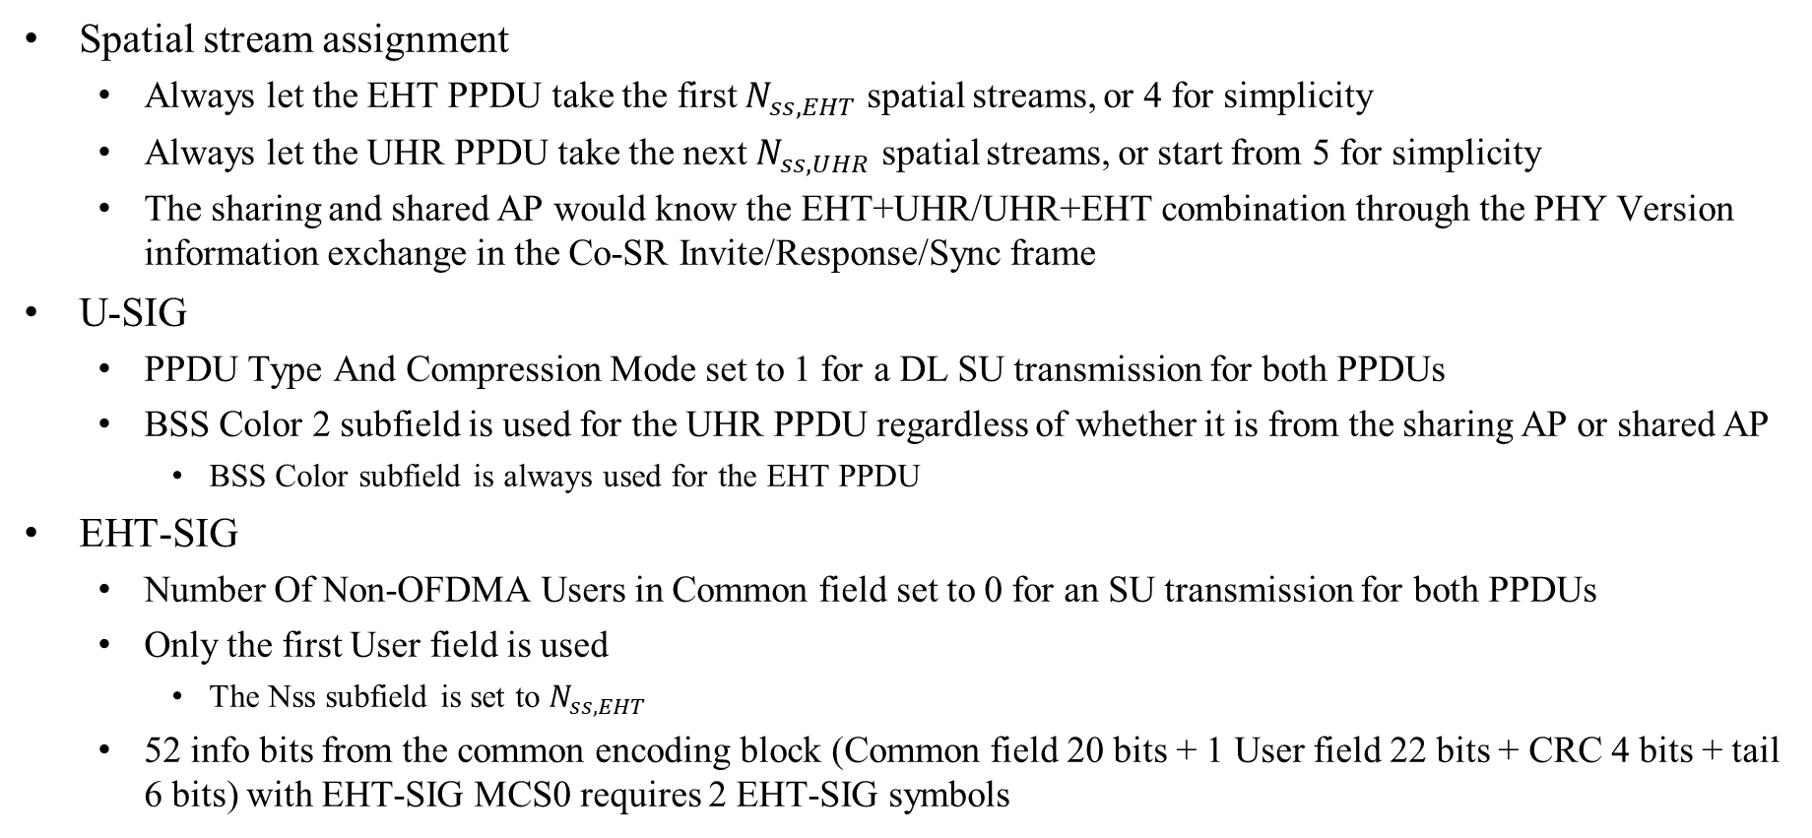
Mode 1: EHT+UHR or UHR+EHT – (1)
Spatial stream assignment
  Always let the EHT PPDU take the first $N_{ss,EHT}$ spatial streams, or 4 for simplicity
  Always let the UHR PPDU take the next $N_{ss,UHR}$ spatial streams, or start from 5 for simplicity
  The sharing and shared AP would know the EHT+UHR/UHR+EHT combination through the PHY Version information exchange in the Co-SR Invite/Response/Sync frame
U-SIG
  PPDU Type And Compression Mode set to 1 for a DL SU transmission for both PPDUs
  BSS Color 2 subfield is used for the UHR PPDU regardless of whether it is from the sharing AP or shared AP
    BSS Color subfield is always used for the EHT PPDU
EHT-SIG
  Number Of Non-OFDMA Users in Common field set to 0 for an SU transmission for both PPDUs
  Only the first User field is used
    The Nss subfield is set to $N_{ss,EHT}$
  52 info bits from the common encoding block (Common field 20 bits + 1 User field 22 bits + CRC 4 bits + tail 6 bits) with EHT-SIG MCS0 requires 2 EHT-SIG symbols

Slide 8
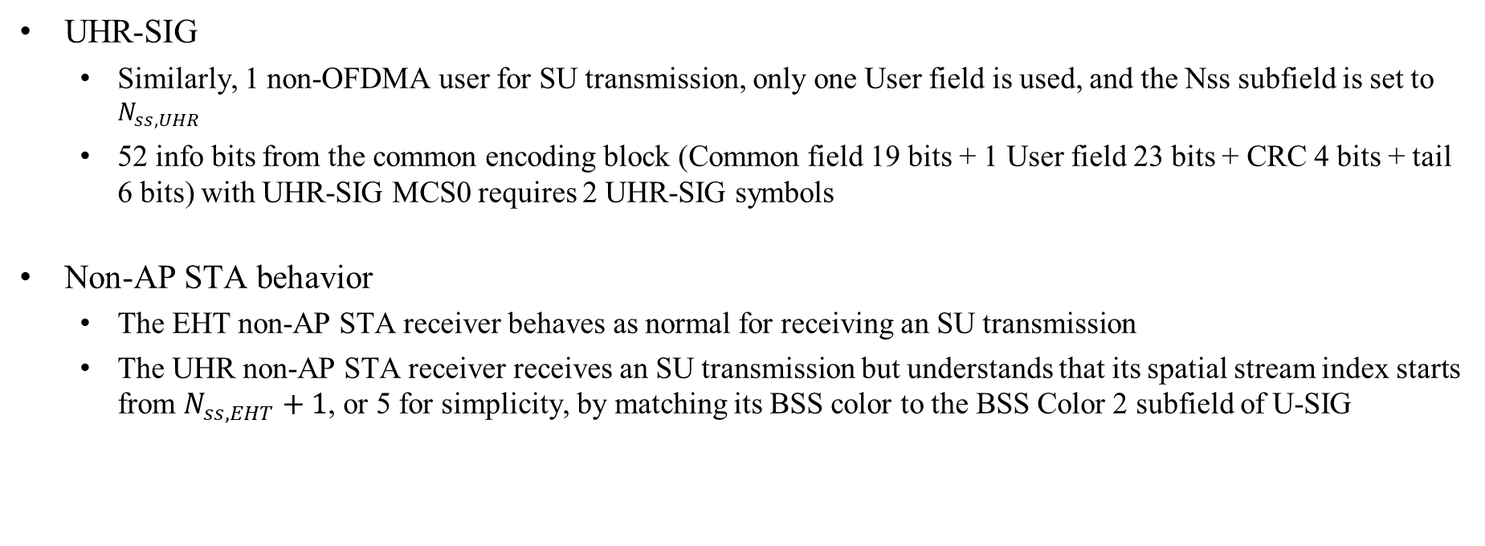
Mode 1: EHT+UHR or UHR+EHT – (2)
UHR-SIG
  Similarly, 1 non-OFDMA user for SU transmission, only one User field is used, and the Nss subfield is set to $N_{ss,UHR}$
  52 info bits from the common encoding block (Common field 19 bits + 1 User field 23 bits + CRC 4 bits + tail 6 bits) with UHR-SIG MCS0 requires 2 UHR-SIG symbols
Non-AP STA behavior
  The EHT non-AP STA receiver behaves as normal for receiving an SU transmission
  The UHR non-AP STA receiver receives an SU transmission but understands that its spatial stream index starts from $N_{ss,EHT}+1$, or 5 for simplicity, by matching its BSS color to the BSS Color 2 subfield of U-SIG

Slide 9
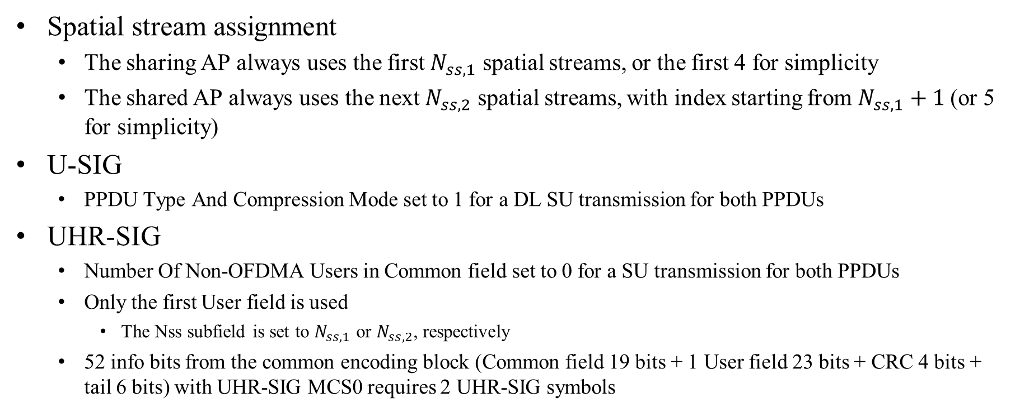
Mode 2: UHR+UHR – (1)
Spatial stream assignment
  The sharing AP always uses the first $N_{ss,1}$ spatial streams, or the first 4 for simplicity
  The shared AP always uses the next $N_{ss,2}$ spatial streams, with index starting from $N_{ss,1}+1$(or 5 for simplicity)
U-SIG
  PPDU Type And Compression Mode set to 1 for a DL SU transmission for both PPDUs
UHR-SIG
  Number Of Non-OFDMA Users in Common field set to 0 for a SU transmission for both PPDUs
  Only the first User field is used
    The Nss subfield is set to $N_{ss,1}$ or $N_{ss,2}$, respectively
  52 info bits from the common encoding block (Common field 19 bits + 1 User field 23 bits + CRC 4 bits + tail 6 bits) with UHR-SIG MCS0 requires 2 UHR-SIG symbols

Slide 10

Mode 2: UHR+UHR – (2)
Non-AP STA behavior
  The UHR non-AP STA receiver of the sharing AP knows its role by matching its BSS Color to the BSS Color subfield in U-SIG and understands that its spatial stream index starts 0
  The UHR non-AP STA receiver of the shared AP knows its role by matching its BSS Color to the BSS Color 2 subfield in U-SIG and understands that its spatial stream index starts from $N_{ss,1}+1$, or 5 for simplicity

Slide 11
Summary
We investigate more design details that are needed to enable the MU-MIMO LTF approach for Co-SR channel estimation
  Spatial stream assignment and how the non-AP receivers obtain the assignment information may depend on the PPDU format combinations of the two concurrent transmissions
    EHT+EHT: treated as MU transmission and the spatial stream assignment is signaled through the Spatial Configuration subfield of the User field in EHT-SIG
    UHR+EHT/EHT+UHR/UHR+UHR: treated as SU transmission and UHR non-AP STAs assume some preunderstanding on the spatial stream assignment through matching the BSS color placement in U-SIG

Slide 12
References
IEEE 802.11-24/0209r19, “Specification Framework for TGbn,” August 2025.
Offline discussion

Slide 13
Backup slides

Slide 14
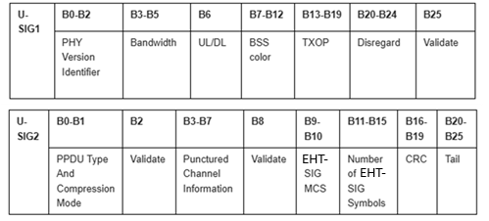
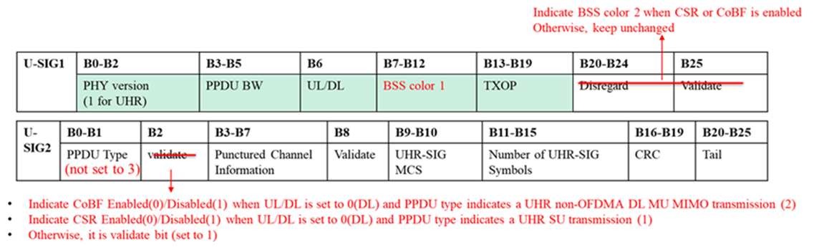
U-SIG
EHT U-SIG
UHR U-SIG

Slide 15
EHT/UHR-SIG – 1
EHT-SIG: Common field for non-OFDMA transmission
B0-B3 | B4-B5 | B6-B8 | B9 | B10-B11 | B12 | B13-B16 | B17-B19
Spatial Reuse | GI+LTF Size | Number of UHR-LTF Symbols | LDPC Extra Symbol Segment | Pre-FEC padding Factor | PE Disambiguity | Disregard | Number of non-OFDMA Users
EHT-SIG: User field for an MU-MIMO allocation
0 | 1 | 2 | 3 | 4 | 5 | 6 | 7 | 8 | 9 | 10 | 11 | 12 | 13 | 14 | 15 | 16 | 17 | 18 | 19 | 20 | 21
STA-ID |  |  |  |  |  |  |  |  |  |  | MCS |  |  |  | Coding | Spatial Configuration
EHT-SIG: User field for an SU transmission
0 | 1 | 2 | 3 | 4 | 5 | 6 | 7 | 8 | 9 | 10 | 11 | 12 | 13 | 14 | 15 | 16 | 17 | 18 | 19 | 20 | 21
STA-ID |  |  |  |  |  |  |  |  |  |  | MCS |  |  |  | Reserved | NSS |  |  |  | Beamformed | Coding
UHR-SIG: Common field for non-OFDMA transmission
B0-B3 | B4-B5 | B6-B8 | B9 | B10-B11 | B12 | B13 | B14-B15 | B16-B18
Spatial Reuse | GI+LTF Size | Number of UHR-LTF Symbols | LDPC Extra Symbol Segment | Pre-FEC padding Factor | PE Disambiguity | IM | Disregard | Number of non-OFDMA Users
UHR-SIG: User field for SU transmission
0 | 1 | 2 | 3 | 4 | 5 | 6 | 7 | 8 | 9 | 10 | 11 | 12 | 13 | 14 | 15 | 16 | 17 | 18 | 19 | 20 | 21 | 22
STA-ID |  |  |  |  |  |  |  |  |  |  | MCS |  |  |  |  | NSS |  |  | UEQM | Beamformed | Coding | 2xLDPC
 |  |  |  |  |  |  |  |  |  |  |  |  |  |  |  |  |  |  |  | UEQM Patterns

Slide 16
EHT/UHR-SIG – 2

