Slide 1
Considerations on Numerology for IMMW-Follow Up
Date: 2025-xx-xx
Authors:
Name | Affiliation | Address | Phone | Email
Insik Jung | LG Electronics | 19, Yangjae-daero 11gil, Seocho-gu, Seoul 137-130, Korea |  | insik0618.jung@lge.com
Eunsung Park |  |  |  | esung.park@lge.com
Insun Jang |  |  |  | insun.jang@lge.com
Dongju Cha |  |  |  | dongju.cha@lge.com
Hongwon Lee |  |  |  | hongwon.lee@lge.com
Jinsoo Choi |  |  |  | js.choi@lge.com
HanGyu Cho |  |  |  | hg.cho@lge.com
Sang Kim |  |  |  | sanggook.kim@lge.com

Slide 2
Introduction
In [1], we have discussed and evaluated the various performances of two different base numerologies (1x based and 4x based) with carrier frequency offsets.
In this contribution, we discuss and evaluate the effect of phase noise for the two different base numerologies in mmWave environments.

Slide 3
Recap: BW Upclocking
Motivations
We can reuse the PPDU structure defined in sub-7GHz standards to reduce the implementation cost
To fully utilize the wide bandwidth characteristics of the mmWave band, we can consider upclocking of the base numerology
Design Considerations
Applying higher upclocking factor brings several benefits
We can achieve higher throughput because of the wider bandwidth
Effects of HW impairments like CFO/PN are reduced
Also, we can prevent the system deviates from the CFO estimation range
It also has some drawbacks
Relatively vulnerable to ISI due to the shorter OFDM symbol duration
We may need faster clock rate to implement wider bandwidth system

Slide 4
Recap: Base Numerologies
Numerology 1
312.5kHz subcarrier spacing
11n/ac-based PPDU can be considered
Robust against CFO/Phase noise when same upclocking is applied
Relatively less complexity (smaller FFT size)
Numerology 2
78.125kHz subcarrier spacing after the legacy part
312.5kHz subcarrier spacing in a legacy part
11ax/be-based PPDU can be considered
Relatively sensitive to CFO/Phase noise when same upclocking is applied
Higher data tone ratio over FFT size
With the same CP length, better throughput can be achieved

Slide 5
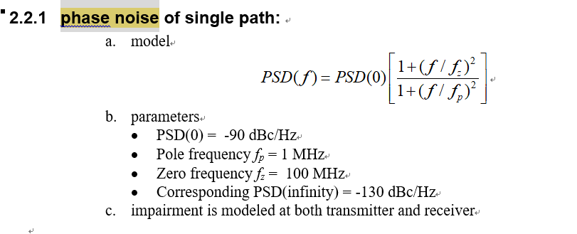
Phase Noise Model
We implemented the phase noise model which is defined for 11ay

Slide 6
Simulation Environment
Parameter | Description
MCS | MCS 3
Base bandwidth | 80MHz
CP length | 0.2us
Channel model | 802.11ad channel model (conference room, CR)
TX/RX | 1T1R
Fc | 60 GHz
Channel coding | BCC
Packet size | 10000bits
CFO | 40ppm
*CFO is estimated and compensated using legacy preamble (e.g., L-STF and L-LTF) for both numerologies

Slide 7
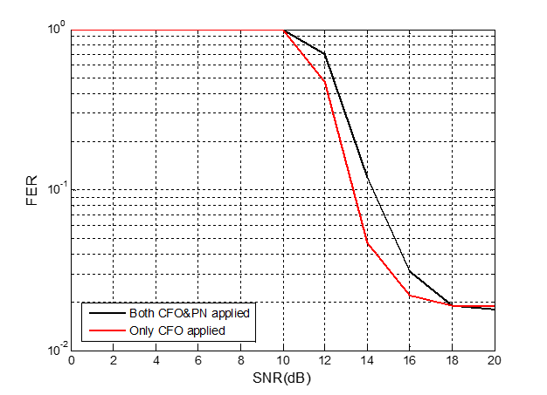
Simulation Results (1/3) :Impact on PN
Settings
1x base numerology is used
4x upclocking is applied
1.25MHz SCS is used
Discussions
FER is almost 1~1.5dB degraded by applying phase noise
The inter-carrier-interference which is caused by the phase noise makes it happen.

Slide 8
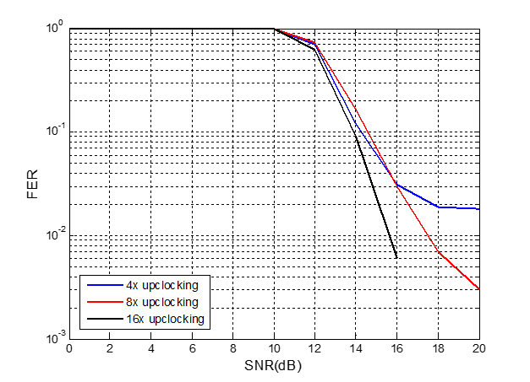
Simulation Results (2/3) :Upclocking Factor
Settings
1x base numerology is used
Both CFO/PN are considered
Discussions
As upclocking becomes higher, we can observe the better FER performance
This is because higher upclocking provides wider subcarrier spacing, which is more immune to the phase noise effect
We also need to consider that higher upclocking poses more HW burden while it has better FER

Slide 9
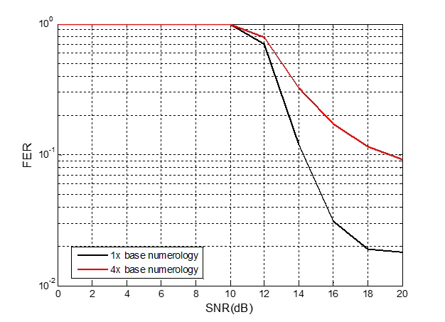
Simulation Results (3/3) : Base Numerology
Settings
4x upclocking is used
1.25MHz SCS for the 1x base numerology
312.5kHz SCS for the non-legacy part of the 4x base numerology (1.25MHz SCS for the legacy part)
Both CFO/PN are considered
Discussions
Overall, 1x base numerology performs better than 4x base numerology
This is because 4x base numerology is more affected by phase noise as it has narrower subcarrier spacing at the data part

Slide 10
Conclusion
We have discussed and evaluated the effect of phase noise of the two different base numerologies for 11bq.
We observed that 1x base numerology performs better when there is both CFO and PN

Slide 11
Straw Poll #1
Do you support the following in 11bq?
1x numerology (e.g., a/n/ac) is reused to upclock the sub-7GHz PHY for 11bq

Slide 12
Reference
[1] 11-25-0854-00, Considerations on numerology for IMMW, LGE

