Slide 1
IMMW Discovery, Association, and Beacon
Date: 2025-07-xx
Authors:
Name | Affiliations | Address | Phone | Email
Cheng Chen | Intel |  |  | cheng.chen@intel.com
Laurent Cariou
Carlos Cordeiro
Ehud Reshef
Notes:
September 2012

Slide 2
Overview
There have been some contributions [1-8] providing high-level thoughts on IMMW protocol design considerations.
In this contribution, we propose some initial considerations for the design of IMMW protocols, focusing on discovery, association, Beacon.

Slide 3
Overall IMMW design philosophy
IMMW PAR:
This amendment defines standardized modifications to both the IEEE Std 802.11™ physical layer (PHY) and the IEEE Std 802.11 Medium Access Control (MAC) that allows Wireless Local Area Network (WLAN) non-standalone operation in unlicensed bands between 42 GHz and 71 GHz using single-user (SU) Orthogonal Frequency Division Multiplexing (OFDM) based transmissions. The amendment requires that an IEEE 802.11 device supporting this amendment also supports at least one of the 2.4 GHz to 7.25 GHz (sub-7.25 GHz) unlicensed bands. The amendment expands the multi-link operation defined in the sub-7.25 GHz band specifications to support non-standalone operation in the unlicensed bands between 42 GHz and 71 GHz.
This amendment leverages or reuses existing PHY and MAC specifications defined for the operation in sub-7.25 GHz bands, e.g. SU transmission PHY Protocol Data Unit (PPDU) format and MAC frames, and defines bandwidth modes operating in non-overlapping channels.
This amendment provides coexistence mechanisms with legacy IEEE 802 devices operating in the unlicensed bands between 42 GHz and 71 GHz.
Our views of the IMMW design philosophy
Integrated mmWave operation
Non-standalone mmWave operation
Different with 11ad/11ay
Limited scope
Focus on SU operation
A limited set of bandwidth
Minimal standard and implementation changes by reusing existing PHY/MAC
Leverage sub-7.25 GHz PHY design
Reuse and extend existing MLO framework

Slide 4
IMMW MLD framework
Basic IMMW MLD architecture
An IMMW STA MLD always consists of at least one affiliated STA in sub-7.25 GHz and one affiliated STA in mmWave band.
There is no single-radio IMMW STA MLD. That is, there is no IMMW STA MLD that consists of sub-7.25 GHz link(s) and an mmWave link but can only operate at one link at a time.
Use of the mmWave link
To minimize the operation complexity and power consumption, the mmWave link should only be used if there is a need to deliver the payload. In other cases, it should mostly stay in power save/disabled mode.
Management/Control functions should be delegated to a sub-7.25 GHz link as much as we can [1-4].

Slide 5
IMMW discovery and association
Overall idea of IMMW discovery and association:
Discovery of an IMMW AP in the mmWave link is primarily done in an out-of-band manner through a sub-7.25 GHz link by reusing the Multi-link discovery mechanism defined in 11be [1][2][7].
We should consider completely disallowing the use of Probe Request/Response and Association Request/Response at the mmWave link.
That is, no in-band discovery in the mmWave link.
Association only takes place in a sub-7.25 GHz link but include the mmWave link in the Multi-link setup procedure.
Initial Beamforming and Polarization closure should be handled after the completion of Multi-link discovery and Multi-link setup complete.
That is, we can first set up the mmWave link without actually closing it. The beamforming and polarization closure procedure can take place later with a separate Beamforming procedure.

Slide 6

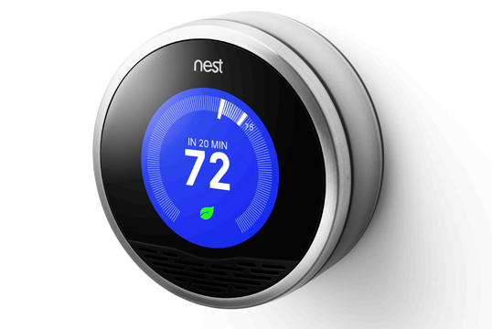
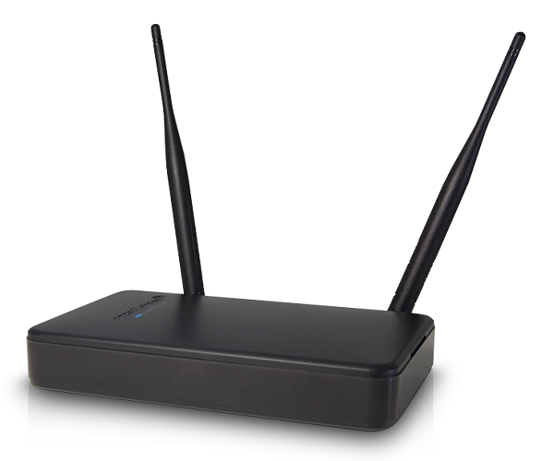
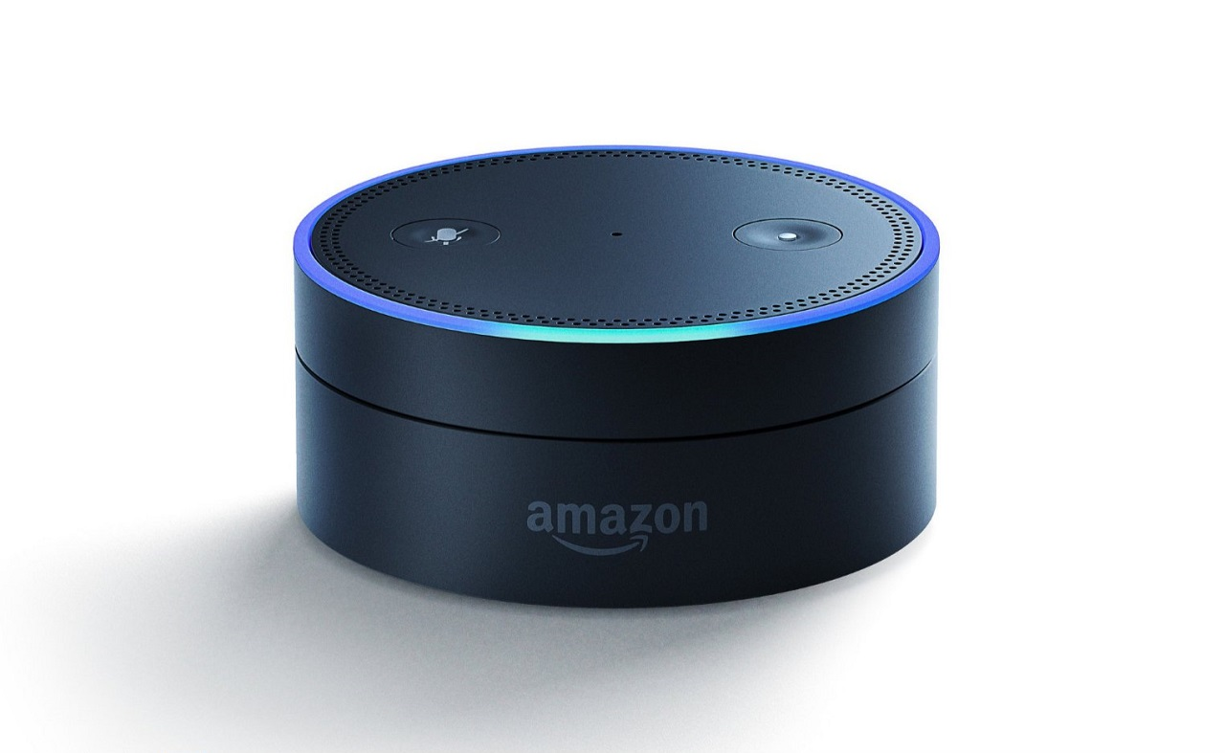

Recap on 11ad/11ay mmWave Beacons
11ad/ay Beacon design:
11ad/ay Beacons are transmitted in a sweeping manner using the Control PHY, i.e., multiple Beacon frames are transmitted by the PCP/AP on different sectors to cover all possible directions.
Sweeping Beacons: Burdensome and time-consuming. However, it is necessary for 11ad/11ay in pre-association phase for unassociated STAs to discover and initiate beamforming with an AP.
Control PHY: Defines the minimum rate all devices may use to communicate before establishing a high-rate beamformed link. Control PHY decreases the data rate significantly, resulting in low spectrum usage.
11ad/ay Beacons: Sweeping directional
Beacons to cover all sectors
Beacon
Beacon
Beacon
Beacon
Beacon
Beacon
Beacon
Beacon

Slide 7
Light Beacon vs. No Beacon
In IMMW, things are simplified due to a mandatory sub-7.25 GHz link, which we can use to facilitate discovery, association, beamforming, and management/control.
mmWave discovery can be done in the lower band by reusing the 11be Multi-link discovery.
Most of capabilities exchange and BSS management at mmWave link can be delegated to sub-7.25 GHz with minimal changes.
There have been proposals talking about either a “light” Beacon option or no Beacon option at the mmWave link [6][7][8].

Slide 8
No Beacons for IMMW
We propose to not define or transmit any IMMW Beacons in the mmWave link due to the following considerations.
mmWave discovery can be done in the lower band by reusing the 11be Multi-link discovery.
Nearly all capabilities exchange and BSS management at mmWave link can be delegated to sub-7.25 GHz with minimal changes.
For example, the TSF offset between the mmWave link and the sub-7.25 GHz links can be included in the Multi-link element, which is already enabled in the MLO framework.
Beacons will need to be at least transmitted in multiple sectors that have associated STAs, which incur large overhead when the number of sweeping sectors increases.
Beacons will need to be transmitted using the Control PHY, which we aim to avoid.
The transmission of periodic “light” Beacons still requires the AP and STAs to keep awake on the mmWave link for a significant amount of time periodically even if there is no transmission scheduled in the mmWave link, which can cause exceeding power assumption.
Particularly for mobile APs, the requirement to transmit periodic Beacons will lead to power consumption which they cannot afford.

Slide 9
IMMW Beacon options
Our preferred option.
11ad/ay Beacons: Sweeping directional
Beacons to cover all sectors
Solution 1 for IMMW: only directional
Beacons to cover associated STAs
Solution 2 for IMMW: No mmWave Beacons
Beacon
Beacon
Beacon
Beacon
Beacon
Beacon
Beacon
Beacon
Beacon
Beacon
Beacon
Beacon

Slide 10
Conclusions
In this contribution, we propose some initial considerations on IMMW protocols design, with the motivation to minimize mmWave link operation complexity by reusing and extending existing MLO framework.
Discovery of the mmWave link is proposed to be done in an out-of-band manner.
Association only takes place in a sub-7.25 GHz link but include the mmWave link in the Multi-link setup procedure.
Most of the Beacon functions are proposed to be delegated to a sub-7.25 GHz link. We should consider the option of having no Beacons in the mmWave link.

Slide 11
SP1
Do you support the following:
The discovery of an IMMW AP operating in the mmWave link is done through AP(s) affiliated with the same AP MLD as the IMMW AP and operating in the sub-7.25 GHz link(s) by reusing the Multi-link discovery mechanism(s)
No in-band discovery in the mmWave link.
Association to an IMMW AP is done only as part of the ML setup procedure and with frame exchanges with AP(s) affiliated with the same AP MLD as the IMMW AP and operating in the sub-7.25 GHz link(s) by including the mmWave link in the Multi-link setup procedure.
No Authentication, Association Request, Association Response frames transmitted in the mmWave link.

Slide 12
SP2
Do you support the following:
There is no Beacon frame transmitted in the mmWave link by an IMMW AP.

Slide 13
References
[1] 11-23-2004-00-immw-technical-scope-proposal
[2] 11-23-1905-00-immw-high-level-thoughts-on-immw
[3] 11-23-1819-01-immw-integrated-mmwave-design-considerations
[4] 11-23-1968-00-immw-discussion-on-general-direction-of-integrated-mmwave
[5] 11-23-1878-01-immw-high-level-design-considerations-of-immw
[6] 11-23-2052-00-immw-mmwave-operation-without-mmwave-beacon
[7] 11-24-0459-00-immw-multi-link-operation-for-immw
[8] 11-25-0428-01-00bq-mmwave-link-mac-txop-protection-medium-access-power-save

