Slide 1
A Simple Procedure to Determine Co-BF Sync-reference and Sync-follower Roles
Date: 2025-09-12
Authors:

Slide 2
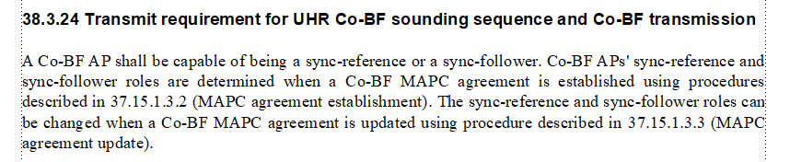
Introduction
A semi-static scheme is proposed in [1] to determine Co-BF MAPC sync-reference/sync-follower roles.
The following text is included in 11bn D1.0:

Slide 3
Purpose
PHY group can give a guideline on procedure to determine and parameter to signal Co-BF Sync-reference/sync-follower roles so that details can be worked out in MAC PDT.
We propose:
  Simple procedure to avoid negotiation on Co-BF Sync reference/follower roles during Co-BF agreement establishment and updates:
    A requesting AP decides and explicitly indicates its Co-BF Sync-reference / Sync-follower role;
    A responding AP assumes the Sync-follower / Sync-reference role left by the requesting AP.

Slide 4
A Simple Procedure to Determine Sync-reference/follower Roles
A MAPC requesting AP(AP1) indicates its sync-reference/follower role explicitly in Co-BF profile in the MAPC Negotiation Request frame it sends to responding AP(AP2) in Co-BF agreement establishment.
  AP1 indicates its sync-reference or sync-follower role in the MAPC Scheme Request Set field of the Co-BF profile.
  The MAPC responding AP assumes the sync-reference/follower role left by the requesting AP if it accepts the Co-BF agreement.
After Co-BF agreement is established, either AP1 or AP2 can send MAPC Negotiation Request frame to update Co-BF agreement.
  It’s recommended to keep a CoBF AP’s sync-reference/follower role semi-static, only changes it in in Co-BF MAPC agreement update when necessary.
  A MAPC requesting AP indicates its sync-reference/follower role explicitly in Co-BF profile in the MAPC Negotiation Request frame it sends to responding AP to update Co-BF agreement.
  The MAPC responding AP assumes the sync-reference/follower role left by the requesting AP if it accepts the Co-BF agreement update.

Slide 5
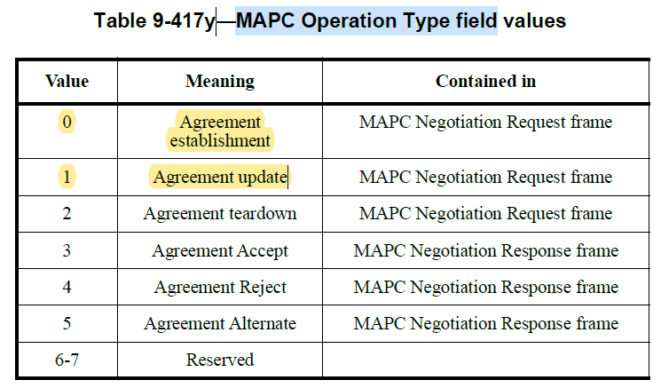
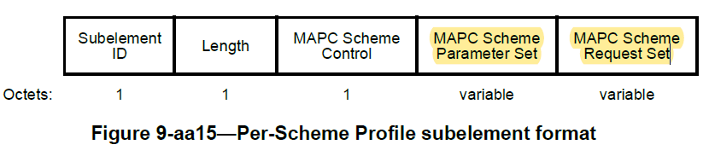
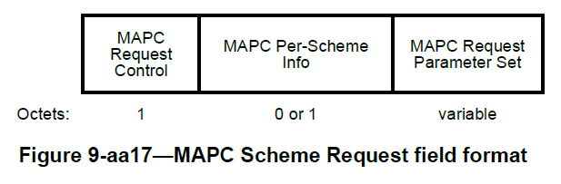
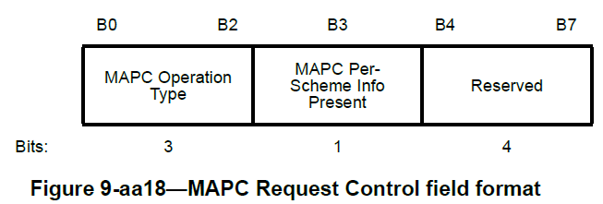
Includes a Sync-role Bit in Co-BF Profile
According to 11bn draft:
  MAPC Scheme Type = 0 in MAPC Scheme Control means Co-BF profile;
  The MAPC Scheme Request Set field carried in a Co-BF profile contains a single MAPC Scheme Request field.
  Use 1 bit in a MAPC Scheme Request field for Sync-role, the location of the bit is TBD.
MAPC Scheme Type=0
Co-BF profile
Includes Sync-role bit

Slide 6
SP
Do you support to use the following procedure to determine MAPC Co-BF sync-reference and sync-follower roles when Co-BF MAPC agreement is established or updated in 11bn?
  A MAPC requesting AP indicates explicitly its sync-reference / sync-follower role in the MAPC Scheme Request Set field of the Co-BF profile in the MAPC Negotiation Request frame.
  A MAPC responding AP assumes the sync-follower / sync-reference role left by the requesting AP if it accepts the agreement establishment or agreement update.
  Note: It’s recommended to keep a CoBF AP’s sync-reference/follower role semi-static, only changes it in Co-BF MAPC agreement update when necessary.

Slide 7
References
[1] Doc 11-25/1129r1, On Determination of CoBF MAP Sync-reference and Sync-follower Roles (Julia Feng et. al)

