Slide 1
MAPC element length issue discussion

Slide 2
Introduction
In this presentation, we offer some thoughts on MAPC element length issue.

Slide 3
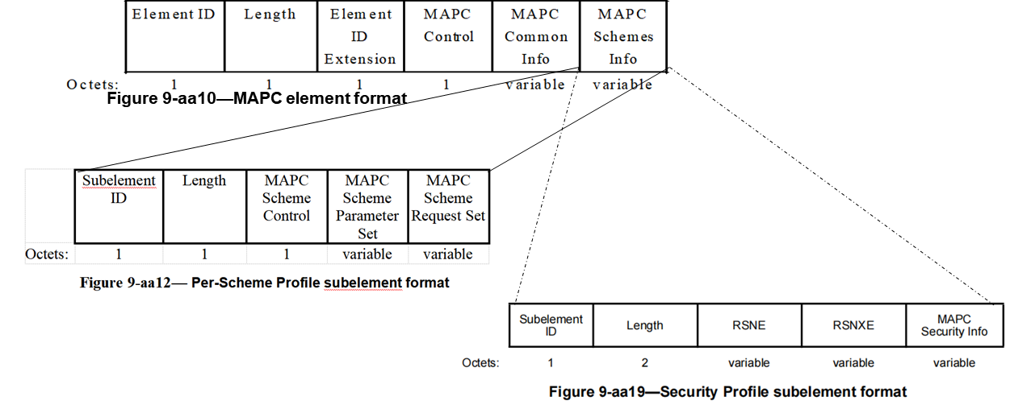
Recap: 1-octet length field in MAPC element
As shown in Figure 9-aa10 in 802.11bn draft1.0, only 1-octet length field in the MAPC element format, which can indicate the maximum 255-octet length of the information.
  In Security Profile subelement, 2-octect length field can indicate the maximum 65535-octet length of the information.

Slide 4
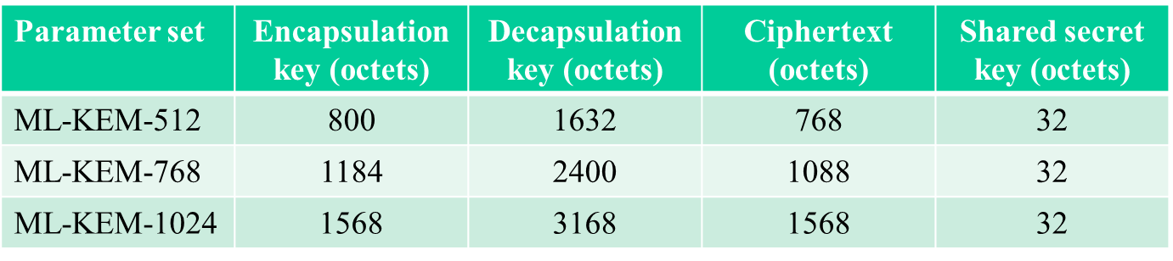
Recap: MAPC supporting PQC
Considering to forward supporting Post-Quantum Cryptography(PQC), MAPC element may include the ML-KEM parameter(s) in its security profile.
  But, the length of Encapsulation key/Cipher text may be up to 1568 octets.
  The total length of security information may be up to 2000+ octets (PQC TLS in 802.1X mode)

Slide 5
Motivation
Obviously, 1-octet length field can’t indicate the whole MAPC element in some scenario.
Propose the following two options to address the issue mentioned above:
Opt1: Fragment the MAPC element but not fragment the security profile. Possibly, need to define some new fragment rules for it.
Opt2: include a 2-octet length extension field to indicate the remaining payload of MAPC element.

Slide 6
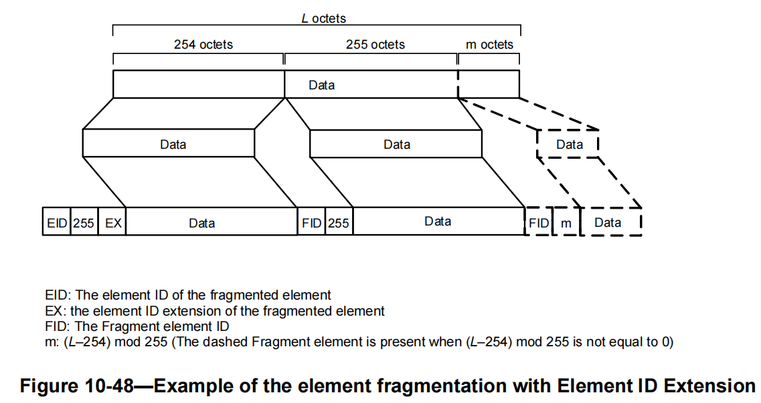
Opt1: Fragment the element
Following the rule defined in 10.28.11 (Element fragmentation) to fragment MAPC element and defragment it on receiver side.
  As shown in Figure 10-48, insert FID and the length field into the fragmented element after each 255-octet payload .
Shortage of Opt1
  Fragment MAPC element including the PQC parameter causing a seriously overhead issue. E.g. The 1568-octets encapsulation key may be fragmented into 7 pieces, that’s, 14 additional octets will be inserted into the total payload.
  Implementations complex. Once one piece of fragmentation or defragmentation error, the whole frame exchange will be failure.

Slide 7
Opt2: include 2-octet length extension field
Define 2-octet length extension field in MAPC common info. field to indicate the remaining length of MAPC element if the total payload length beyond 255-octet.
  Define length extension present in MAPC control Info. field to indicate when the length extension field in MAPC common info. field or not.
  That’s, when the total length of payload beyond 255-octet, length extension present field will be set to 1, otherwise, it’s set to 0.

Slide 8
The following figure depicts the proposed signaling(in red font)
Figure 9-aa8—MAPC Control field format
 | B0 | B1 | B2 B7
 | AP ID Present | Length Extension present | Reserved
Bits: | 1 | 1 | 6
Figure 9-aa9— MAPC Common Info field format
 | MAPC Common Info Length | MAPC Capabilities | MAPC Parameters | AP ID | Length Extension
Octets: | 1 | 2 | 2 | 0 or 2 | 0 or 2

Slide 9
Summary
Analyze the length issue when the length of payload in MAPC element beyond 255 octets, and provide two options to address it.
  Opt1: Fragment/defragment MAPC element, may involve new potential issues, like overhead issue, implementation complex.
  Opt2: Define a 2-octect length extension field in MAPC Common Info field.

Slide 10
Reference
[1]. 24/1103r1 Post-Quantum 802.11
[2]. 25/218r1 Post-Quantum Opportunistic Wireless Encryption (OWE)
[3]. 25/1108r3 pqc-protocol-definitions
[4]. 2025/1297r1 Post-Quantum Opportunistic Wireless Encryption specification

Slide 11
THANK YOU ☺

