Slide 1
PQC element length issue discussion

Slide 2
Introduction
In this presentation, we offer some high level thoughts on post-quantum element length issue.

Slide 3
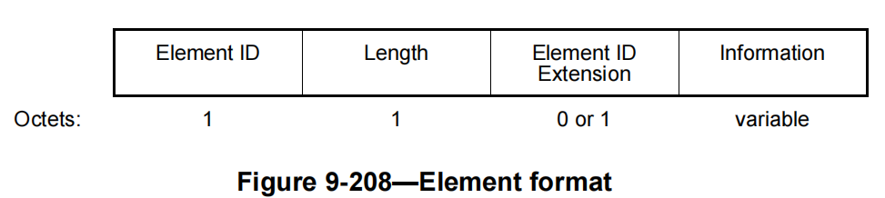
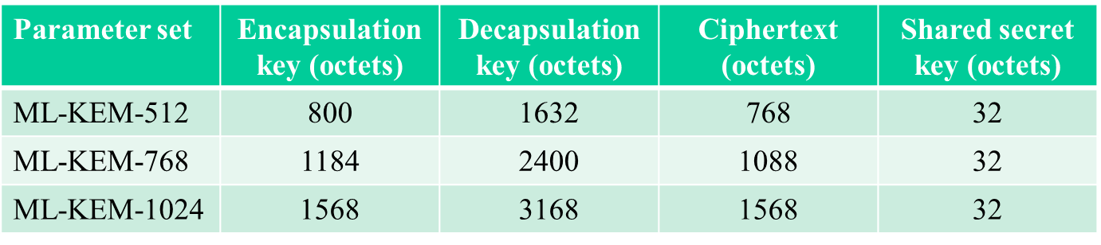
Recap: 1-octet length field in element and ML-KEM
As shown in Figure 9-208, only 1-octet length field in the element format, which can indicate the maximum 255-octets length of the information.
On other hand, the length of Encapsulation key/Cipher text may be up to 1568 octets.

Slide 4
Recap-2: the proposed public key/cipher text in the element
Several contributions propose to include ML-KEM public key/cipher text into the maximum 255-octets length elements
  Quote the proposed text from 25/1108r3 and 25/1297r1 respectively as bellow:
  Obviously, 1-octets length field can’t indicate
  the whole length of the PQC Parameters.
Table 9-130—Element IDs
Element | Element ID | Element ID Extension | Extensible | Fragmentable
Tunneled PASN (see 9.4.2.315 (Tunneled PASN element)) | 255 | 143 | Yes | No
PQC Key Selector | 255 | <ANA8> | Yes | Yes
PQC Key | 255 | <ANA9> | Yes | Yes
PQC Commit | 255 | <ANA10> | Yes | Yes
Ciphertext | 255 | <ANA11> | Yes | Yes
PQC Signature | 255 | <ANA12> | Yes | Yes
Reserved | 255 | <ANA12>+1144-255
Element | Element ID | Element ID Extension | Extensible | Fragmentable
Tunneled PASN (see 9.4.2.315) | 255 | 143 | Yes | No
KEM Encapsulation Key (see 9.4.2.xxx) | 255 | <ANAeid> | Yes | Yes
KEM Ciphertext (see 9.4.2.yyy) | 255 | <ANAeid+1> | Yes | Yes
Reserved | 255 | < ANAeid+2>-255

Slide 5
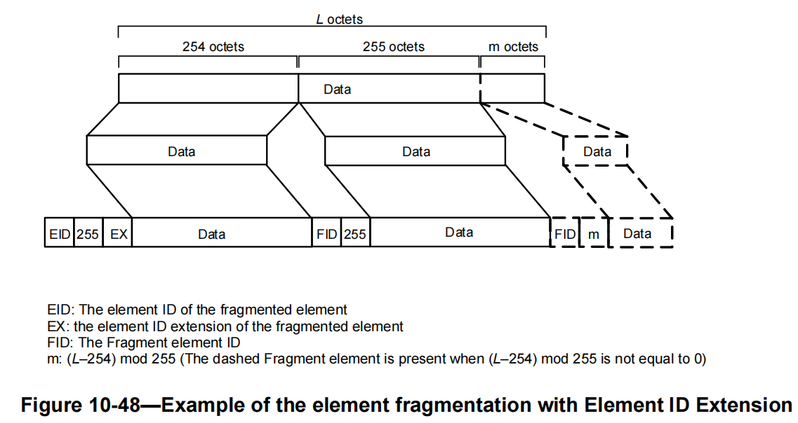
Opt1: Fragment the element
Following the rule defined in 10.28.11 (Element fragmentation) to handle the element including PQC parameter(Encapsulation key , Cipher text, etc. ).
  As shown in Figure 10-48, insert FID and the length field into the fragmented element after each 255-octet payload .
Shortage of Opt1
  Fragment the PQC parameter causing a seriously overhead issue. E.g. The 1568-octets encapsulation key may be fragmented into 7 pieces, that’s, 14 additional octets will be inserted into the total payload.
  Implementations complex. Once one piece of fragmentation or defragmentation error, the whole frame exchange will be failure

Slide 6
Opt2: 2-octets length field in the new element format
In the post-quantum era, a longer payload in the element may become more and more common.
  It’s time to define 2-octets length field in a new element format to meet Wi-Fi industry requirement. The new format is shown as bellow.
  Using a reserved Element ID defined in Table 9-130 (like: Element ID=155)
  Such new element format can be used by any PQC relevant parameter as well as other new information in the future by setting different values in Element ID Extension field.
 | Element ID | Length | Element ID Extension | PQC Parameter
Octets: | 1 | 2 | 1 | variable

Slide 7
Summary
Analyze the length issue when the PQC parameter is included in traditionally element format, and provide two options to address it.
  Opt1: fragment/defragment, may involve new potential issues, like overhead issue, implementation complex.
  Opt2: Define a 2-octet length field in the new element format.

Slide 8
Reference
[1]. 24/1103r1 Post-Quantum 802.11
[2]. 25/218r1 Post-Quantum Opportunistic Wireless Encryption (OWE)
[3]. 25/1108r3 pqc-protocol-definitions
[4]. 2025/1297r1 Post-Quantum Opportunistic Wireless Encryption specification

Slide 9
THANK YOU ☺

Slide 10
SP1
In order to support PQC parameter included in the element, do you agree to define a 2-octets length field in a new element format shown as bellow?
Note: The PQC parameter can be Encapsulation key , Cipher text, etc.
 | Element ID | Length | Element ID Extension | PQC Parameter
Octets: | 1 | 2 | 1 | variable

