Slide 1
Hybrid PQC
Date: 2025-09-15
Authors:
Yong Liu (Apple)

Slide 2
Motivations
What is hybrid PQC?
  For key establishment, shared secrets are generated using both a classical key exchange algorithm and a PQC algorithm.
  The shared secrets are then combined to produce a final session key.
Why hybrid?
  PQC algorithms are relatively new compared to classical algorithms, which have undergone real-world testing for decades.
  If a chosen PQC algorithm is found broken or insecure later, the protection provided by the classical algorithm can still be effective.

Slide 3
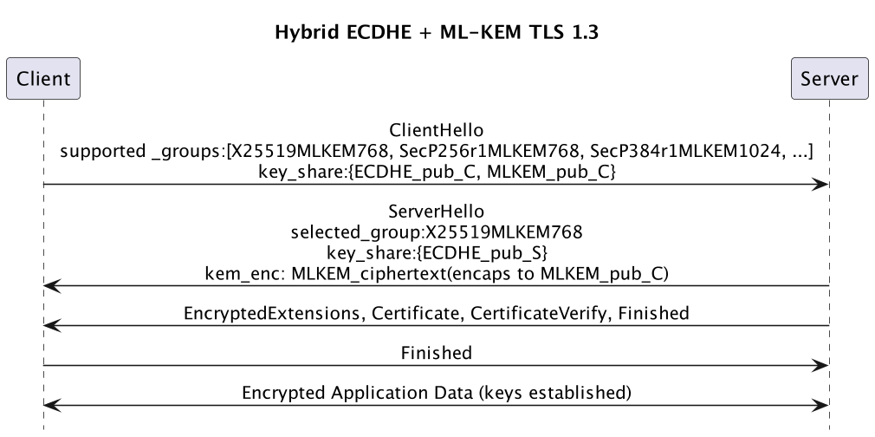
Example: Hybrid ECDHE-MLKEM for TLSv1.3
Key derivation (both sides):
ECDHE secret: ss_e
ML-KEM secret: ss_k
For X25519MLKEM768: handshake_secret = HKDF‑Extract(derived(early_secret), ss_k || ss_e)
Reference: “Post-quantum hybrid ECDHE-MLKEM Key Agreement for TLSv1.3”, draft-ietf-tls-ecdhe-mlkem-00

Slide 4
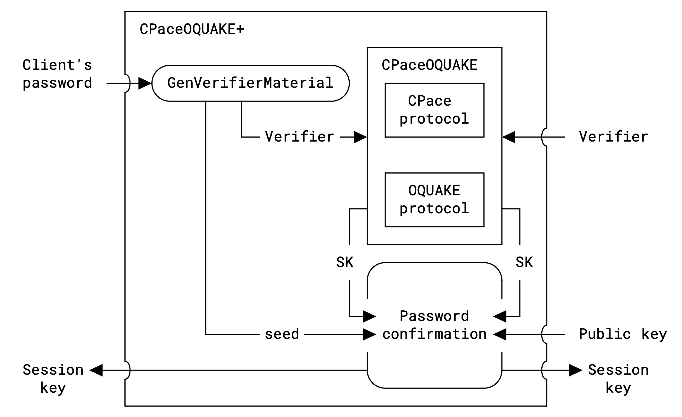
Example: CPaceOQUAKE+
A hybrid aPAKE protocol composed by CPace and OQUAKE
  CPace is a classical elliptic curve-based PAKE
  OQUAKE is a PAKE built from a BUKEM
  A registration phase is required to set up server-side record (verifier) that enables aPAKE
The recommended configurations:
  CPace-Group: CPACE-RISTR255-SHA512
  BUKEM: ML-BUKEM768 for the OQUAKE component.
  PC-KSF: Scrypt for the registration
  PC-KEM: X-Wing (a hybrid KEM) for the password confirmation
Reference: “Hybrid Post-Quantum Password Authenticated Key Exchange”, draft-vos-cfrg-pqpake-00

Slide 5
Conclusion
Adopting hybrid PQC solutions delivers immediate protection from “Harvest-Now, Decrypt-Later” and builds future resilience by combining classical and post-quantum security, ensuring continuity even if one cryptographic pillar falters.
Two hybrid PQC examples are presented to initiate the discussion in this direction.

