Slide 1
AMP group acknowledgement
Date: 2025-09-11
Authors:
Name | Affiliations | Address | Phone | email
Sam Shi | OPPO |  |  | sam.shi@oppo.com
Chuanfeng He |  |  |  | hechuanfeng@oppo.com
Weijie Xu |  |  |  | xuweijie@oppo.com
Yinan Qi |  |  |  | v-qiyinan@oppo.com

Slide 2
Background
The motion about the support pf AMP Ack was agreed.[1][2]
FM-4: 802.11bp defines an AMP Ack frame that an AMP AP transmits to acknowledge the received UL AMP frame(s).
It was not discussed how to acknowledge the received UL AMP frame with AMP ACK frame.

Slide 3
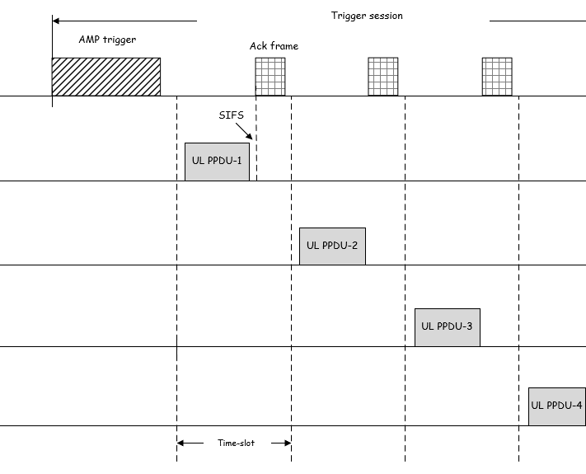
Scheme 1: Individual ACK in ACK frame
The AMP AP transmits an ACK frame at the end of each time slot to acknowledge the UL PPDU received in that time slot.
An AMP STA may enter the doze state immediately after receiving the ACK frame.
The overhead of ACK frame is large.
Each UL PPDU is individually acknowledged.
The time slot length needs to accommodate both the UL PPDU and the corresponding ACK frame.
It can be challenging for an AMP STA to switch from transmit mode to receive mode within a SIFS interval in order to receive the ACK frame in the same time slot.

Slide 4
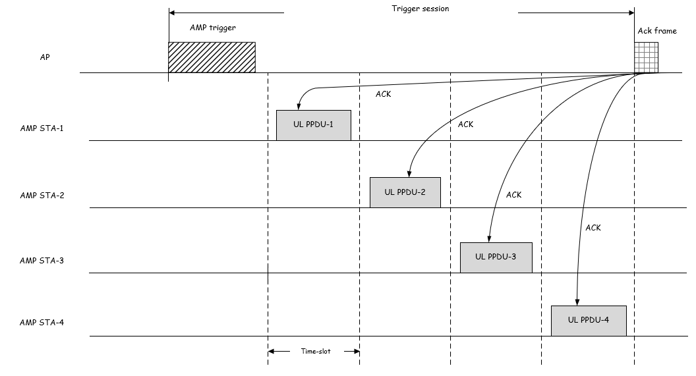
Scheme 2: Group ACK in ACK frame
The AMP AP transmits a group ACK frame after all uplink time slots indicated by the AMP trigger have concluded, to acknowledge the UL PPDUs received in those time slots.
An AMP STA remains awake until the end of the trigger session, or may enter a doze state prior to transmission of the group ACK frame.
Reduced overhead compared to individual ACK.
AMP STAs have sufficient time to switch from Tx to Rx for ACK frame reception.

Slide 5
Scheme 3: ACKs in trigger frame
The AMP AP embeds ACKs in an AMP DL frame to acknowledge the received UL PPDUs solicited by an AMP trigger frame.
In some use cases, the AMP AP transmits AMP trigger frames sequentially to solicit uplink transmissions. In such cases, rather than transmitting a dedicated ACK frame, the AP may use a subsequent AMP trigger frame to acknowledge the UL PPDUs solicited by the preceding AMP trigger frame.
ACK information in AMP trigger replaces the dedicated ACK frame to confirm the UL PPDUs solicited by the previous AMP trigger frame.

Slide 6
ACK frame format
For an ACK frame carrying group ACK, multiple ACKs are included within a single ACK frame. The number of ACKs depends on the number of UL PPDUs successfully received by the AMP AP.
The ACK frame needs to indicate the number of included ACKs, for example via a subfield in the Frame Control field.
The acknowledgement information in the ACK frame may consist of AMP STA identifiers, used to acknowledge the corresponding AMP STAs.

Slide 7
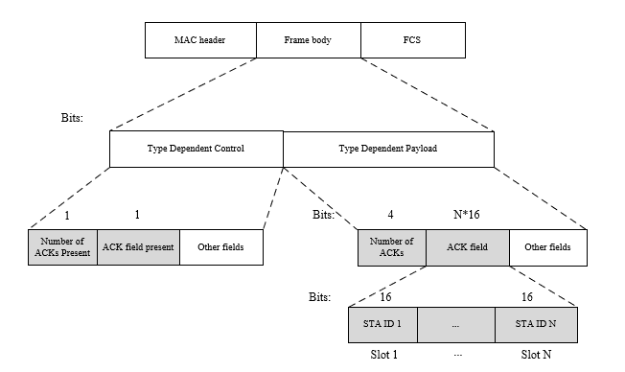
ACK field in AMP trigger frame
For an AMP trigger frame carrying joint acknowledgements, multiple ACKs are included in the ACK field. The number of ACKs depends on the number of UL PPDUs successfully received by the AMP AP.
The AMP trigger frame needs to indicate the number of ACKs together with the group ACK information, for example in the Frame Body field.
The acknowledgement information may consist of AMP STA identifiers, used to acknowledge the corresponding AMP STAs.

Slide 8
Summary and Proposal
To acknowledge UL PPDUs, the following AMP ACK mechanisms were considered:
Individual ACK.
Group ACK.
ACK embedded in the AMP trigger frame.
The individual ACK approach raises concerns regarding channel efficiency, which is critical for AMP operation.
Proposal:
The AMP AP transmits Group ACK information in an AMP DL frame.
The AMP DL frame carrying Group ACK information may be either a dedicated ACK frame or an AMP trigger frame.
The number of ACKs, together with the corresponding Group ACK information, shall be carried in the AMP DL frame.

Slide 9
Straw Poll #1
Do you agree with the following text:
802.11bp defines an AMP DL frame, transmitted by the AMP AP, that carries Group ACK for all UL AMP frames received from AMP STAs in response to an AMP Trigger.
Yes
No
Abstain

Slide 10
Straw Poll #2
Do you agree with the following text:
802.11bp defines an AMP ACK frame to carry AMP ACK information including the number of ACKs and the corresponding Group ACK information.
Yes
No
Abstain

Slide 11
Straw Poll #3
Do you agree with the following text:
802.11bp defines a mechanism that allows an AMP ACK to be embedded in an AMP trigger frame.
Yes
No
Abstain

Slide 12
Straw Poll #4
Do you agree with the following text:
802.11bp defines an AMP ACK field in an AMP trigger frame to carry AMP ACK information including the number of ACKs and the corresponding Group ACK information.
Yes
No
Abstain

Slide 13
Reference
IEEE 802.11-24/1613r12, Specification framework for tgbp
IEEE 802.11-25/0398r0, AMP frames, Qualcomm

