Slide 1
Further considerations on secure AMP operation
Date: 2025-09-12
Authors:
Name | Affiliations | Address | Phone | email
Sam Shi | OPPO |  |  | sam.shi@oppo.com
Chuanfeng He |  |  |  | hechuanfeng@oppo.com
Weijie Xu |  |  |  | xuweijie@oppo.com
Yinan Qi |  |  |  | v-qiyinan@oppo.com

Slide 2
Background
The following motions about secure communication and key generation were agreed.
  MM-17: 802.11bp defines a mechanism to generate a transient key for an AMP non-AP STA that supports secure communication, where:
    An AMP AP transmits a downlink frame containing an ANonce.
    After receiving the downlink AMP frame from the AMP AP that contains an ANonce, an AMP non-AP STA generates an SNonce.
    The AMP non-AP STA generates a transient key using the ANonce, the SNonce, the Authenticator Address (AA), the Supplicant Address (SA), and a Pairwise Master Key (PMK) between the AP and the client.
    Note—Whether to include backscatter non-AP STAs in this procedure is TBD.
  MM-18: 802.11bp defines a mechanism to generate a transient key for an AMP AP that supports secure communication, where:
    In response to the DL AMP frame from the AMP AP that contains an ANonce, the AMP AP receives an UL AMP frame from an AMP non-AP STA that carries the SNonce and a MIC.
      The AMP non-AP STA generates the MIC using the derived transient key at the AMP non-AP STA.
      If the uplink AMP frame is carrying any UL data, the data payload portion of the uplink AMP frame may be encrypted using the transient key generated at the AMP non-AP STA.
    If the MIC is verified:
      The AP uses the ANonce it transmitted in the previous downlink AMP frame, the SNonce, the Authenticator Address (AA), the Supplicant Address (SA), and the PMK to generate the transient key.
      Using the generated transient key, the AMP AP decrypts the UL data payload (if the payload was encrypted).
    Note - Whether to include backscatter non-AP STAs in this procedure is TBD.

Slide 3
Background
  MM-19: the transient key generation at the AP and the AMP client in 802.11bp may occur concurrently with AMP downlink and uplink data communication:
    The downlink AMP frame from the AP carries ANonce along with downlink data from the AP (e.g., AMP trigger).
    The uplink AMP frame from the AMP client carries SNonce and MIC along with the UL data (e.g., UL response to the AMP trigger).
      The UL data may be encrypted using the transient key generated at the AMP non-AP STA.
    Note—Whether to include backscatter non-AP STAs in this procedure is TBD.
  MM-20: the transient key generation at the AP and the AMP client in 802.11bp may be performed immediately before AMP downlink and uplink data communication:
    Once the transient key is derived at both the AP and the AMP client, subsequent AMP data communication between the AP and the client can be secured using MIC and/or encryption based on the generated transient key.
    Note—Whether to include backscatter non-AP STAs in this procedure is TBD.

Slide 4
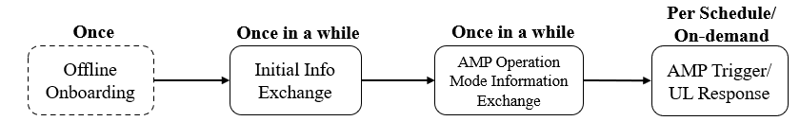
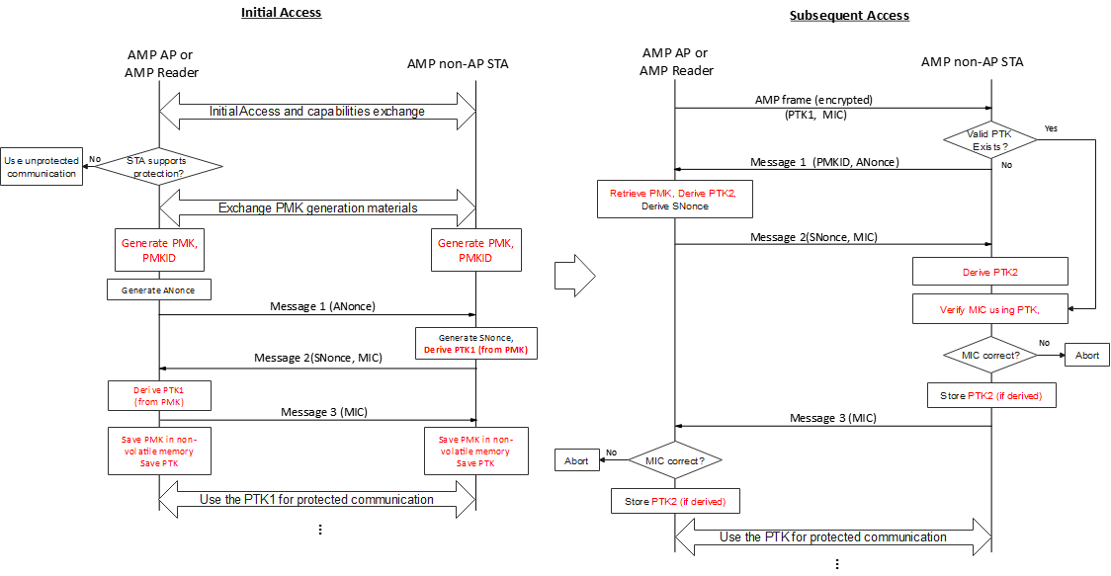
Recap: Lightweight secure AMP operation
In [4], Initial Info Exchange and AMP Operation Mode Information Exchange (can also be protected) are required before protected Trigger @ UL transmission.
In [5], PMK and PTK generation procedure before protected communication was discussed.

Slide 5
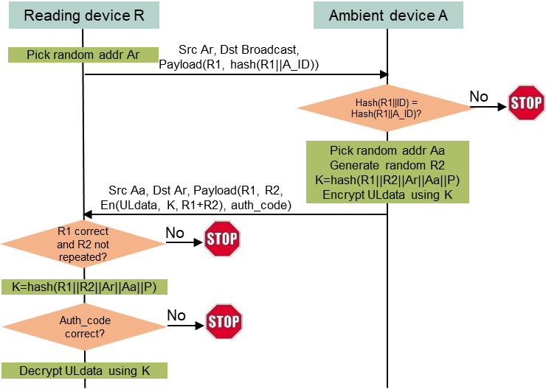
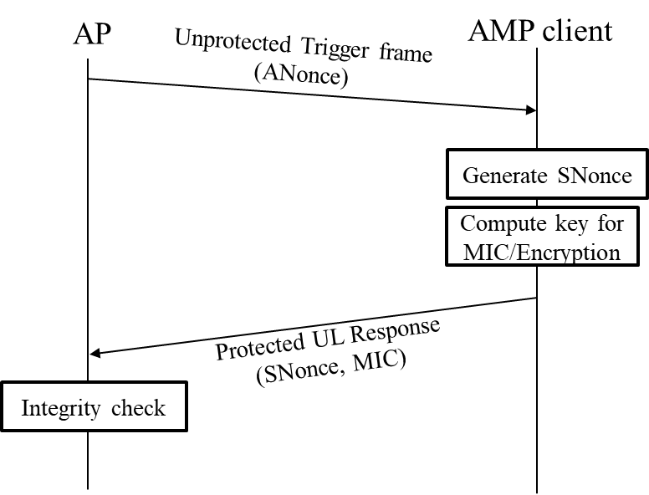
Recap: Lightweight secure AMP operation
In [3][4], it was proposed to have an integrated procedure for key generation and protected data transmission.

Slide 6
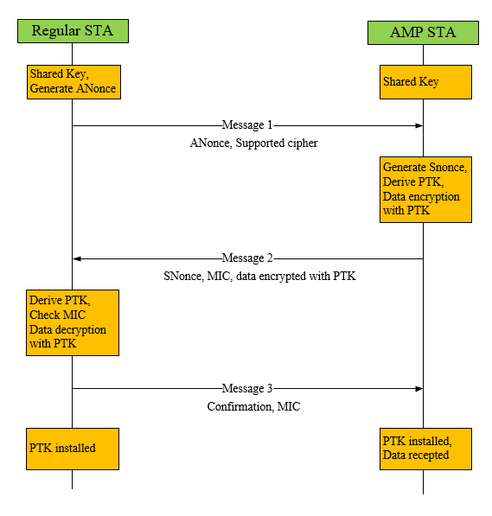
Recap: Lightweight secure AMP operation
  In[2], It was also proposed to have an Integrated Security and data transaction for AMP to simplify the secure data communication procedure for AMP STA. Key generation and protected data communication is combined in the same procedure.
    It helps to reduce frame exchange during secure transaction to address energy constraints and low latency for logistics type of use cases.

Slide 7
Key generation
  Key generation procedure is similar but simplified compared to existing 802.11 security protocols.
    The existing RSNE – Association – Authentication - 4-way handshake procedure is simplified.
    PMK: still open how PMK is provisioned and/or generated.
    Transient Key: derived from ANonce, SNonce, the Authenticator Address (AA), the Supplicant Address (SA), and PMK.
  In AMP use case, energy availability is limited, and airtime efficiency is critical. Any parameters exchanged over the air should be minimized.
  To generate transient key, parameters that must be transferred over the air should be reduced in size.
    ANonce and Snonce
    AA and SA

Slide 8
Key generation
  In existing 802.11, ANonce and SNonce = 256 bits.
    Too large for AMP (limited data rate, energy budget).
  Pros and cons of using short Nonces for key derivation
  Collision probability of different sizes of Nonces:
    32-bit Nonces: ~50% collision after 2^16 (65,536) uses.
    64-bit Nonces: ~50% collision after 2^32 (4.3 billion) uses.
    128-bit Nonces: ~50% collision after 2^64 uses.
Risk evaluation: Why short Nonces are still acceptable
    AMP threat model is constrained: short sessions, limited airtime, and lower adversary capabilities assumed.
    Energy-first design: using shorter nonces reduces airtime and power cost, making secure key exchange feasible.
Pros | Cons
Reduced airtime cost: energy savings. Lower computational load and simplified key derivation. | Reduced Randomness: higher risk of replay/collision. Shorter nonces reduce safe unique sessions.

Slide 9
Key generation
  Existing 802.11 uses 48-bit MAC addresses for AA (Authenticator Address) and SA (Supplicant Address). In AMP context, 48 bits are relatively large overhead compared to payload size.
  Design philosophy:
    Derive short IDs from full MAC using a hash/truncation.
    Allocate local session-specific short IDs.
    Ensure uniqueness within AMP network scope
  Analysis:
    Collision risk: Multiple devices may map to same short ID unless controlled.
    Loss of global uniqueness: short IDs valid only within one AP domain.
  Risk evaluation: Why shortened MACs/IDs are still acceptable
    Local uniqueness: AP can assign and manage short IDs
    Energy-first trade-off
48-bit MAC | Space: ~2.8 × 10^14 unique addresses | 50% collision chance after ~16 million device
32-bit ID | Space = ~4.3 billion | 50% collision chance after ~65,000 device
24-bit ID | Space = ~16.7 million | 50% collision chance after ~5,000 devices
16-bit ID | Space = 65,536 | 50% collision chance after ~300 devices

Slide 10
Key generation
  In existing 802.11 security, ANonce and SNonce are exchanged between AP and STA for key derivation.
  AMP introduces trigger-based exchanges with multiple STAs (random access or scheduled).
  AP may need to include multiple ANonces in a single DL frame to support simultaneous security procedures with different STAs.
  This is to ensure secure and parallel key establishment without excessive frame overhead.
  Takeaway:
    AMP requires an enhanced nonce handling mechanism to support multi-STA secure handshake within trigger frame operations.

Slide 11
Summary and Proposal
  We have analyzed the feasibility of reducing overhead in AMP key establishment by shortening both nonces (ANonce, SNonce) and MAC addresses (AA, SA). The motivation is to reduce airtime and energy cost while maintaining acceptable levels of security for the AMP context. Our evaluation shows that shorter values introduce collision risk, but can still be acceptable.
  Proposal 1: Use shortened ANonce/SNonce (exact size TBD, e.g. 32/64/128 bits) for transient key derivation in AMP.
  Proposal 2: Replace 48-bit MAC addresses with shortened IDs (exact size TBD, e.g., 16/24/32 bits) managed by the AP, valid only within the local AMP session, for transient key derivation in AMP.
  Proposal 3: Allow an AP to include multiple ANonce to support security procedure of multiple AMP STAs.

Slide 12
Straw Poll #1
  Do you agree with the following text:
    Use shortened ANonce/SNonce (exact size TBD, e.g. 32/64/128 bits) for transient key derivation in AMP
Yes
No
Abstain

Slide 13
Straw Poll #2
  Do you agree with the following text:
    Replace 48-bit MAC addresses with shortened IDs (exact size TBD, e.g., 16/24/32 bits) managed by the AP, valid only within the local AMP session, for transient key derivation in AMP.
Yes
No
Abstain

Slide 14
Straw Poll #3
  Do you agree with the following text:
    Allow an AP to include multiple ANonce to support security procedure of multiple AMP STAs.
Yes
No
Abstain

Slide 15
Reference
  IEEE 802.11-24/1613r12, Specification framework for tgbp
  IEEE 802.11-24/1203r0, Authentication and Security transaction for AMP
  IEEE 802.11-24/1998r1, Secure transaction methods with low computation complexity for AMP
  IEEE 802.11-24/2112r0, Secure E2E Operation for AMP
  IEEE 802.11-24/1548r2, Thoughts on security for AMP

